Slide 1
Hydropower Challenges in the Pacific Northwest
Clark Mather, Executive Director
Mid-West Annual Meeting | December 11, 2024
clark@nwriverpartners.org

Slide 2
Who we are
“Lead the charge for the Northwest to realize its clean energy potential using hydroelectricity as the cornerstone.”

Slide 3
Our mission: Lead the charge for the Northwest to realize its clean energy potential using hydroelectricity as the cornerstone
We educate the public and policymakers about the important role of hydroelectricity
We partner with our members, Native American tribes, communities, agencies and businesses to achieve common goals
We support research and analytics so the region can reach informed decisions
We engage in public processes to provide balanced insights and suggestions
“Lead the charge for the Northwest to realize its clean energy potential using hydroelectricity as the cornerstone.”

Slide 4
Hydro in the PNW 101
“Lead the charge for the Northwest to realize its clean energy potential using hydroelectricity as the cornerstone.”

Slide 5
Hydropower = PNW backbone
Courtesy: Northwest Power and Conservation Council
“Lead the charge for the Northwest to realize its clean energy potential using hydroelectricity as the cornerstone.”

Slide 6
Hydropower = Affordable energy
PNW customers pay some of the lowest electricity rates in the U.S.
ID – 2nd cheapest retail cost
OR – 6th cheapest retail cost
MT – 10th cheapest retail cost
WA – 5th cheapest retail cost
Courtesy: Getty Images/iStock Photo
Courtesy: U.S. Energy Information Administration, U.S. Electricity Profile 2022
“Lead the charge for the Northwest to realize its clean energy potential using hydroelectricity as the cornerstone.”

Slide 7
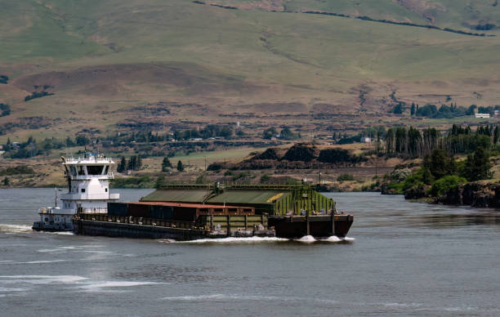
Hydropower System = Jobs
Our marine highways move 51 million tons of international trade
Billions of dollars in value
40,000 jobs tied to trade
Courtesy: Getty Images
Courtesy: Pacific Northwest Waterways Association, Columbia Snake River System Facts
“Lead the charge for the Northwest to realize its clean energy potential using hydroelectricity as the cornerstone.”

Slide 8
Q: Can salmon and
dams co-exist?
“Lead the charge for the Northwest to realize its clean energy potential using hydroelectricity as the cornerstone.”

Slide 9
A: Yes and they are.
“Lead the charge for the Northwest to realize its clean energy potential using hydroelectricity as the cornerstone.”

Slide 10
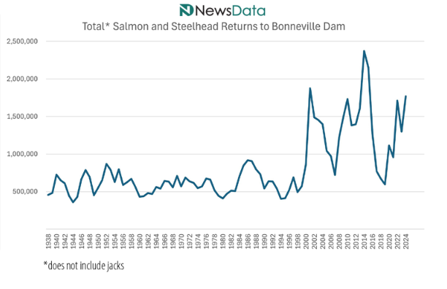
“Lead the charge for the Northwest to realize its clean energy potential using hydroelectricity as the cornerstone.”

Slide 11
Pressure on clean hydropower
is everywhere
“Lead the charge for the Northwest to realize its clean energy potential using hydroelectricity as the cornerstone.”

Slide 12
Others push for breaching as we need more energy
“Lead the charge for the Northwest to realize its clean energy potential using hydroelectricity as the cornerstone.”

Slide 13
Oregon & the Northwest faced record-breaking low temperatures, high winds, snow and freezing rain.
More than 100,000 lost power due to damaged lines. In total, an estimated 17 people died from falling trees, electrocution, and hypothermia.
Natural gas experienced equipment failures, and wind generation dropped to near-zero.
MLK Weekend 2024
“Lead the charge for the Northwest to realize its clean energy potential using hydroelectricity as the cornerstone.”

Slide 14
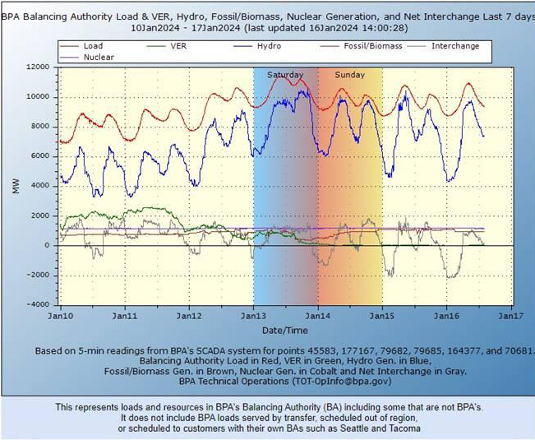
Wind, Solar
“Lead the charge for the Northwest to realize its clean energy potential using hydroelectricity as the cornerstone.”

Slide 15
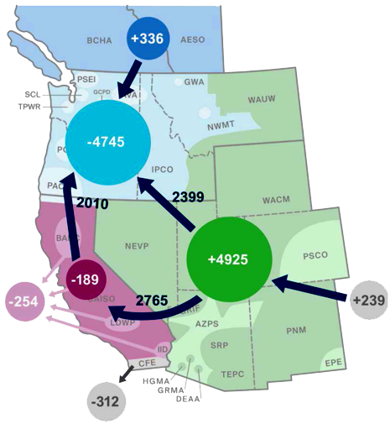
MLK Weekend:
Hydro, Imports Prevent Blackouts
Courtesy: NewsData, Salem Electric
“Lead the charge for the Northwest to realize its clean energy potential using hydroelectricity as the cornerstone.”

Slide 16
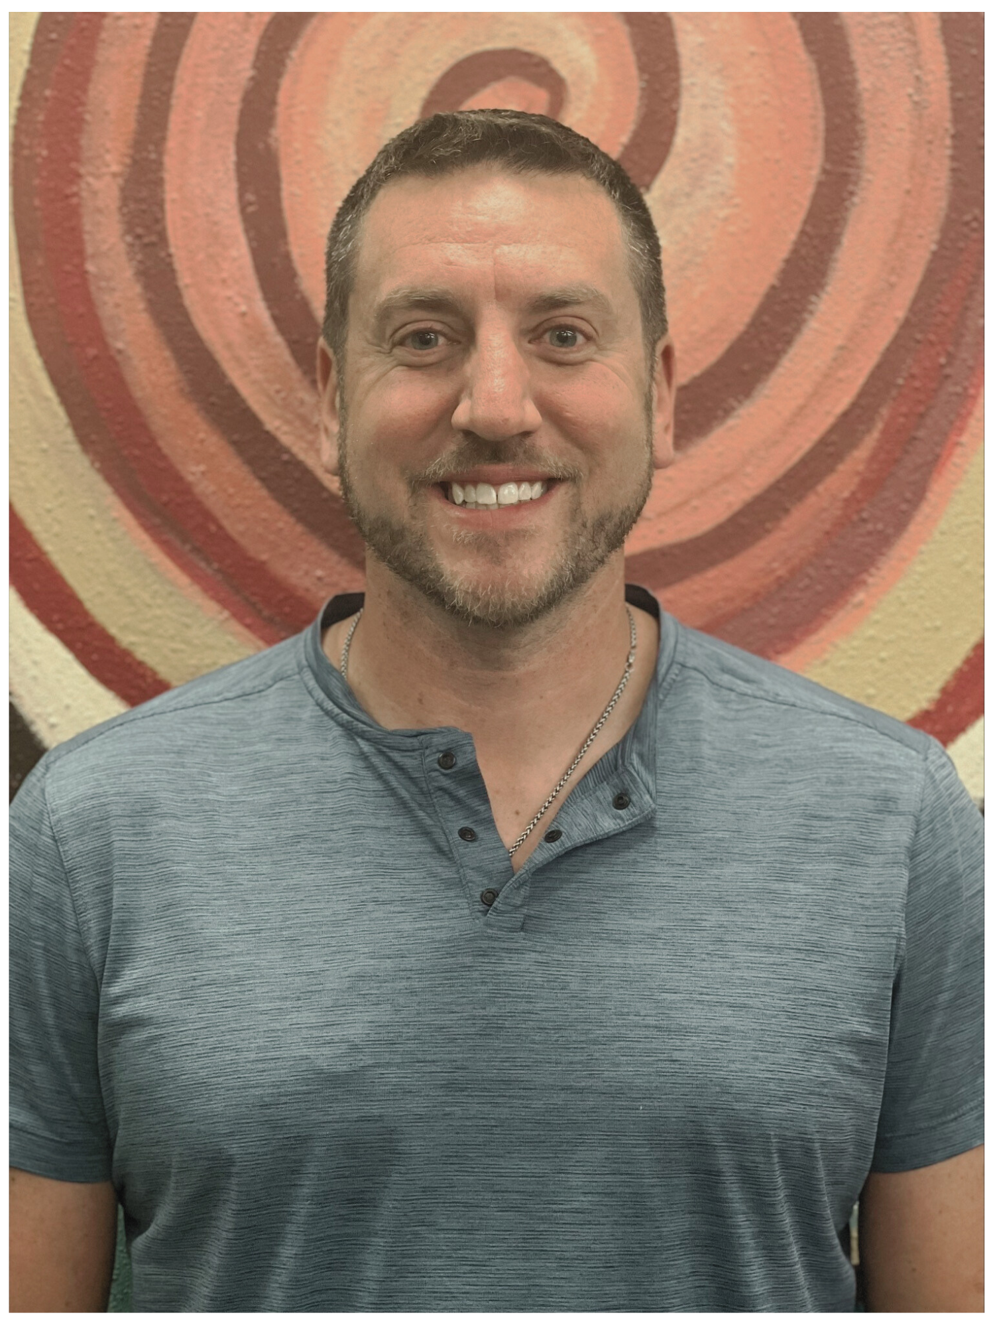
Reliability + Affordability = Human Health
“This is a life-or-death issue. We lose lives when we don’t focus on reliability,” he added.
Source: Politico.com, “Gas, greens and brownouts: The energy war is boiling over. June 5, 2024
FERC Chair Willie Phillips
32% of clients at the Flathead Food Bank said that increasing energy costs had driven them to seek assistance.
Source: “Dam” Podcast. August 30, 2024
Chris Sidmore, Flathead Food Bank
“Lead the charge for the Northwest to realize its clean energy potential using hydroelectricity as the cornerstone.”

Slide 17
What can we do?
“Lead the charge for the Northwest to realize its clean energy potential using hydroelectricity as the cornerstone.”

Slide 18
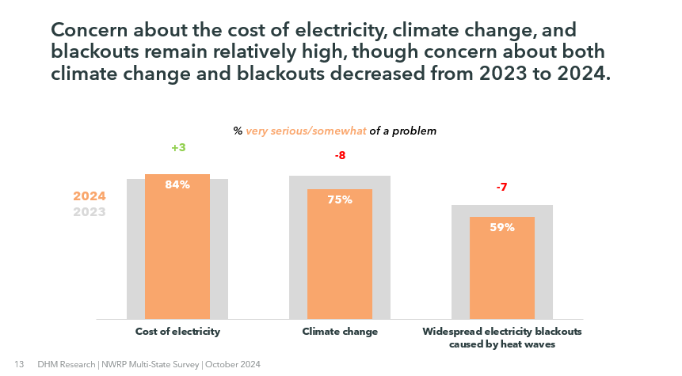
Affordability is the top concern
“Lead the charge for the Northwest to realize its clean energy potential using hydroelectricity as the cornerstone.”

Slide 19
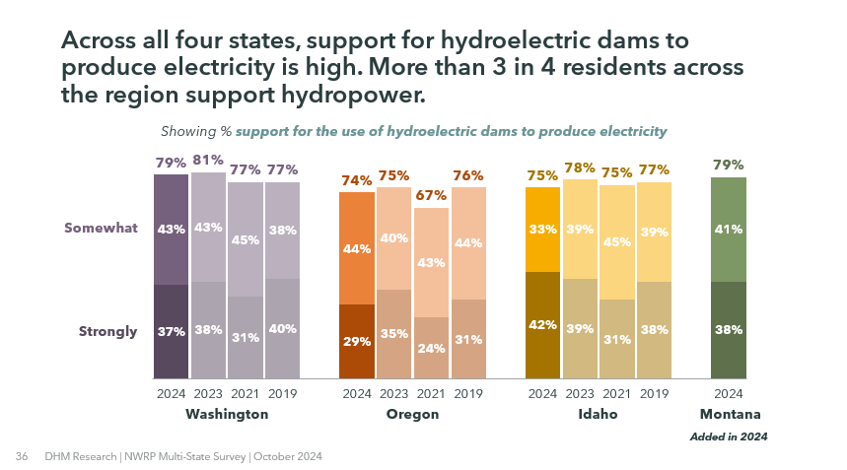
Our region supports hydropower
“Lead the charge for the Northwest to realize its clean energy potential using hydroelectricity as the cornerstone.”

Slide 20
New opportunities
“Lead the charge for the Northwest to realize its clean energy potential using hydroelectricity as the cornerstone.”

Slide 21
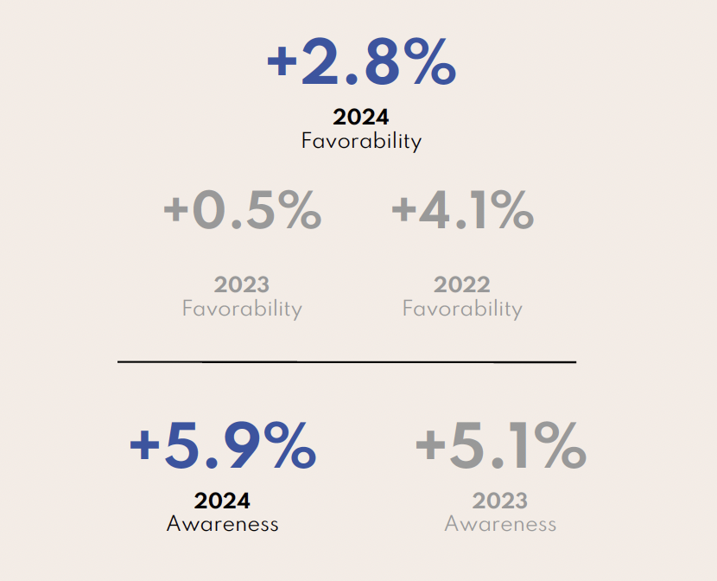
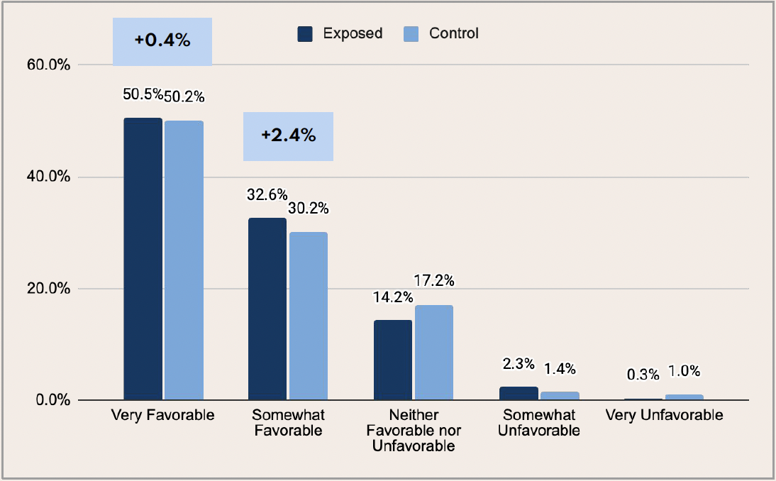
Results
“Lead the charge for the Northwest to realize its clean energy potential using hydroelectricity as the cornerstone.”

Slide 22
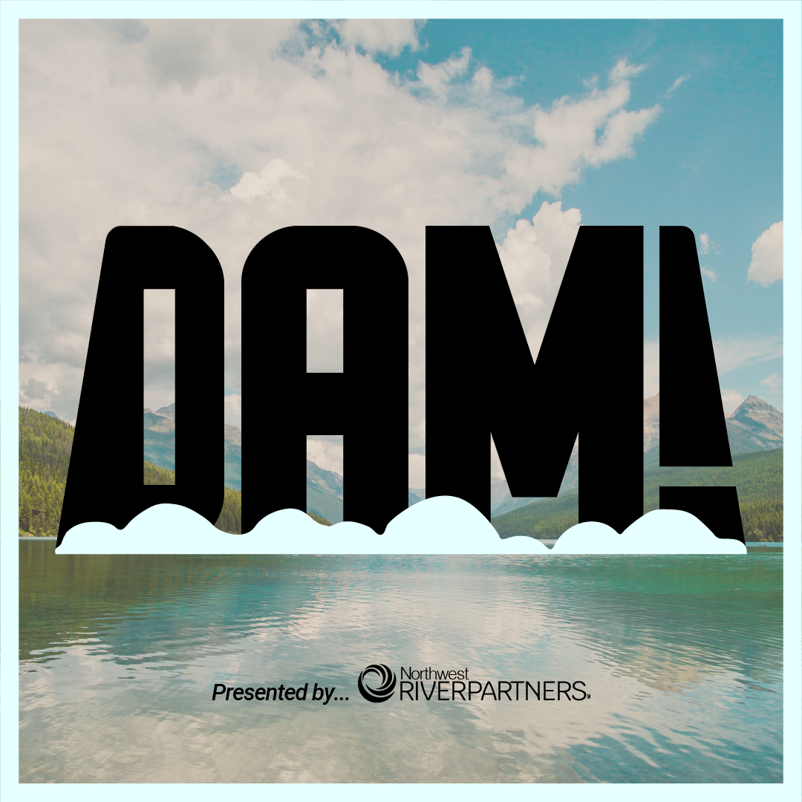
“Lead the charge for the Northwest to realize its clean energy potential using hydroelectricity as the cornerstone.”

Slide 23
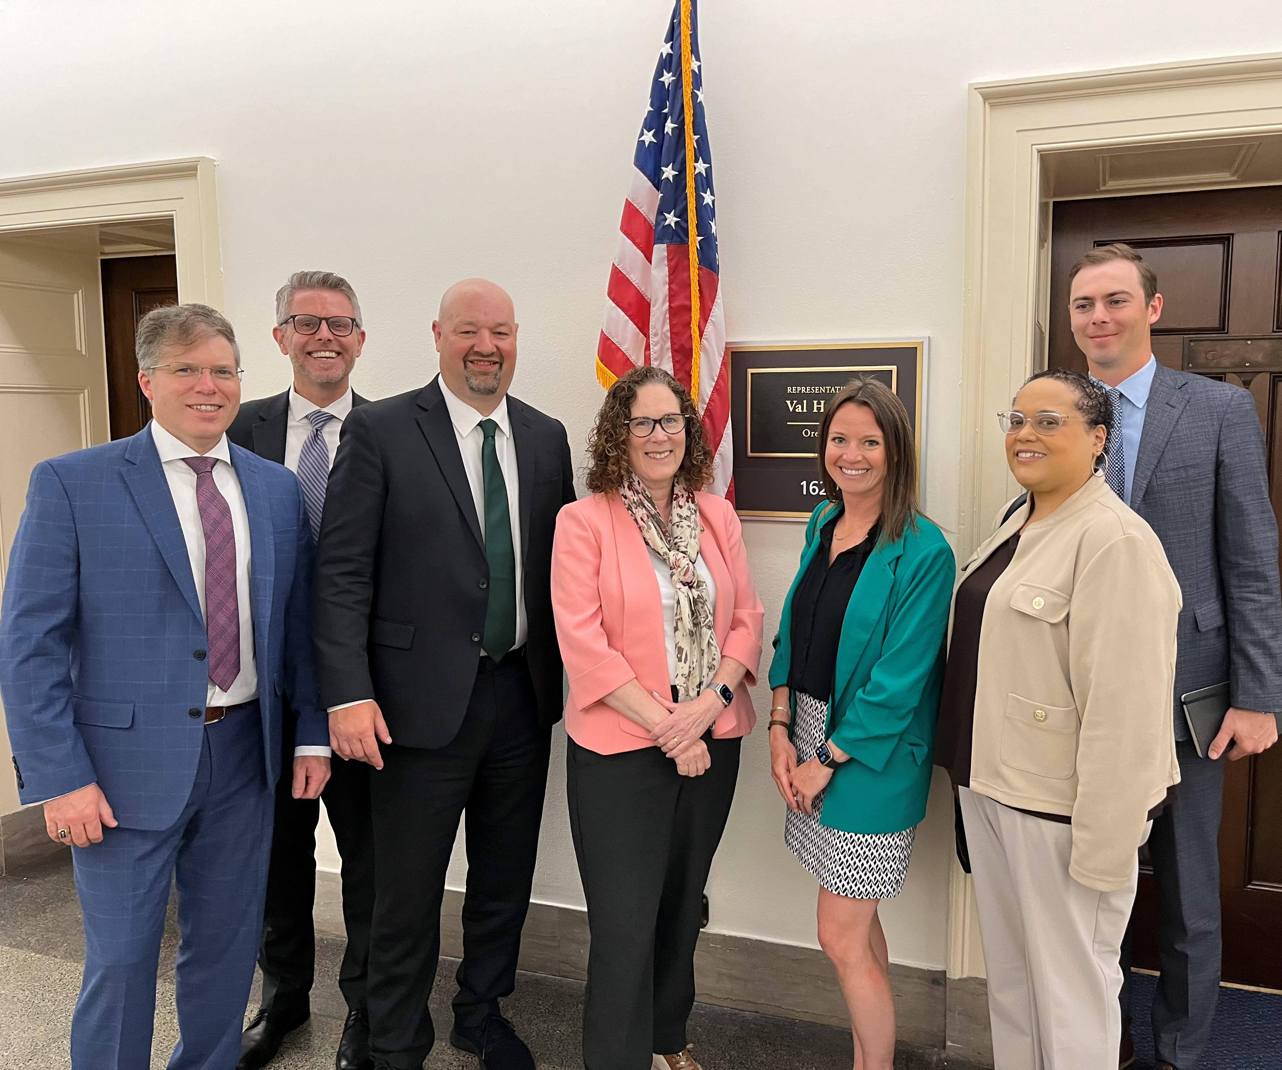
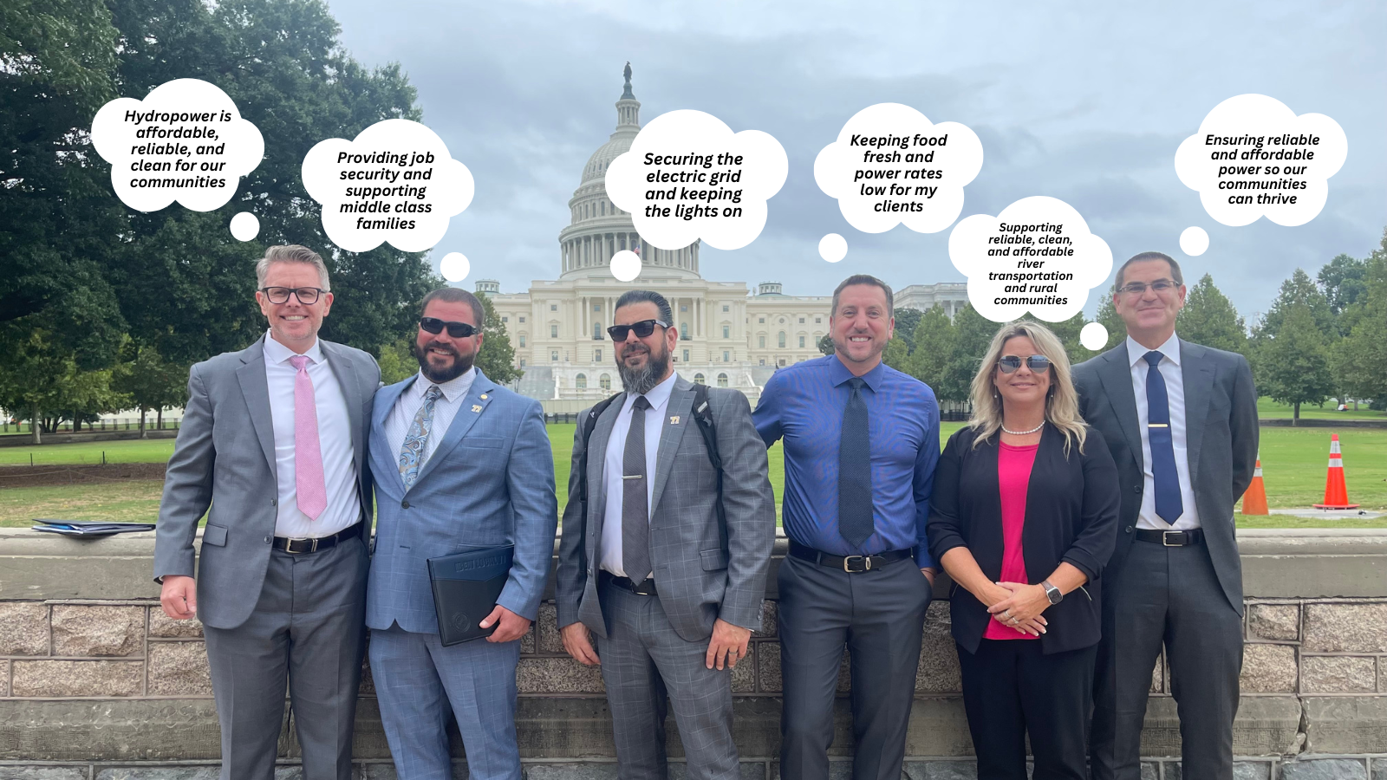
Growing Coalition Advocates
“Cost Cap Legislation” moving through Congress
Pushing to be at all decision-making tables in ‘12/14 agreement’ implementation
Holistic approach for hydropower based on science and facts
“Lead the charge for the Northwest to realize its clean energy potential using hydroelectricity as the cornerstone.”
Notes:
Growing a diverse coalition
EIS work is continuing
Cartoon

Slide 24
Hydropower Challenges in the Pacific Northwest
Clark Mather, Executive Director
Mid-West Annual Meeting | December 11, 2024
clark@nwriverpartners.org

Slide 25
Appendix
“Lead the charge for the Northwest to realize its clean energy potential using hydroelectricity as the cornerstone.”

Slide 26
Salmon & the climate
“Lead the charge for the Northwest to realize its clean energy potential using hydroelectricity as the cornerstone.”

