Slide 1
NRECA’s Military Program and GRIP Projects
2024 Mid-West Annual Meeting
Lauren Khair

Slide 2
Military Program

Slide 3
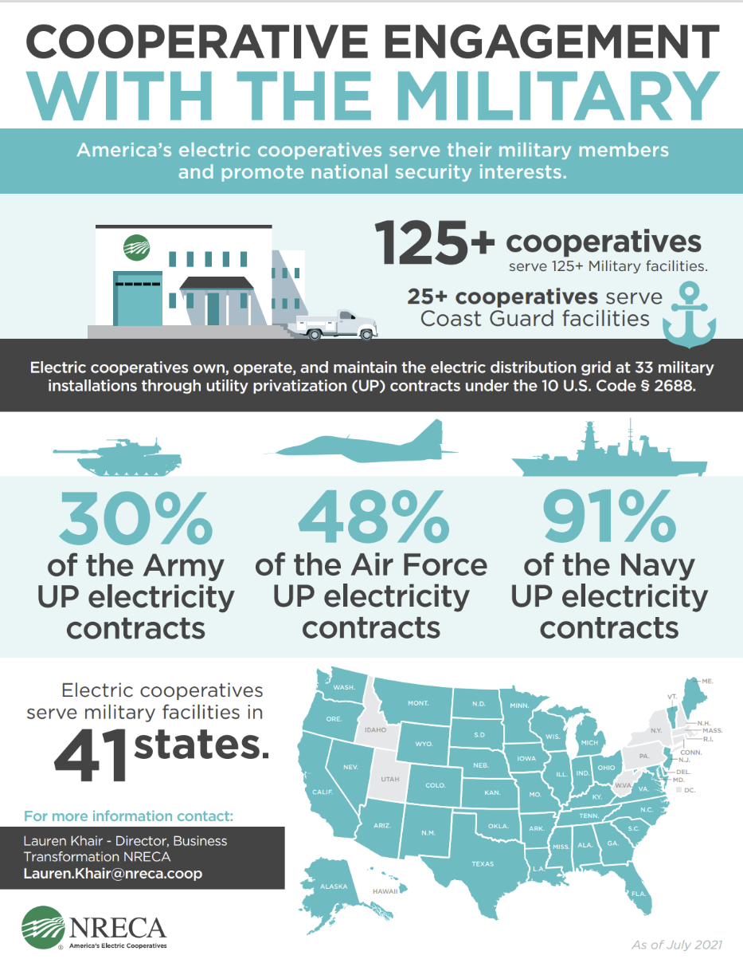
Cooperative Engagement with the Military
More than 150 co-ops serve military and Coast Guard facilities in 41 states, including owning and operating base electric grids through utility privatization (UP) contracts
The experience and lessons of serving these facilities has wide applicability to other critical loads and other large commercial and industrial members

Slide 4
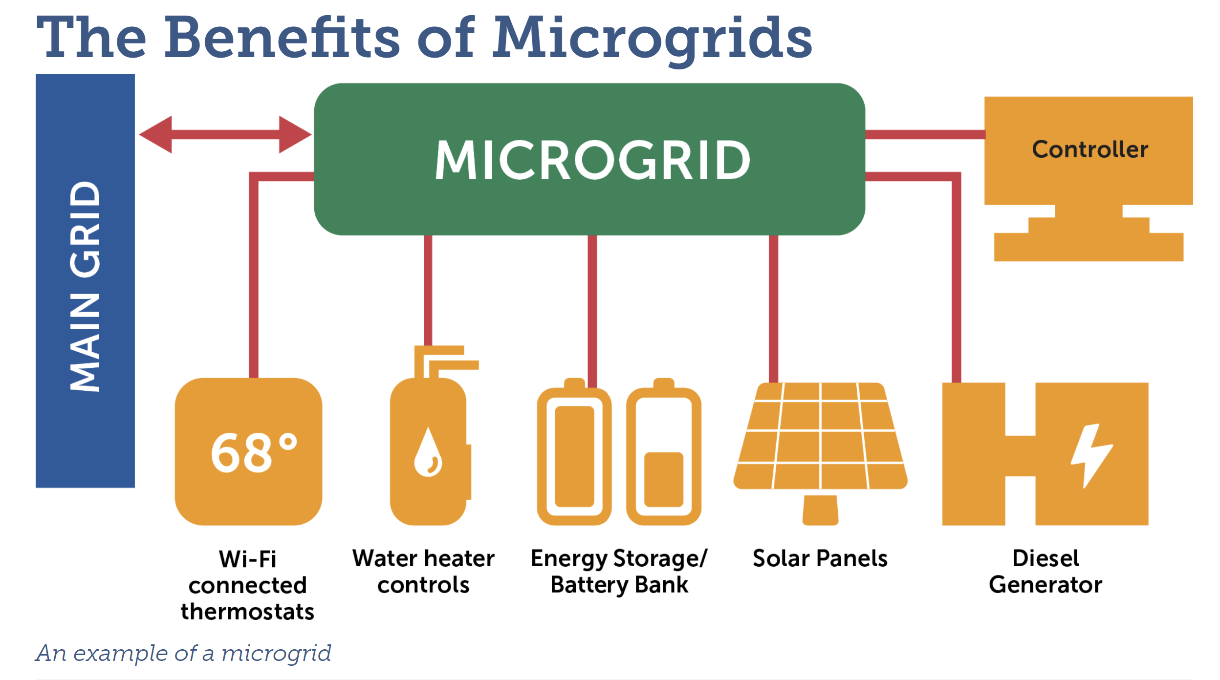
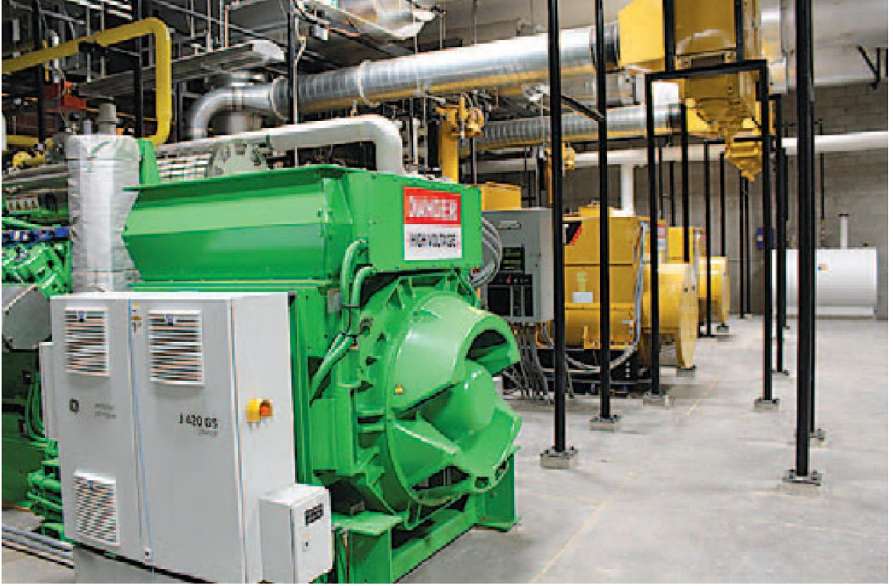
Cooperative Innovation:
Microgrids and Energy Storage Systems
Fort Knox: Nolin Rural Electric Cooperative: 44 MW
  Can island the entire systems on microgrid
Military Ocean Terminal Sunny Point: Brunswick Electric Membership Corporation: ~ 2MW
Fort Moore: Flint Energies: 9.75 MW
Fort Stewart: Canoochee EMC: 1.5 MW

Slide 5
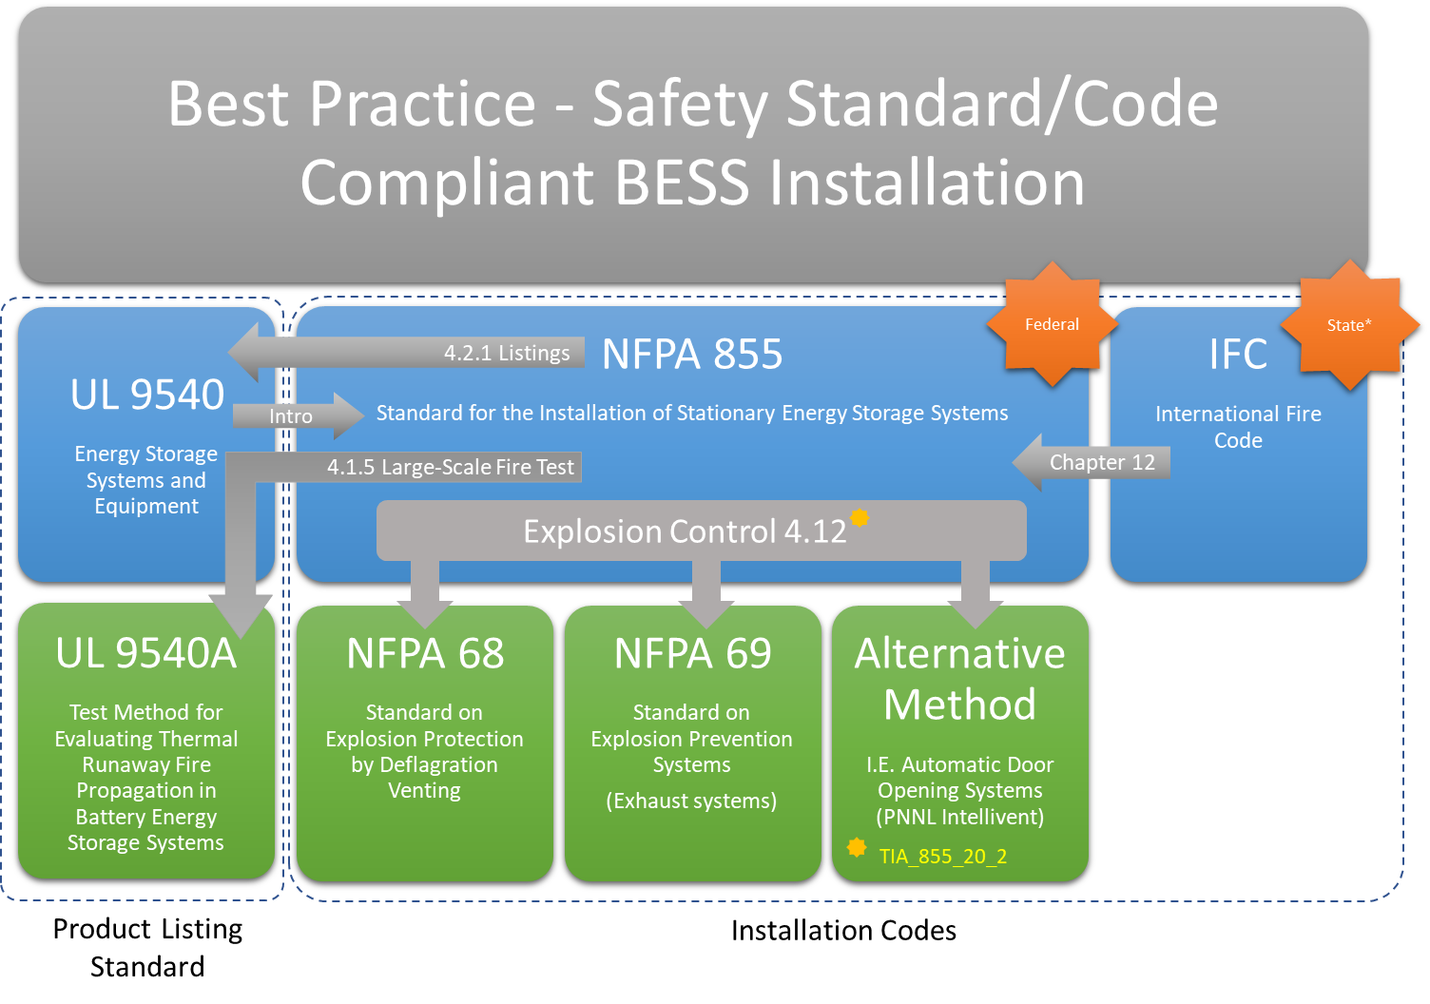
Rural Energy Storage Deployment Program (RESDP) at Ellsworth AFB
  The goal of the RESDP program is to successfully deploy battery energy storage systems (BESS) at rural critical infrastructure served by electric cooperatives to increase resiliency, improve system efficiency and to collect best practices and lessons learned from these deployments to share with electric cooperatives across the country. For more information, visit the project page at www.cooperative.com/resdp.
  This projected is funded through the U.S. DOE Office of Electricity’s Energy Storage Program.
  Technical Assistance provided by Sandia National Laboratories and Pacific Northwest National Laboratory.
Safety Considerations for Lithium-Ion Projects Paper

Slide 6
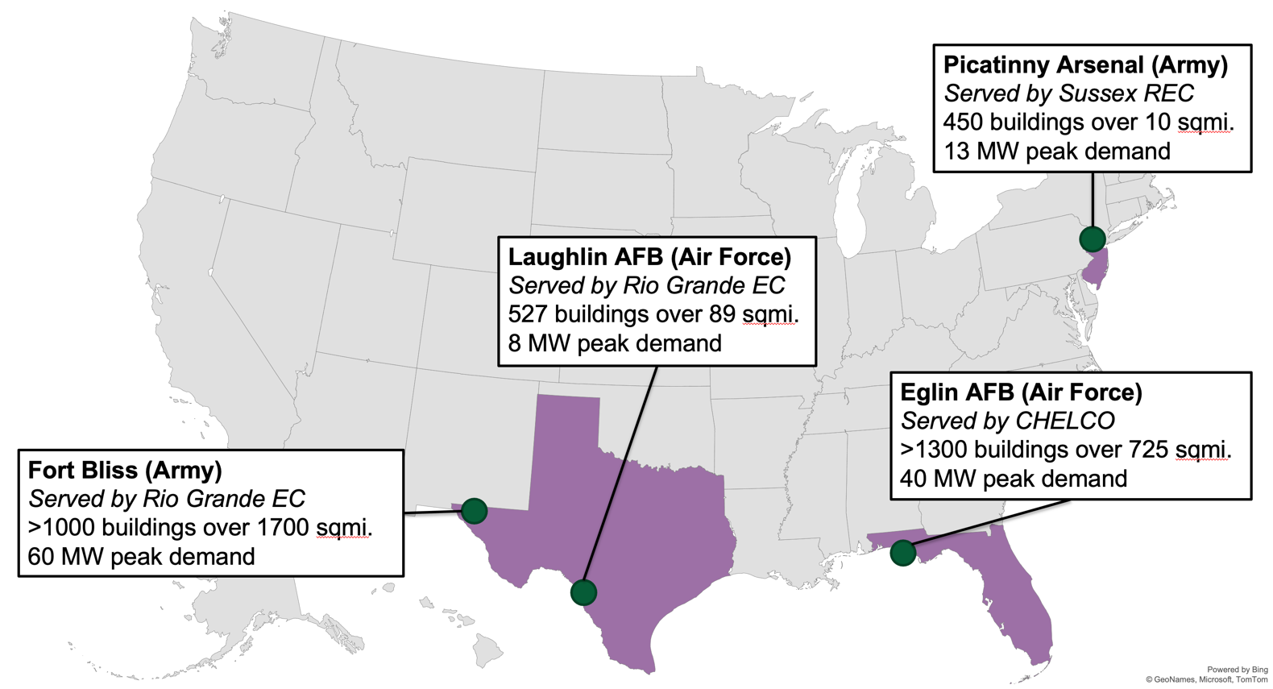
Cooperative Innovation:
DoD Research Project - MicrogridUP
Problem Statement
  Military installations depend on bulk power system to operate (e.g. through multi-day outages)
  Microgrids can provide cost-effective local power supply, but they are challenging and expensive to plan (soft costs c. 30% of total system cost, no mature planning tools for all contingencies and technology choices)
  Decarbonization is growing in importance as a DoD goal, and microgrids provide an opportunity to integrate renewable generation in a resilient way
Objective:
  Quickly and easily identify cost-effective microgrid options for any military installation
Technology Description:
  Planning software for optimal microgrid and distribution planning
MicrogridUP Website

Slide 7
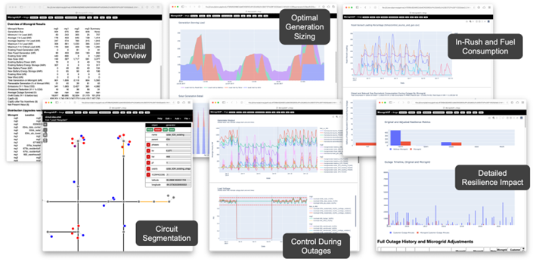
MicrogridUP: Comprehensive Microgrid Planning Tool

Slide 8
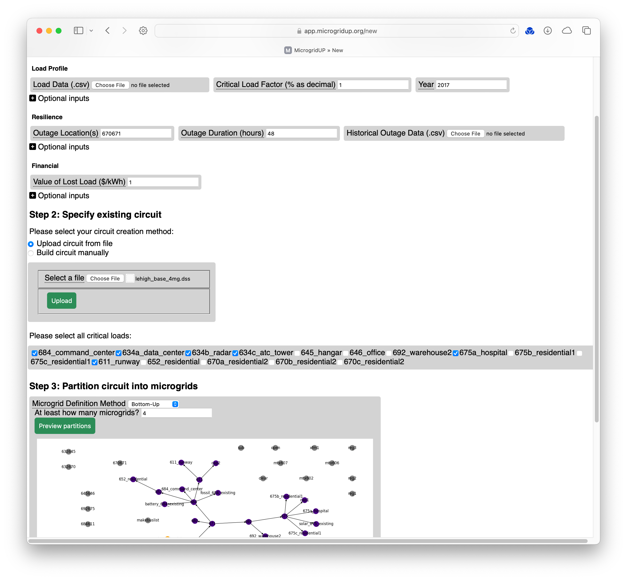
MicrogridUP: Wizard
Interactive input wizard to speed up project creation and editing.
Circuit-builder for cases where no good circuit model exists
Dynamic criticality marking and segmentation to enable quick experiments
Everything self-documenting

Slide 9
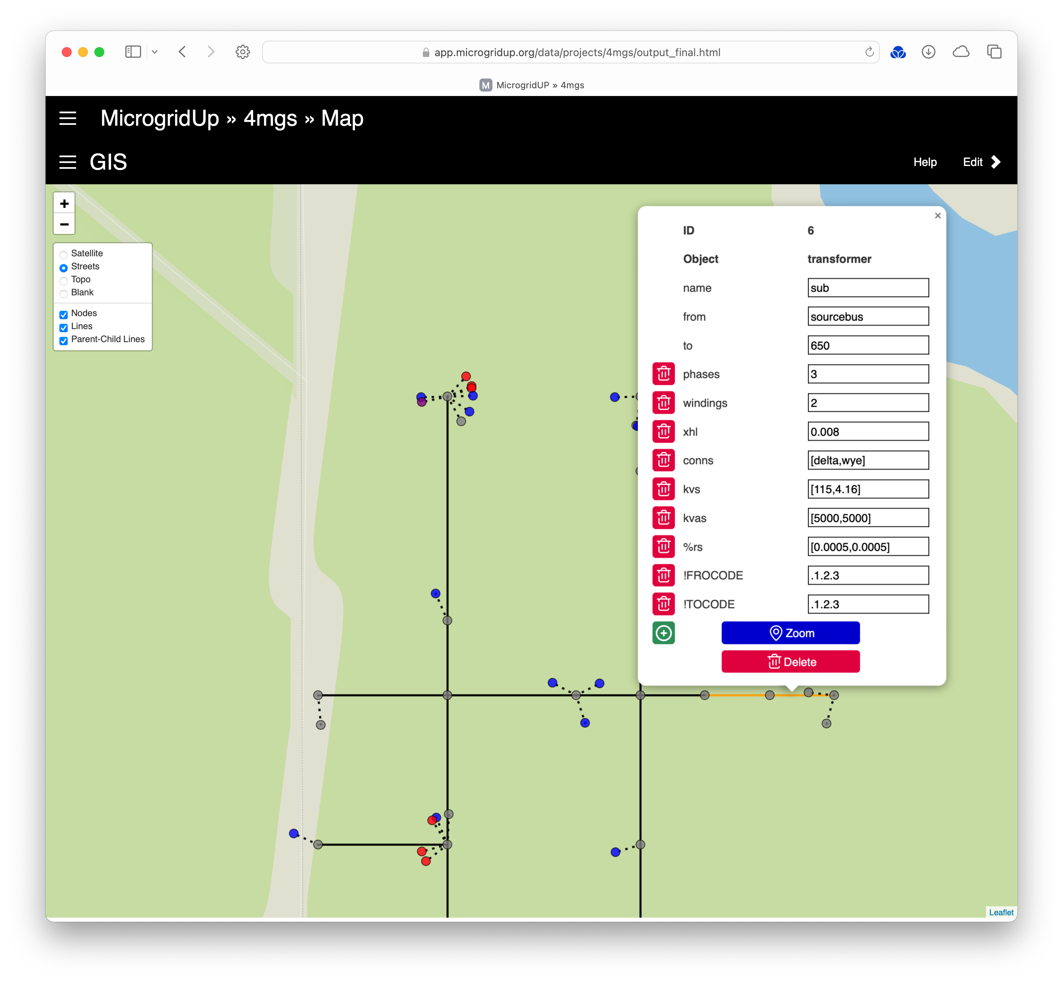
MicrogridUP: Circuit Segmentation
Geospatial and circuit editing capabilities combined into one interface
Facilitates the multi-stakeholder discussions that are necessary (utility, installation energy staff, mission owners, ESCOs)
Rich search, editing, annotation, and additional GIS layer integration

Slide 10
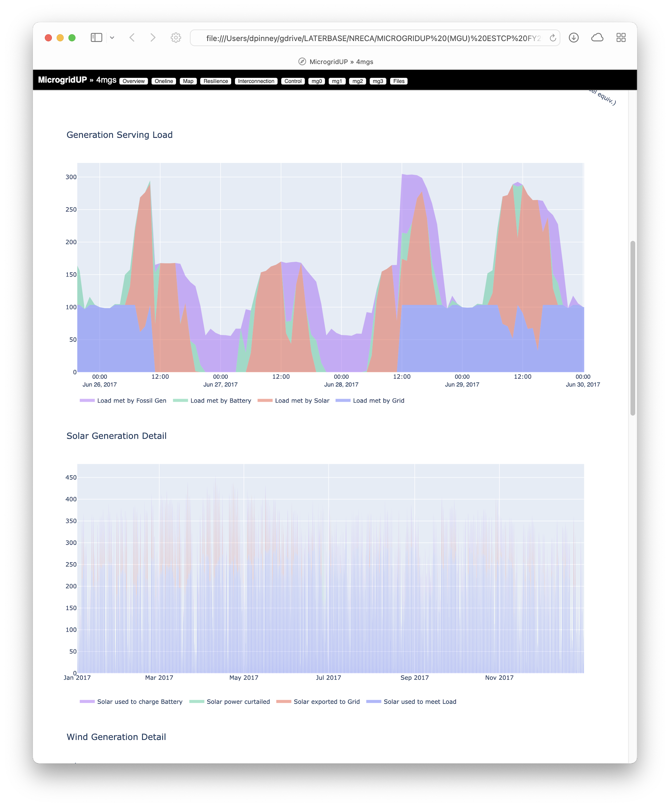
MicrogridUP: Resource Mix Module Details
REOpt used to generated financial and resilience for each candidate microgrid
Cost-optimized mix of fossil, BESS, and renewable generation
Generation guaranteed to survive critical user-chosen outage (e.g. 7 days)
Survival probability given for durations beyond the critical outage

Slide 11
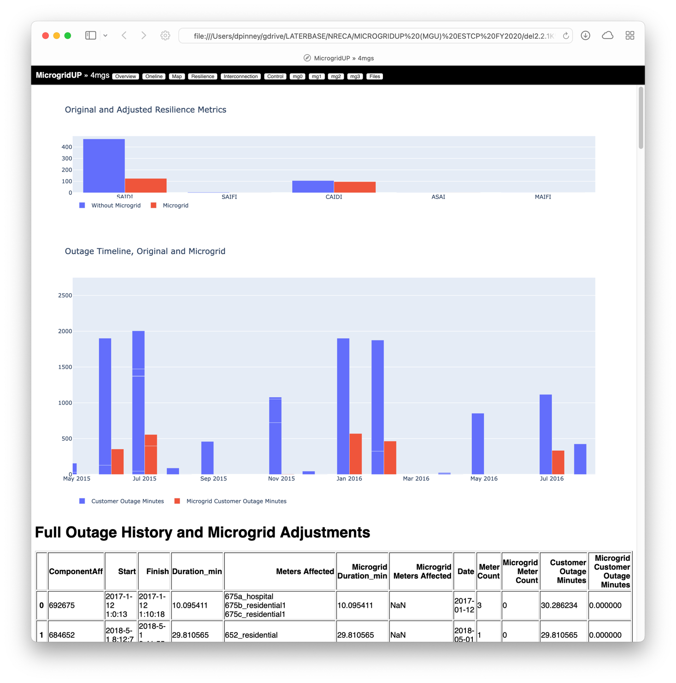
MicrogridUP: Resilience Results Module
Import industry-standard historical outages including components affected and duration
Using all historical and forecasted outages, we can generate detailed estimates of how the microgrids would perform on typical/non-critical outages.
Results in whole system expected outage minutes avoided

Slide 12
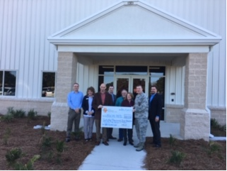
Cooperative Innovation: How to Use Other People’s Money
Infrastructure Investments & Jobs (IIJA)
Inflation Reduction Act (IRA)
Capital Credits
  Capital credits (sometimes referred to as patronage capital) refers to each co-op member’s allocated share of income remaining after the co-op pays its expenses. Paying or ‘retiring’ capital credits in cash or bill credit is a practice unique to cooperatives whereby that allocation is gradually paid back to each member over time.
  These retired credits could be used on military installations for resiliency projects for in-kind services like other rebates.
Photo Credit Choctawhatchee Electric Cooperative

Slide 13
GRIP Projects

Slide 14
Overall Submission Details
GRIP Round 1
Grid Resilience and Innovation Partnership Program
GRIP Round 2
Grid Resilience and Innovation Partnership Program
Number of Concept Papers Submitted
Topic 1: 250
Topic 2: 225
Topic 1: 289
Topic 2: 326
Number of Concept Papers Encouraged to Full Application
Topic 1: 144
Topic 2: 157
Topic 1: 163
Topic 2: 160
Number of Awards Selected
Topic 1: 16 (5.5%)
Topic 2: 34 (10.4%)
Topic 1: 14 (5%)
Topic 2: 24 (10%)

Slide 15
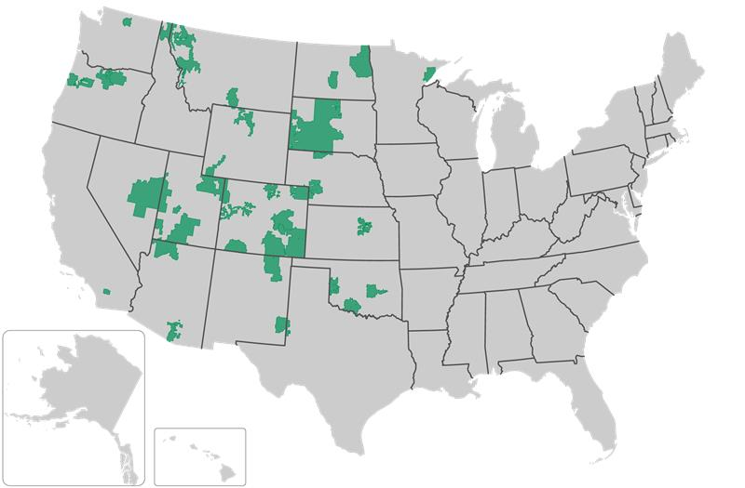
Grid Resilience and Innovation Partnerships (GRIP) Round 1 – In Execution
Wildfire Assessment and Resilience for Networks (WARN)
WARN Consortium Members
Prime: Holy Cross Energy
Cooperatives: 37
States: 16
Period of Performance: 5 years
Total Meters Served: > 810,000 meters
Budget:
Federal Share: $99,328,430
Cost Share: $45,762,816
Total Project: $145,091,246

Slide 16
Types of Projects in WARN
Project | Scope of Work
Underground-1: | Focus on overhead-to-underground conversion of mostly continuous lengths of distribution circuit with hardening at a few locations near ends and taps.
Underground-2: | Significant overhead-to-underground conversion in addition to hardening, fireproofing, or vegetation management of either 1) long lengths of overhead line at the ends of the underground section, or 2) a large number of underground service taps.
Advanced Reclosers-1: | Focus on upgrading existing overhead power lines by installing new advanced reclosers and monitoring and control to either modify the reclosing sequence or purposefully de-energize sections of distribution line during periods of high fire risk.
Advanced Reclosers-2: | Similar scope to AR-1 plus 1) system hardening in the form of underground conversion or pole replacement/upgrades, 2) vegetation management, or 3) battery-based microgrids
Vegetation Management-1 | Focused on advanced vegetation management around existing overhead power lines utilizing satellite monitoring of right of way combined with artificial intelligence or machine learning to identify where condition-based maintenance is required.
Vegetation Mangement-2: | Similar scope to VM-1 plus additional system hardening of existing overhead power lines, typically using fire-resistant wrapping of wooden poles.
Overhead-H: | Focus on hardening of existing overhead power lines, typically through upgrades to nonflammable poles and reconductoring with low-sag cables.

Slide 17
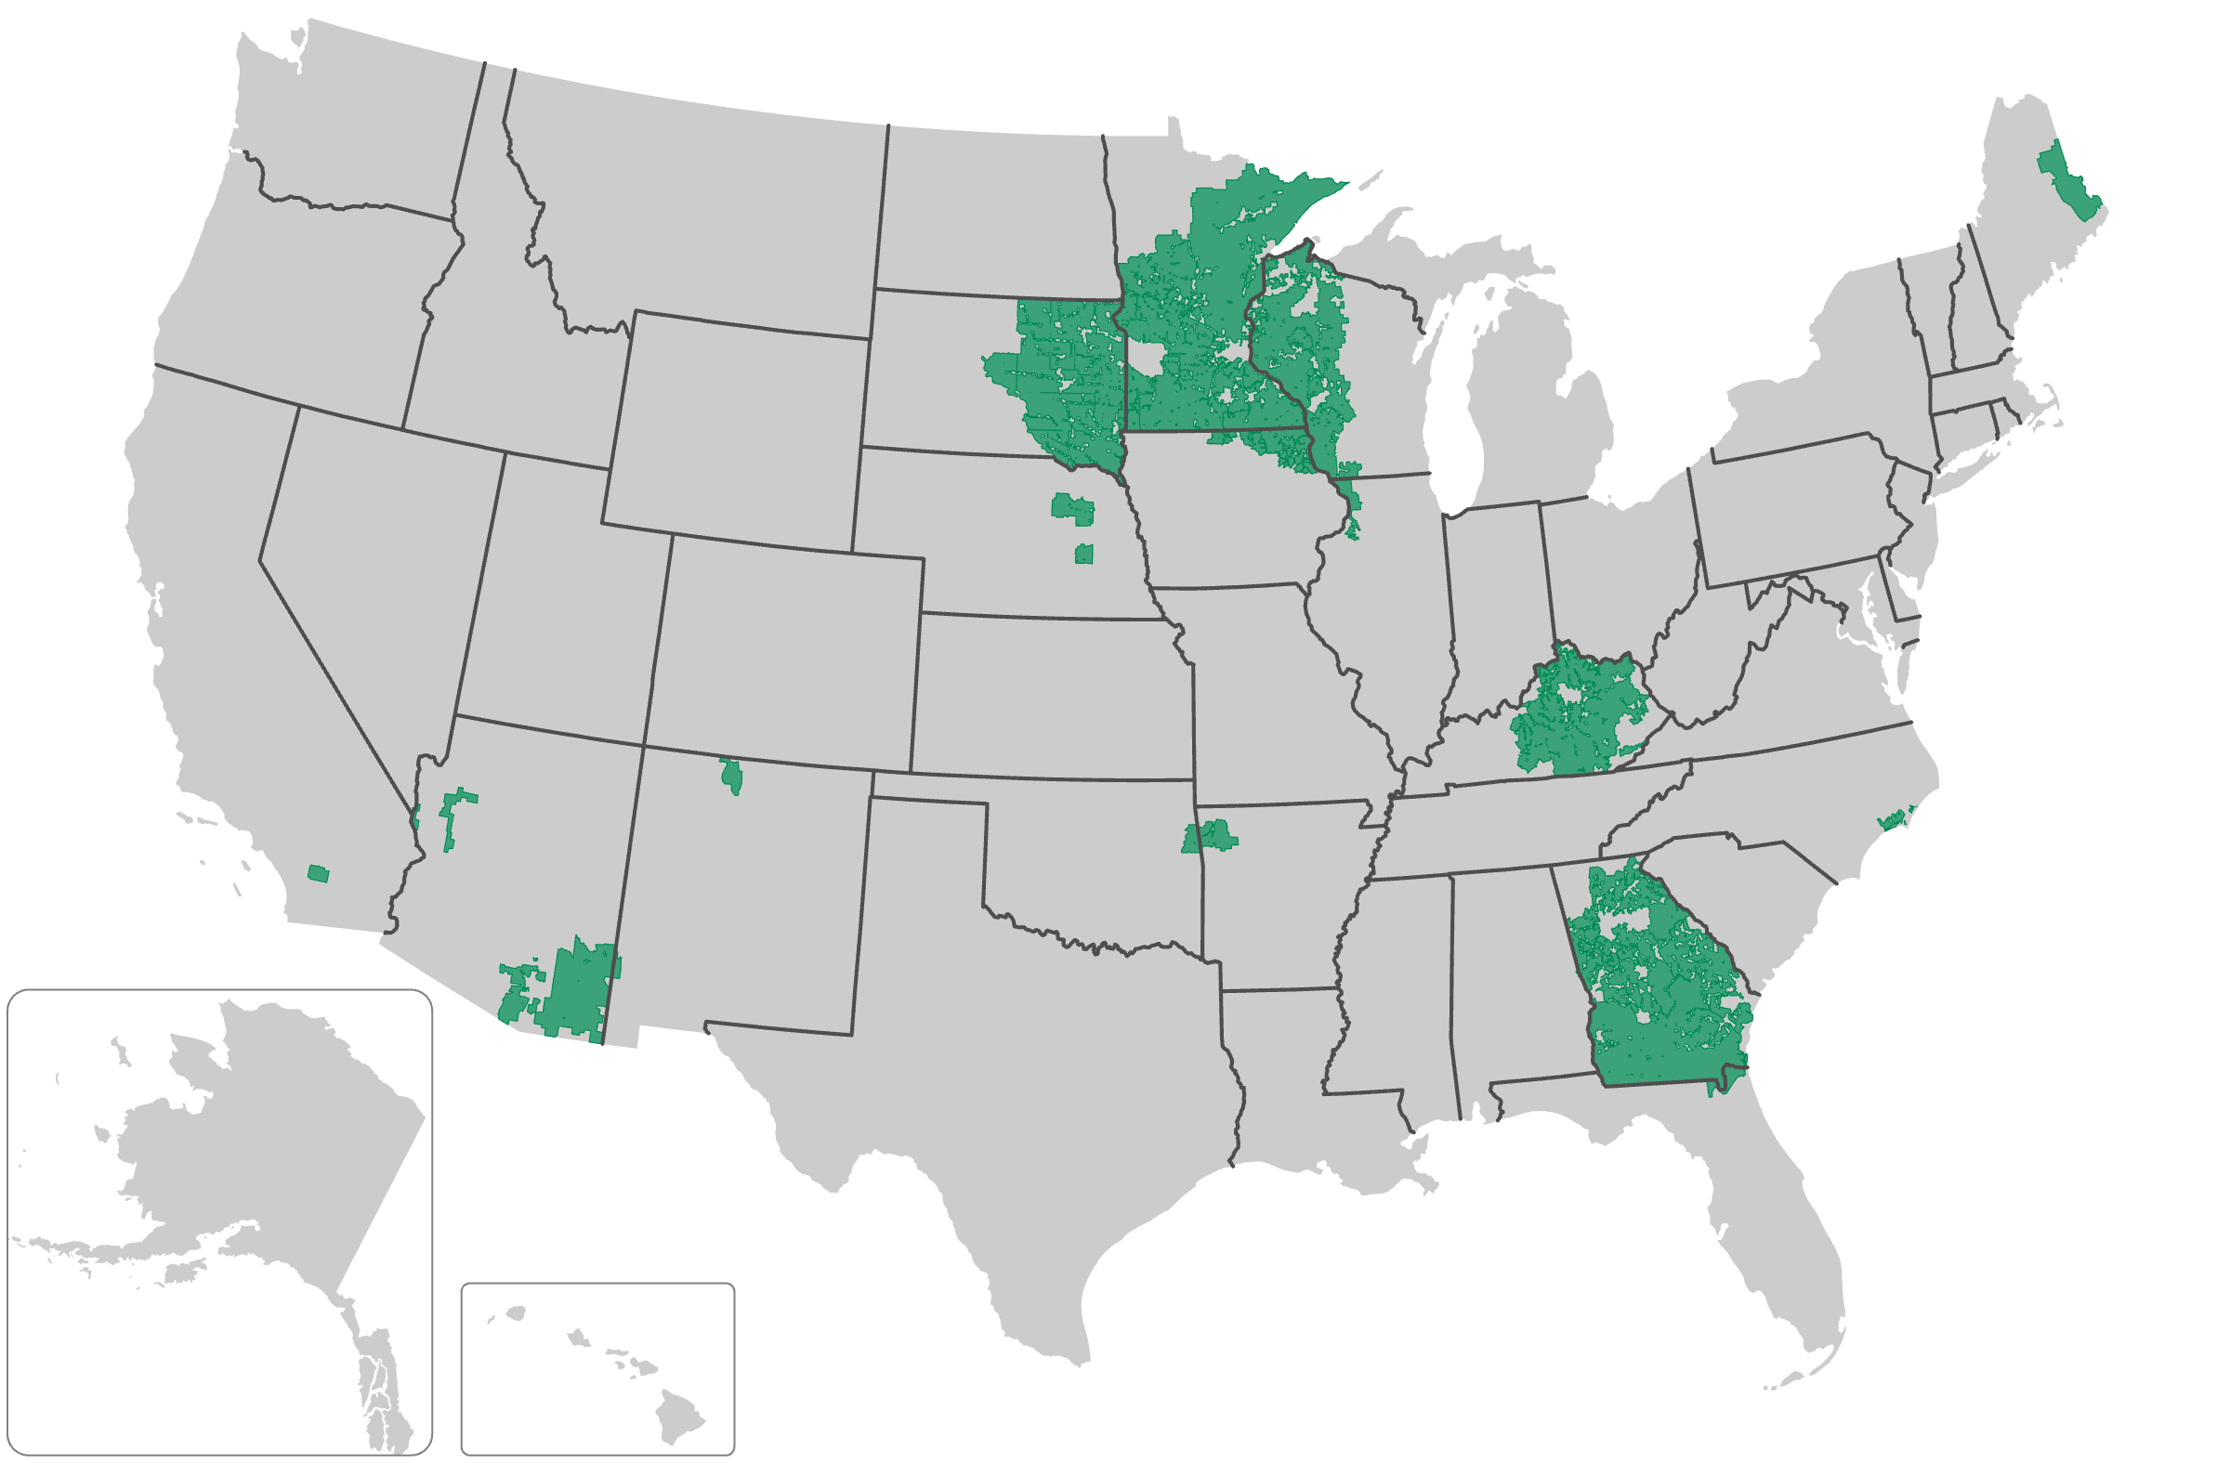
Grid Resilience and Innovation Partnerships (GRIP) Round 2 – In Negotiations
Smart Technologies for Advanced Resilient Transmission (START)
Prime: Georgia Transmission Corporation
Cooperatives: 12
  2 PPD’s
  6 G & T’s
  4 Distribution
States: 11
Period of Performance: 5 years
Total Meters Served: > 4 million meters
START Consortium Members
Budget:
Federal Share: $97,910,605
Cost Share: $97,910,605
Total Project: $195,821,210
| Pg. 16

Slide 18
Grid Resilience and Innovation Partnerships (GRIP) Round 2 – In Negotiations
Project Goals
Cost-effective improvements in resilience, reliability, and transfer capacity—Improve the reliability, resilience, and transfer capacity of START’s transmission networks, by rebuilding/reconductoring existing or building new transmission lines to complete a redundant loop, at lower total by leveraging the techno-economic advantages of AOHC conductors.
Shift in grid design process—Drive a fundamental shift in grid designs by developing and contrasting AOHC- and ACSR-based design alternatives to show how to fully leverage the benefits of AOHC and integrating our Transmission Siting Tool to improve the designs, avoid sensitive areas, improve community acceptance, and reduce costs.
Increased utilization of AOHC—Drive increased utilization of AOHC by expanding utility familiarity and comfort level with AOHC, its uses, and benefits by issuing a AOHC Technical Design Bulletin that documents how to fully leverage AOHC and by issuing an AOHC Use Cases Report that documents real-world implementation of AOHC.
DAC participation in workforce—The combination of our community outreach and workforce development efforts will lead to stronger connections between the DACs and their utilities. These connections will tap into the human potential in the DACs to create a skilled workforce for the utilities and opportunities and jobs inside the DACs.
| Pg. 17

Slide 19
Grid Resilience and Innovation Partnerships (GRIP) Round 2 – In Negotiations
| Pg. 18

Slide 20
Other GRIP 2 Projects
Tennessee Valley Authority (Nashville, Tennessee): $250 million to support TVA and project partners, including some co-ops, on grid resilience projects across eight states.
Hoosier Energy Rural Electric Cooperative (Bloomington, Indiana) and Southern Illinois Power Cooperative (Marion, Illinois): $116.8 million to build new transmission feeds to loop transmission to 10 substations in seven counties.
Jones-Onslow Electric Membership Corp. (Jacksonville, North Carolina): $42.3 million for enhancements including a new step-down station, new transmission lines to provide feeds from multiple sources, and structure hardening of existing facilities.
Rita Blanca Electric Cooperative Inc. (Dalhart, Texas): $40.7 million to construct a new 55-mile transmission line between Dalhart, Texas and the Three-Corners Substation at the Texas, Oklahoma and New Mexico border.
Delaware County Electric Cooperative (Delhi, New York): $27.7 million for grid resilience projects to avoid outages caused by weather events and tree damage due to invasive species.
Black Hills Electric Cooperative Inc. (Custer, South Dakota): $20.54 million for grid technology, a wildfire alert system and system operations tools to mitigate risk from high winds, extreme temperatures and wildfires in South Dakota and Nebraska.
Randolph Electric Membership Corp. (Asheboro, North Carolina): $11.5 million to replace 24 aging circuit ties over 50 miles and install advanced predictive maintenance and fault location devices.
Tombigbee Electric Cooperative (Hamilton, Alabama): $11.2 million to modernize its electric distribution system, including with energy storage, reconductoring and deploying a distributed energy resources management system.
Kotzebue Electric Association (Kotzebue, Alaska): $7.5 million to improve its power plant to protect against blizzards and extreme weather.

Slide 21
Questions?

