Slide 1
2024 Annual Report
Mid-West Electric
Consumers Association
Jim Horan, Executive Director

Slide 2
Mid-West Value
Lobbying
Regulatory Advocacy
Legal Representation
Mid-West advocates on issues important to federal power customers with legislators in 9 states.
Mid-West engages with federal agencies & represents federal power customers on basin restoration efforts.
Mid-West engages in the federal administrative law process on behalf of federal power customers.

Slide 3
2024 Highlights
WAPA Rate Process
Legislative Wins
WRDA
Purchase Power and Wheeling
Basin Restoration Efforts
Fort Peck Test Flows
MRRIC
Value of Hydropower

Slide 4
Informal discussions at least monthly with Mid-West Water and Power Committee.
Meeting with WAPA leadership, finance and rates teams as well as with USBR and USACE.
Informal discussions allow for the greatest direction, feedback, and counsel from customers to the agencies.
Stepped in rate over the next two years.
Need to watch Drought Adder and see WAPA actually implement cost control.
WAPA Rate Process

Slide 5
Water Resources Development Act (WRDA)
Direction to the USACE from Congress on applying the reduce cost share allocation at Garrison, Oahe and Peck.
Hydropower remains priority authorized purpose at USACE facilities.
PMA Administrator makes final decision on what is in rates.

Slide 6
Success in short-term fix for scoring.
Legislation drafted in the House (Congresswoman Fischbach R-MN).
Need permanent fix to be resolved before significant drought impact.
Progress with Senate Leaders, CBO, OMB and Budget Committees.
Purchase Power and Wheeling (PP&W)

Slide 7
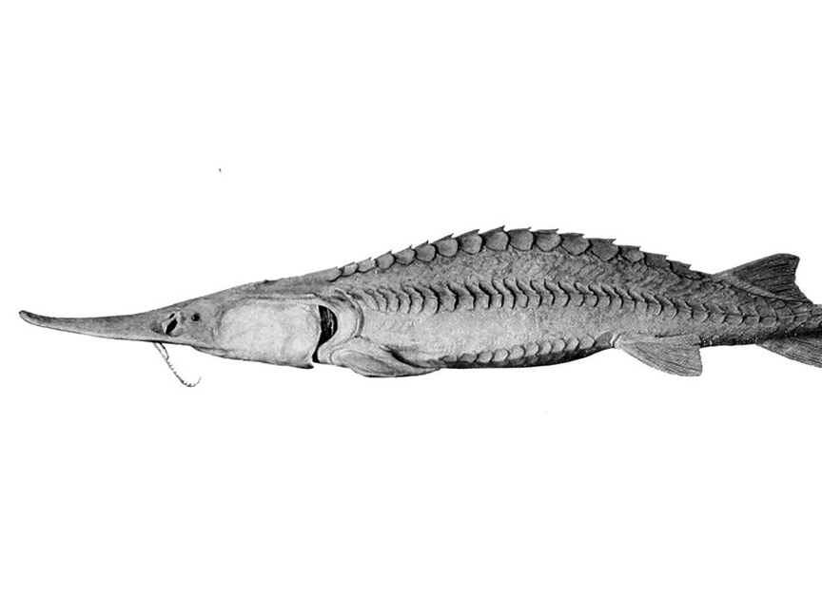
Fort Peck Test Flows
Initial test occurred in late spring and early summer.
Weekly calls with USACE, USFWS and stakeholders.
Waiting to see results analysis (March).
USACE doesn’t expect to run test flows in 2025.

Slide 8
Missouri River Recovery & Implementation Committee
Elected to third term as Committee Vice-Chair
Improves relationships with leadership
Building coalitions – tribes, irrigation, water supply, etc.
Stakeholder Process vs. Litigation
Focus on test flow impact and seeking consensus on need to delist piping plover.
50 additional species threatened in Missouri River Basin.

Slide 9
New versus Old
Economics driving removal debate
Unusual Coalitions
Amnesia
Threats to Hydropower

Slide 10
2025 Priority Resolutions
Federal Power Marketing Administrations
Net Zero Appropriations
Diversion of Federal Power Revenues
Adequate Funding at Federal Hydropower Projects
Payment of Non-Reimbursable Costs
Dan Safety Cost Allocation

Slide 11
Federal Power Marketing Administrations
Mid-West vigorously opposes the sale of the federal power marketing administrations or divestiture of their power and transmission facilities.
We reaffirm our support for the longstanding congressionally approved standard of cost-based rates for electric power generated at federal projects.
We will work to improve the efficiency of federal power operations, protect the contractual federal power supply rights of its members, and resist any unjustifiable increases in electric rates to the ultimate consumers.

Slide 12
Net Zero Appropriations
Mid-West supports the Congressional budget scoring that allows a “net zero” appropriation for the annual expenses of the WAPA.
MID-WEST ELECTRIC CONSUMERS ASSOCIATION

Slide 13
Diversion of Federal Power Revenues
Mid-West urges Congress and the Executive Branch to adhere to principles and policies of federal law governing designation of project uses, allocation of costs and irrigation assistance repayment for existing and future federal projects

Slide 14
Adequate Funding at Federal Hydropower Projects
Mid-West strongly supports appropriate federal funding of hydro facilities for the PMAs, the Bureau of Reclamation and the USACE through appropriations.
In the absence of sufficient federal funding, however, financial support is best provided by those most closely associated with and affected by it, namely local support through Western States Power Corporation.
Mid-West opposes:
- Additional borrowing authority.
- Alternative financing.
- Policies and programs that would cause customers to pay for unnecessary costs without offsetting benefits.

Slide 15
Dam Safety Cost Allocation
Mid-West supports the allocation of dam safety modification costs in accordance with the non-reimbursable provisions of the Dam Safety Act of 1986, thus limiting the allocation of these costs for project purposes to 15%, consistent with the law.

Slide 16
Mid-West Electric Consumers Association opposes any administrative changes or legislation that requires payment of non-reimbursable costs at federal multipurpose water projects by power and water consumers.
Payment of Non-Reimbursable Costs

Slide 17
Legacy of Power
Are we ready to leave the same legacy of power
that was given to us?

Slide 18
WE NEED YOUR ENGAGEMENT
JOIN A COMMITTEE
ENGAGE
GIVE US FEEDBACK
Water and Power
&
Resolutions
Invitations Welcome
Ask Questions
Promote Mid-West Issues
Tell us where we can do better because that’s the only way we get better.

Slide 19
Join me in thanking
ROSALIE HATHAWAY
&
BOB GALE

Slide 20
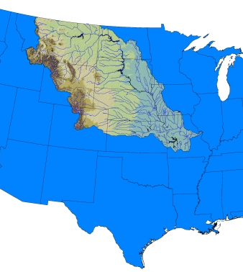
Thank you!
Jim Horan
jimbhoran@meconsumers.com
Cell: 303-748-3170
We hope to see you all next year!

