Slide 1
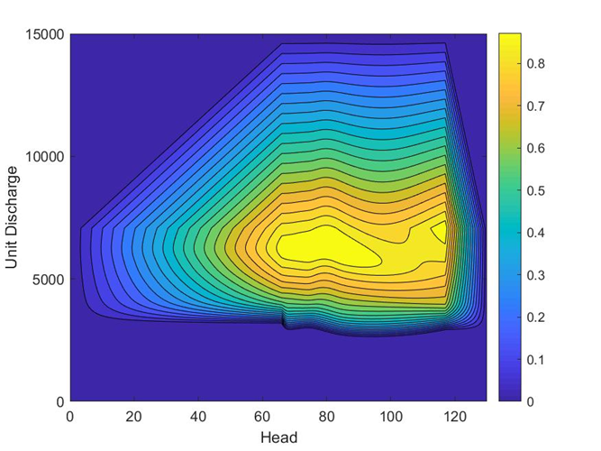
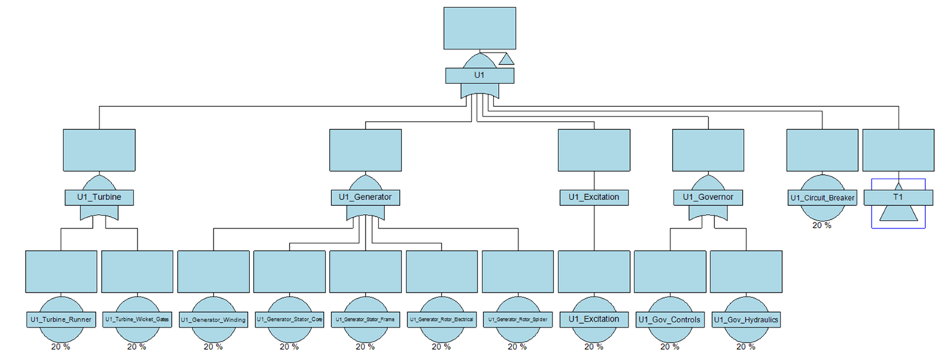
Introduction to the Hydropower Analysis Center (HAC)
Scope and Methods
Mark Parrish,
Chief, Hydropower Analysis Center

Slide 2
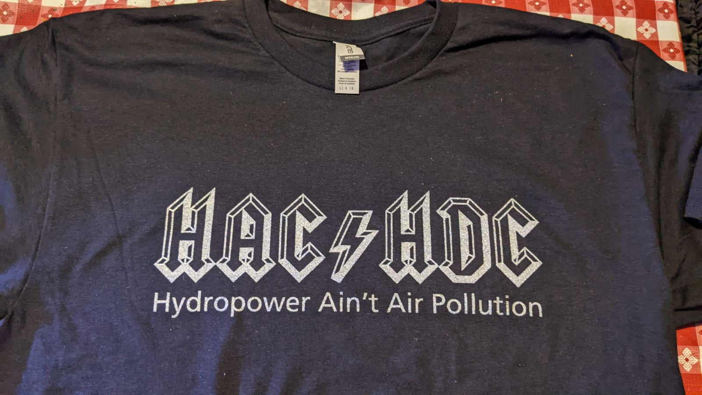
Hac’s History and Mission
History-
In 2001, HDC was designated as an MCX responsible for hydroelectric power plant engineering and design and a TCX for pumping plant engineering and design
The Hydropower Analysis Center (HAC) was designated as an MCX for the economic evaluation of hydropower in 1996 and as a Planning Center of Expertise for Hydropower in 2003.
In 2008 HDC and HAC merged
The Hydropower Analysis Center (HAC) is a Planning Center of Expertise (PCX) and MCX within the HDC and provides services such as hydropower valuation studies, asset management, and data analytics.

Slide 3








Hydropower analysis center
Mark Parrish
Chief, HAC
GS-14 Tech Expert – VACANT
Economist
Margaret Ryan
Economist
David Sanna
Economist
Mike Paruszkiewicz
Economist (EIT)
Audrey Demeaux
Mathematician
Hastings Marek
Mathematician
(EIT)
Mesa Walker
Data Scientist
(Student Intern)
Hunter Burr

Slide 4
Current scope of HAC’s work
Design/ Asset Management
USACE Planning
Digital Transformation
How is the hydropower fleet performing:
Unexpected event reporting
Machine condition monitoring
How do we want the hydropower fleet to perform?
Turbine sizing studies
Asset investment strategies
How does hydropower interact with other project purposes?
Water supply reallocations
Environmental Impact statements

Slide 5
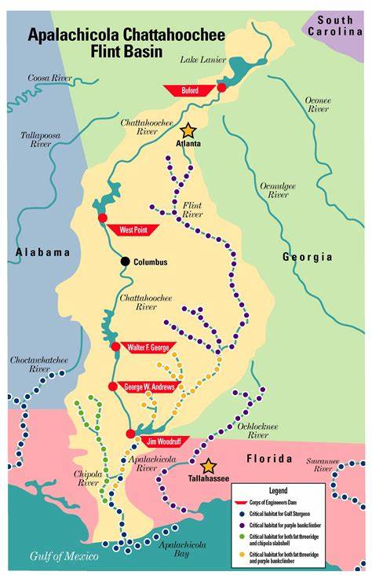
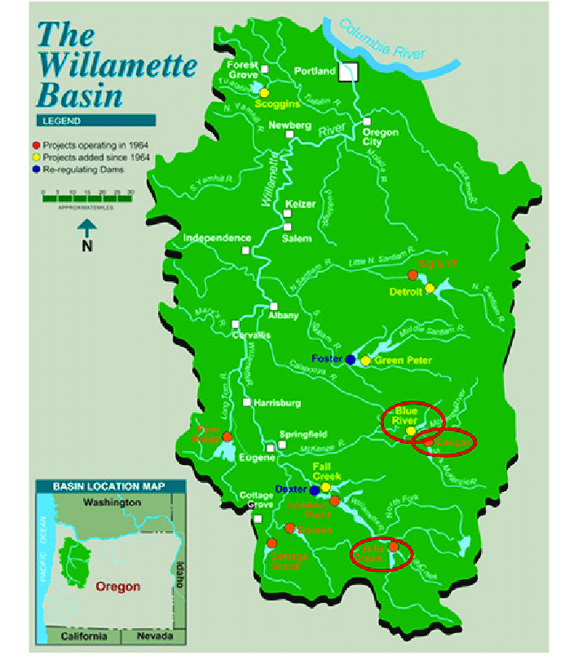
Hydropower Planning
Areas of Responsibility:
  HAC is the National Planning Center of expertise for Hydropower
    Technical services-quantifies impacts to hydropower in complex and controversial studies (EIS, Water supply reallocations)
    Peer Review-responsible for ATR of hydropower studies
    Research and Development
    Process Improvements
Trends:
  Water supply use is changing the availability of water for hydropower use
  Environmental demands can impact water availability for hydropower use and also increase cost (joint-use) for mitigation structures
  Power Marketing Agencies (PMAs) and power customers are asked to make investment decisions under this uncertainty
Innovations:
  Designing and developing models that capture benefits that reflect the current state of the market and PMA use
  Collaboration with the PMAs and power customers to properly quantify value of hydropower –updating guidance to include grid support, environmental, and updated energy market benefits

Slide 6
Updating EM 1110-2-1701
Engineer Manual 1110-2-1701 Engineering and Design – Hydropower is used as our guidance to quantify the value of hydropower.
Its was published and last updated in 1985.
The current methodologies are deemed inadequate and outdated for assessing impacts in today’s regulatory, policy, and technological setting.
HAC has been holding inter-agency meetings with PMAS to help develop methodologies to value hydropower for current and future uses.
Appropriately measure and value hydropower production and investment impacts
Meet diverse analytical needs: asset management studies, water supply studies, operations research, and others
The methods we develop should…
Be consistent with current Federal and Army guidance as it relates to comprehensive public benefits accounting (economic, environmental, social, and other)
Be transparent, reproducible, and well documented

Slide 7
Digital Transformation
Data Collection
and Acquisition
Areas of Responsibility:
  Leading national USACE Hydropower Digital Transformation effort
  Coordinating multidisciplinary team working across the Corps to identify future digital needs and roadmap to success
  Serve as hub for collaboration to share ongoing DT projects across USACE and engagement with external industry groups on other DT lessons learned
Trends:
  Multiple plants exploring use of data diodes to extract and centralize operational data
  Hydropower Research Institute: identifying Use Cases to demonstrate value of aggregated industry data while growing USACE data participation
Innovations:
  Development and implementation of Unexpected Event Reporting and Data Dashboard projects
  Identifying changes needed to existing systems to enable data to be extracted into a coordinated framework to drive effective operations, maintenance, and asset management of the USACE fleet
Data Organization
and Storage
Data Analysis
and Utilization

Slide 8

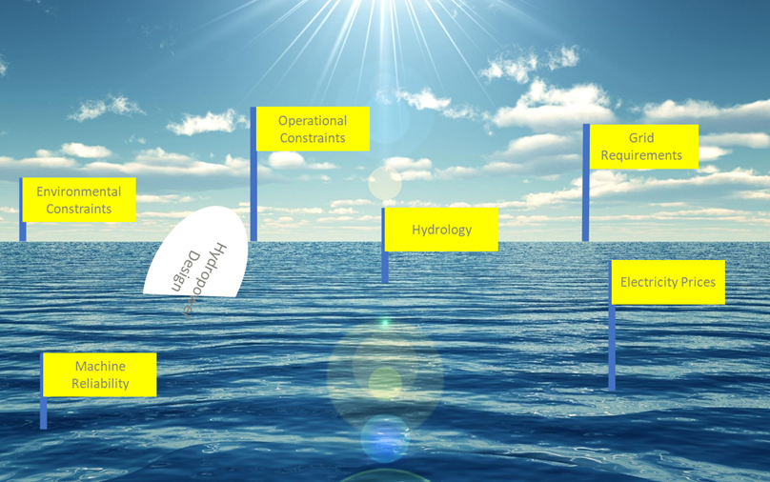
The State of Design / Asset Management For The
USACE Hydropower Fleet
Trends:
  Federal Hydropower remains in the rehab stage
  Most Project Funding comes through the customer funding (SWPA, WAPA, and SEPA) or direct funding BPA mechanisms
  Hydrologic variability, electricity price uncertainty , and environmental constraints shape the design of the powerhouse
USACE Innovations/ongoing efforts:
  Designing and developing models that capture benefits that reflect the current state of the market and PMA use
  Development of Stochastic Benefit Cost Analysis methodology that addresses the uncertainty of hydrology and the energy market
  Using systems analysis approach to justify needs of transformer spares across similar plants

Slide 9
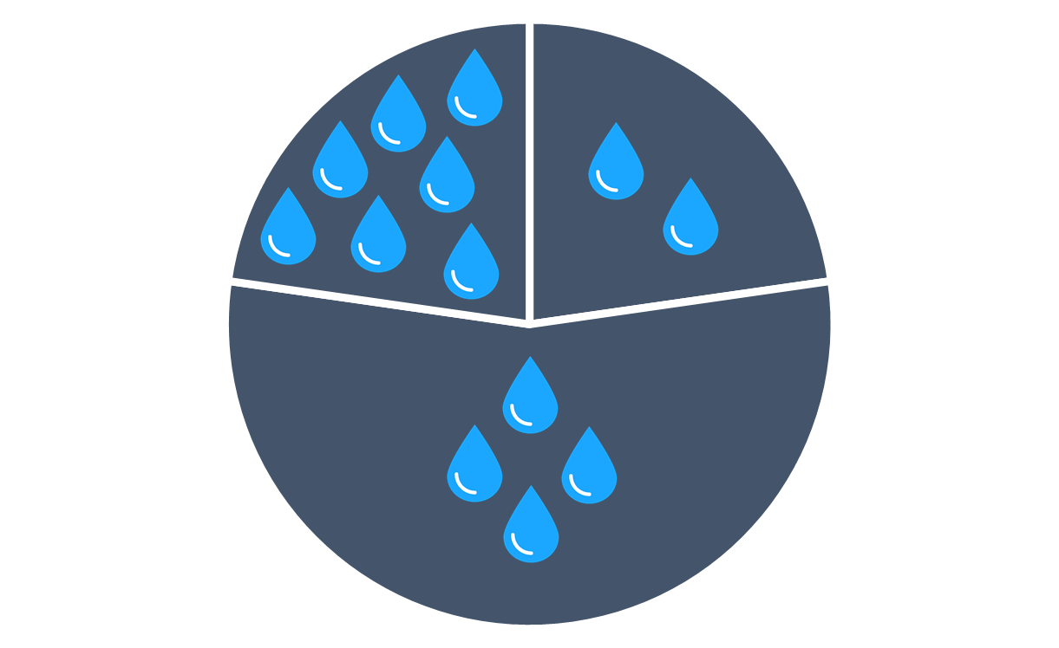
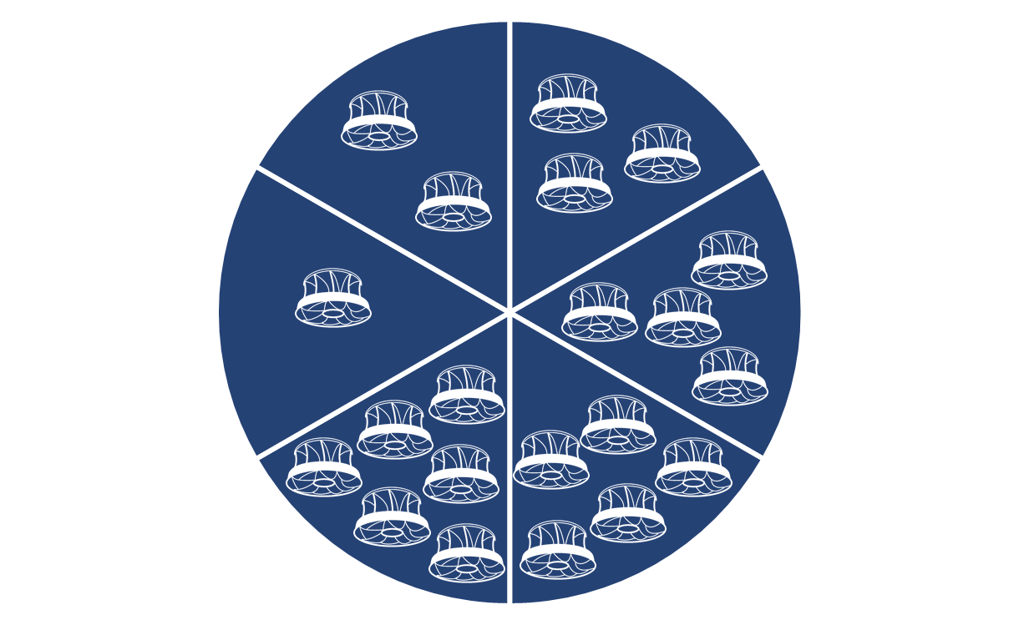
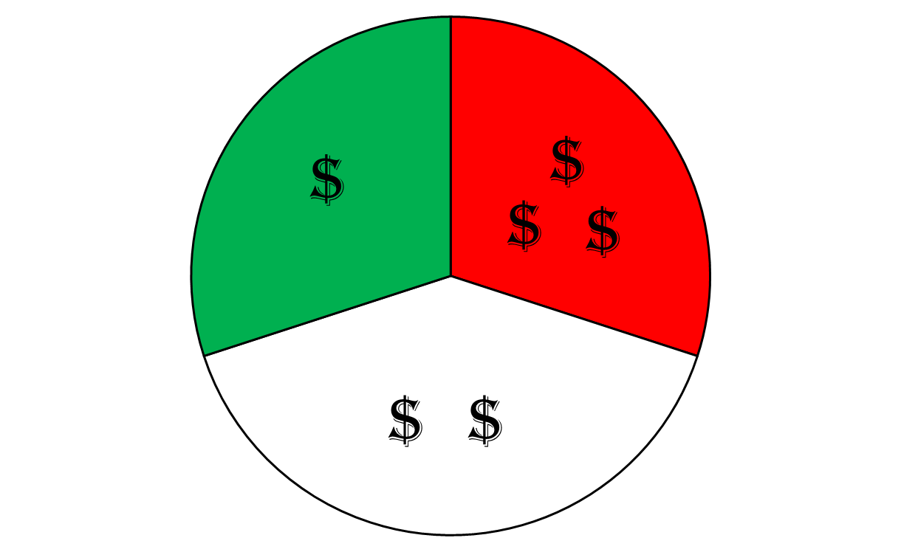

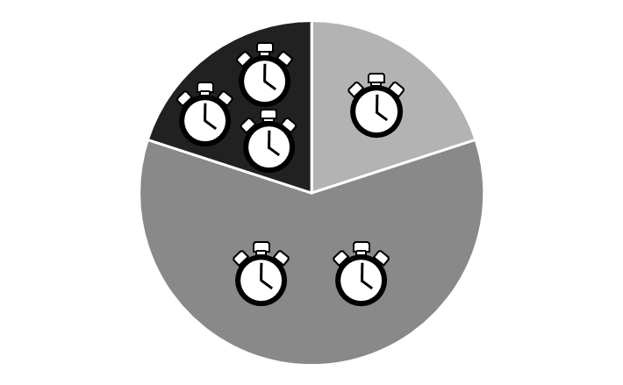
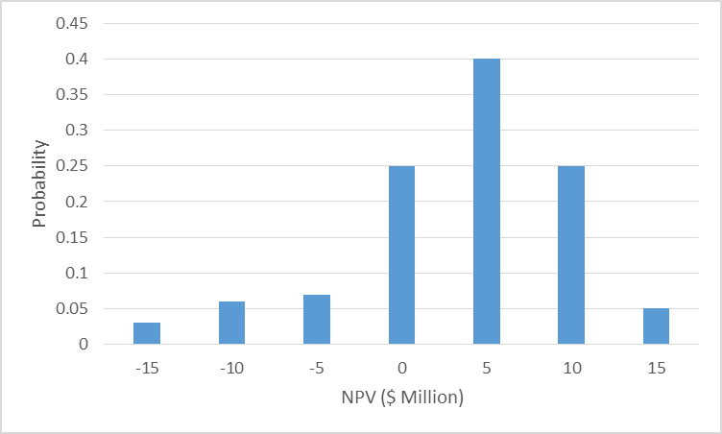
Stochastic vs Deterministic Analysis
Hydrology
Unit Availability
Project Cost
85% Probability that NPV > 0
NPV=
-$15 mil
$10 mil
Energy Prices
Outage/Project Duration

Slide 10
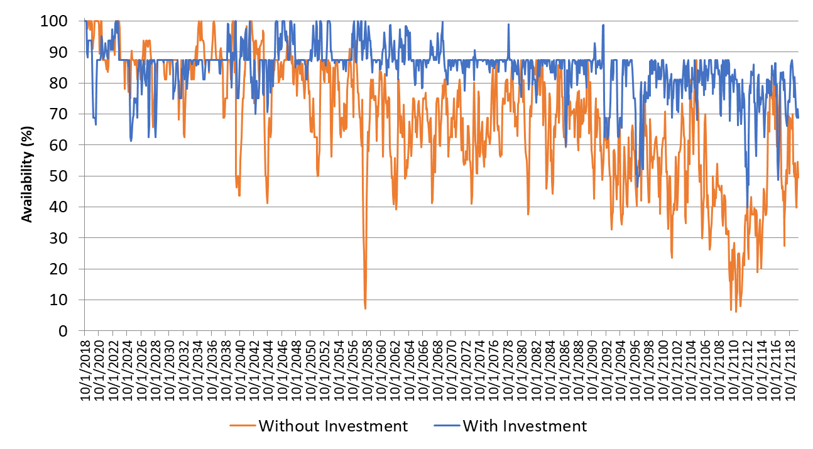
Availability workbench (AWB) simulated Availability
The Availability Workbench (AWB) simulation engine employs Monte Carlo simulation methods to estimate system and sub-system parameters such as unavailability, number of expected failures, production capacity and costs
Baseline (Alt 0): No action alternative. No scheduled replacements. Assets will fail and then repaired to
Hydroamp score.

Slide 11
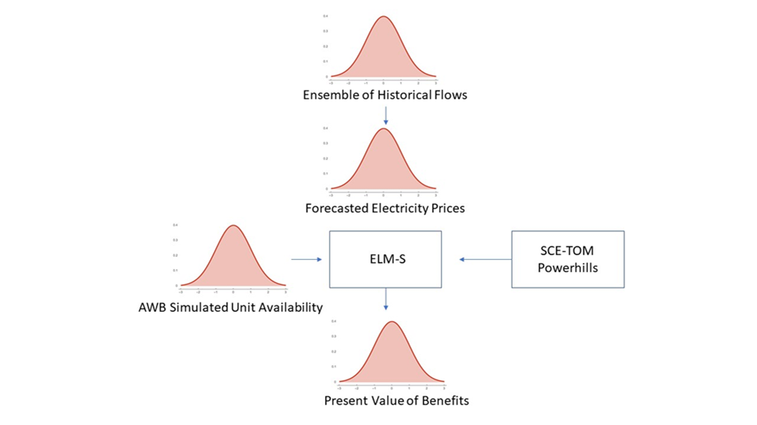
SCE-TOM Modeling Suite
SCE-TOM ( Optimal Unit Dispatch Model)
ELM-Energy Linking Model
Optimal until turbine dispatch model developed to quantify benefits of turbine replacement across different families, and fully capture efficiency gains/losses
Monte Carlo simulation developed to simulate the response of the hydropower plant to uncertainties including electricity prices, hourly operations, hydrology and reliability.

Slide 12
Alternatives Modeling/Collaboration Process
Stochastic Reliability Model
Stochastic Energy Model
Final Outputs (1000 Simulations)
Turbine Design (Performance Curves)
Hourly Generation (MWh)
Equipment Condition
Failure Curves
Hourly Reserve Potential (MW)
Simulate Unit Availability
(Hourly, 50+ years, 1000 Simulations)
Hourly Flow and Head
Simulate Generation
(Hourly, 50+ years, 1000 Simulations)
Outage Schedule
Unit Starts and Stops
Hourly Energy Price Forecast
Forced Outage Durations
MVAR Capability
Hourly Unit Status
Planned Outage Durations
Hourly Energy Value ($)
Net Present Value
Failure Repair Costs
Benefit Cost Ratio
Capital Costs

Slide 13
Questions we’ve analyzed with this framework
Optimal timing and alternative for investment
Optimal number of units to modernize
Optimal design (Flexible vs Peak, sizing)
Optimal # of spares
Tradeoffs of fixed vs adjustable turbines
Value of new units
Transmission line impacts
Reserve capability and voltage support

Slide 14
Typical Benefits of asset replacement in an energy Capacity market
Typical Benefit Expectation

Slide 15
Beyond energy and capacity: Ancillary Services
Spinning Reserves: Online generation that is reserved to quickly respond to system events (such as the changes in renewable energy like wind and solar) by increasing or decreasing output.
Supplemental (non-spinning) reserve: Offline generation that is capable of being connected within a specified period (usually 10 minutes) in response to an event in the system.
Reactive power and voltage support: The portion of electricity that establishes and sustains the electric and magnetic fields of AC equipment.
Black start (restoration) service: The capability to start up in the absence of support from the transmission grid. This capability is of value to restart sections of the grid after a blackout and can typically be provided by hydropower.

Slide 16

The Road ahead
SCE-TOM improved computational efficiencies and new features
  Speed up the process and solve memory issues
  Expand modeling techniques to quantify ancillary services and new hydrologic operational regimes
2) Standardize Engineering Cost Estimates-
  Survey current HDC practice
  Align escalation methods
  Justify/incorporate uncertainty
  Incorporate market trends/ and industrial constraints
3) Publishing and Implementing EM-1110 updates

Slide 17
Questions?

