Slide 1
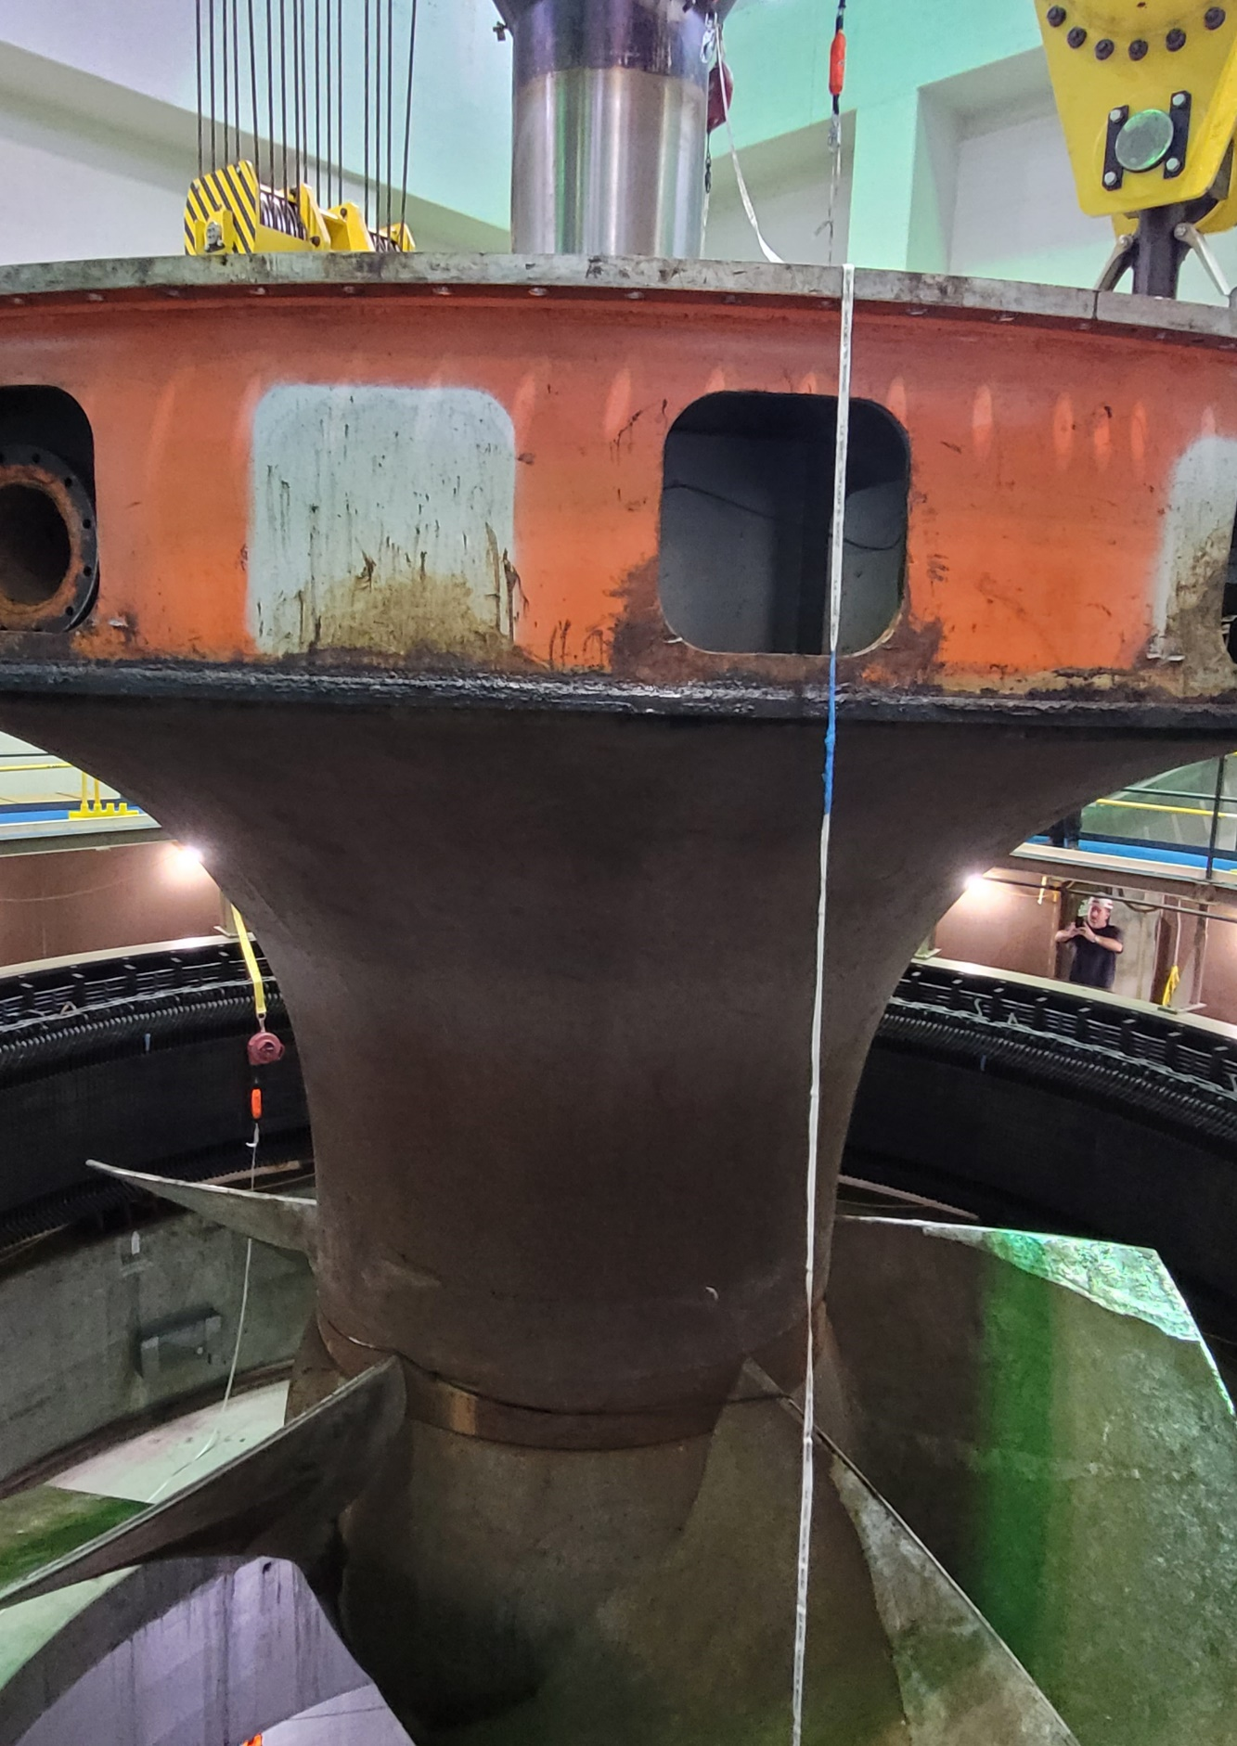
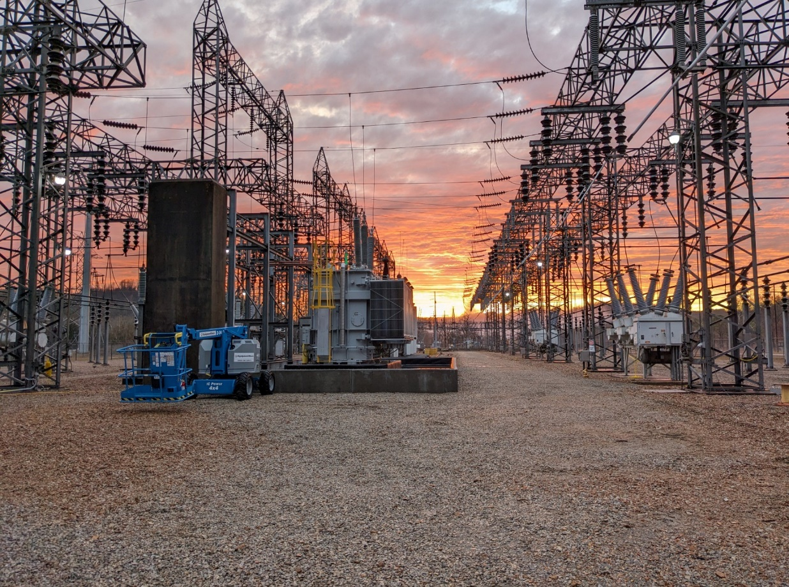
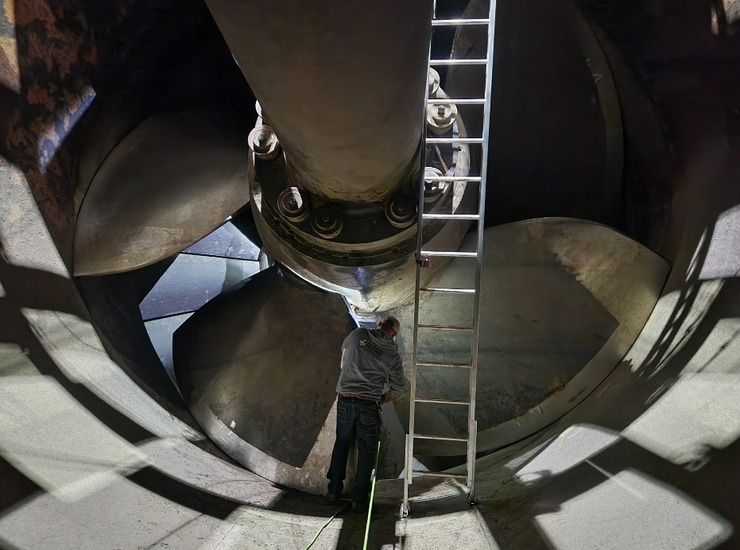
Hydroelectric Design Center (HDC)
Organizational Overview
Mid-West Electric Consumers Association (MECA)
Annual Meeting
Kallan Mrozek, P.E.
Regional Design Manager
10 December 24
Denver, CO

Slide 2
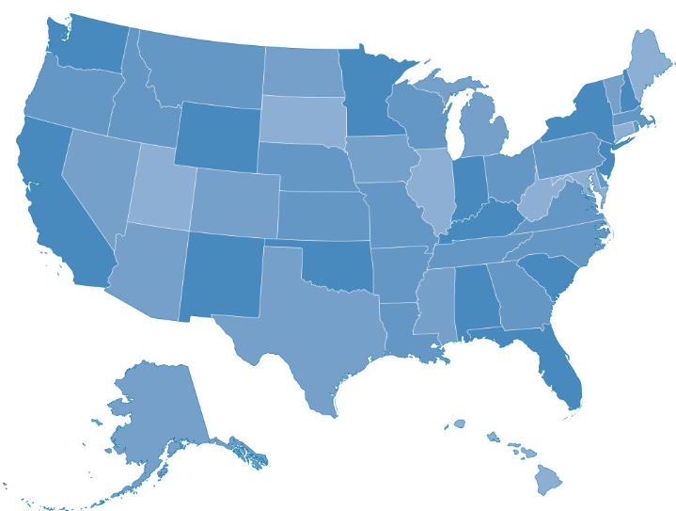

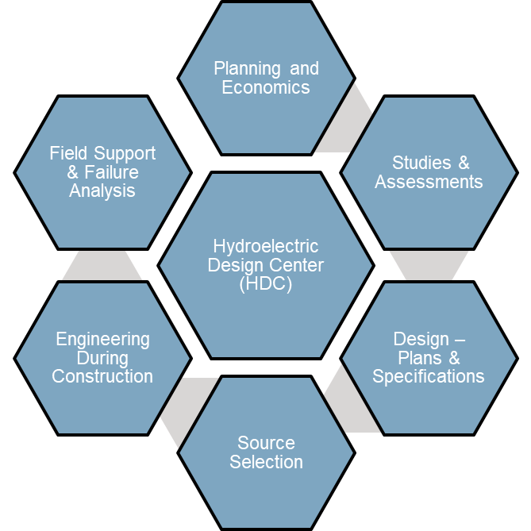

Hydroelectric Design Center
180+ Hydro professionals
MCX & TCX (ER 10-1-53 – Roles and Responsibilities HDC)
  Mandatory Center of Expertise (MCX) for hydroelectric power economic evaluation, engineering and design
  Technical Center of Expertise (TCX) for pumping plant engineering and design
GENERIC DATA ACQUISITION & CONTROL SYSTEM (GDACS)
  Presently, GDACS controls 33 plants
    31 USACE – 68% & 2 USBR – 49%; 23,080 MW, 176 units
  GDACS is scheduled to control 50 plants
    40 USACE – 74% & 10 USBR – 50%, 24,694 MW, 262 units
HYDROPOWER ANALYSIS CENTER (HAC)
  Reallocation and Uprate Studies, Guidance Updates, Digital Transformation, Asset Mgt, Benchmarking
NATIONAL HYDROPOWER PROGRAM SUPPORT & INITIATIVES
  Hydropower R&D
  Hydropower Acquisition Strategy Board (HASB)
  Standards Development -
    EM 1110-2-3006 – Hydroelectric Power Plants Electrical and Mechanical Design (PUBLISHED 2024)
    HAC (EM 1701) - Value of Hydropower EC
    IEEE, ASTM
  Industry Outreach (CEATI, NHA, NWHA)
HDC HQ in Portland, OR
Forward Office in Mobile, AL
Remote Employee Locations
600+ PROJECTS ANNUALLY
$40+ MILLION PROGRAM

Slide 3
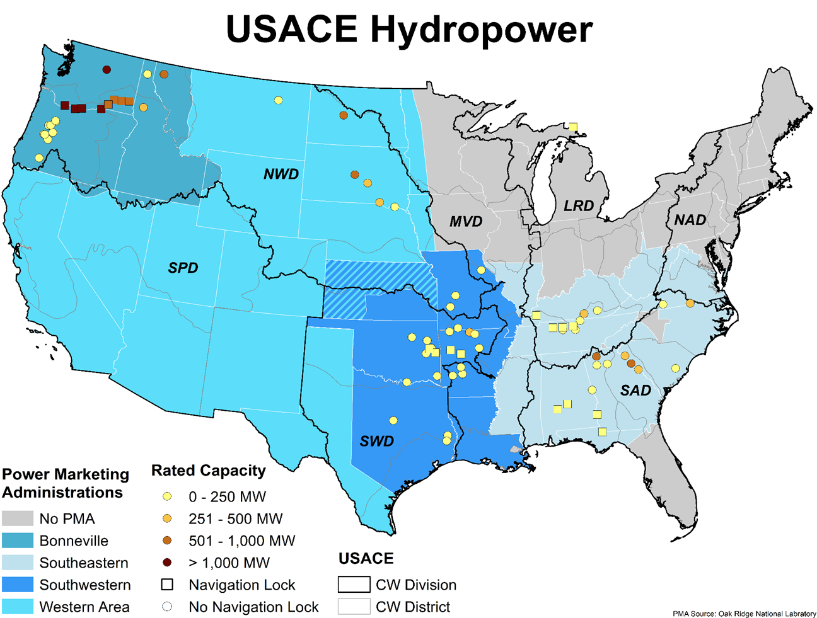
Ensure USACE hydropower assets are available to provide reliable renewable energy and flexible capacity to our nation’s electric grid
Part of the Corps Civil Works Portfolio
75 Hydropower Projects with a Total of 356 Grid Connected Hydroelectric Generators
Largest Hydropower Producer in the United States; Provides approximately 25% of the Hydropower Produced in the U.S.
Hydropower Assets Cover 5 Divisions and 16 Districts Across USACE
Capacity and Generation is Marketed by the Department of Energy’s 4 Power Marketing Administrations to Non-Profit Municipalities and Cooperatives Known as Federal Preference Customers to Repay Costs
Program Goals
  Transform O&M
  Effectively Apply Funding
  Ensure Confidence in Value of Hydropower
Focus Areas:
  Operations Efficiencies
  Maintenance & Investment Planning
  Hydropower Acquisitions

Slide 4

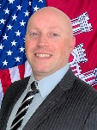




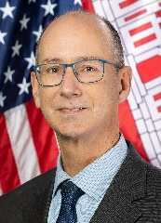
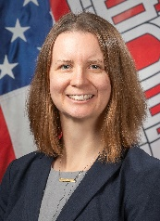
THE HDC TEAM
Jordan Fink, PE
Director
Vinnie DiBlasi, PE
Deputy Director
Automation Controls & Cyber Security Branch
Steven Ernst, PE
Electrical Branch
John Yen, PE
Front Office/ Admin Officer
Scot Hale
Hydropower Analysis Center
Mark Parrish
Mechanical / Structural Branch
Jim Calnon, PE
Program Integration & Delivery Branch
Ellen Ballantine, PE
NWP/NWW Integration
CJ Veatch, PE
Power Systems
Deanna Dinh, PE
Largest Cyber Engineering Unit in USACE
Designing Cyber ICS & SCADA Solutions
Turbomachinery
Kellen Shide, PE
Program Analysts
Dora VanZandt
SAD Integration
Nathan Henshaw, PE
Generation Equipment
Teresa Casper, PE
Largest Concentration of
Electrical Engineers in USACE
Designing Electrical Hydropower Systems
Mechanical Systems
Jim Kiel, PE
Regional Design Managers &
Design Managers
NWS/USBR/BPA Integration
Austin Roskamp, PE
Protection Systems
Luke Raynor, PE
Structural
Sharon Demeaux, PE
ACCS Program Manager
Largest Concentration of
Mechanical Engineers in USACE
Designing Mechanical Hydropower Systems
HQ Integration Lead
Product Development
Chris Alexander, CISSP
Control Systems
Eric Vaughn, PE
Engineering Support
Eric Holzapfel
Ten National Technical Hydropower Experts in Mechanical Engineering, Electrical Engineering, and ACCS
Cybersecurity
Michael McGrath, CISSP

Slide 5
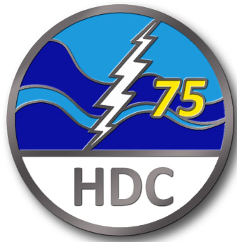
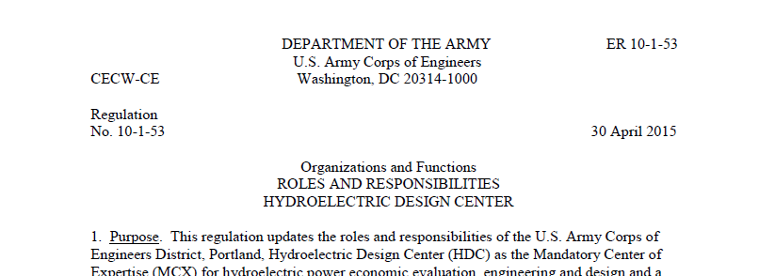
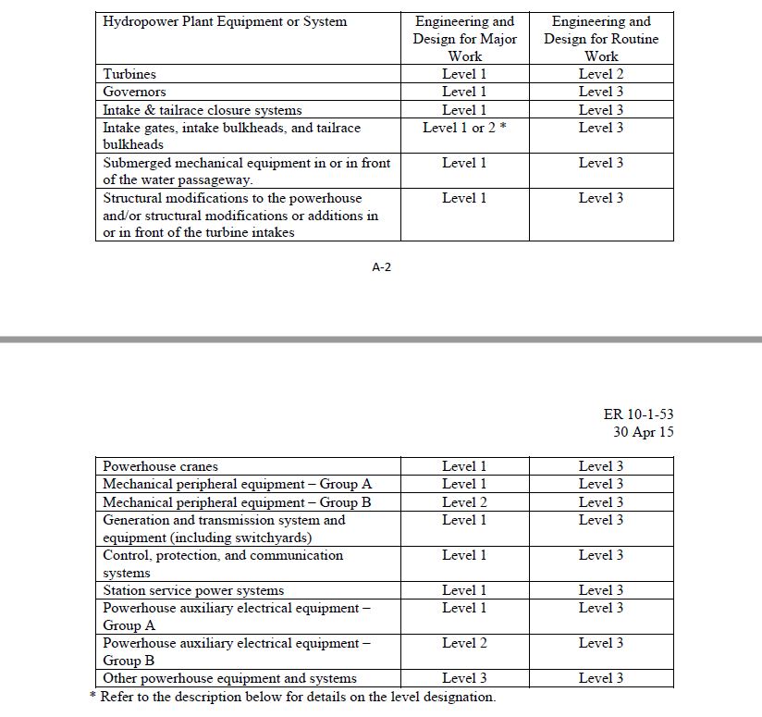
Engineering Regulation (ER) 10-1-53
Roles and Responsibilities
Value of an MCX in Hydropower
  Improve and concentrate capabilities in hydropower
  Eliminate redundancies
  Optimize use of specialized expertise and resources
  Enhance USACE-wide consistency
  Maintain institutional knowledge and share lessons learned
  Improve service to partners
  Rapid response to emergencies
ER Work Levels
  Level 1: HDC must perform
  Level 2: HDC must scope and approve final design, but District may perform design
  Level 3 HDC must be informed of the work to discuss the scope and offer the benefit of HDC’s related experience
Major Work/Routine Work
  Major Work: Equipment or system replacement or rehab. Work that is beyond routine preventative maintenance requirements.
  Routine Work: Equipment maintenance and repairs, replacement in kind; work that is normally the responsibility of project operations.
Established in 1948 to support new hydroelectric development on the Columbia River

Slide 6
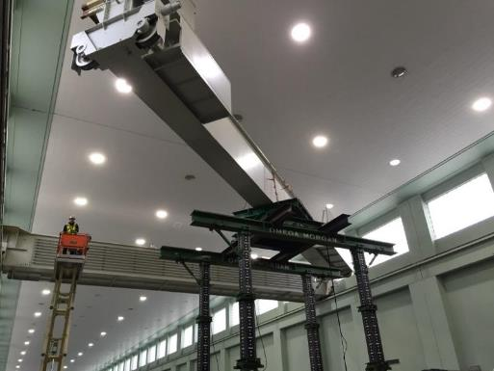
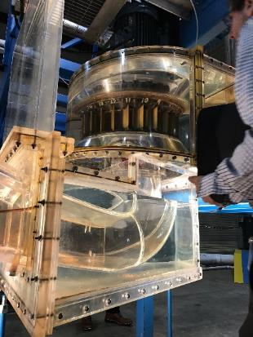
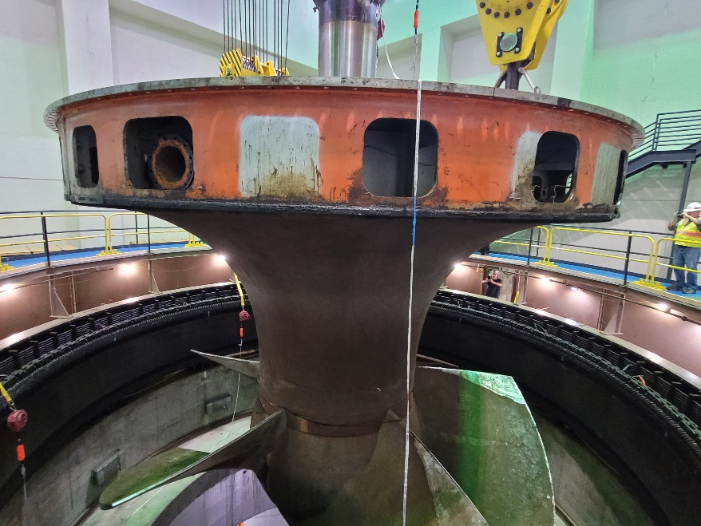
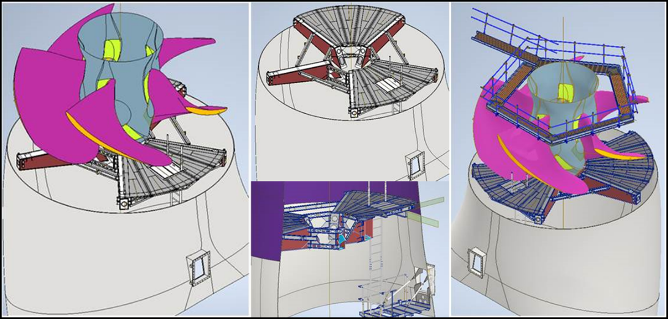
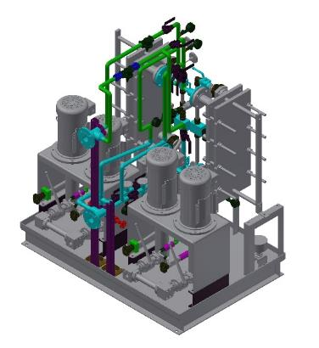
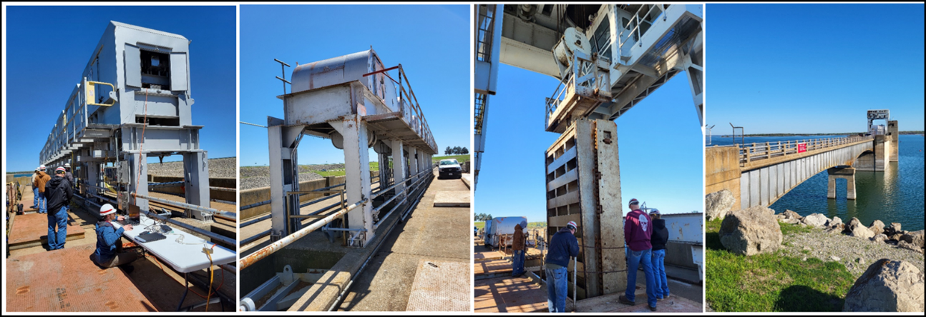
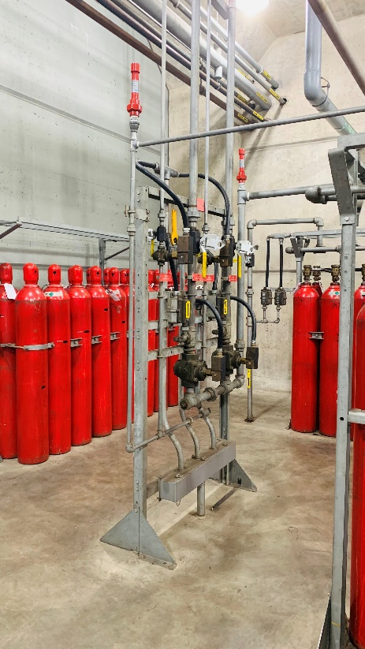
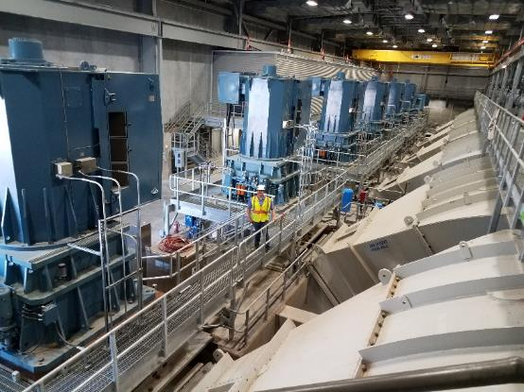
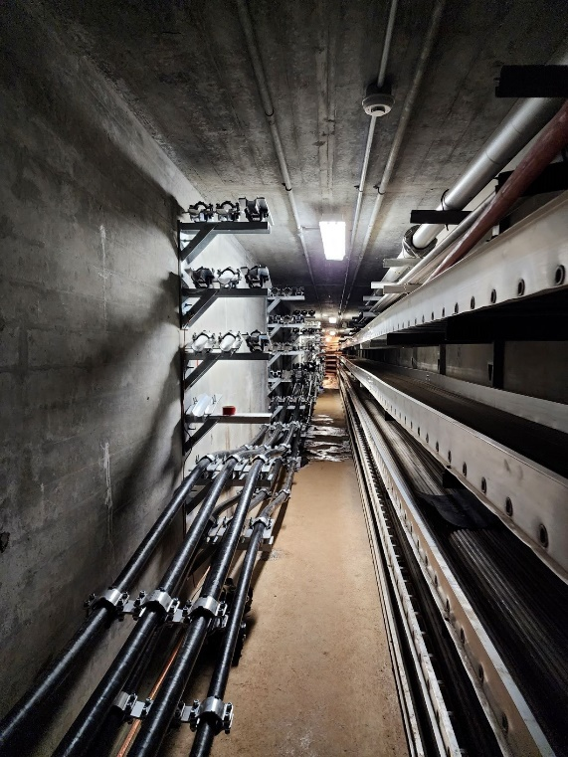
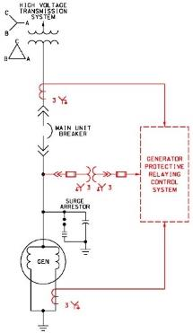
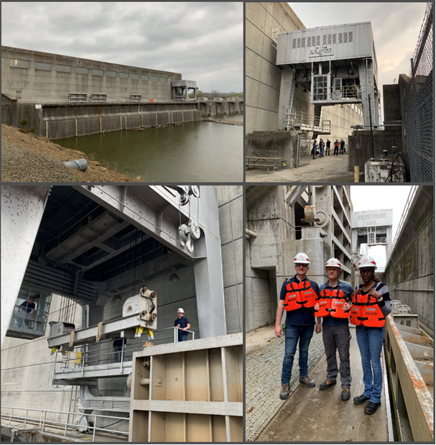
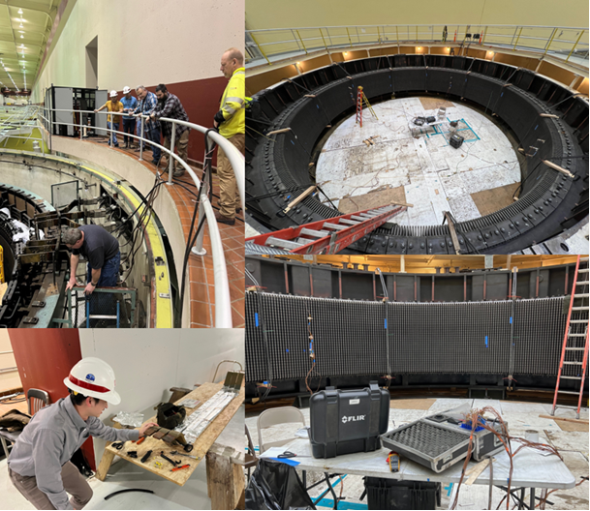
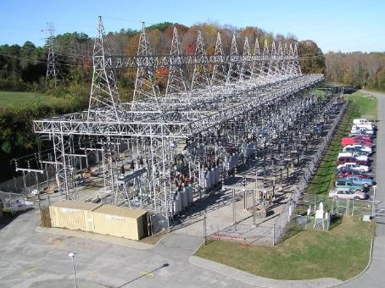
What We Do
BRIDGE CRANE REPLACEMENT
TURBINE MAINTENANCE PLATFORM
SCALED TURBINE MODEL
TURBINE REPLACEMENT
INTAKE GATE DOWNPULL TESTING
PUMP STATION SUPPORT
FIRE SUPPRESION SYSTEM UPGRADE
MEDIUM VOLTAGE CABLE INSTALLATION
INTAKE GATE REPLACEMENT
GENERATOR TESTING
SWITCHYARD SUPPORT

Slide 7








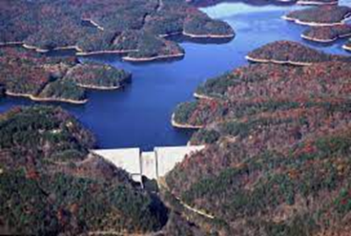
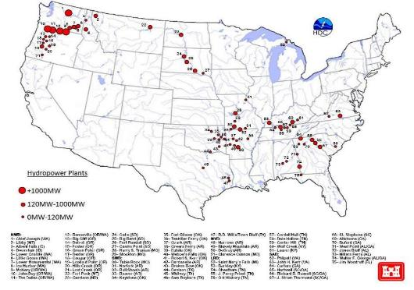

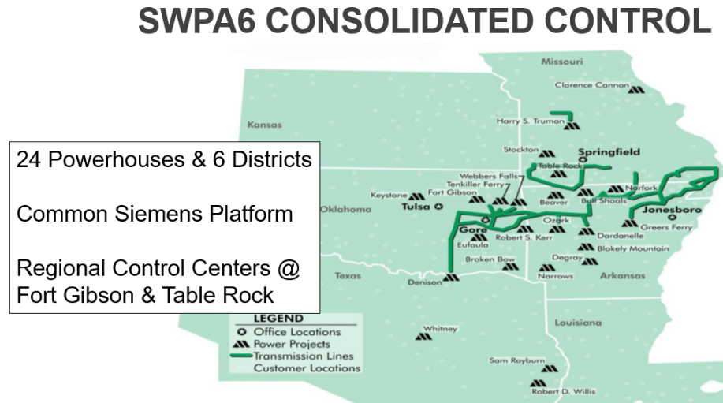
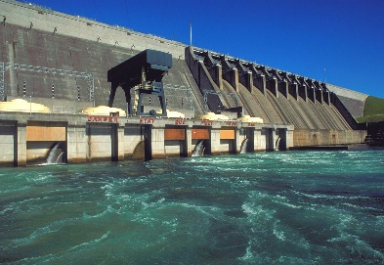
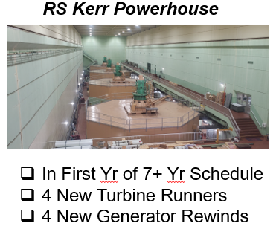
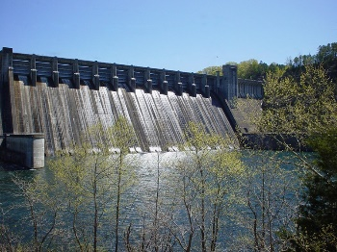
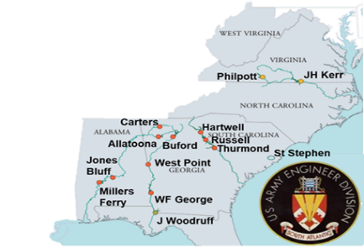


Improving USACE Hydro Reliability
McNary Powerhouse
Fort Randall Powerhouse
Wolf Creek Powerhouse
Old Hickory Powerhouse
Chief Joseph Powerhouse
Oahe Powerhouse
In PHASE II (Fabrication)
14 New Turbine Runners
3 New Generator Rewinds
In PHASE II (Fabrication)
8 New Turbine Runners
8 New Generator Rewinds
Barkley Powerhouse
In PHASE I (In Design)
6 New Turbine Runners
4 New Generator Rewinds
In PHASE II (Construction)
27 New Generator Rewinds
In PHASE II (Construction)
3 New Turbine Runners
  Optional 4th Unit
3 New Generator Rewinds
PHASE IA complete (Engineering Study)
7 New Turbine-Generator Units
Full Powertrain Assessment
John Day Powerhouse
Philpott Powerhouse
In PHASE I (in Design)
12-16 New Turbine Runners
12-16 New Generator Rewinds
In PHASE II (Fabrication)
4 New Turbine Runners
3 New Generator Rewinds
In PHASE II (Construction)
2 New Turbine Runners
2 New Generator Rewinds
15MW TO 19 MW
Hartwell Powerhouse
In PHASE II (Construction)
2 New Generator Rewinds
Norfork Powerhouse
SAD Centralized Regional Control
In PHASE II (Construction)
2 New Turbine Runners
2 New Generator Rewinds
In PHASE II (Construction)
4 New Turbine Runners
4 New Generator Rewinds
13 Powerhouses & 3 Districts
2 Regional Control Centers

Slide 8






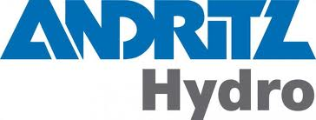














National partnerships & Collaboration
Hydro Owners and Operators
Industry
Federal
Hydro

Slide 9
Hydropower innovation
  ERDC Partnership
  DoE & National Labs
  BoR collaboration
  CEATI & NHA
Hydropower Innovation
National Hydropower Research & Development Program
Hydropower Acquisition Strategy Board
Implement into Technical Design
Internal HDC Processes
Industry Engagement
  Bureau of Reclamation
  CEATI / Owner-Operators
  Clean Currents
  OEM Partnering
  Knowledge sharing across USACE hydropower business line
  Unique acquisition methods and solutions
  Ongoing training course opportunities
  Adoption of EMS for database use
  Design guides / guide specifications
  Floor space adaptations
  Dissolved oxygen turbine runners
  John Day water filled hubs
  Self-lubricating bushings
  Digital governors
  Cold spray technologies for cavitation repair

Slide 10










National Hydropower r&D Program
The Hydropower R&D Program is a national program that serves all USACE Hydropower by considering the R&D needs and ideas from all MSCs and facilitates identifying funding, writing proposals, tracking project execution, and communicating progress to USACE Hydropower leaders.
Mission
Prioritize and align defined hydropower needs with R&D funding opportunities to:
Reduce the cost of generation.
Reduce outage frequency and duration.
Increase the longevity of the equipment.
Improve environmental stewardship.
Improve safety.
SharePoint Site: https://usace.dps.mil/sites/KMP-HP/SitePages/R%26D-Program.aspx
Program Structure
The program is comprised of 5 groups, the Steering Committee, Advisory Committee, and three action groups (R&D Program Identification, R&D Funding Identification, and R&D Project Execution groups).
Steering Committee
Comprised of representatives from HDC, ERDC, and HQ
Build and maintain a USACE-wide Hydropower R&D Program that:
  Gathers R&D ideas from across the enterprise that align with the mission areas
  Align funding/execution opportunities with top R&D Priorities and facilitate proposal process
  Identifies existing R&D efforts internal & external to USACE and communicates to enterprise
Coordinates with Advisory Committee & Stakeholders
Advisory Committee (LRD – Loren McDonald)
Comprised of representatives from each MSC, ERDC, HDC, HQ, and Operations
Provide knowledge of their region’s R&D needs to communicate and align with submitted R&D Ideas
Prioritize ideas
Assist Steering Committee with regional coordination
Action Groups
Responsible for gathering ideas, identifying funding sources, and executing R&D projects
FY25 Program Overview
DOE HydroWIRES
Value of Repairing Pump Storage Capability at DeGray & Clarence Cannon
ANL is the lead with support from PNNL & HDC
POC: Mark Parrish (HDC)
Effort/Requirements of Converting Non-Pumping Hydro to Pumping Hydro
PNNL is the lead with support from ORNL & HDC
POC: Dan Patla (HDC)
ERDC-RARG
Environmentally Acceptable Lubricants in Thrust Bearings ($1.03M)
Funded with BPA funds in FY24 ($100k), will be funded further in FY25 by ERDC
POC: Catherine Campbell (HDC), Aaron Petri (ERDC-CERL)
Impacts of High Chloride Content on Fatigue Life of Cast Stainless Steel Turbines ($400k)
Funded by ERDC in FY24 ($15k), will be funded further in FY25 by ERDC
POC: Dan Patla (HDC), William Horner (ERDC-GSL)
DOE Lab Calls
EALs in Thrust Bearings - PNNL ($250k)
Bushing Test Stand Development - PNNL ($250k)
Actions
Get the word out! Talk about the program and share the SharePoint site link.
Submit ideas! Share the idea form link (on SharePoint) with your region.
Let us know about innovative things your region is doing so we can share with the enterprise.
What’s Next?
FY25 project priorities will be complete in October 2024 and will be shared in the next Hydropower Newsletter and on the SharePoint site.
R&D proposals will be submitted by December 2024.
Continue existing work and continue to find new ways to execute the projects.
FY24 Annual Report will be complete by November 2024.
For more information contact the Program Manager: Locke Williams, Locke.M.Williams@usace.army.mil
SharePoint Site: https://usace.dps.mil/sites/KMP-HP/SitePages/R%26D-Program.aspx

Slide 11
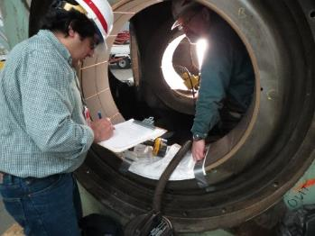

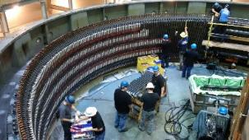
HDC Points of Contact
Jordan Fink, HDC Director, 503-808-4200 Jordan.S.Fink@usace.army.mil Vinnie DiBlasi, Deputy Director, 503-808-4210 Vincent.J.DiBlasi@usace.army.mil Ellen Ballantine, Chief, PID Branch, 503-808-4225 Ellen.B.Ballantine@usace.army.mil Mark Parrish, Chief, HAC, 503-808-4221 Mark.A.Parrish@usace.army.mil Jim Calnon, Chief, M-S Branch, 503-808-4250 James.D.Calnon@usace.army.mil John Yen, Chief, Electrical Branch, 503-808-4275 John.Z.Yen@usace.army.mil Steven Ernst, Chief, ACCS Branch, 503-808-3732 Steven.G.Ernst@usace.army.mil

