Slide 1

Mid-West Electric
Consumers Association
Annual Meeting
COL Robert Newbauer
U.S. Army Corps of Engineers
Omaha District
Commander

Slide 2
TOPICS
DISTRICT MISSION
HYDROPOWER TODAY
ONGOING CHALLENGES
PROJECT UPDATES
QUESTIONS

Slide 3
DISTRICT MISSION

Slide 4
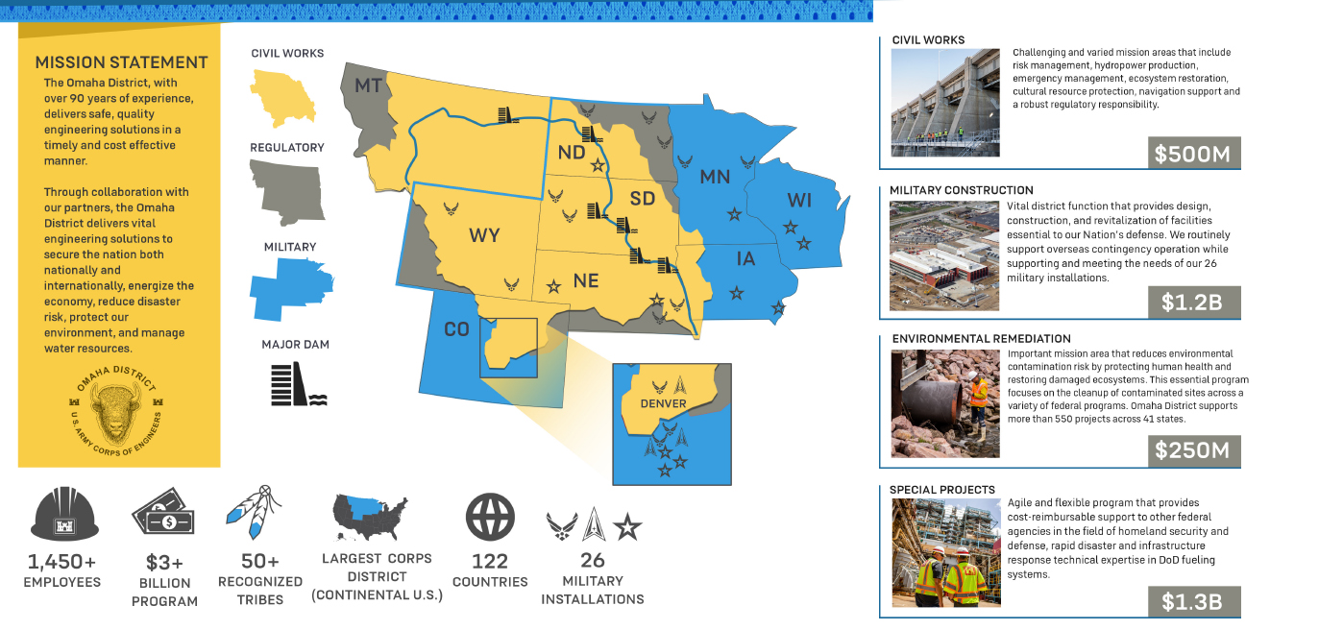
DISTRICT MISSION

Slide 5
Hydropower today

Slide 6
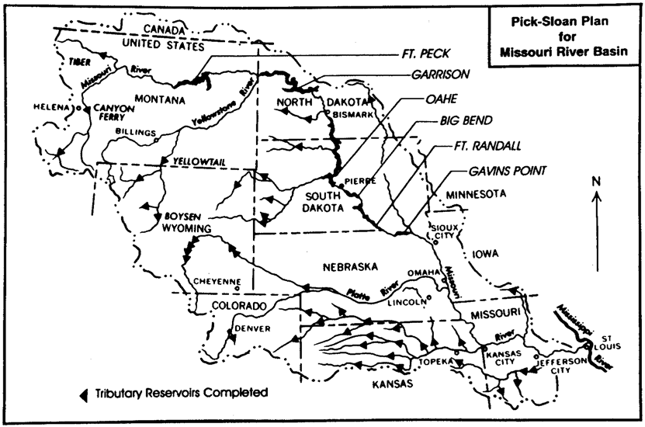
Hydropower today

Slide 7
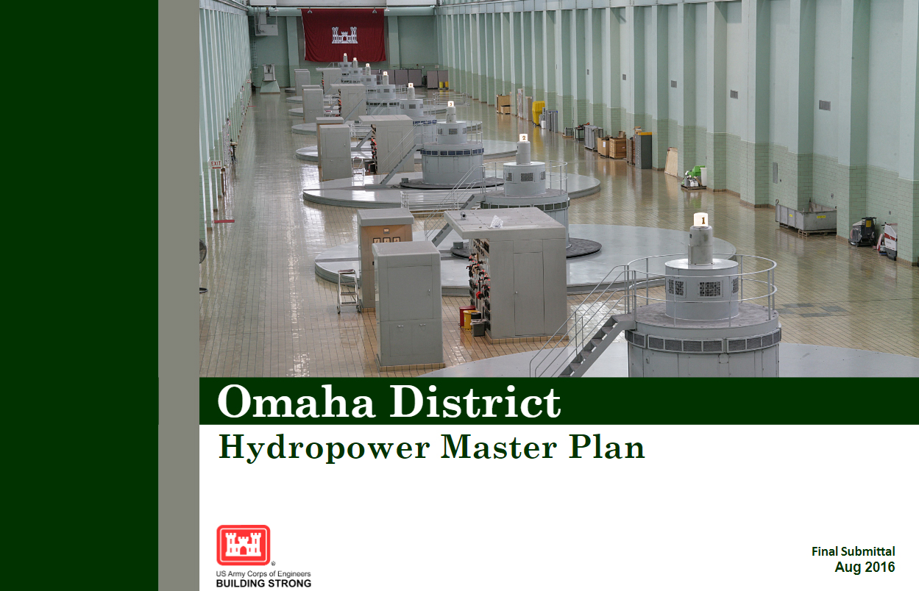
Hydropower today

Slide 8
Ongoing challenges

Slide 9


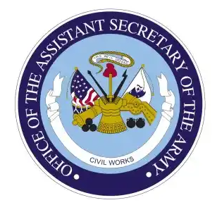



Ongoing challenges

Slide 10
Project updates

Slide 11
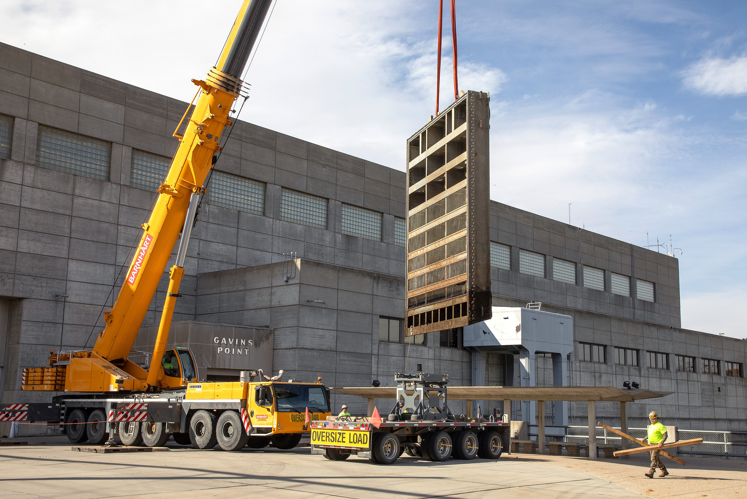
Project updates

Slide 12
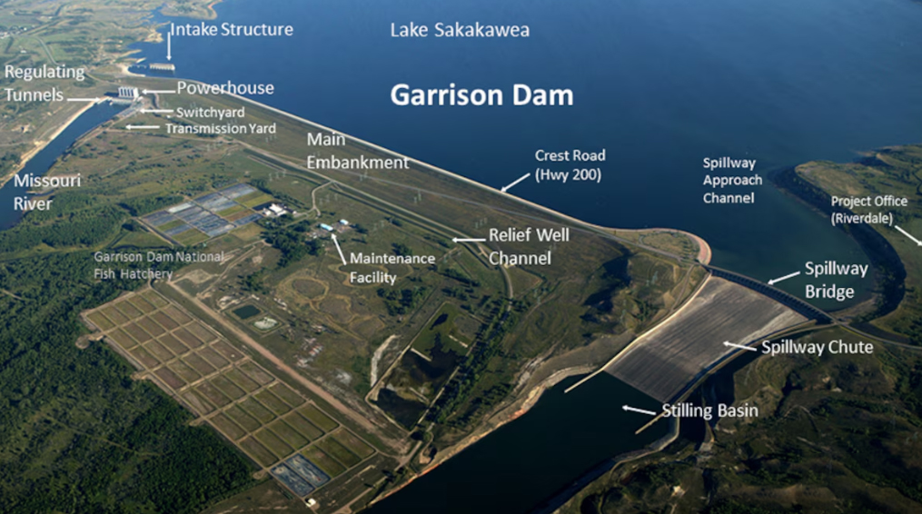
Project updates

Slide 13
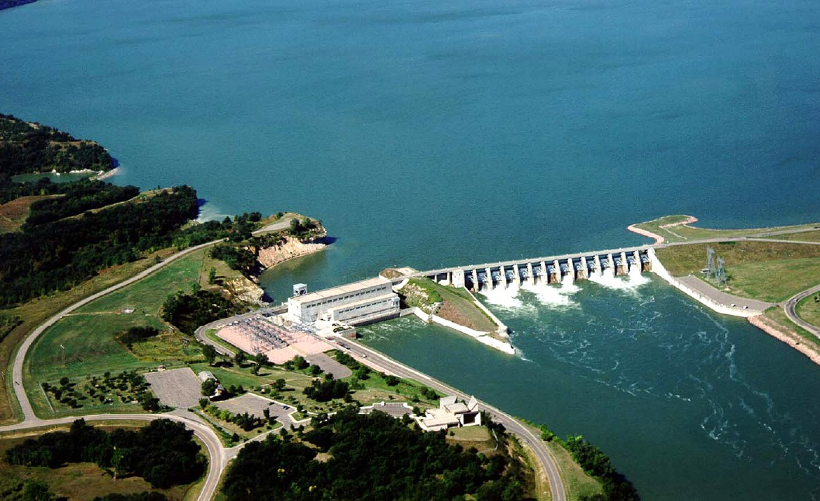
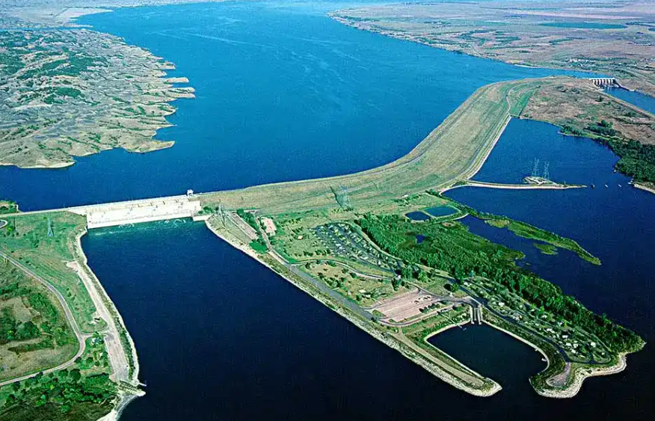
Project updates

Slide 14
Thank you

