Slide 1
ELLSWORTH AIR FORCE BASE BESS
(Battery Energy Storage System)
Part of NRECA's RURAL ENERGY STORAGE DEPLOYMENT PROGRAM (RESDP)

Slide 2
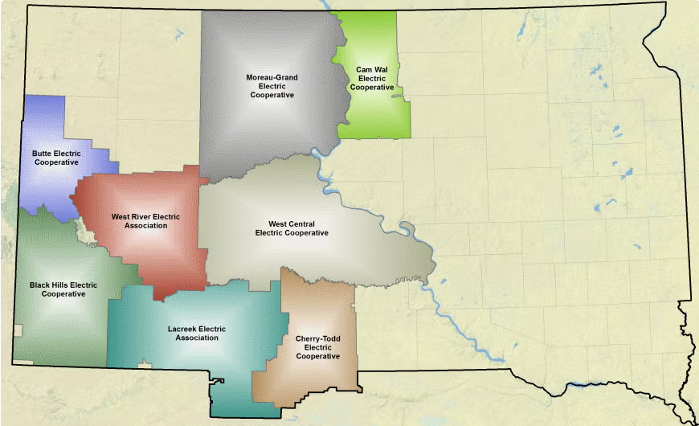
20k+ Meters
60 Employees
4,500 Square Miles
7.35 Meters Per Mile

Slide 3
BESS - If We Knew Then What I Know Now.
Todays Agenda
Our WHY
Picking Your Site
Choosing Your Team/Contractor

Slide 4
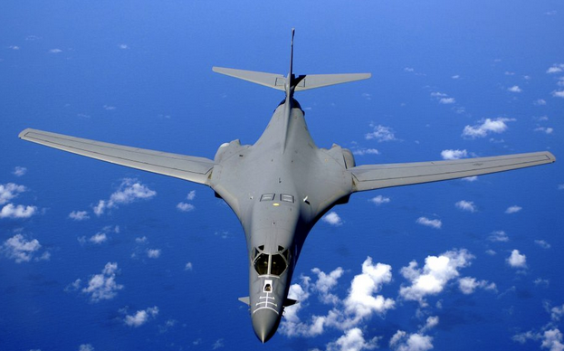
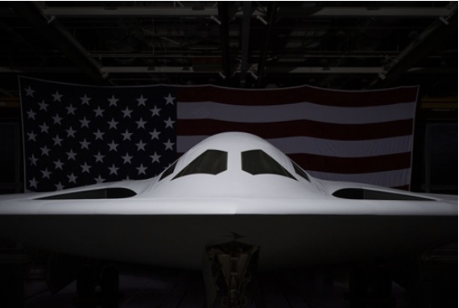
ELLSWORTH AIR FORCE BASE
Box Elder, SD
3611 Active Members
420 Civilians
B-1 Bomber (One Of Three Bases)
B-21 Raider (Mid – 2020s)

Slide 5
THE BEGINNING
Part of NRECA's RURAL ENERGY STORAGE DEPLOYMENT PROGRAM (RESDP)​
NRECA Annual Meeting 2020
DOE, NRECA, DoD
Labs
PNNL (Pacific Northwest National Laboratory)
Sandia National Laboratories

Slide 6
OUR WHY
Safety / Training
Resiliency
Positive & Supportive Relationship
Go To Trusted Energy Advisor
Load Shedding and Data Collection

Slide 7
RFP
17 Venders
6 Proposals
5 Met The Proposal Requirements
Major Overlooked Requirements
NFPA 855
UL Listed
Buy American Act
51%
Size Of Our Project
To Small For Some Of The Venders
Decommissioning And Recycling / Disposal
$5 To $ 10 Per kWh

Slide 8
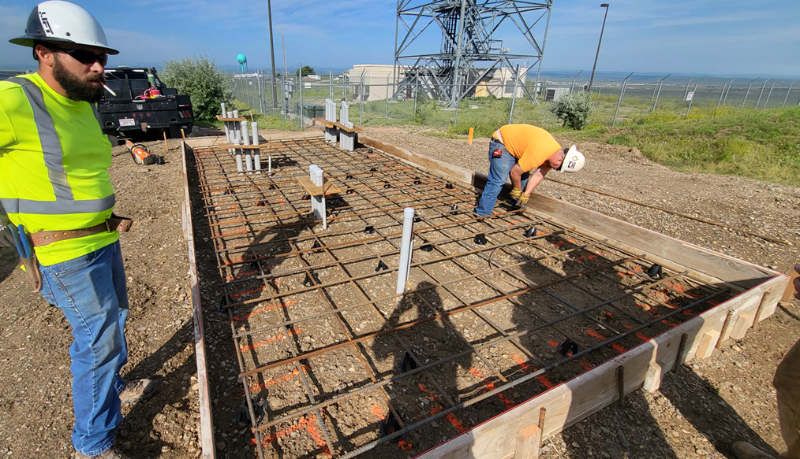
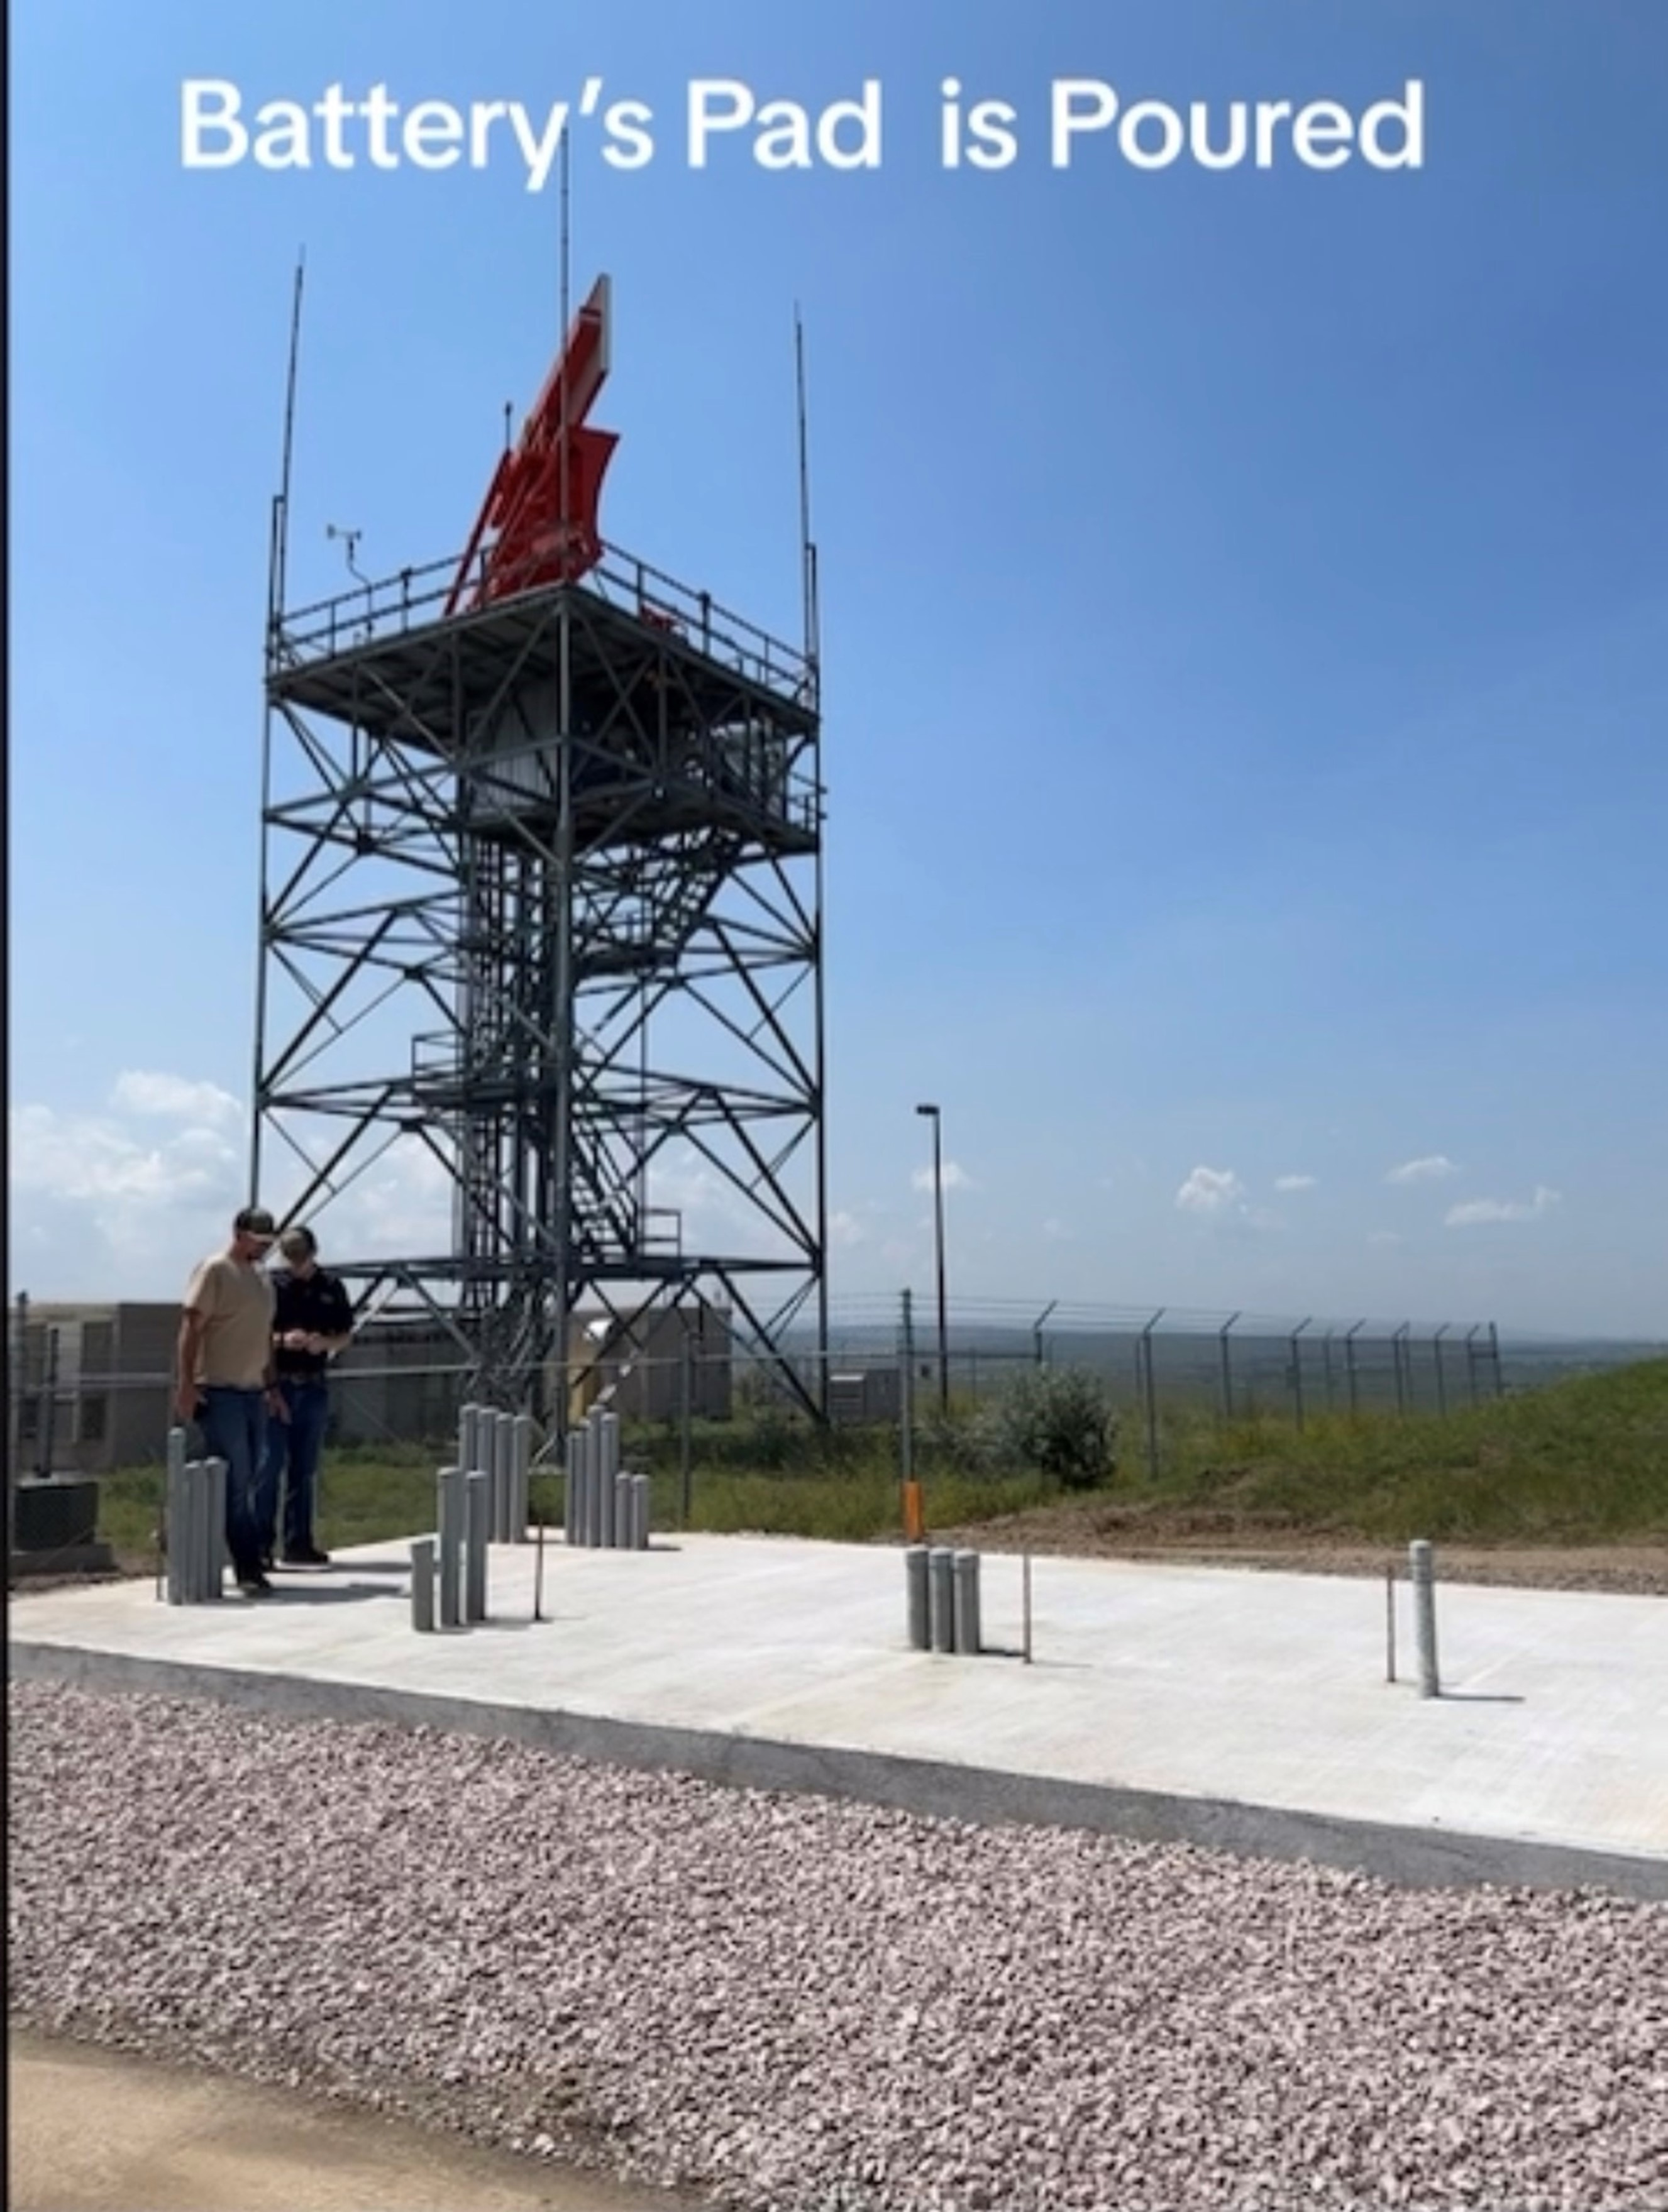
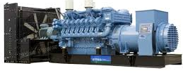
SITE LOCATION FACTORS
Building Ideas
Mission Critical
Load
Resiliency
Hours, Days, Weeks
Generator (Parallel Setup)
Occupied Structures

Slide 9
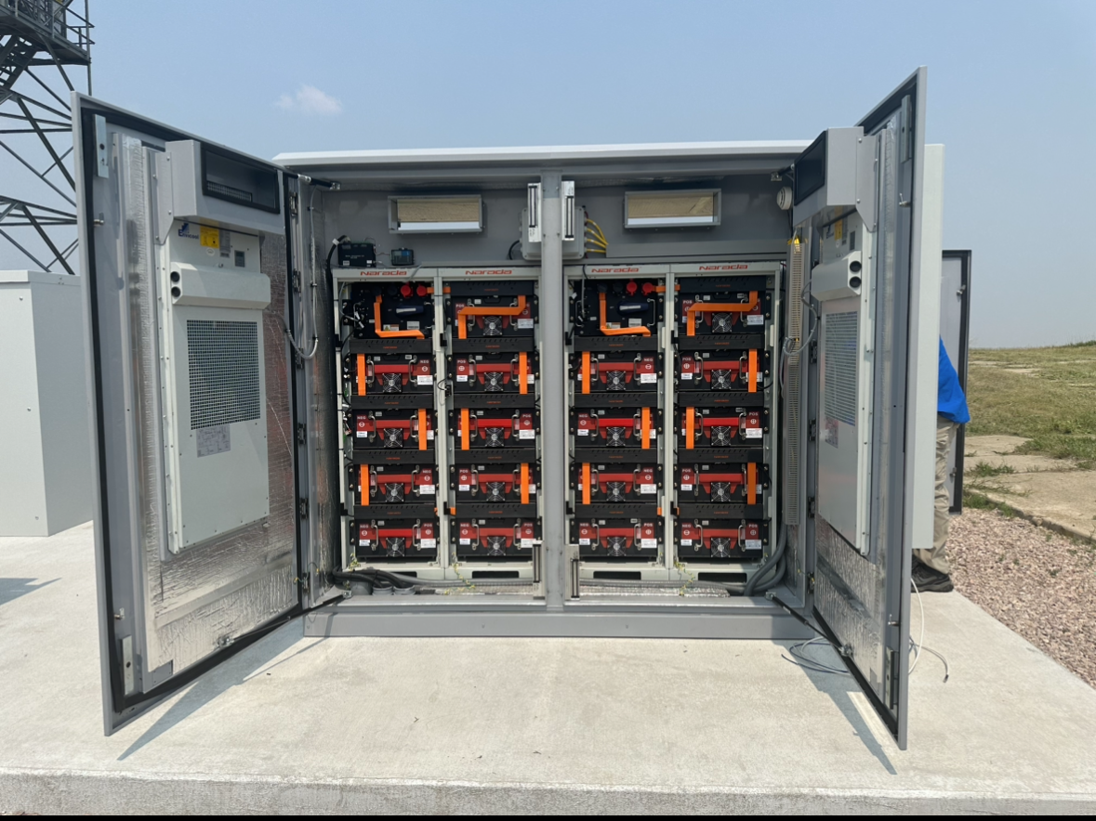
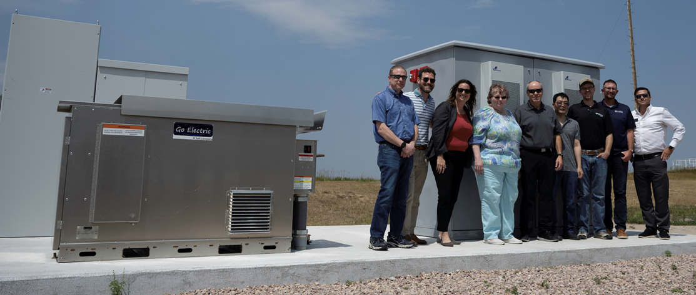
Our Battery
Go Electric Troes Battery / Microgrid Controller
Lithium Ion Battery
75kW
277 kWh
10 Year Warranty
80 % Degradation
FEND Data Diode
IntelliVent - explosion prevention system, developed by Pacific Northwest National Labs (PNNL)

Slide 10
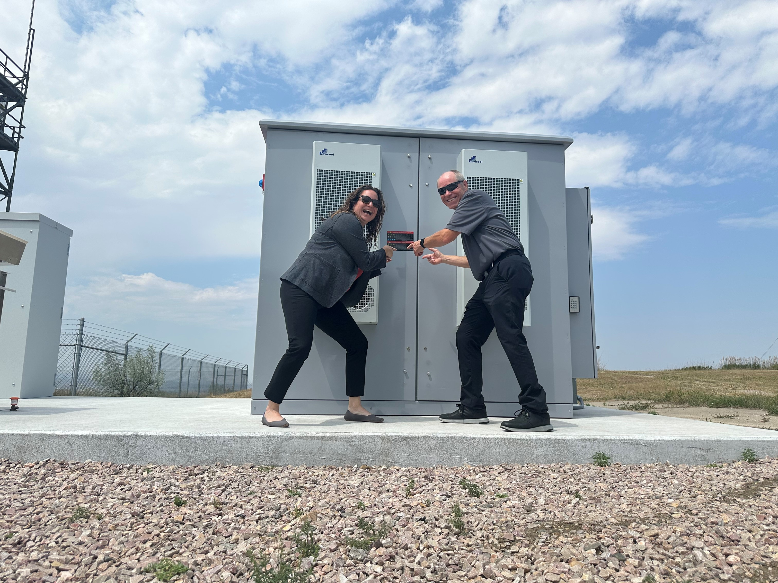
TAKE AWAYS
KNOW YOUR WHY
LARGE SCALE BEHIND THE METER IS NEW
BEWARE OF PLUG AND PLAY
DO YOUR HOMEWORK (NFPA & UL)
WE'RE STILL WAITING FOR THE UL LISTING (Maybe Jan 2025)
A $400k Battery is now $750k

Slide 11
Special Thanks:
NRECA Staff & Labs
West River Electric's CEO and Board
Adam Daigle
Energy Advisor
Sean Bestgen P.E.
Staff Engineer

Slide 12
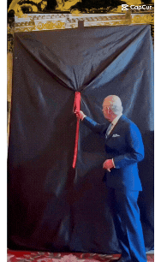
Questions?
Robert Raker
Manager of Public Relations
Robert.raker@westriver.coop
605-393-1500

