Slide 1
US Bureau of Reclamation Hydropower Priorities
Mid-West Electric Consumers Association
December 2024

Slide 2
Presentation Agenda
Reclamation Hydropower Overview
Reclamation Hydropower Strategic Plan
Challenges / Focus Areas

Slide 3
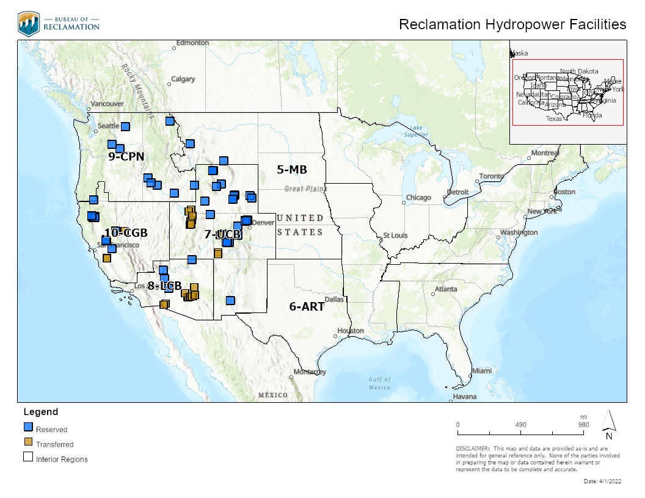
Reclamation Overview
#1 US Water Wholesaler
~ 187 Water Resource Projects
~ 337 Reservoirs
~ 476 Dams
#2 US Hydropower Generator
77 Reclamation-Owned Facilities
53 Reclamation-Owned/Operated
~ 14,750 MW

Slide 4
Reclamation Hydropower Program
Reclamation Region | Facility (#) | Unit (#) | Capacity (MW) | Net Generation (MWh)
Columbia-Pacific Northwest | 10 | 56 | 7,537 | 20,737,011
California-Great Basin | 10 | 26 | 1,910 | 3,847,052
Lower Colorado Basin | 3 | 28 | 2,454 | 4,809,569
Upper Colorado Basin | 9 | 22 | 1,816 | 4,814,168
Missouri Basin | 21 | 44 | 1,041 | 2,786,783
Reclamation Total | 53 | 176 | 14,758 | 36,994,584
Facility: Reclamation owned, operated, and maintained (“reserved works”) power facilities.
Net Generation (MWh): Ten-year rolling average.
Source: https://www.usbr.gov/power/facil/Reclamation_Hydroelectric_Powerplants_Summary_Table_11_24.pdf

Slide 5
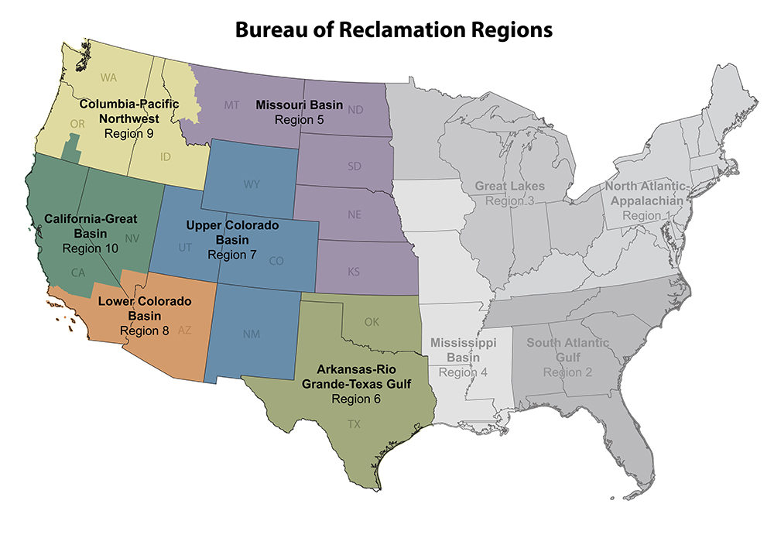
Reclamation Hydropower Program
Senior Advisor, Hydropower and the Power Resource Office are responsible for development and oversight of the Reclamation-Wide Hydropower Program, and to provide support to the Regional Power Programs
Regional Power Programs are managed by Regional Directors through Regional Power Managers
Implementation is carried out through Area Offices

Slide 6
Reclamation Hydropower Program
Reclamation Hydropower Management Team (HMT)
Senior Advisor, Hydropower
Manager, Power Resources Office (PRO)
Regional Hydropower Business Line Managers (Regional Power Managers)
Memorandum of Agreement between the Senior Advisor, Hydropower and the Regional Directors establish roles, responsibilities and communication expectations of the HMT members.

Slide 7
Reclamation Hydropower Program
HMT strives to work as One Reclamation to find optimal solutions to agency challenges that result in good business decisions
Must be balance that recognizes that there a differences in equipment, power markets and the relationships/arrangements with power customers

Slide 8
Strategic Plan
Reclamation Hydropower Strategic Plan for FY2021-2026
Reclamation Hydropower Strategic Action Plan
https://usbr.gov/power/

Slide 9
Strategic Plan
Goals
Ensure Reclamation hydropower is a valuable part of the long-term national energy portfolio
Customer satisfaction is core to the long-term success of Reclamation hydropower.
Invest in our people to ensure Reclamation continues to employ a skilled, dedicated, and capable workforce.

Slide 10
Objectives to meet the Goals
Goal 1: Ensure that Reclamation hydropower is a valuable part of the long-term national energy portfolio
Objective 1: Demonstrate the Value of hydropower.
Quantify the value of hydropower, beyond energy generation, through the development of a valuation of the real-world benefits associated with ancillary services, development of guidelines on carbon-free generation credits. MOU engagement.
Investigate new marketing strategies with the PMAs
Objective 2: Educate and Engage the Public and our Partners in advancing the importance of Hydropower.
Use products from objective 1 and work with Partners to promote the benefits of hydropower. MOU engagement
Public outreach campaign using social media, other mediums – engage Public Affairs Office.

Slide 11
Objectives to meet the Goals
Goal 2: Customer satisfaction is core to the long-term success of Reclamation Hydropower
Objective 1: Achieve Cost Stability of hydropower resources while maintaining high reliability.
Establish a world class asset management program – life cycle management
Look to best practices, experiences across Reclamation that can be implemented in other locations
Objective 2: Maximize Benefits of hydropower through increased efficiencies.
Research ways to obtain standardized equipment
Performance/Risk based maintenance vs time-based maintenance
Maintenance Management, Outage Scheduling

Slide 12
Goal 2 Continued
Goal 2: Customer satisfaction is core to the long-term success of Reclamation Hydropower
Objective 3: Enhance Scientific capacity and technological tools necessary to increase hydropower performance.
Performance/Risk based maintenance monitoring equipment – Predictive forced outage and maintenance tools
Maximize use and benefit of Maximo, condition assessment tools and analytics.
Objective 4: Maximize collaboration with partners to maintain cutting edge technology and efficiencies in providing hydropower.
Research diagnostic tools that help inform decision making.
Draw on partners experience and implemented practices related to efficiencies and technology. MOU engagement.

Slide 13
Objectives to meet the Goals
Goal 3: Invest in our people to ensure Reclamation continues to employ a skilled, dedicated, and capable workforce
Objective 1: Cultivate and enhance an effective and diverse workforce to meet current and future challenges in delivering reliable water and power to the West.
Staff Retention
Staff Development – Shared crews across Reclamation for major jobs and cross training
Human Performance training and investment
Objective 2 Provide a positive and safe work environment to support employee development and performance.
Online training support for apprentice programs and continued education.
Maintenance task training videos.

Slide 14
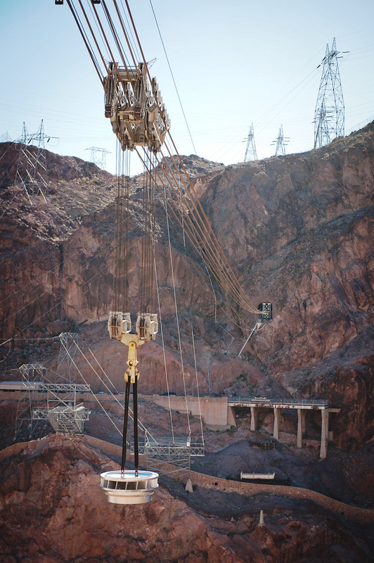
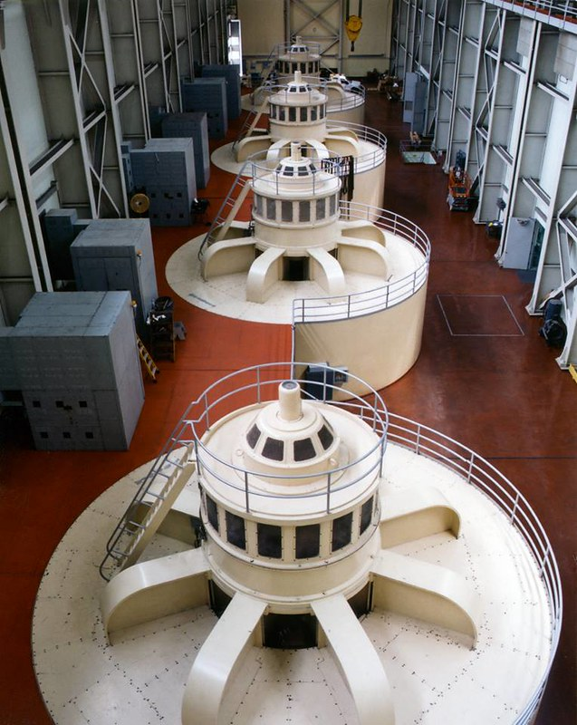
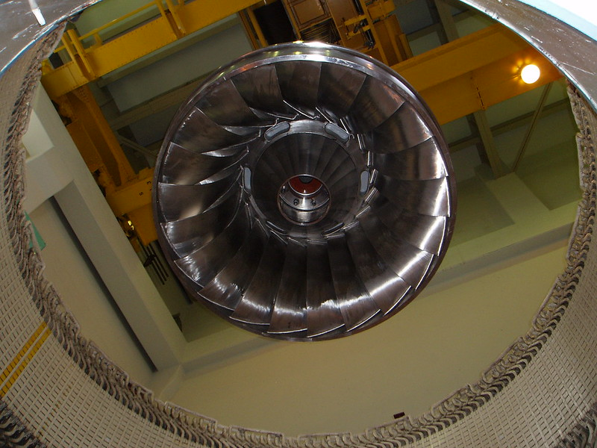
Challenges and Opportunities

Slide 15
Persistent Drought
FY Period | Net Generation Rolling Average (MWh) | Percent Change (from Previous FY Period)
1985-1994 | 41,266,801.07
1995-2004 | 44,628,049.05 | 8.1%
2005-2014 | 41,212,450.62 | -7.7%
2015-2024 | 36,994,584.67 | -10.2%

Slide 16
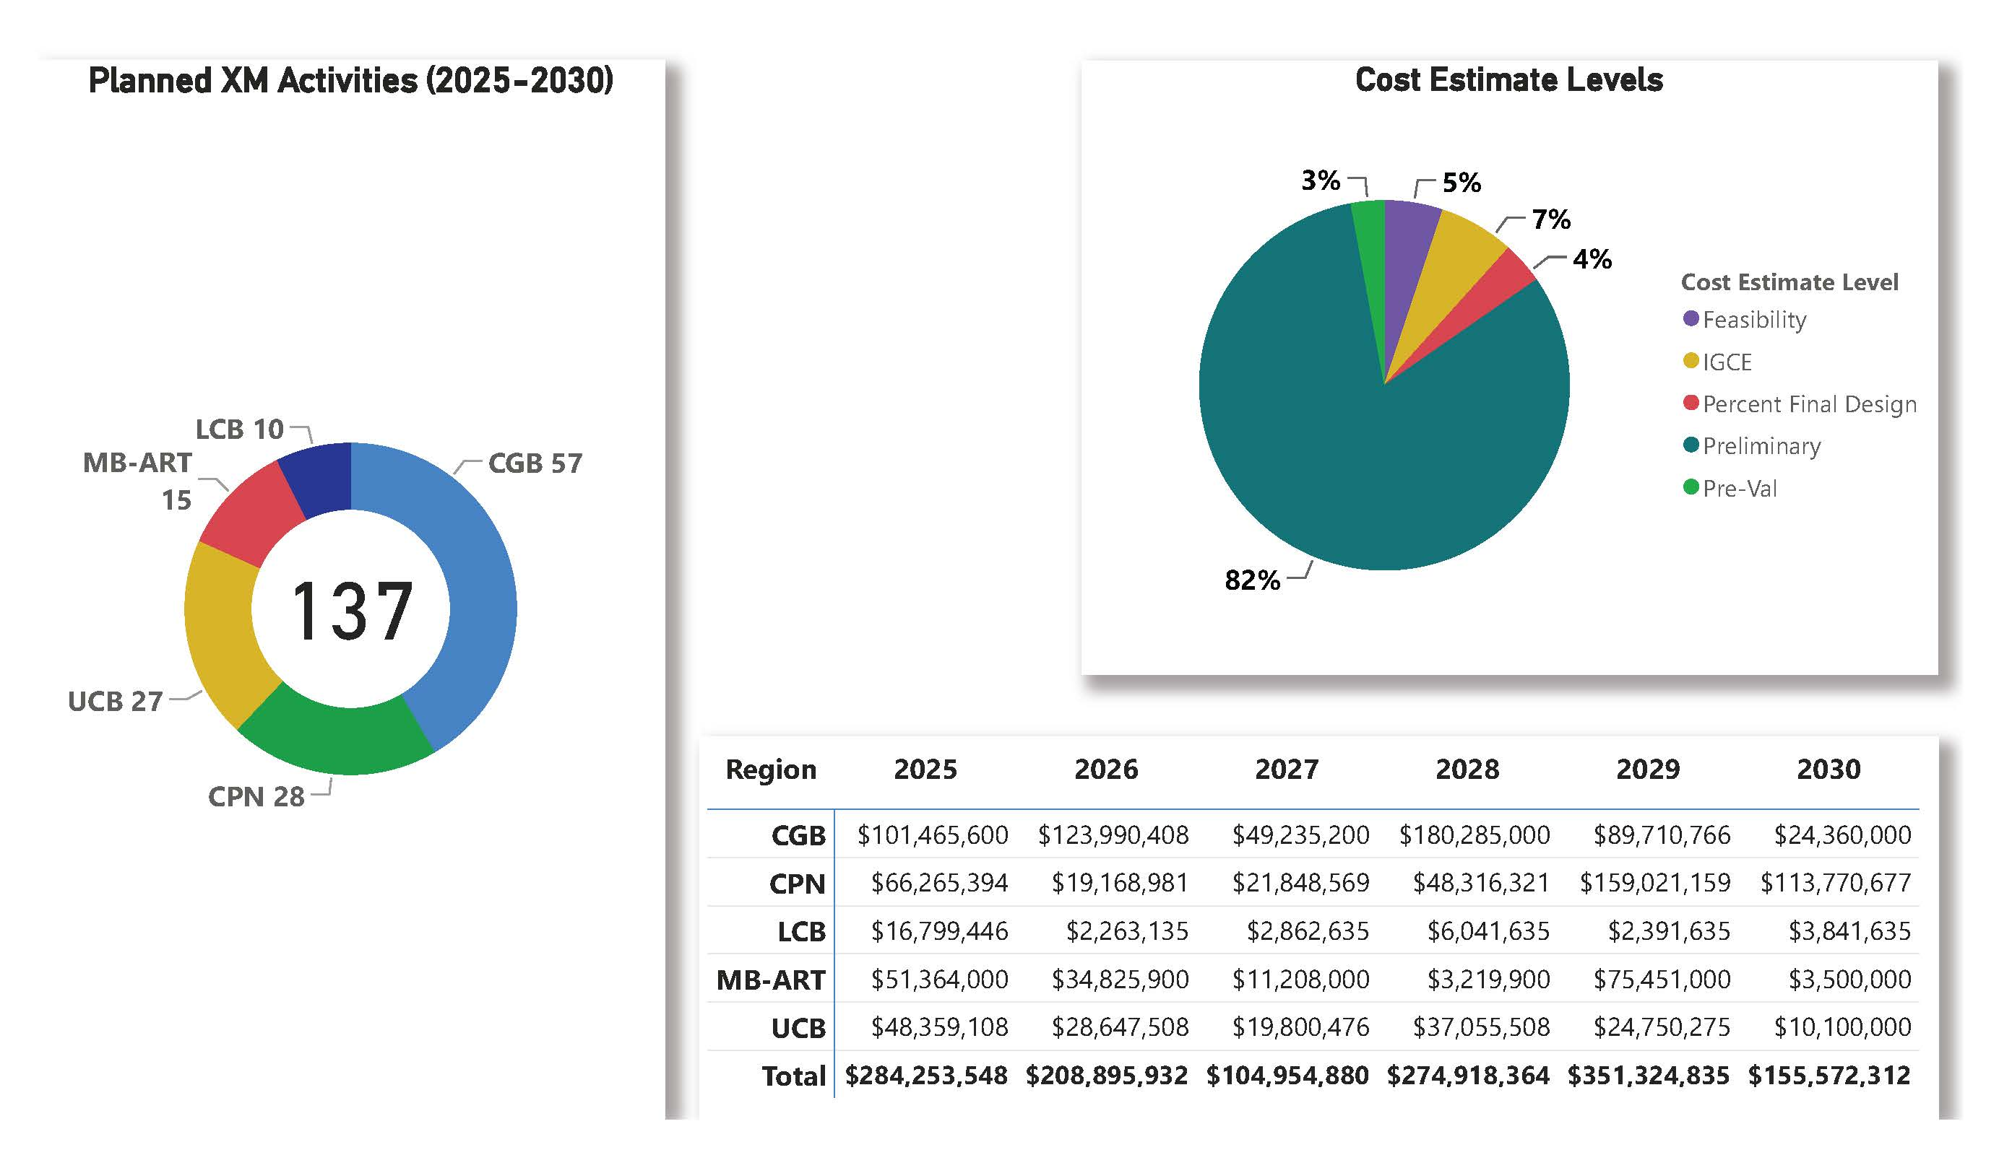
Capital Investment and Repair Needs - Power

Slide 17
Supply Chain
Long lead times and limited domestic manufacturing are creating strain
DOE recently released a report on these challenges at https://www.energy.gov/eere/water/hydropower-supply-chain-deep-dive-assessment

Slide 18
Getting to Predictive Maintenance
Provide Alternatives to Time-Based Inspections Requiring Outages
Investigate Technology and Return on Investment
Provide a Toolbox of Methods to Allow Management Flexibility and Appropriate Reliability
Stabilize Maintenance Costs
Increase Workforce Efficiency

Slide 19
Improve Project Planning and Execution
Working with EPRI and TVA to improve our project planning
Creating acquisitions and contracting tools to speed up contracting process
Better planning up front can help us execute projects efficiently and on time

Slide 20
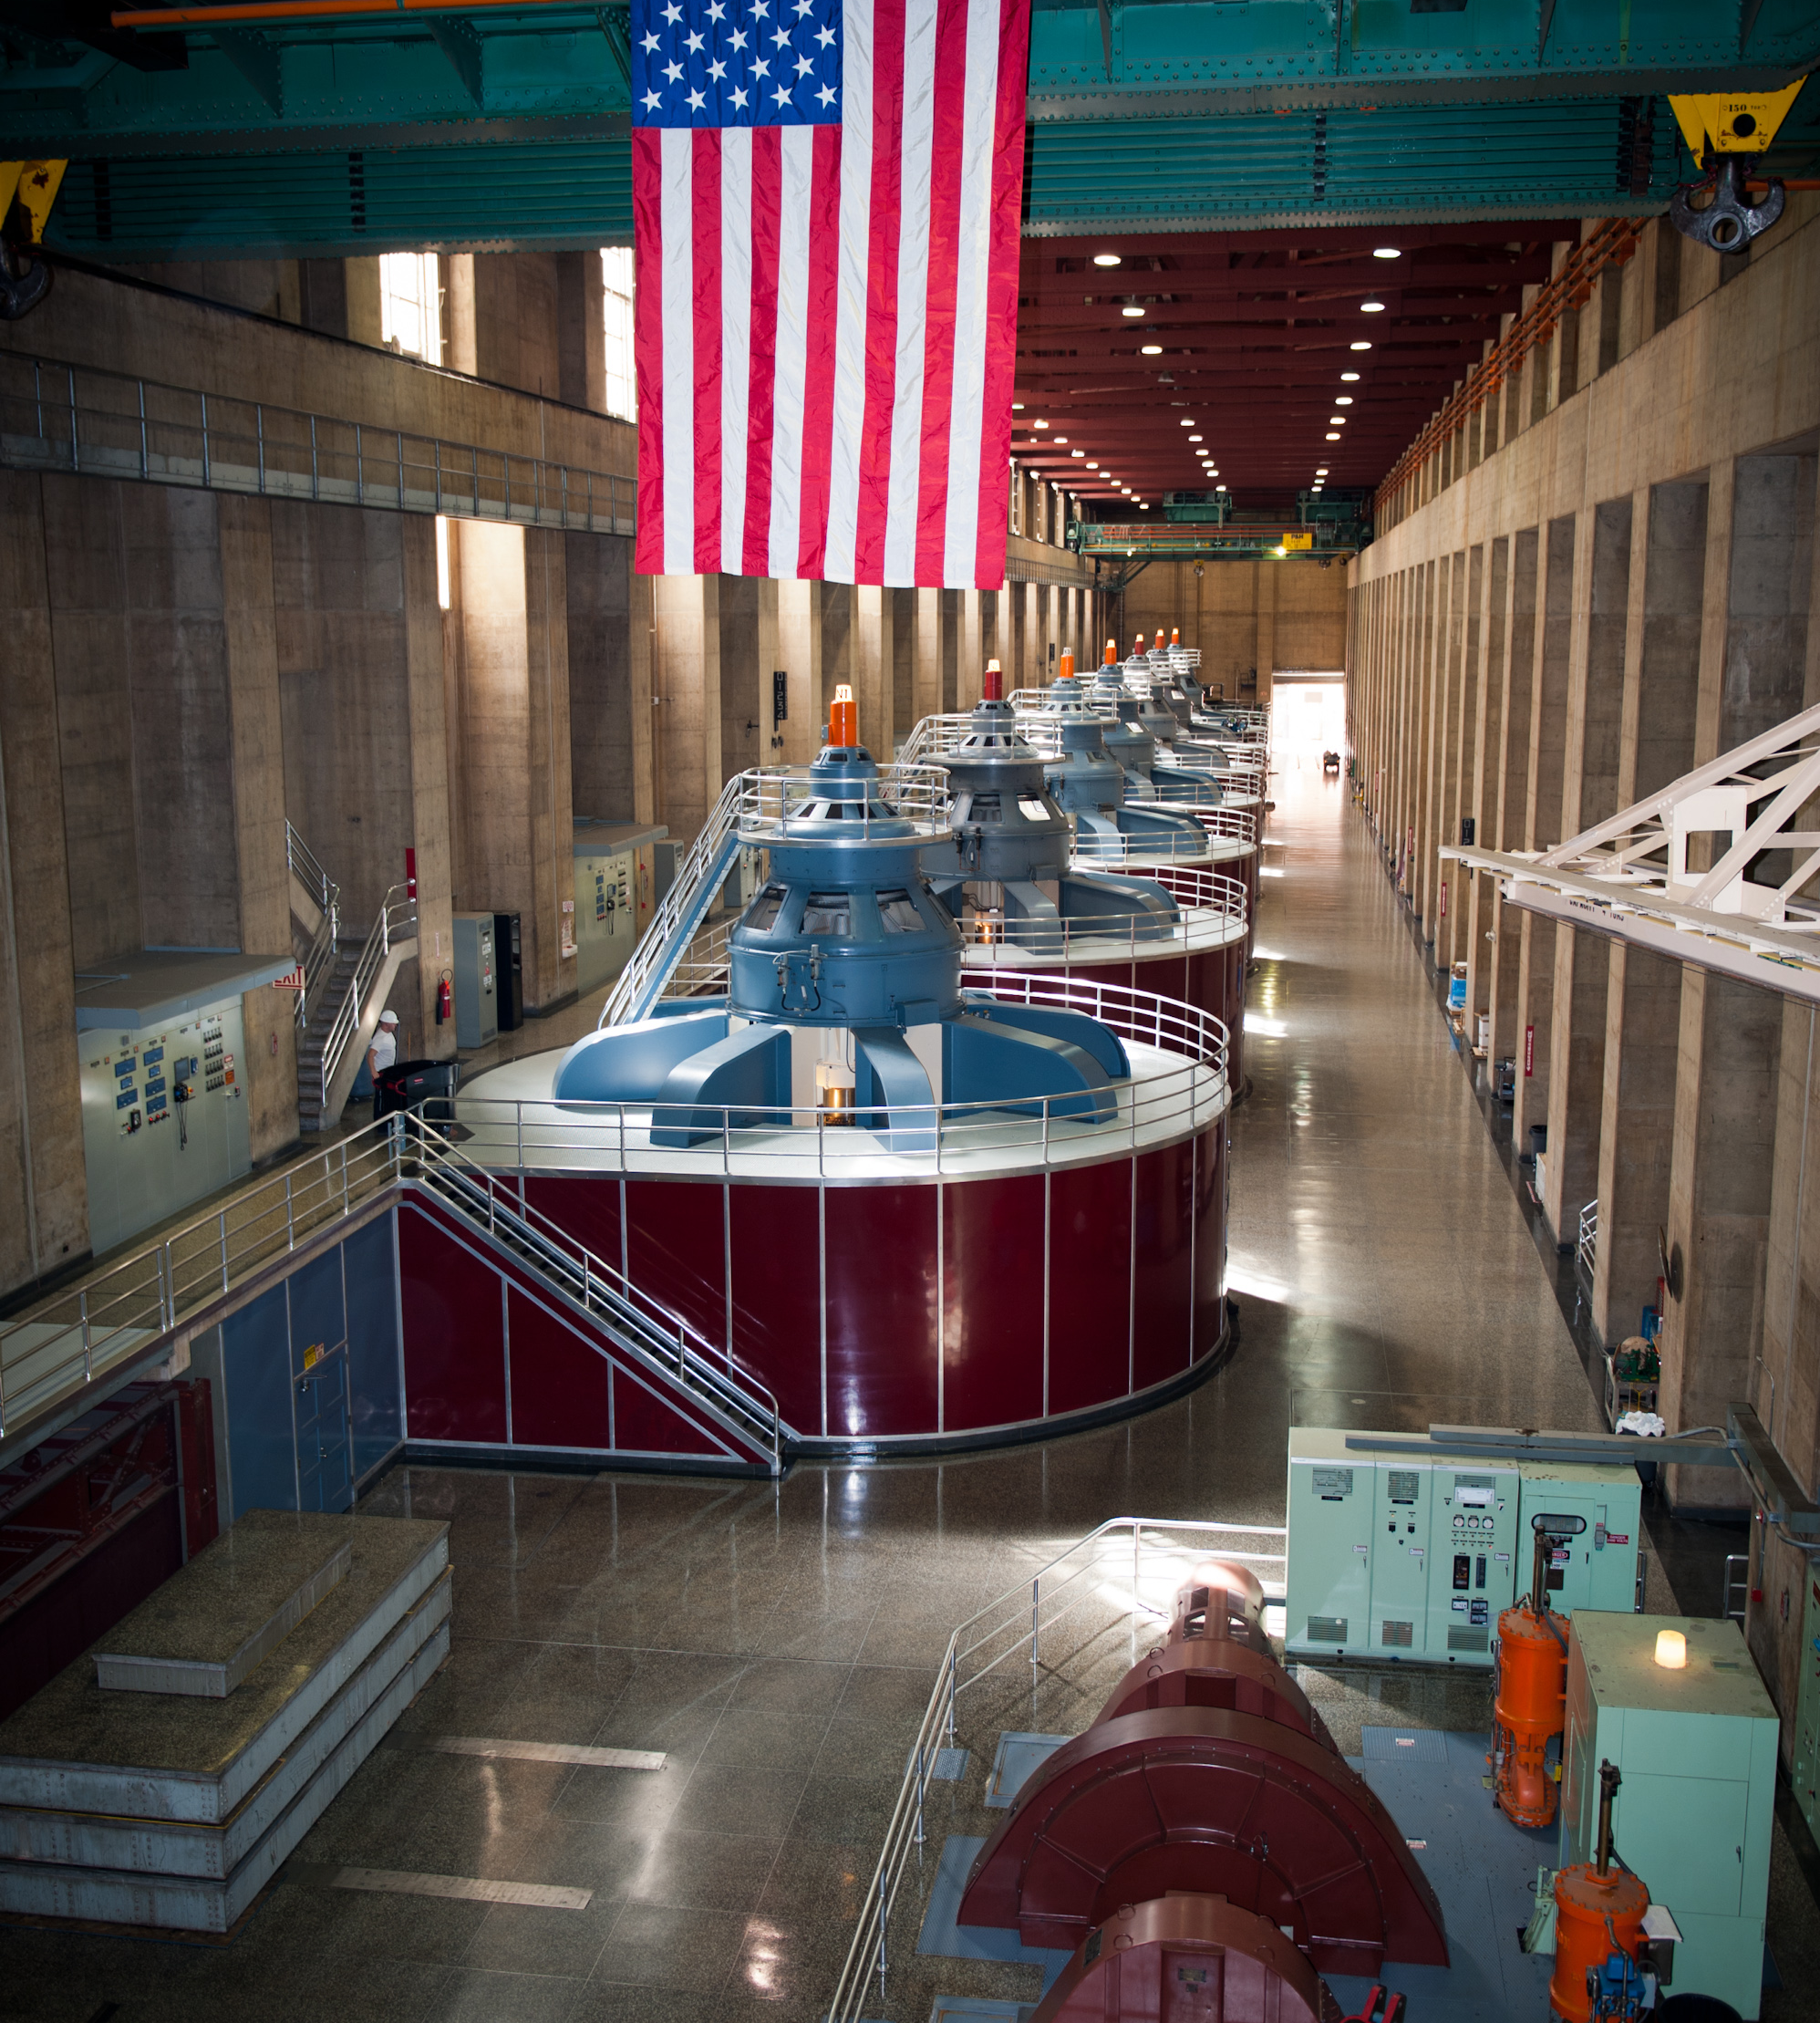
Optimizing Operations
Developed and deployed a unit dispatch optimization system that has increased our generation efficiencies on average by about 2%
Have installed turbines that have high efficiencies at a wide head range
Work closely with the PMAs to ensure we are flexible and reliable to provide generation when it is most valuable to our customers

Slide 21
Bottom Line – Provide Value to our Customers
Reclamation has a long history of meeting our challenges and providing value to our customers
We are attuned to our current challenges and see opportunities to more efficiently provide reliable and valuable hydropower to our customers
Continue to work to make Reclamation hydropower a valuable resource to our country, the West and our customers for the next 100 years.

Slide 22
Michael Pulskamp
Senior Advisor, Hydropower
mpulskamp@usbr.gov
https://www.usbr.gov/power/

