Slide 1
Pumped Storage Hydropower Potential and Opportunities
Stuart M. Cohen, Ph.D.
MWECA Annual Meeting
Denver, Colorado
December 11, 2024
Notes:
https://meconsumers.com/

Slide 2
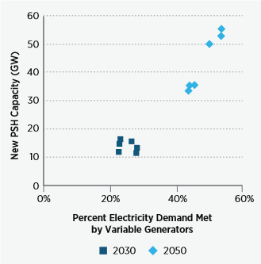
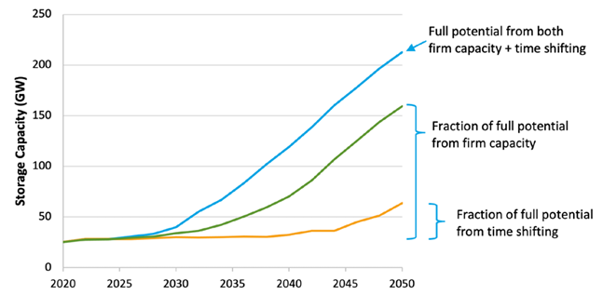
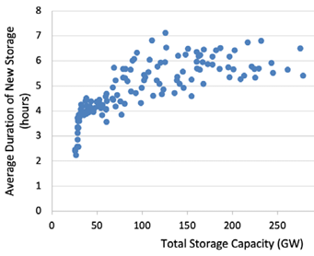
Pumped Storage Hydropower (PSH) Has Potential Balance the Grid and Integrate Variable Renewables
2016 DOE Hydropower Vision
2021 Storage Futures Study (Frazier et al.)
Storage provides many critical grid services without direct emissions
  Energy balancing
  Firm capacity
Storage helps facilitate variable renewable deployment at lower cost
PSH is a proven storage technology with substantial growth potential
  Operating reserves
  Grid stability

Slide 3
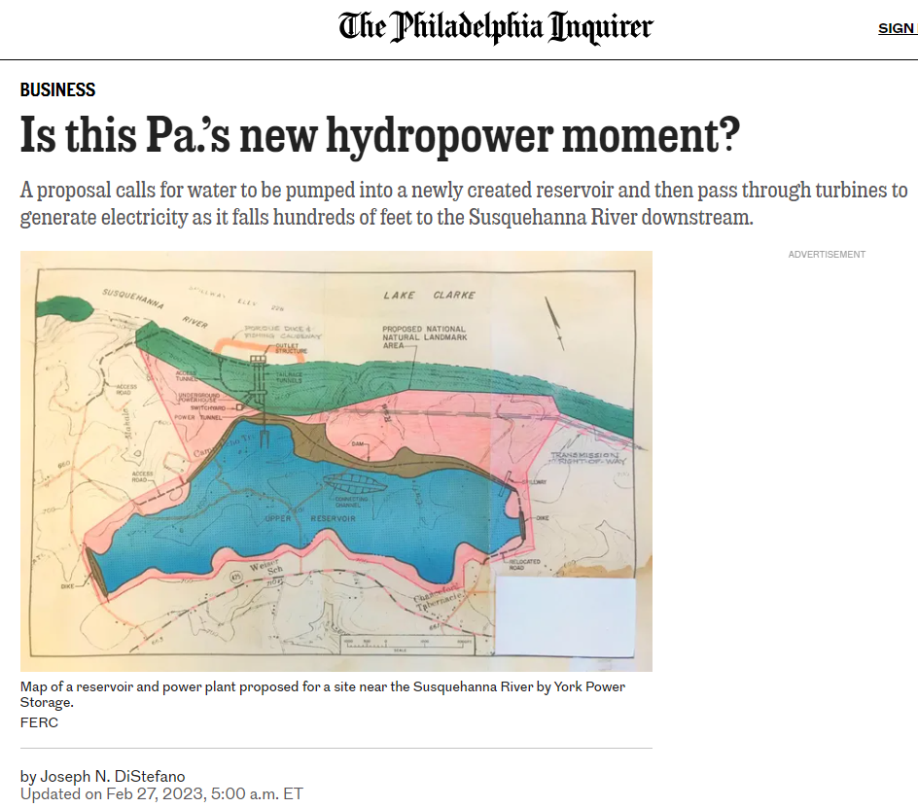
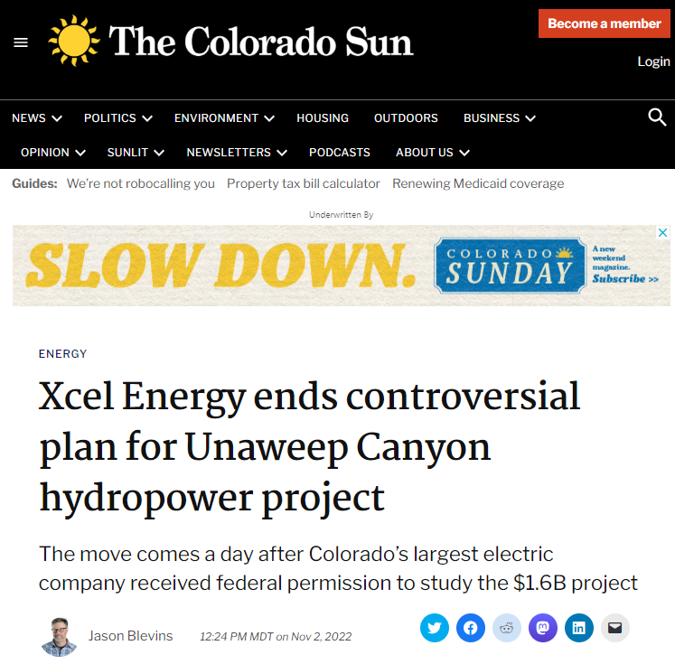
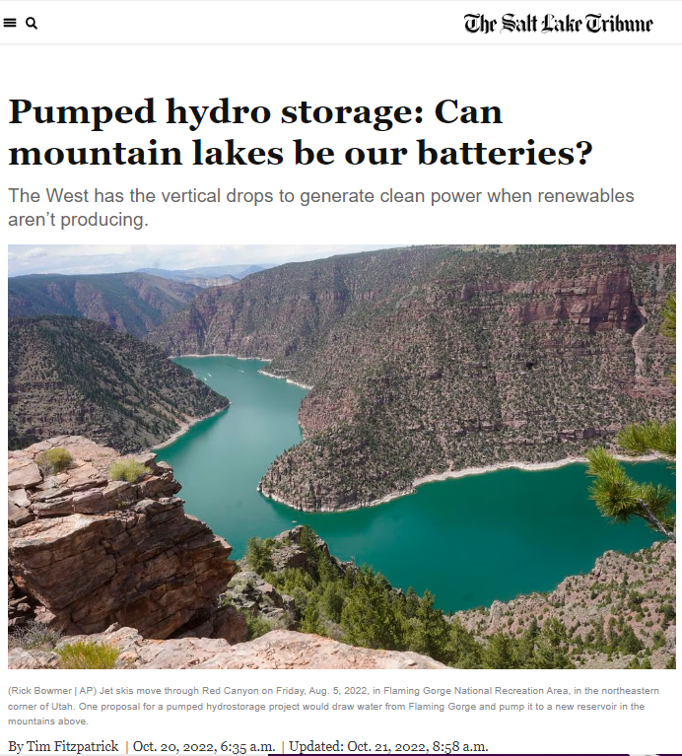
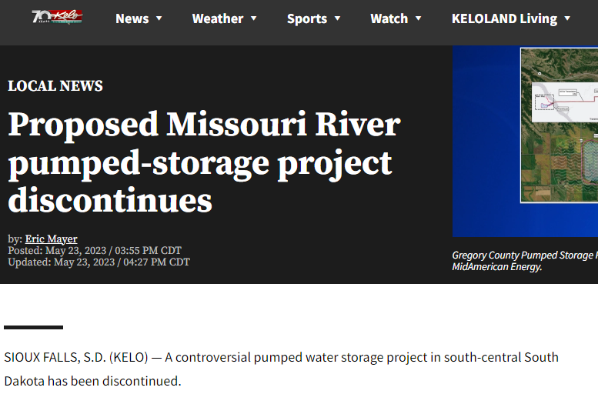
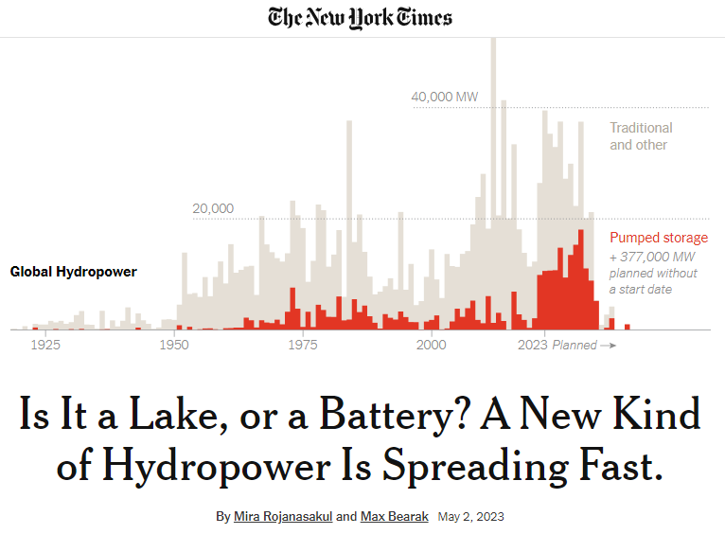
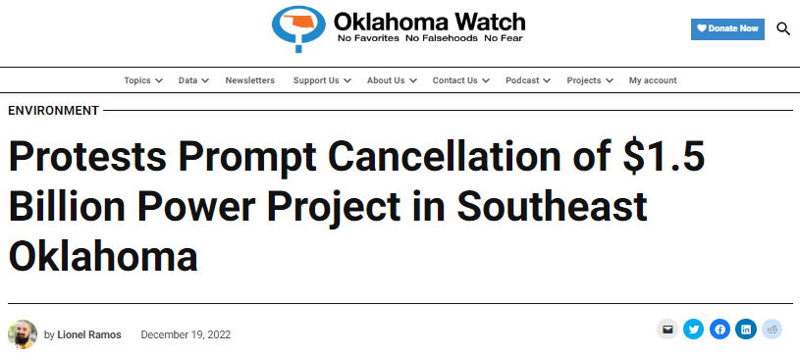
PSH Value is Being Recognized, but
Siting and Cost Hurdles Hinder Deployment
Notes:
https://www.nytimes.com/interactive/2023/05/02/climate/hydroelectric-power-energy.html
https://www.inquirer.com/business/susquehanna-hydro-power-york-20230227.html
https://www.sltrib.com/renewable-energy/2022/10/20/pumped-hydro-storage-can/
https://oklahomawatch.org/2022/12/19/protests-prompt-cancellation-of-1-5-billion-power-project-in-southeast-oklahoma/
https://coloradosun.com/2022/11/02/xcel-energy-ends-plan-for-unaweep-canyon-hydropower-project/
https://www.keloland.com/news/local-news/proposed-missouri-river-pumped-storage-project-discontinues/

Slide 4
NREL is Developing Data and Tools to Better Inform Discussions About PSH Deployment
PSH resource assessment
Long-Term Grid Capacity Expansion Modeling
Component-Level Bottom-up PSH cost modeling
PSH life cycle Greenhouse Gas (GHG) impacts analysis (LCA)

Slide 5
A Bottom-Up Cost Model Offers
Unprecedented Detail in a Public-Facing Tool
User or GIS Data
Reservoir Volume, Head Height, Conveyance Length etc.,
Other Site-Specific Inputs
Time and Locational Adjustments
Model Output (Net $)
Land and Land Rights
Access Roads
Powerplant Structure
Reservoirs, Dams, Waterways
Concrete lined water conductors
Power Station Equipment
Substation/Switchyard
Transmission Line
Sales Tax, Contingency
Overhead & Profit
Power Station Structure & Equipment, Embankment, Intakes, Shafts, Water Conductors, Penstocks etc.,
Component Cost Functions
PHS Site Screening Cost Model
Spreadsheet model allows user-input site specifications and assumptions
Calculations use industry-vetted formulas and data (e.g., EPRI PSH guide)
Cost results can be explored for one site or many
https://www.nrel.gov/water/pumped-storage-hydropower-cost-model.html

Slide 6
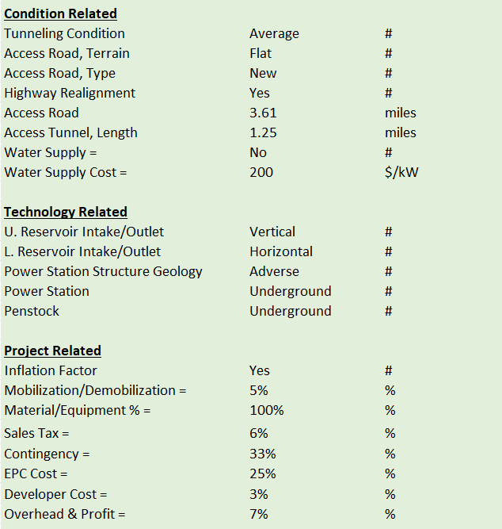
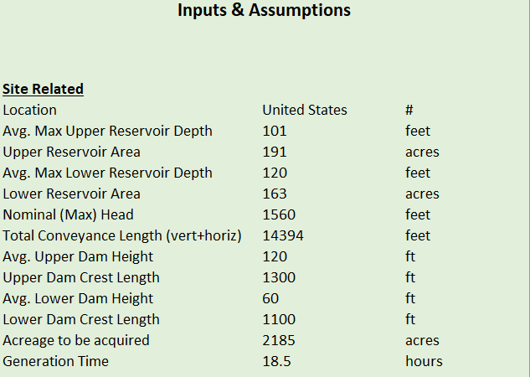
The Spreadsheet Offers Versatile Cost Estimation

Slide 7
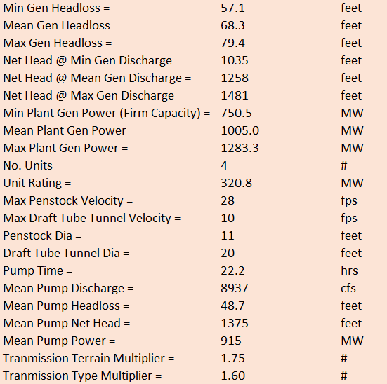
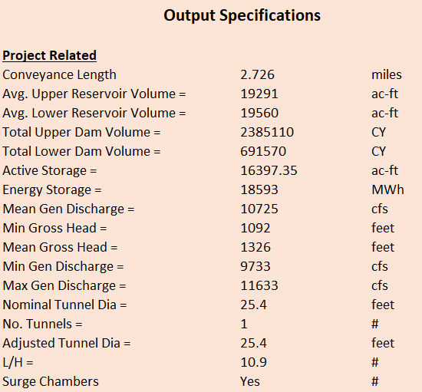
The Spreadsheet Offers Versatile Cost Estimation

Slide 8
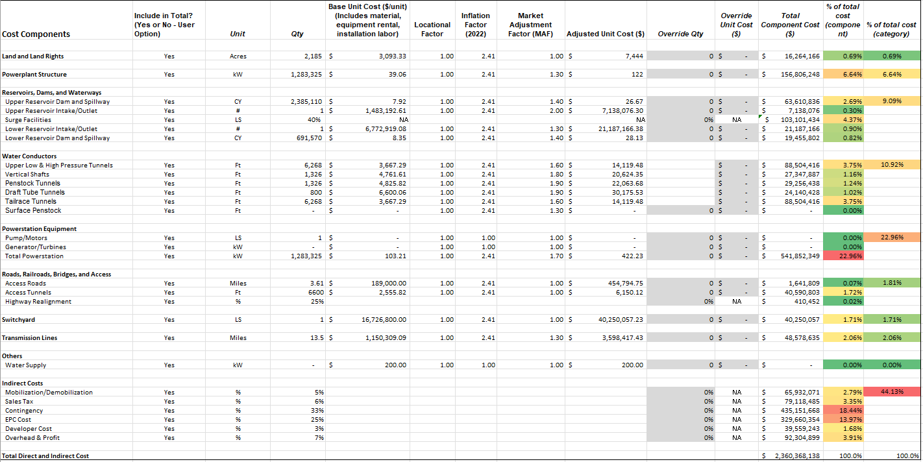
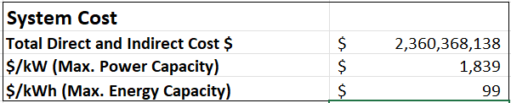
The Spreadsheet Offers Versatile Cost Estimation

Slide 9
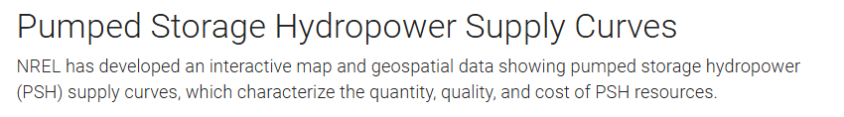
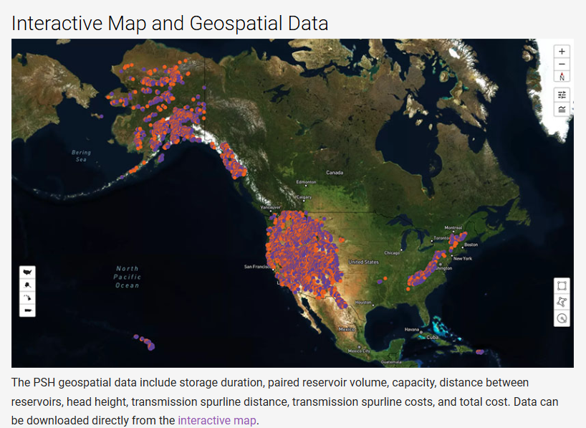
Resource Assessment Identifies Utility-Scale Opportunities for Detailed Site Evaluation
Geospatial analysis finds potential reservoirs using topography data.
Reservoirs are filtered out if they intersect with incompatible land uses, e.g., critical habitats, national parks.
Upper and lower reservoirs are paired based on distance, head, and size similarity.
A set of non-overlapping systems are selected based on lowest $/kW capital cost (using the bottom-up cost model).
https://www.nrel.gov/gis/psh-supply-curves.html
Notes:
- Mention AK, HI, PR

Slide 10
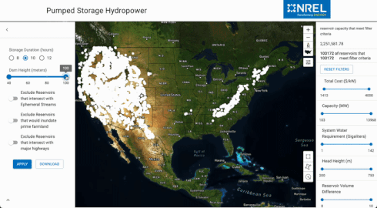
Resource Data Can Be Explored
With an Interactive Web Tool
Select scenario: storage duration, dam height range, technical exclusions (left)
Use filters to screen sites: cost, capacity, etc. (right)
Determine one or more reservoirs to assess further by clicking on sites or querying custom regions
Gather site-specific details
Download data
https://www.nrel.gov/gis/psh-supply-curves.html
Closed-loop PSH
Add-on PSH to existing reservoirs
Open pit mine reservoir opportunities
Concrete ring dams on flat mesas (soon)

Slide 11
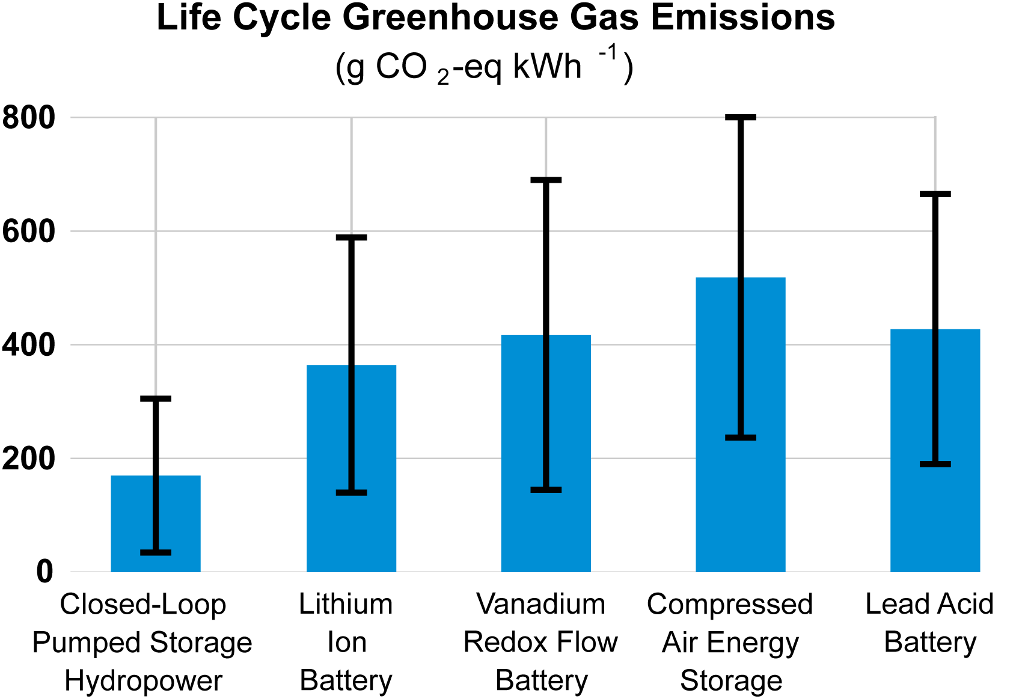
Life Cycle Analysis (LCA) Enables GHG
Impacts Comparisons with Other Technologies
NREL has completed the first-ever LCA for new closed-loop PSH
  Includes GHG impacts from construction and operation but not end-of-life or reservoir emissions
  Accounts for future changes in the carbon intensity of the charging electricity mix
PSH has lower life cycle GHG impacts than competing storage technologies
Article published in Environmental Science & Technology
https://pubs.acs.org/doi/10.1021/acs.est.2c09189

Slide 12
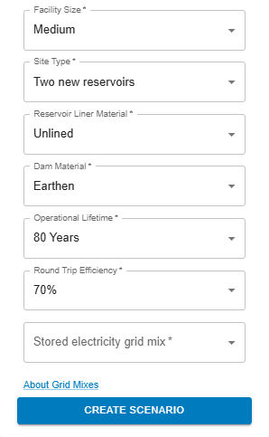
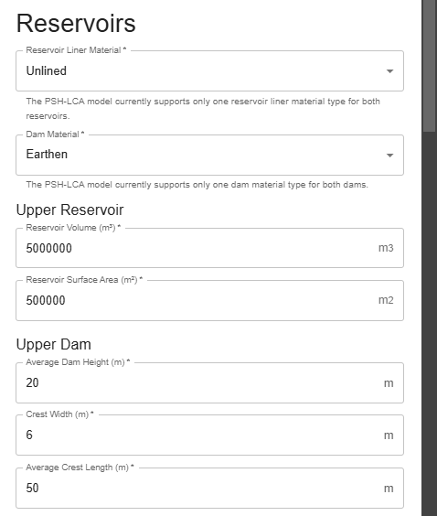
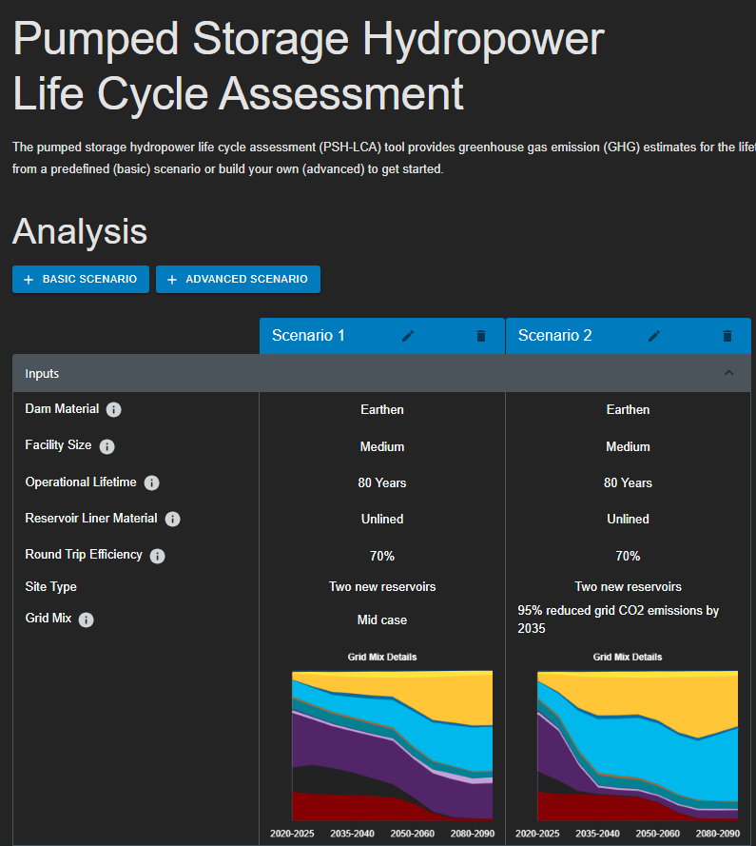
A Versatile Web App Will Allow Users to Explore Life Cycle GHG Impacts of Any Candidate Site
Basic Mode allows users to chose from a small set of design options and compare representative PSH systems
Advanced Mode allows users to enter detailed specifications to evaluate specific PSH sites
https://www.nrel.gov/water/life-cycle-assessment-closed-loop-pumped-storage-hydropower-facilities.html

Slide 13
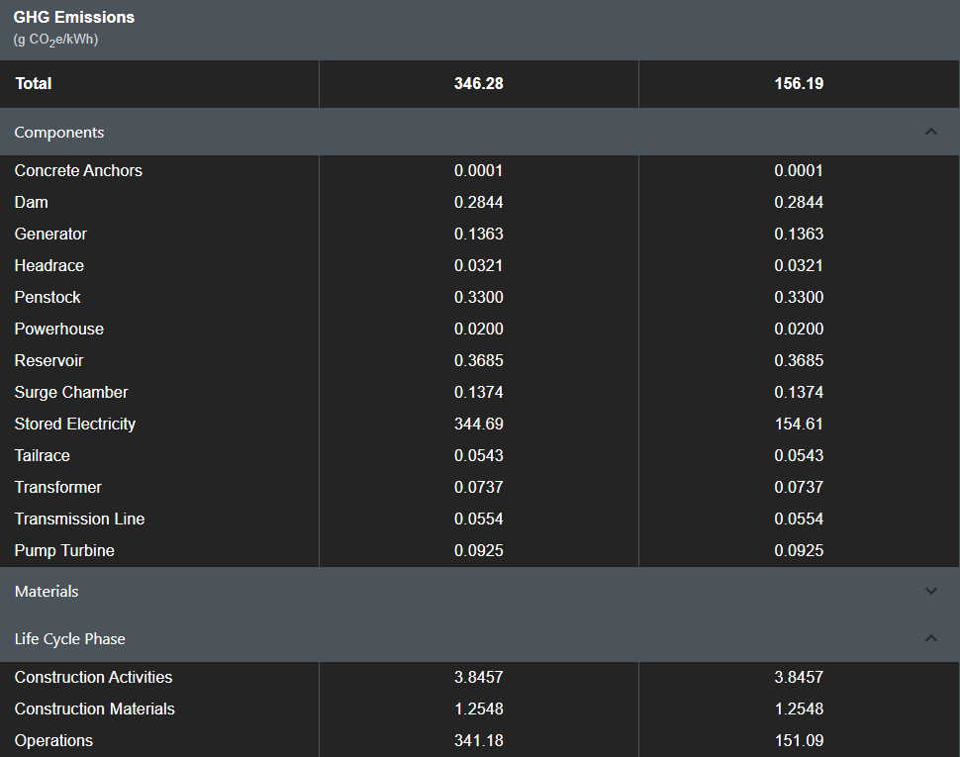
GHG Impacts Can Be Viewed in Several Ways
Life cycle GHG emissions can be compared by component, material, or life cycle phase
Most PSH GHG impacts arise from electricity used for pumping
Future work
  Integrate the PSH cost model into the same web interface
  Link to the PSH resource map so users can “open a site” in the Cost-LCA tool
https://www.nrel.gov/water/life-cycle-assessment-closed-loop-pumped-storage-hydropower-facilities.html

Slide 14
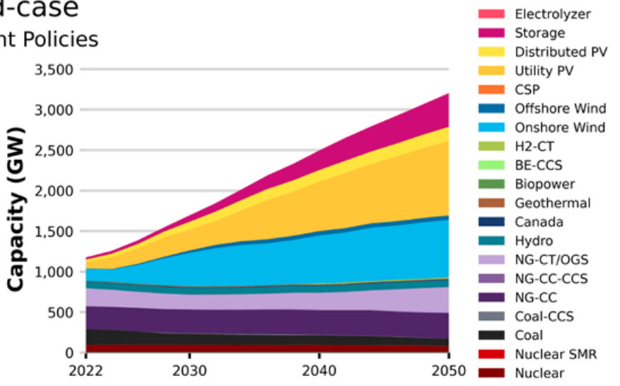

Capacity Expansion Modeling Uses PSH Cost and Resource Data to Explore Deployment Potential
Resource and cost data form a supply curve
PSH supply curves are used along with other technology cost, resource, and performance data in the ReEDS grid planning model
ReEDS finds the least-cost mix of generation, transmission, and storage technologies through 2050 or beyond
  Sub-state level resolution
  Hourly data with representative periods
  High-resolution resource and load profiles
  Constraints for energy, capacity, flexibility, and policy requirements
  Open-access code and data
Regional Energy Deployment System
https://www.nrel.gov/analysis/reeds/
2023 Standard Scenarios Report (Gagnon et al.)

Slide 15
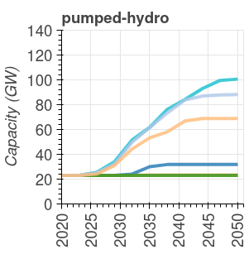
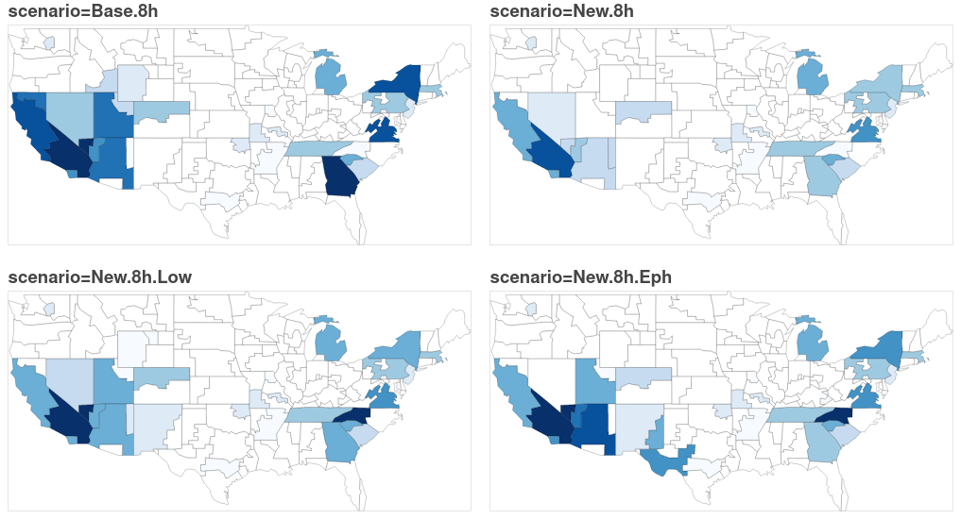
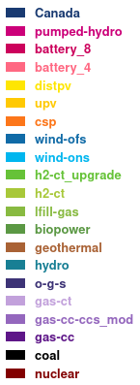
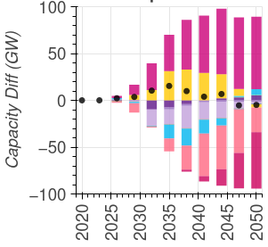
ReEDS Enables Broad Scenario Analysis to Explore PSH Opportunities
PSH deployment can be projected under alternative scenario assumptions
Local market potential can be related to PSH site quality and grid needs
Scenarios can quantify how PSH competes with and complements other technologies
Modeling also produces cost, price, emissions, and other impact metrics
Regional PSH deployment through 2050
deployment in cost, policy, and resource scenarios
Change in the grid mix with new PSH
Preliminary Example Data: Do Not Cite or Distribute
Notes:
- This is largely because of the new max head height limit

Slide 16
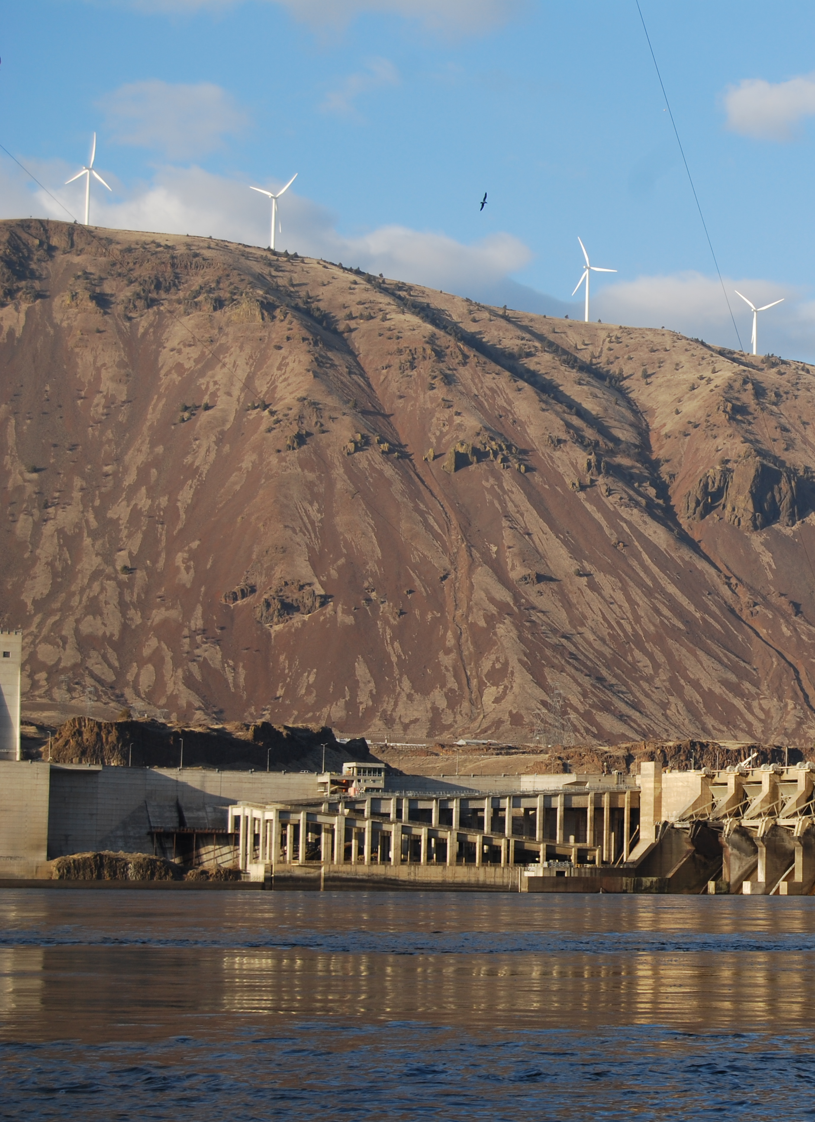
Summary
NREL has built a versatile suite of open data and tools to help understand the future role of PSH in the electric grid.
Cost and resource assessment and grid modeling can find favorable scenarios for large-scale PSH deployment.
Continued tool and data expansions will facilitate robust assessments of PSH cost-benefit tradeoffs by hydropower stakeholders.

Slide 17
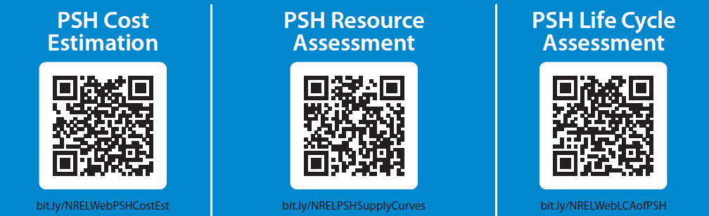
Thank You
www.nrel.gov/water/hydropower-research.html
Stuart.Cohen@nrel.gov

Slide 18
Extra

Slide 19
Parametric Analysis Can Explore
Component Cost Sensitivity
Users can identify which input assumptions are most important to total cost
Cost sensitivities can be compared between small and large PSH
Preliminary Data: Do Not Cite or Distribute

Slide 20
Resource Assessment Identifies Utility-Scale Opportunities for Detailed Site Evaluation
Input Parameter | Value/Description/Source
Max Distance | Dynamic based on l:h ratio
Min Head | 200 m
Max Head | 750 m
Max l:h ratio | 12
Glaciers/Ice Exclusion | NLCD 2019
Wetlands Exclusion | NLCD 2019
Urban Areas Exclusion | GHSL 2022 Classes 30:12
Flowlines Exclusion | No Ephemeral as scenario
Roads Exclusion | Major Roads as scenario
Size Similarity Constraint | 10%
Reservoir Search Buffer | 7 km
Dam Heights | 40m, 60m, 80m, 100m
Geospatial analysis finds potential reservoirs using topography data.
Reservoirs are filtered out if they intersect with incompatible land uses, e.g., critical habitats, national parks.
Upper and lower reservoirs are paired based on distance, head, and size similarity.
A set of non-overlapping systems are selected based on lowest $/kW capital cost.

