Slide 1
RMR Update 2024 Mid-West Annual Meeting December 11, 2024
Barton V. Barnhart
Senior VP and Rocky Mountain
Regional Manager

Slide 2
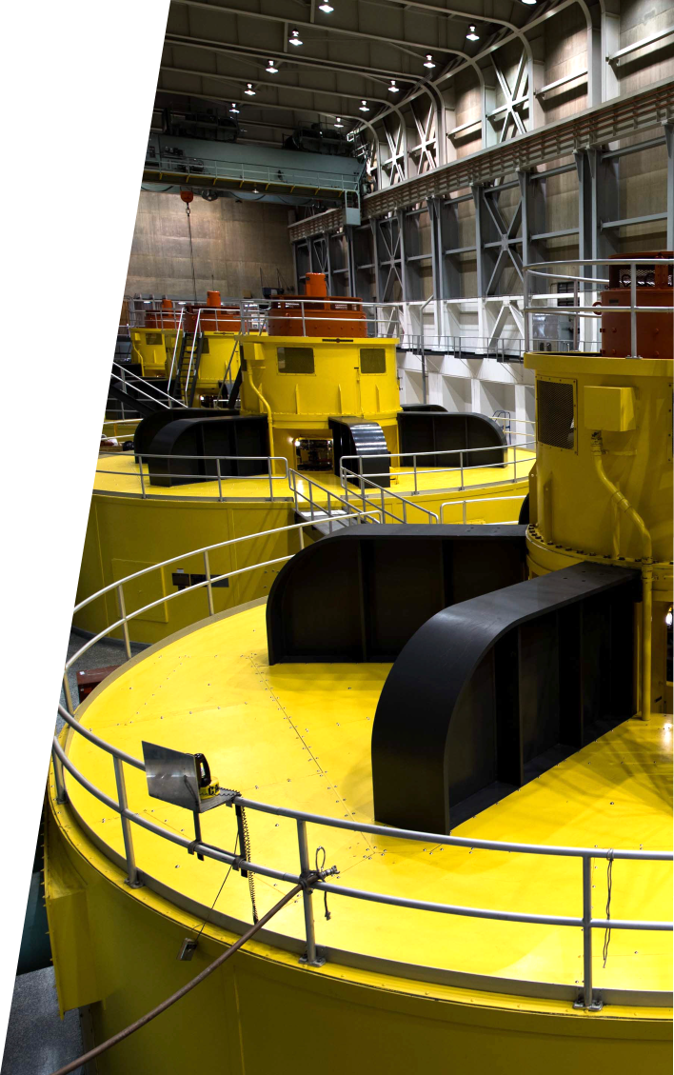
Agenda
RMR Leadership Changes
LAP Rates
2025 Power Marketing Initiative
SPP Implementation Update
Office of Infrastructure Asset Management & Planning

Slide 3
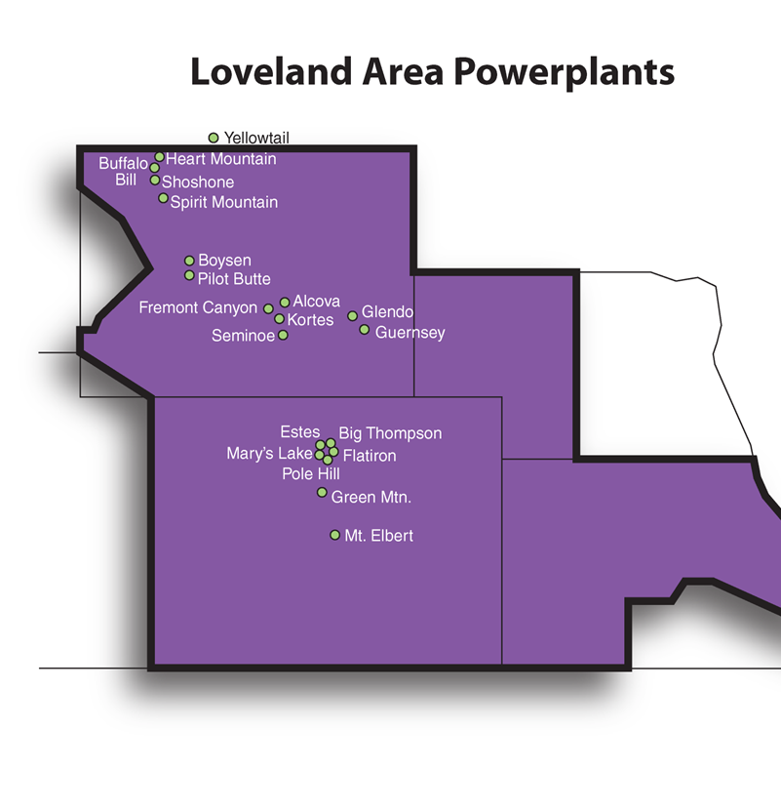
RMR Leadership Changes
RMR Key Retirements:
Pete Heiman – VP of Transmission Svcs for RMR/CRSP/DSW Retired December 31, 2023
Dave Neumayer – RMR VP of Power Marketing Retired May 31, 2024
33 years with PMAs (Bonneville and WAPA)
15.5 years as VP of Power Marketing
New RMR Leaders:
Zea Flores – VP of Transmission Svcs for RMR/CRSP/DSW
Parker Wicks – VP of Power Marketing
Jodee Miller – Contracts & Energy Svcs Manager
Loveland Area Projects -- Powerplants

Slide 4
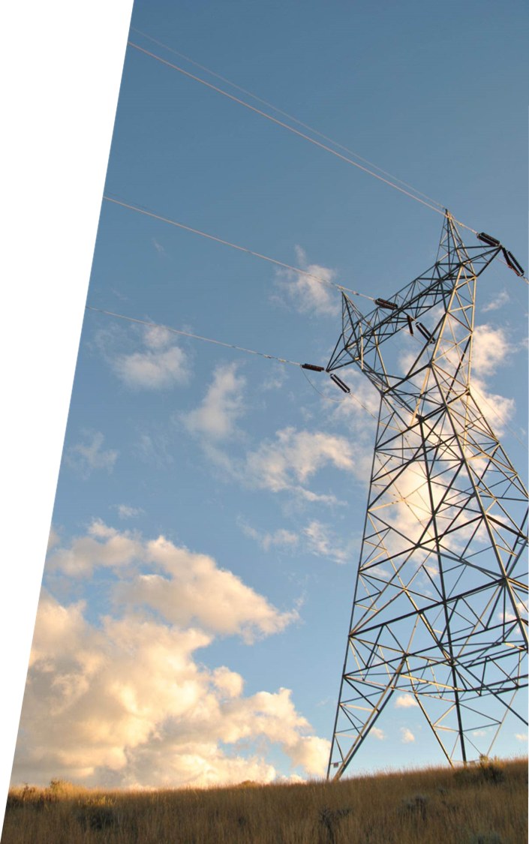
LAP FES Rates
Final Rate FRN Published Nov 20, 2024
At least 30-day notice prior to effective
First step of new rate effective Jan 1, 2025
39.84 mils/kWh
Includes 2.40 mils/kWh drought adder
Second step of new rate effective Jan 1, 2026
43.10 mils/kWh
Includes 1.38 mils/kWh drought adder
LAP = Loveland Area Projects
FES = Firm Electric Service
FRN = Federal Register Notice

Slide 5
2025 Power Marketing Update
New 2025 FES contracts began Oct 1, 2024
30-year term
Terminate Sep 30, 2054
New Power Marketing Initiative started in 2011, 14 years of work!
With start of new contracts, 12 new LAP customers get the benefit of Federal Hydropower (9 Kansas, 2 Nebraska, 1 Colorado)
Most new LAP customers since 2004

Slide 6
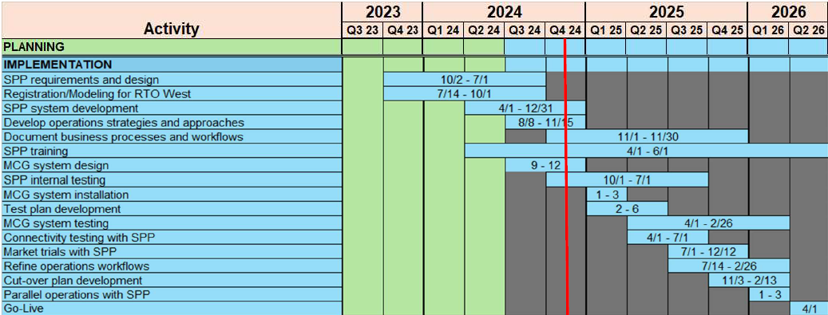
SPP Implementation Update
Currently working to complete registration actions
Transmission Zone assets finalized
Working with SPP and customers to document FES allocations for FSE application

Slide 7
Office of Infrastructure Asset Management & Planning (OIAMP)
What are we in the process of doing?
Unify infrastructure functional policy/guidance and leadership under one senior executive
Why do we need to do that?
Infrastructure responsibilities fragmented across HQ and Regions
Multiple challenges to transmission system maintenance, security, and modernization
In next 5 years, more than one-half of planned construction is related to aging infrastructure

Slide 8
OIAMP
How will we do it?
Hire “Infrastructure SES” (also under COO)
Unify infrastructure program under Infrastructure SES
Asset Management, Long-Term Transmission Planning, Aviation, Engineering, Wildfire Strategy
Infrastructure SES take ownership of infrastructure policy
Create/Revitalize infrastructure policy framework and guidance
Regions remain WAPA’s execution arm
COO = Chief Operating Officer
OIAMP = Office of Infrastructure Asset Management & Planning
SES = Senior Executive Service
TIP = Transmission Infrastructure Program

Slide 9
OIAMP
Additional info
Focus on consistency and alignment across Regions
Emphasis on data-driven decisions and collaboration
Infrastructure workload growing across WAPA; evolve practices to avoid overloading shared resources
Prioritize customer needs at enterprise level to streamline interactions between HQ/field
Fast moving train
No rate impact, No job losses, No required relocations
It’s not about “incremental improvement”; set course to be an energy sector leader

Slide 10
Questions?

Slide 11
Realignment Implementation Team
Tina Ko
Senior Sponsor
Bart Barnhart
Wildfire Strategy, PM Certification & Training Standards, Customer Liaison
Jennifer Rodgers
EPTC/KM Realignment to OCAO
Bryan
Griess
Wildfire Strategy Coordination, PSOC and TPMT Liaison
Kim Bentley
Chrystal Dean
Project Management Policy, Standards & Governance

Slide 12
Realignment Implementation Team
Tim Padden
Asset Management Maturity
Kim Bentley
Implementation Lead – IAMP Stand-up, Reorganization Processes
Brittanie Paquette
Change Management Lead
Trish Covello
Admin Support, Meeting Coordination, Travel
Implementation Support
Human
Resources
Public Affairs
Admin Support
AOs
Finance

Slide 13
Org Chart
CEO Administrator
COO
Regional
Managers
SES Infrastructure
TIP
Infrastructure Policy
Asset Management
Long Term Transmission Planning
Wildfire Strategy
Aviation
Engineering

