Slide 1
Unleashing Intelligence: Navigating the Evolving Landscape of AI Data Centers and their Energy Market Ripple Effects
Jeff Johnston, Lead Economist Digital Infrastructure
December 11, 2024

Slide 2
Data center market
Energy challenges and the move to secondary/ rural markets
Current state and AI’s expected impact
Will it last?

Slide 3
Data center market
Energy challenges and the move to secondary/ rural markets
Current state and AI’s expected impact
Will it last?

Slide 4
AI is setting records in user adoption rates
Time it took for online services to reach one million users
Netflix
Airbnb
Twitter
Foursquare
Facebook
Dropbox
Spotify
ChatGPT has grown to over 200 million users since its launch in late 2022
Instagram
ChatGPT
Source: Data Center Knowledge | * one million nights booked ** one million downloads

Slide 5
A Look Back at What Got Us Here
Average Zettabytes
108
Generative AI
Breakthrough chip technology
Energy shortages
Next Industrial Revolution!
Internet adoption begins
Basic mobile computing
Central telecom hubs
Copper circuits dominate
Advanced mobile computing (4G)
Increased fiber
Emergence of cloud computing
71
5G cellular
Online gaming
Cloud computing
Streaming video
Work from home
16
<1
2000-2010
2011-2019
2020-2021
2022-Present

Slide 6
Types of Data Centers
Risk:
ENTERPRISE
Company-owned
Managed internally
All IT infrastructure hosted on or off premise
EDGE
Smaller and closer to where applications are being run
Ownership structure flexible
Good for low latency applications
COLOCATION
Third party owns the data center
Can rent equipment, space, bandwidth from owner
Lower capex
HYPERSCALE
Owned and operator by a third party (Amazon, Microsoft, etc.)
Provides flexibility to scale up/down operations
Enormous scale and can process massive amounts of data

Slide 7
Amazon Web Services
Amazon has been growing its cloud business at a 40% compounded annual growth rate since 2013
$100
$90.7
$80
$60
Revenue (billions)
$40
$20
Source: Statista; CoBank

Slide 8
Data center capex
According to AMD, the market for AI chips could grow to $400B in four years
Global cloud service providers’ capex (billions)
$225.8
1H 2024
2H 2024F
IT equipment spend
Total hyperscaler capex
Source: Counterpoint Research; CoBank

Slide 9
U.S. data center growth
U.S. data center absorption and construction (megawatts)
The U.S data center market expected to reach 35GW by 2030
2022
2030
AI deployments to reach 7GW by 2026, representing approximately 30% of total data center demand
New capacity coming online in 2025 has already been leased
2020
2021
2022
2023
Source: JLL
Notes:
The U.S data center market is expected to reach 35 gigawatts (GW) by 2030, up from 17GW in 2022
AI deployments to reach 7GW by 2026, representing approximately 30% of total data center demand
New capacity coming online in 2024 has already been leased

Slide 10
Vacancy rates
Demand is driving North American data center vacancy rates to all-time lows
Lease rates up between 13 and 37%
from 2023 to 2024
2021
2022
2023
Source: Data Center Hawk

Slide 11
We’re just getting started

Slide 12
Data center market
Energy challenges and the move to secondary/ rural markets
Current state and AI’s expected impact
Will it last?

Slide 13
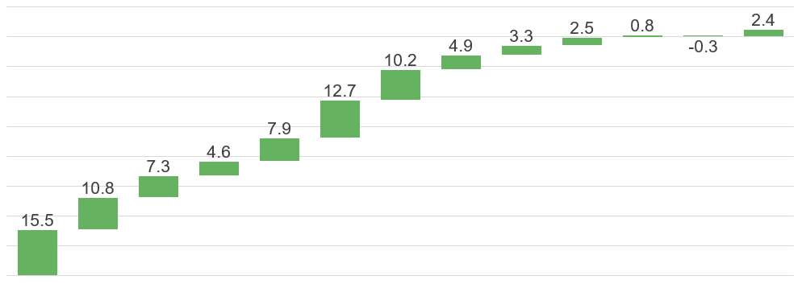
Demand is surging for the first time since the 1990s
Growth in Electricity Demand (% per annum)
2nd industrial revolution
(1870)
3rd industrial revolution
(1969)
4th industrial revolution
(2020)
1902
1912
1920
1930
1940
1950
1960
1970
1980
1990
2000
2010
2020
2030
Source: Pre-1950, Edison Electric Institute; Post-1950 EIA
Notes:
There have been a terrific amount of headlines that either predict the end of the EV Golden Age (for example the sale of 1/3 of the Hertz EV fleet and the fact that large automakers are less bullish than they were a year ago) but there are also the numbers that show an increasing number of Americans are adopting EVs. But you can see that even within the forecast circles there is a lack of consensus. Nevertheless this is one of the trends that will continue to impact our expectations of growth.

Slide 14
Energy complex struggling to keep up
Georgia Power pipeline for new online electricity (megawatts)
In approximately one year, Georgia Power increased its long-term electricity power needs by 114%
“
When you look at the numbers, it is staggering…this has created a challenge like we have never seen before.
Jason Shaw, Chairman of the Georgia Public Service Commission
Source: Georgia Power Company

Slide 15
LLMs and active inference
Rural America is emerging as an ideal place for new AI data centers
Large Language Models
Active Inference
Powered by deep learning on massive datasets (Wikipedia, books, news articles, etc.)
Models are trained (computation-intensive)
Teaches relationship between data input and output
Mimics human abilities to sense, perceive, and interact in real time
Continuously adapts its world– akin to how humans adapt–and engages in complex problem-solving tasks
Workloads are not location dependent
Workloads are location dependent

Slide 16
AI training
Training AI models so they can make better, more accurate predictions is computation-intensive
ChatGPT parameter counts
“
The amount of computing needed to train Llama 4 will likely be almost 10 times more than what we used to train Llama 3, and future models will continue to grow beyond that.
Source: Barclays

Slide 17
Secondary market construction
Rising data center demand and limited capacity is driving increased construction in secondary markets
450% increase in secondary market
construction
17.7%
Nov 2022
ChatGPT launch
22.3%
21.5%
8.6%
14.4%
14.1%
9.6%
21.3%
Source: JLL

Slide 18
Data center market
Energy challenges and the move to secondary/ rural markets
Current state and AI’s expected impact
Will it last?

Slide 19
AI hype – is it real?

Slide 20
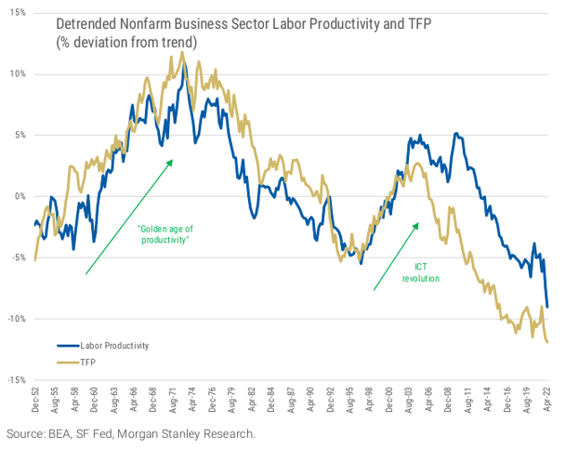
Productivity growth
Detrended nonfarm business sector labor productivity and TFP (% deviation from trend)
15%
10%
History shows that new technologies increase economic productivity and job growth
Executives are anxious to reverse post-COVID labor productivity declines
Artificial intelligence poised to help improve labor productivity
5%
0%
-5%
“Golden age of productivity”
ICT* Revolution
-10%
Labor productivity
Total factor productivity (TFP)
-15%
1950s
1960s
1970s
1980s
1990s
2000s
2010s
2020s
*Information and Communications Technology
Source: BEA, SF Fed, Morgan Stanley Research

Slide 21
Labor supply demand imbalance
Number of unemployed persons per job opening, seasonally adjusted
7
6
SEPTEMBER 2024
0.9 unemployed people for every one job opening
= 1.1 open jobs for every one person looking for a job
5
4
3
2
1
0
2009
2012
2015
2018
2021
2024
Shaded areas indicate U.S. recessions
Source: U.S. Bureau of Labor Statistics

Slide 22
Unemployment rate
Despite the recent increase, the unemployment rate remains well below its historical average
Average: 6.1%
Source: St Louis Fed

Slide 23
Birth rate in decline
Working-age population in Europe and North America is expected to decline from 730 million to 680 million over the next two decades
Source: St Louis Fed | BLS

Slide 24
Early results
PayPal
“AI is already making the coding development team 30% more productive and we expect similar improvements across front office and back office”
Dan Schulman, PayPal CEO
Unity Create
“Now, something that might have taken a group of artists 3 months can now take a server run about 10 minutes”
Marc Whitten, Unity Create President
Walmart
Able to “improve over 850 million pieces of data and the catalog. Without AI it would have required 100 times the current headcount”
Boston Consulting Group / Harvard Study
AI tools increased output and quality
Screen Actors Guild / Writers Strike
Use of generative AI and other digital technologies to replicate faces and voices

Slide 25
CoBank resources
Digital Infrastructure Reports
All Day Digital Podcast

