Slide 1
Grid Reliability and Transmission
Mid-West Electric Consumers Association
Annual Meeting
Claire Vigesaa – Executive Director
ND Transmission Authority
December 13, 2023

Slide 2
North Dakota Transmission Authority
Statutory Authority 17-05 North Dakota Century Code
Created by North Dakota Legislature – 2005
Authority – comprised of the three members of the ND Industrial Commission
Governor – Attorney General – Ag Commissioner
Broad Authority
Grants or loans
Issue up to $800 in revenue bonds
Enter lease-sale contracts
Own, lease, rent, dispose of transmission facilities
Enter contracts to construct, maintain or operative transmission facilities
Investigate, plan, prioritize and propose transmission cooridors
Participate in regional transmission organizations

Slide 3
Topics…
Factors that impact grid reliability
Areas of transmission congestion in ND
What increased transmission capacity means for ND’s “all of the above strategy”
Transmission projects approved for ND
Projects under consideration for ND
Recent Generation Adequacy Studies in ND

Slide 4
Factors Impact Grid Reliability
Electric Generation Adequacy
Maintenance & Operations of the Grid
Natural Disasters
Man-made Disasters – Physical Security
Cyber Security
Energy Policy!

Slide 5
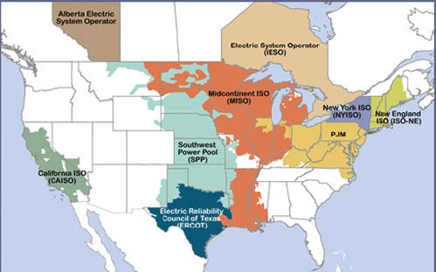
Areas of Congestion in North Dakota
The Bakken
Southeast ND

Slide 6
What Increased Transmission Capacity Means for ND
North Dakota…rich in energy resources
North Dakota is a major energy consumer
Transmission Lines…like Interstate Highways
Power can flow both directions
Provides path to market
Improves system reliability/resilience

Slide 7
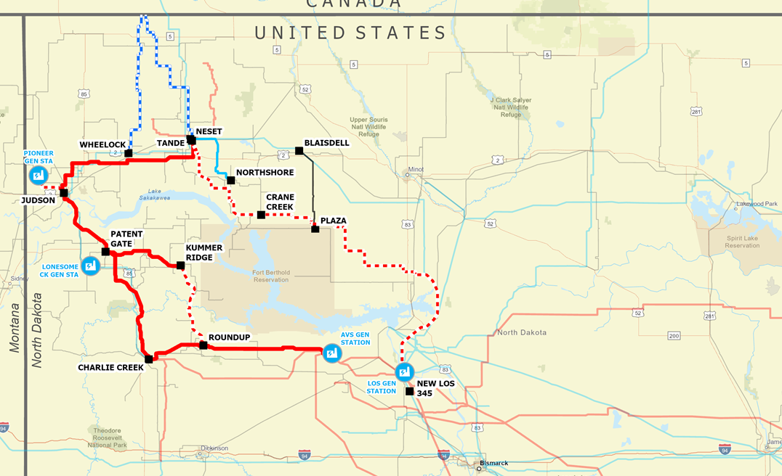
SPP Approved Transmission Projects for ND
345kV Roundup to Kummer Ridge – 35 miles - 2025
345kV Leland Olds to Tioga – 175 miles - 2026
230kV Wheelock-SK 50 miles - 2027
230kV Tande-SK 60 miles - 2027
Statcom – New Town

Slide 8
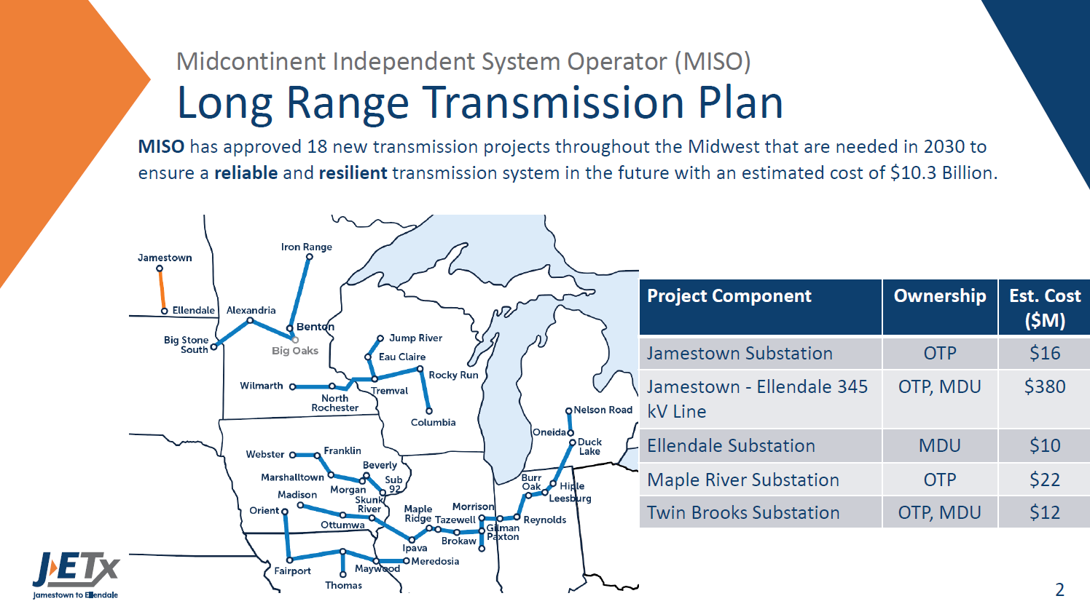
MISO Approved Otter Tail Power – MDU JETx Project

Slide 9
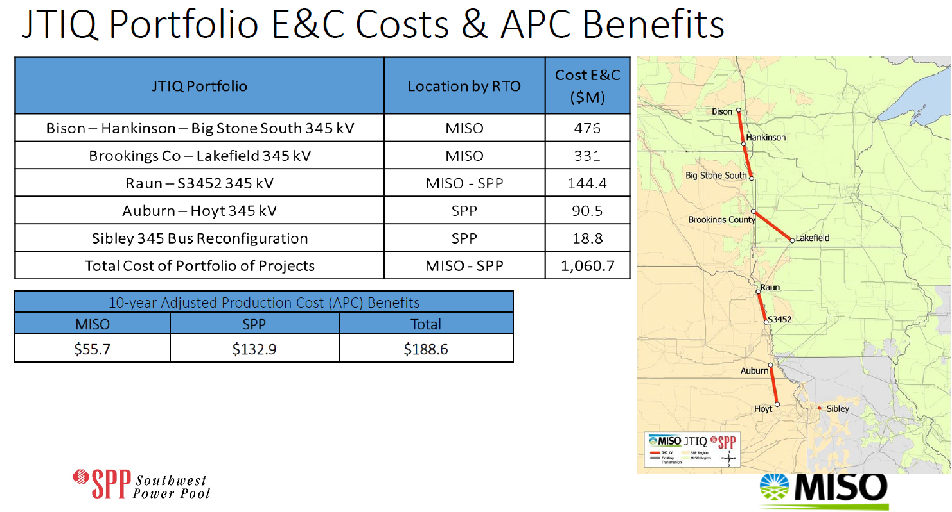
Joint Targeted Interconnection Queue
Recipient of $464 million
DOE GRIP Grant
October 2023
Costs have increased dramatically over this estimate

Slide 10
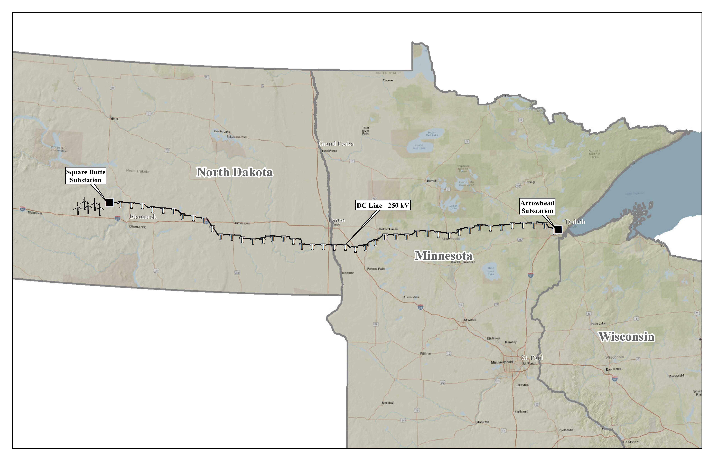

HVDC Modernization Project - MN Power Allete
Construction
2028-2031
$50 million DOE
Grant Recipient
October 2023
Waiting on MN decision from DOC EERA
ND…working on ND route permit and corridor certificate…submitting early 2024
Increase capacity from 550MW to 900MW…1,500MW

Slide 11
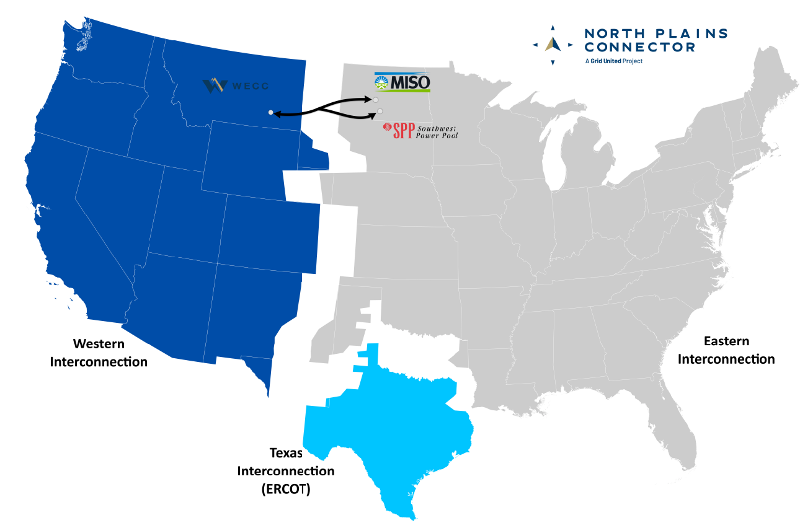
North Plains Connector
Linking Together the US Grid
Increasing ND’s Export Capacity

Slide 12
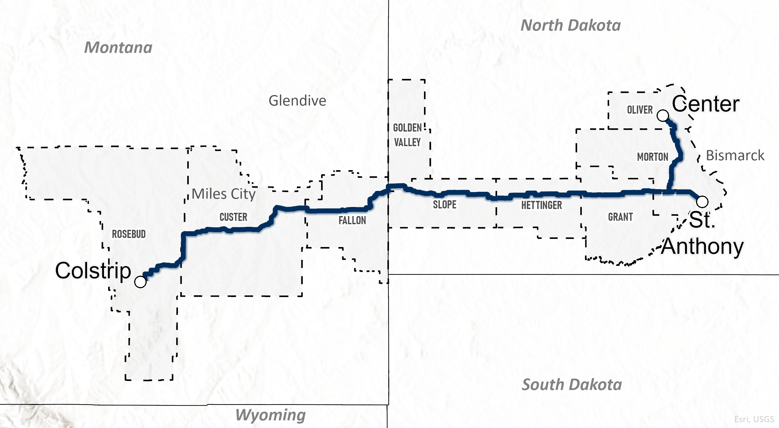
North Plains Connector - Overview
Project Configuration
Overview Map
Route:
  Length: 400 miles
Rating:
  HVDC (VSC), 525kV, 3,000MW
Transmission Interconnections:
  WECC – 3,000MW into Colstrip, MT 500kV system
  MISO – 1,500MW (AC) to Center, ND Substation
  SPP – 1,500MW (AC) to new substation near St. Anthony, ND
Expected in service date: 2030-2031
  Project’s route is under active development and is subject to change.
Notes:
Brant

Slide 13
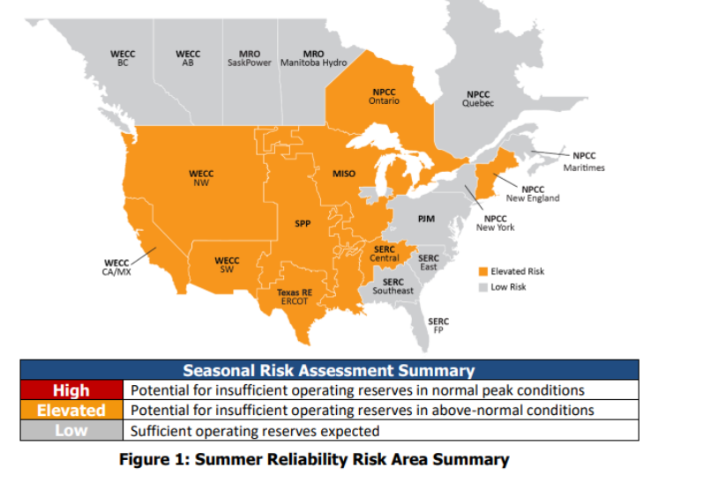
NERC Summer 2023 Reliability Risk
Many alerts this summer!

Slide 14
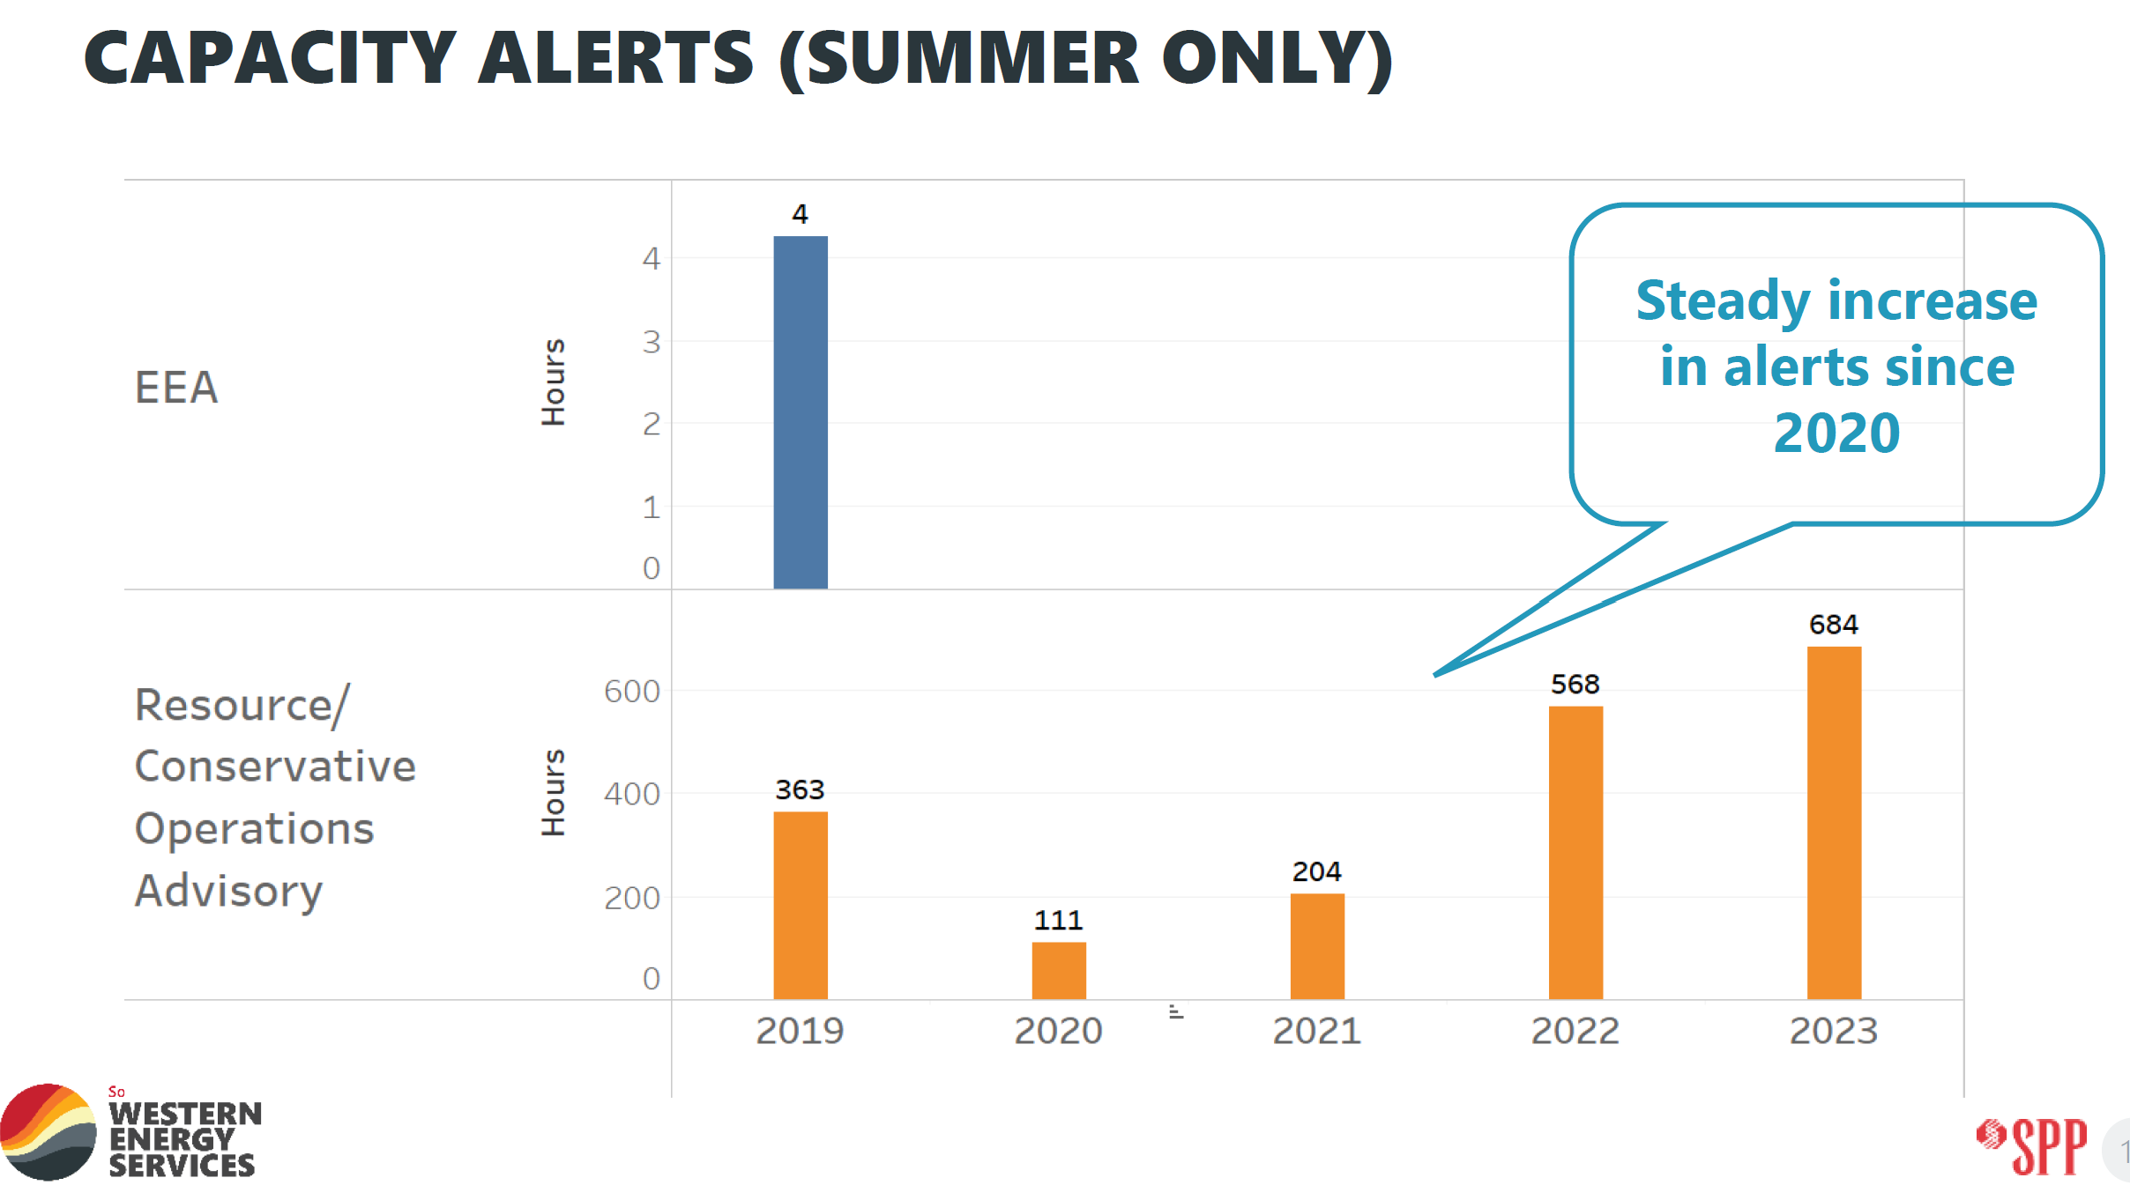
SPP Alert Trend

Slide 15
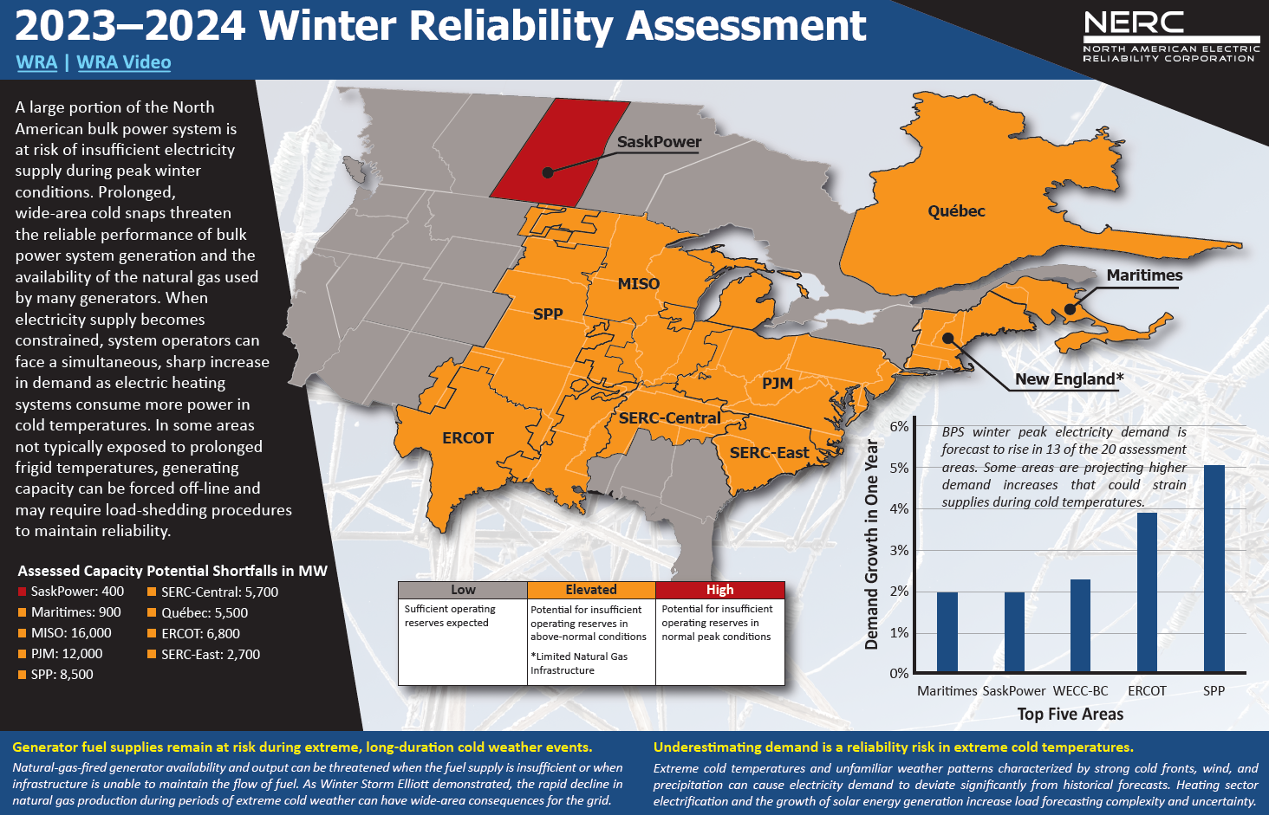
NERC Winter 2023-2024 Reliability Risk Map

Slide 16
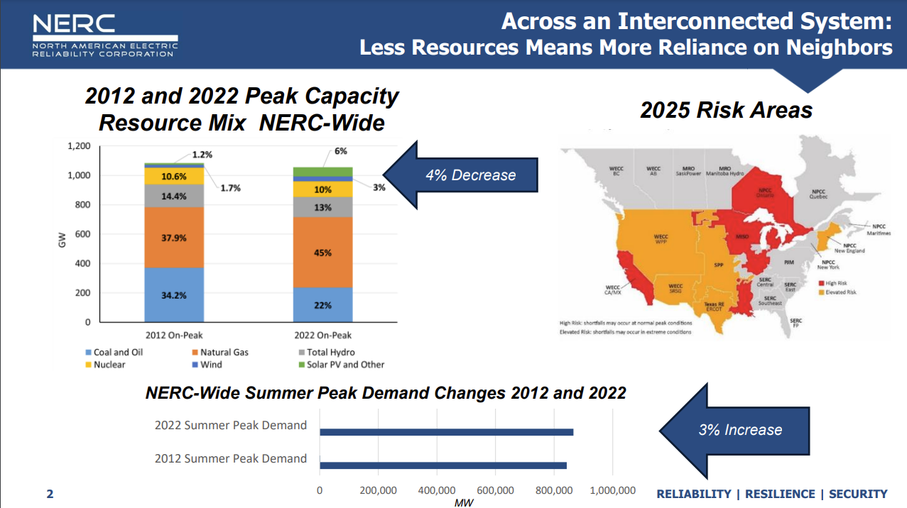

Slide 17
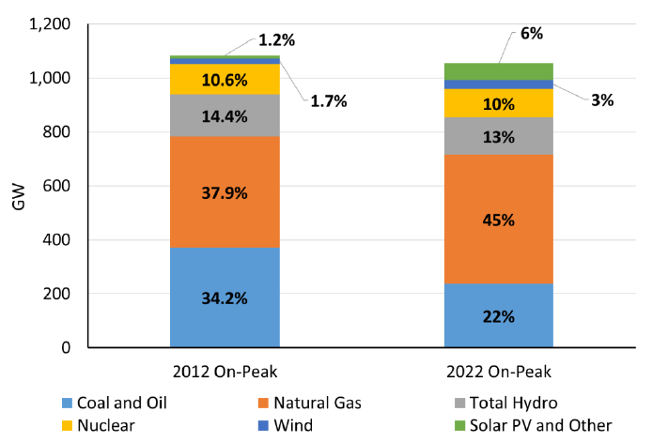
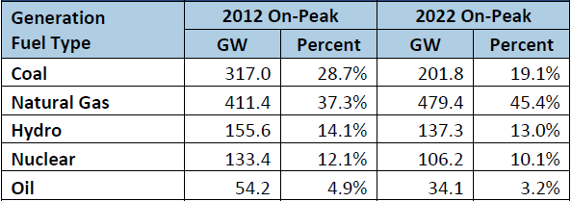
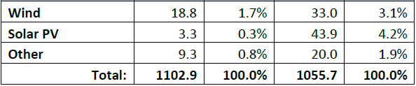
2012 – 2022 On National Peak Generation Comparison
Installed wind nameplate went from 56 to 149 GW in past 10 years, yet capacity at peak load only increased 14 GW representing 3.1% of total resource capacity today

Slide 18
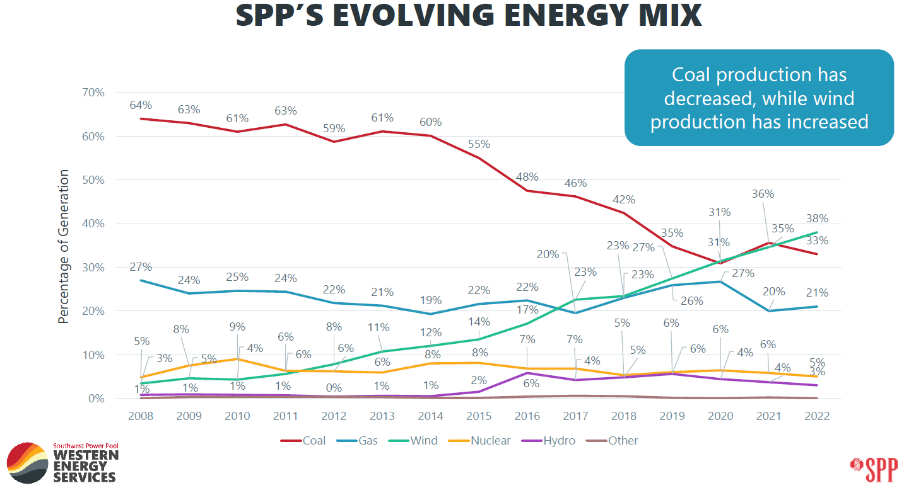

Slide 19
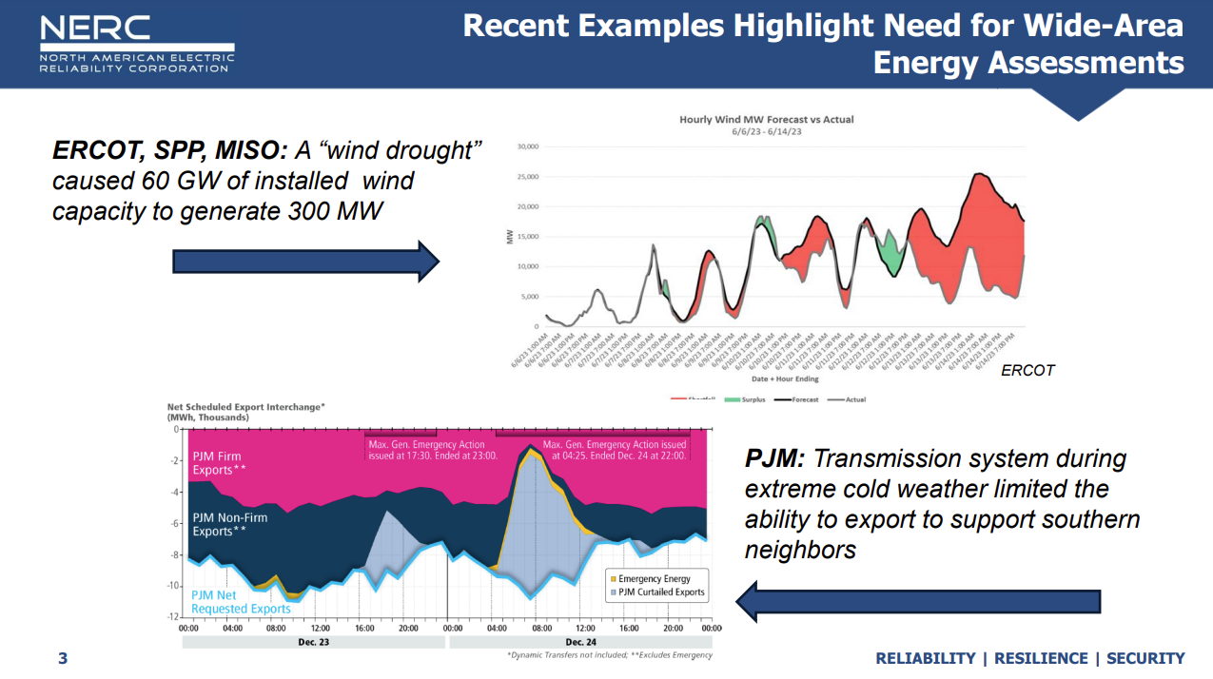
That’s 0.5%!!

Slide 20
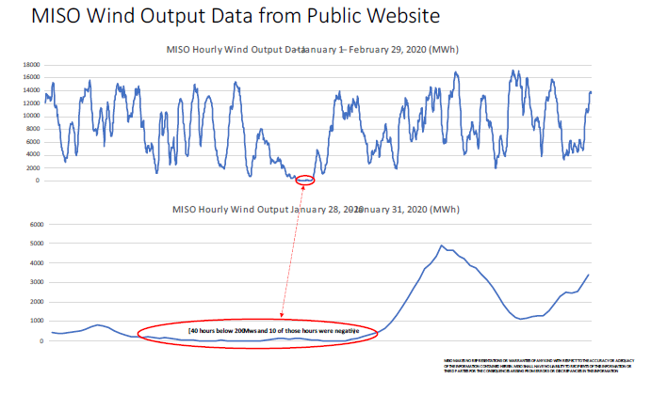
40 hrs below 200MW
10 hrs actually negative

Slide 21
Objectives: Model Resource Adequacy and Cost in
MISO and SPP Under Two Scenarios
Step 1: Develop Reasonable Accreditation Values for Wind and Solar
  2018-2022 hourly dataset
    Peak load availability.
    Net peak load availability.
Step 2: Reference Scenario
  EIA planned additions and retirements by 2035.
  Replace with modeled wind solar and four-hour storage.
  Peak load and net load.
Step 3: Ozone Transport Rule (OTR) and Coal Combustion Residual (CCR) Scenario
  Loss of coal and gas by 2035.
  Replace with natural gas, wind, solar, and four-hour storage.
  Peak load and net load.

Slide 22
Methodology- Developing a Standardized Capacity Accreditation for Renewable Resources
Assess wind and solar variability during peak load and net peak load hours
  Peak Load: The hours with the highest electricity demand.
  Net peak load: Gross demand minus wind and solar generation, which allows us to assess the highest demand hours where wind and solar output is the lowest. This is the standard new wind and solar resources should be judged by going forward.

Slide 23
Even With No EPA impact
MISO Relying Upon Weather & Imports for Reserve
Year | Reserve Margin
2022 | 34%
2023 | 32%
2024 | 30%
2025 | 30%
2026 | 28%
2027 | 27%
2028 | 26%
2029 | 25%
2030 | 23%
2031 | 22%
2032 | 21%
2033 | 20%
2034 | 19%
2035 | 18%
Estimated firm capacity using net peak load capacity accreditation values for wind (5.8%) and solar (12%), 95% for nuclear, and 90% for other thermal generators. Different than MISO cleared UCAP (unforced [accredited] capacity).

Slide 24
MISO OTR + CCR Scenario: Capacity Shortfall Risk
Year | Reserve Margin
2022 | 34%
2023 | 33%
2024 | 31%
2025 | 30%
2026 | 28%
2027 | 27%
2028 | 25%
2029 | 24%
2030 | 23%
2031 | 22%
2032 | 21%
2033 | 20%
2034 | 19%
2035 | 18%
Estimated firm capacity using net peak load capacity accreditation values for wind (5.8%) and solar (12%), 95% for nuclear, and 90% for other thermal generators. Different than MISO cleared UCAP (unforced [accredited] capacity). Under this scenario, MISO would be dependent on intermittent resources to meet peak load.

Slide 25
Even With No EPA impact, SPP Relying Upon
Weather & Imports for Reserve at SPP
Year | Reserve Margin
2022 | 19%
2023 | 20%
2024 | 21%
2025 | 22%
2026 | 23%
2027 | 22%
2028 | 22%
2029 | 20%
2030 | 20%
2031 | 19%
2032 | 18%
2033 | 17%
2034 | 16%
2035 | 15%
Estimated firm capacity using net peak load capacity accreditation values for wind (7.5%) and solar (20.4%), 92% for nuclear, 88% for coal, 83% for natural gas, and 90% for other thermal generators.

Slide 26
OTR & CCR SPP Scenario: Capacity Shortfall Risk
Year | Reserve Margin
2022 | 19%
2023 | 20%
2024 | 20%
2025 | 21%
2026 | 22%
2027 | 21%
2028 | 20%
2029 | 19%
2030 | 18%
2031 | 18%
2032 | 17%
2033 | 16%
2034 | 16%
2035 | 15%
Estimated firm capacity using net peak load capacity accreditation values for wind (7.5%) and solar (20.4%), 92% for nuclear, 88% for coal, 83% for natural gas, and 90% for other thermal generators. Under this scenario, SPP is dependent on intermittent resources to meet peak load by 2026.

Slide 27
EPA’s Modeled Grid Only Meets EPA’s Reserve Margin With Generous Wind and Solar Capacity Accreditation and LMR/Import Assumptions

Slide 28
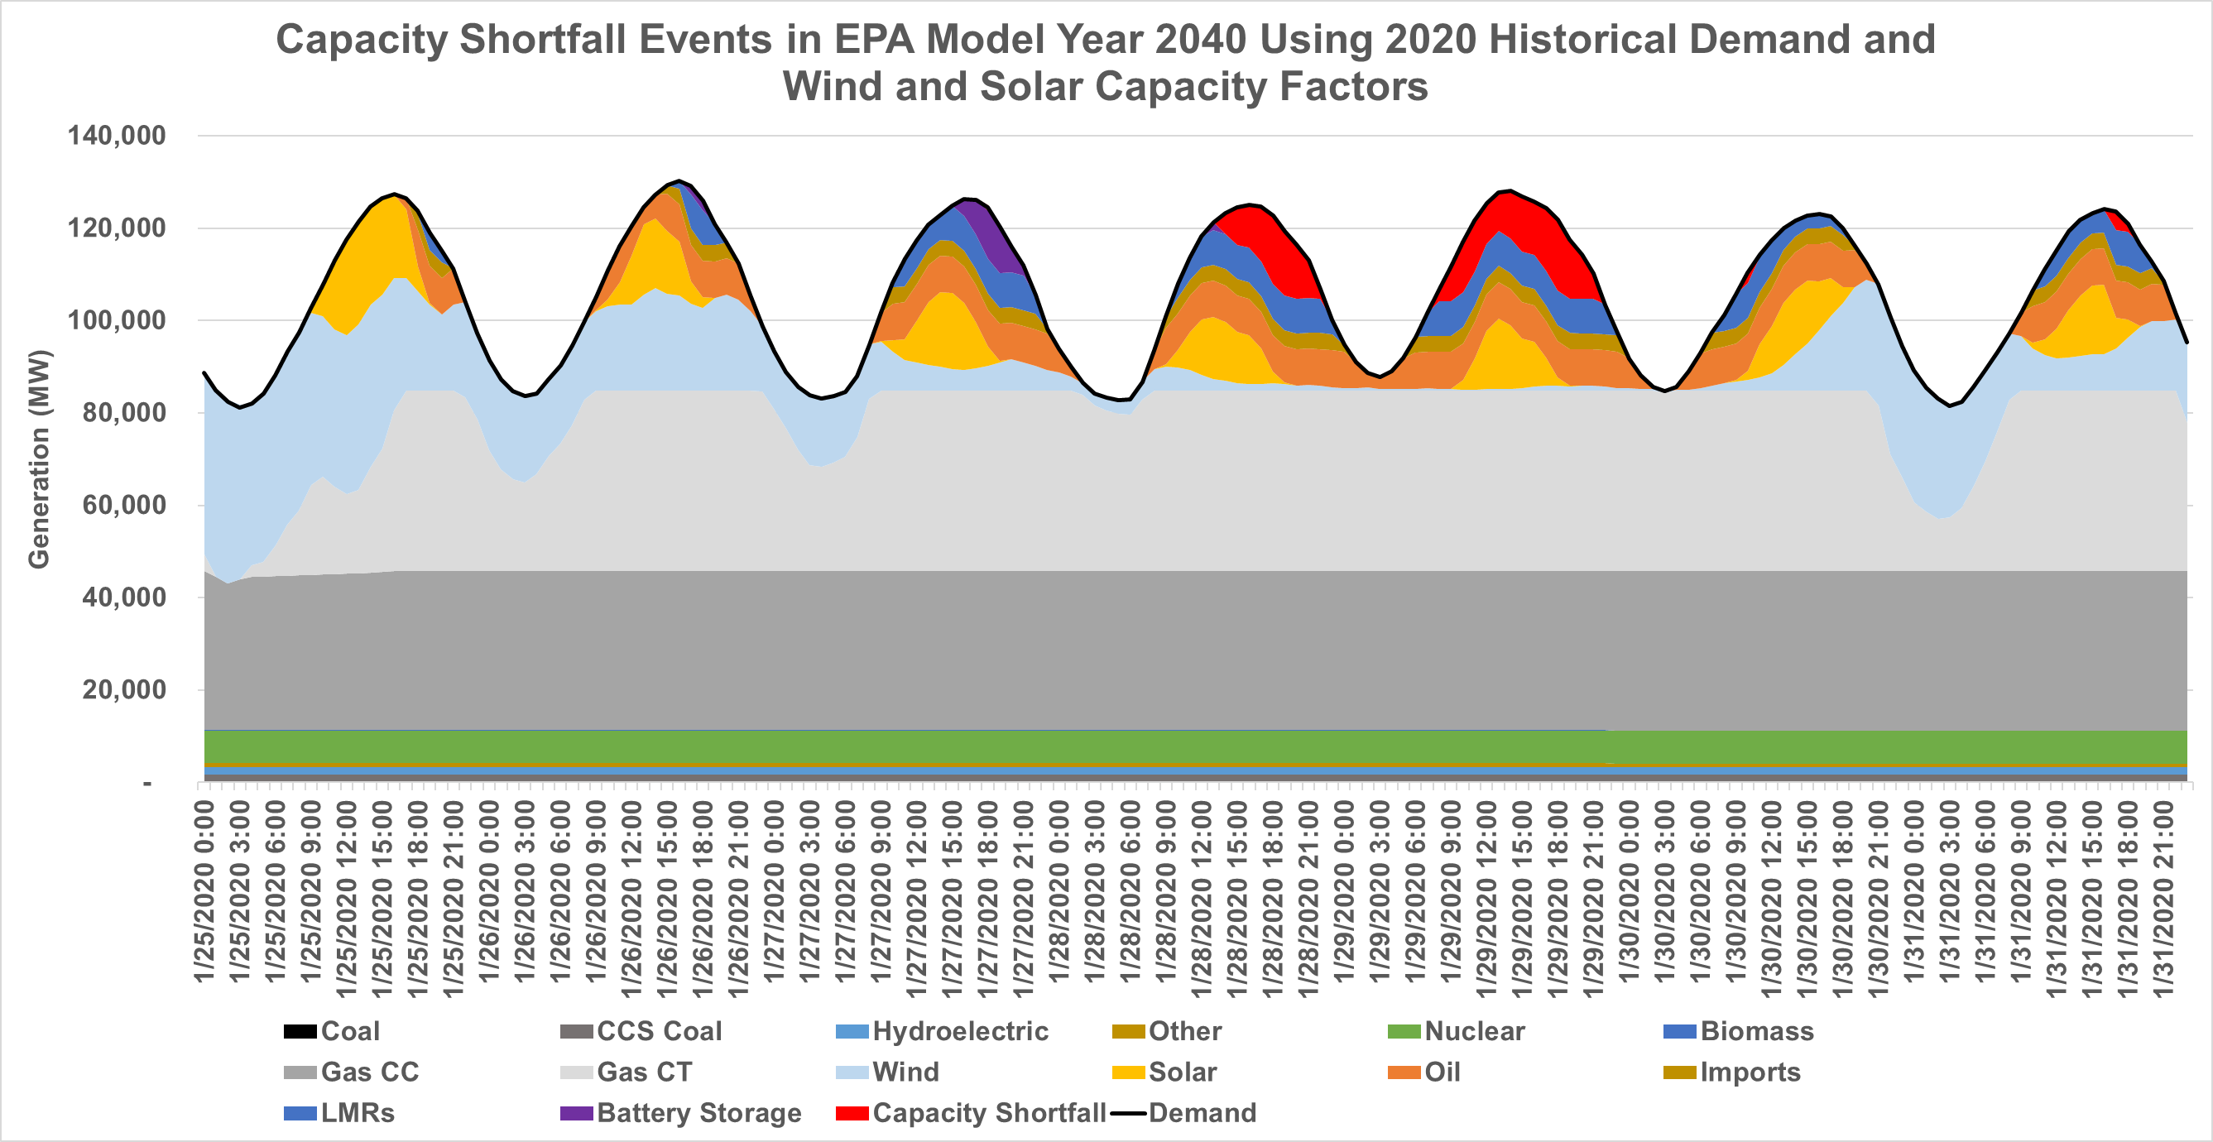

EPA’s Modeled Grid Would Result in Blackouts
EPA’s modeled resource portfolio cannot keep the lights on.
Our modeling found severe capacity shortfalls (rolling blackouts) in MISO when conducting hourly reliability assessments based on historic hourly electricity demand and hourly wind and solar capacity factors.

Slide 29
Conclusion for Mid-West Members!
Hydro power…increasingly valuable
WAPA increasingly valuable
Claire’s personal suggestion
  Make every effort to strengthen your public power relationships
  Identify ways to strengthen the WAPA business enterprise
  Help WAPA strengthen is transmission network!
  Help WAPA maintain and build new transmission assets
  “A successful enterprise needs to build and grow”

