Slide 1
Rocky Mountain
Region Update
Mid-West Annual Meeting
Barton V. Barnhart
Senior VP and Regional Manager
December 13, 2023

Slide 2
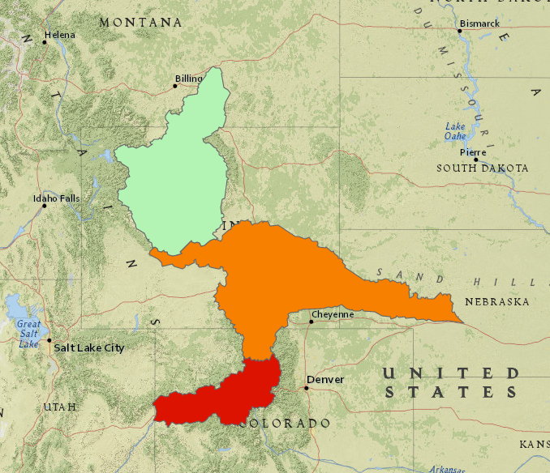


LAP Water Conditions
(3 Basins)
Bighorn Basin
North Platte Basin
Colorado
Big Thompson
2

Slide 3
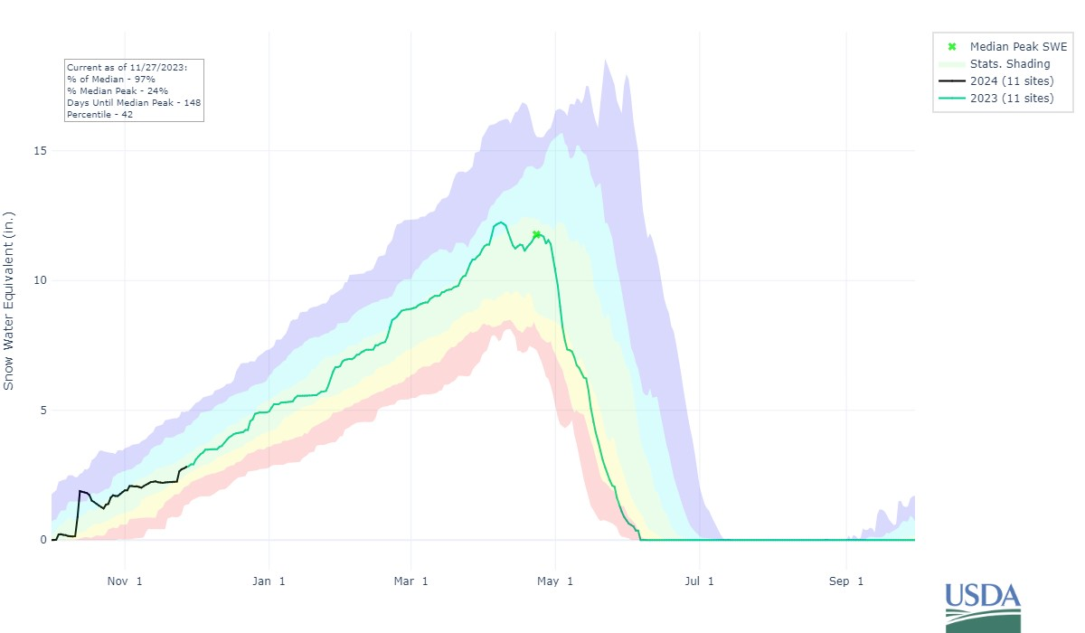
Snow Water Equivalent Big Horn Basin
3

Slide 4
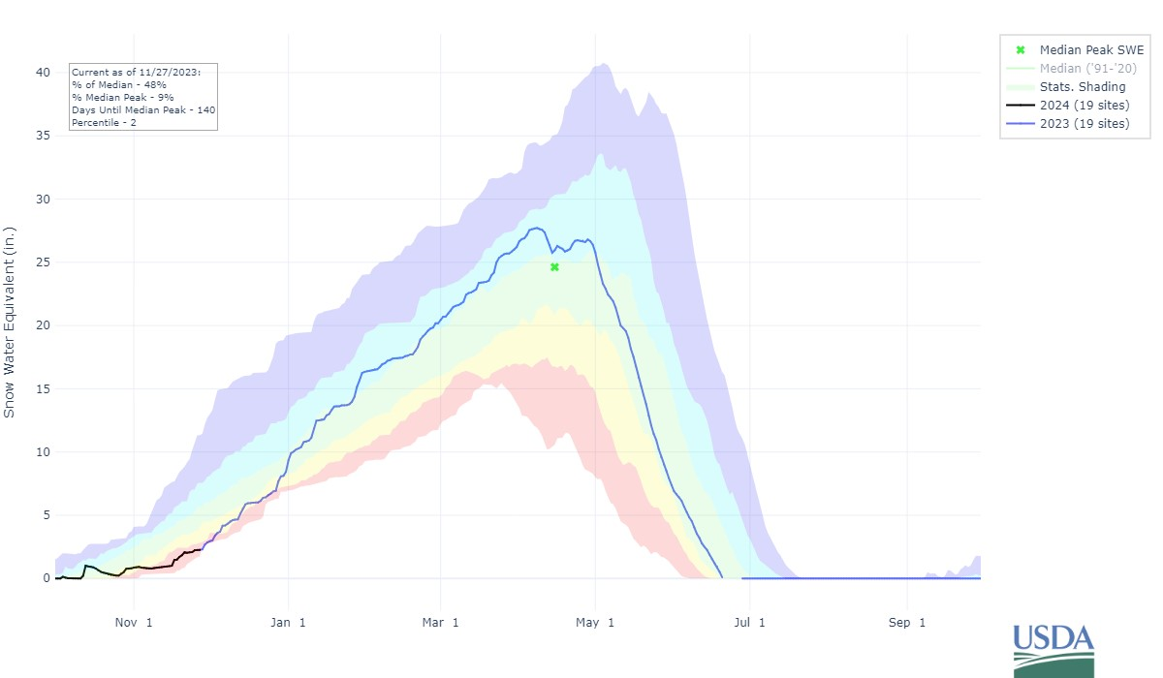
Snow Water Equivalent Upper North Platte Basin
4

Slide 5
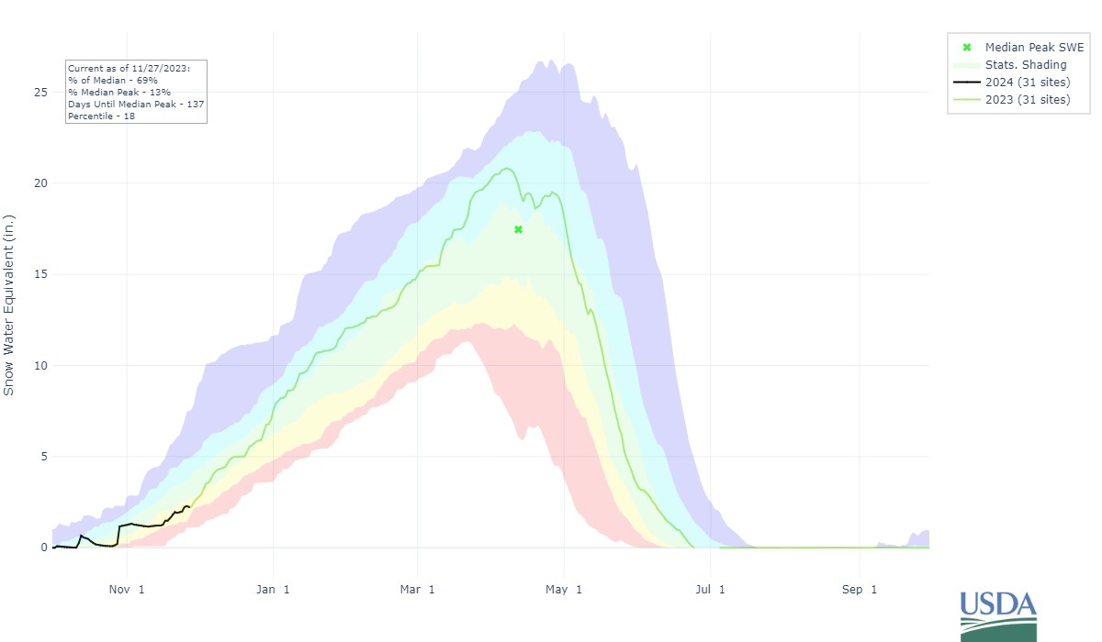
Snow Water Equivalent Colorado Headwaters
5

Slide 6
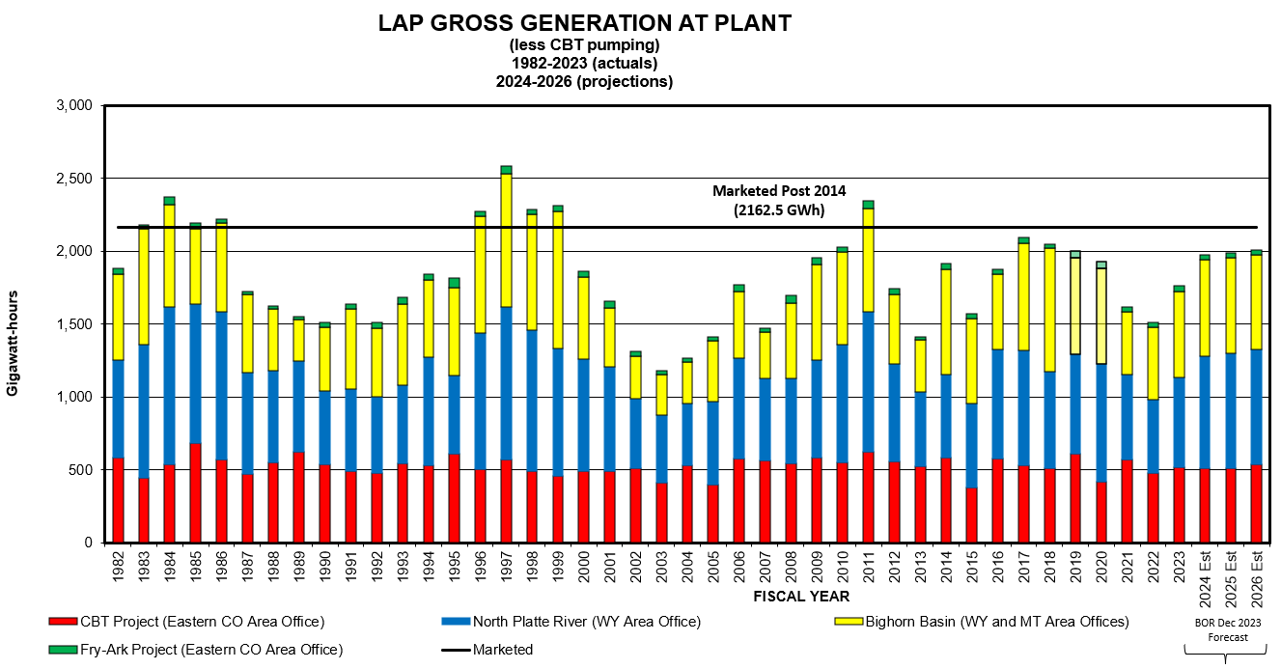

Slide 7
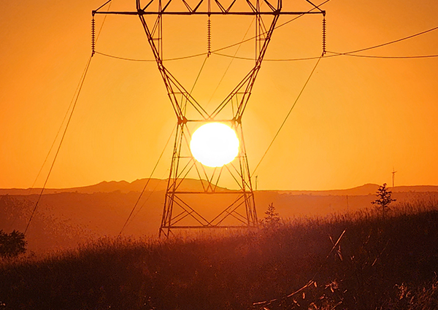
LAP Rates
Upcoming Formal Rate Processes:
LAP FES
  Formal adjustment process
  ~Apr–Nov 2024
  Rates in effect Jan 1, 2025
WAPA Non-Firm Transmission under WestConnect (expire May 31, 2024)
  Formal extension process
  ~Feb-Apr 2024
  Rates in effect Jun 1, 2024
LAP/WACM Transmission and Ancillary Services (expire Sep 30, 2024)
  Formal extension process
  ~Mar–Aug 2024
  Rates in effect Oct 1, 2024
7

Slide 8
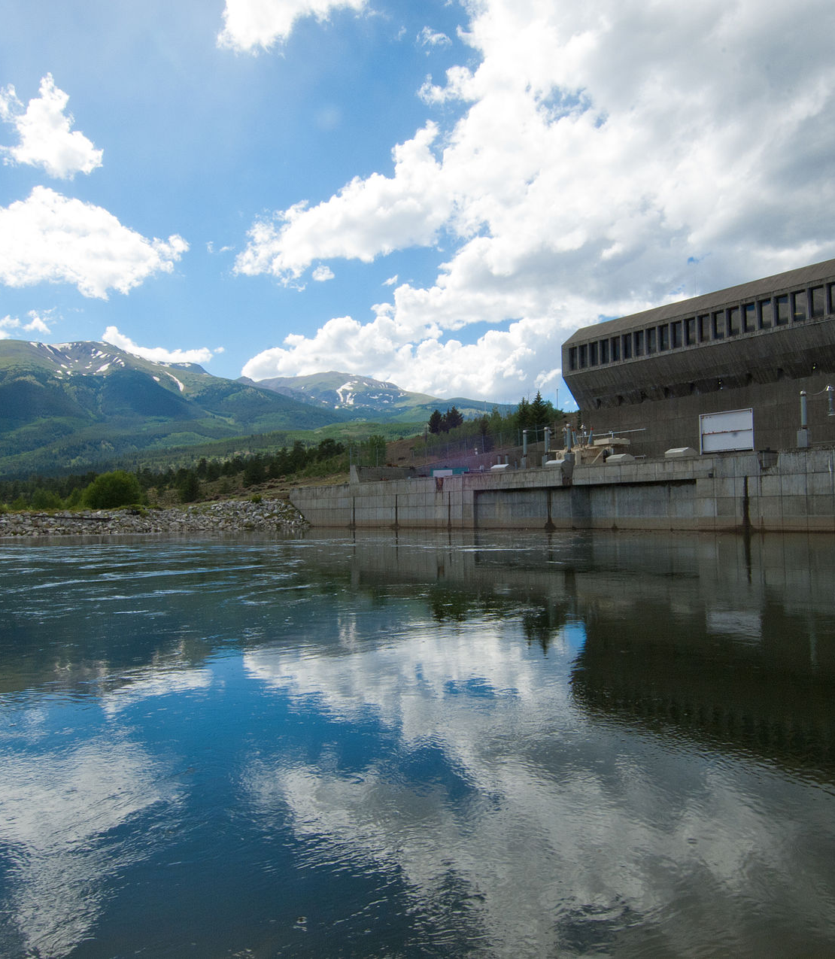
Fryingpan-Arkansas Project
Fry-Ark integrated with Pick Sloan–WD forms Loveland Area Projects (LAP)
Mt. Elbert 200-MW Pumped-Storage Plant
  LAP contract holders have scheduling rights
Issue: Optimize benefit of pumped storage in SPP integrated market (upon RM joining RTO)
  Pilot program to yield scheduling rights so RM can optimize plant in market
  Financial benefit to LAP rate
8

Slide 9
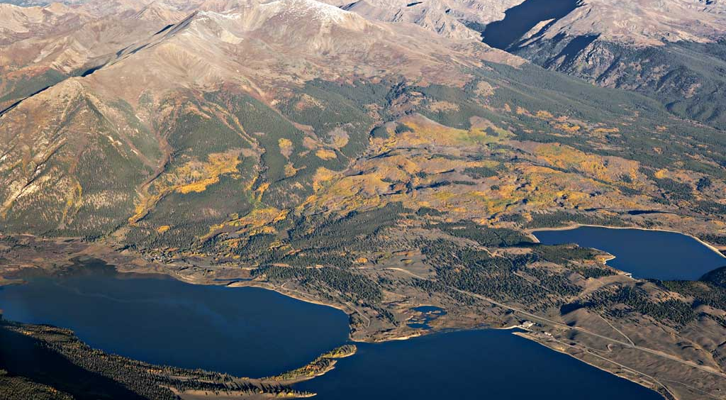
Mt. Elbert
Pumped Storage
N
Forebay
Powerhouse
Twin Lakes
Afterbay
9
Notes:
Mt. Elbert (top)
Twin Lakes (bottom)
Upper Forebay (right side)
Mt. Elbert Power Plant – circled

Slide 10
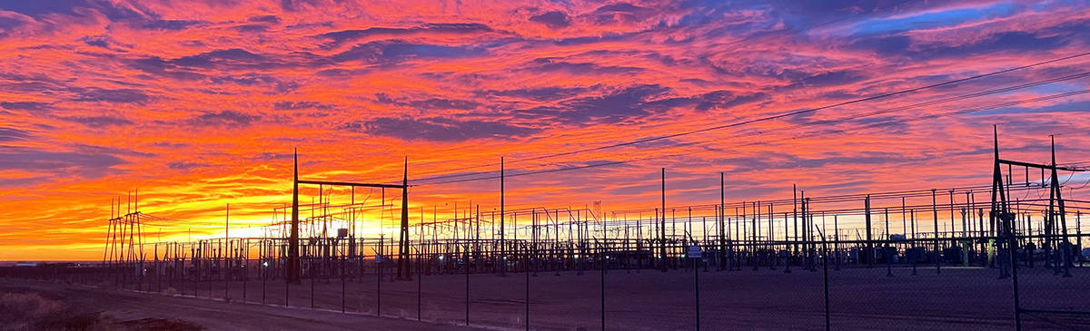
RTO
Considerations
Operations and Transmission Services
Current situation: Separate divisions in RMR service RMR/DSW/CRSP
  Operate WACM/WALC BAA's and back each other up in emergency
If we go RTO change will become necessary
  RTO (SPP), WEIM (CAISO) processes complicate ability to back each other up
Possible organization change: Recombine Ops/Trans Svcs, split by region
  In UGP, Ops/Trans Svcs are combined into a single division (SNR does same)
Discussions underway to determine path forward
10

Slide 11
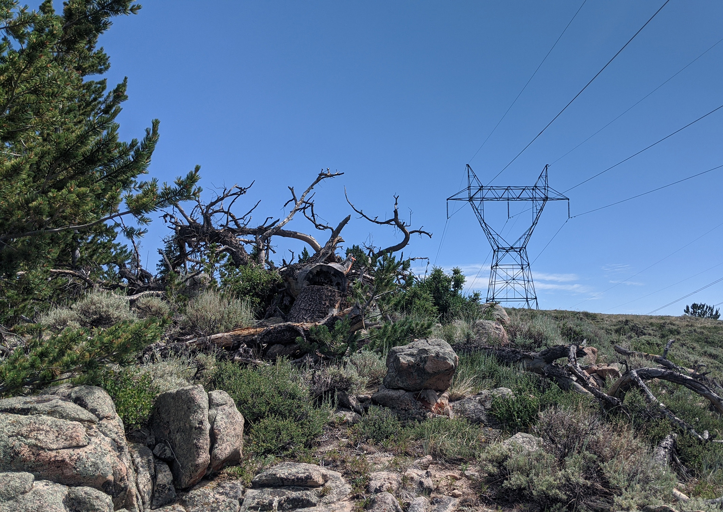
Recent Project Completions
Thermopolis 115-kV Breaker Replacements
Archer-Stegall Structure Replacement (storm damage)
Beaver Creek and Cheyenne Breaker Replacements
Estes-Flatiron Double Circuit Line Rebuild
Archer 230-kV Bus and Structure Upgrade
Casper-Glendo-Whiterock OPGW
Spence Station Service
11

Slide 12
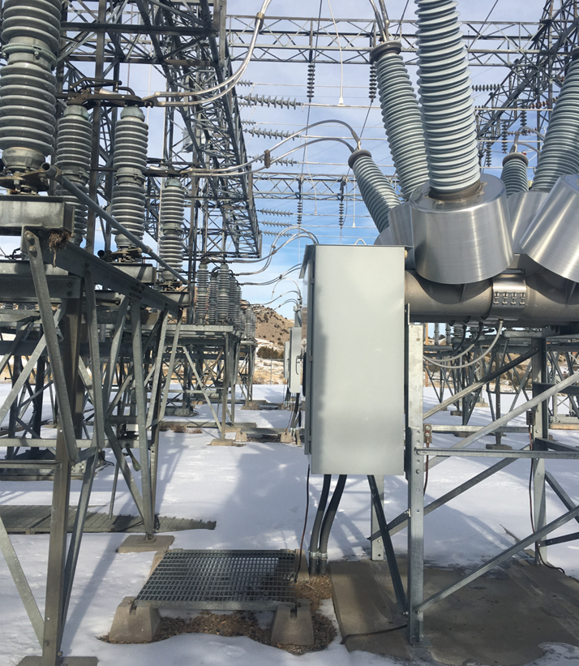
Thermopolis 115-kV Breaker Replacement
Completed by WAPA in-house workforce.
Scope: Replace nine, 30+ year old, 115-kV oil-filled breakers with new SF-6 breakers.
Cost: $2.30M.
Old sub with very tight spacing complicated work.
Had to install new conduits to support control cabling.

Slide 13
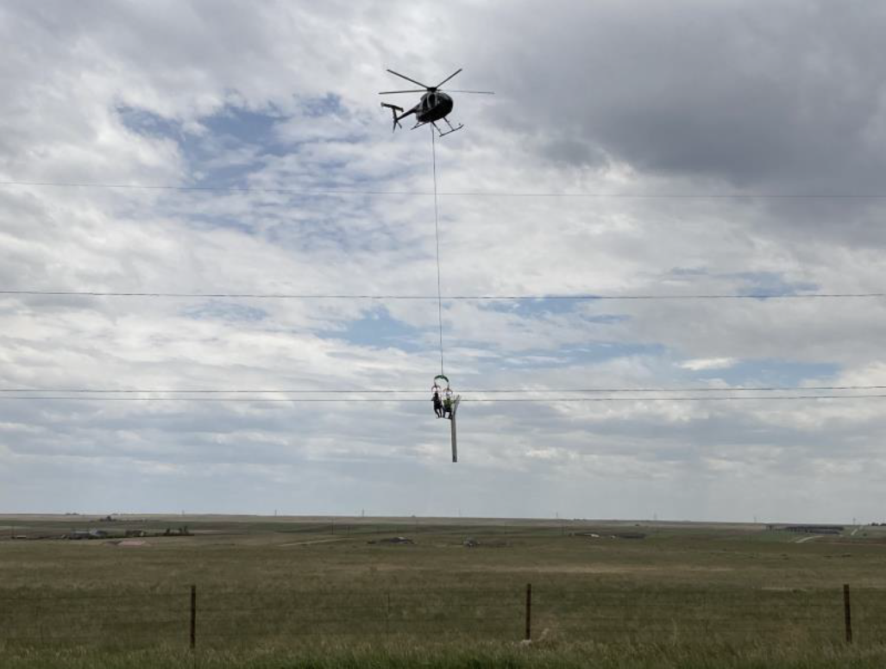
Archer-Stegall Structure Replacement
(storm damage)
Necessitated by galloping conductors that ripped cross arms off structures along a stretch of about two miles.
Completed, but not started, by WAPA in-house workforce.
Contractor terminated for poor work.
Clawed back $$$ from contractor for WAPA crews to complete job.
Cost: $1.12M

Slide 14
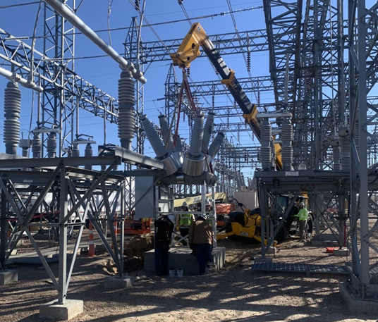
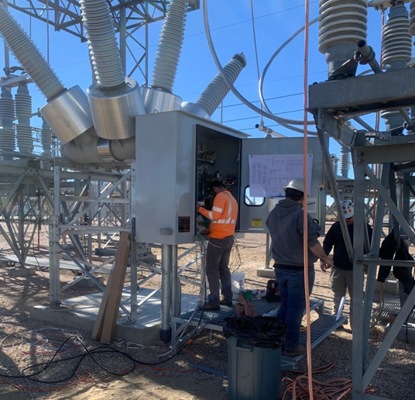
Beaver Creek/Cheyenne Breaker Replacements
(storm damage)
Four new breakers at each substation (eight total).
Contractor struggled, but completed the job with much involvement from WAPA construction inspection team.
Outage coordination was also a challenge.
Cost: $3.19M

Slide 15
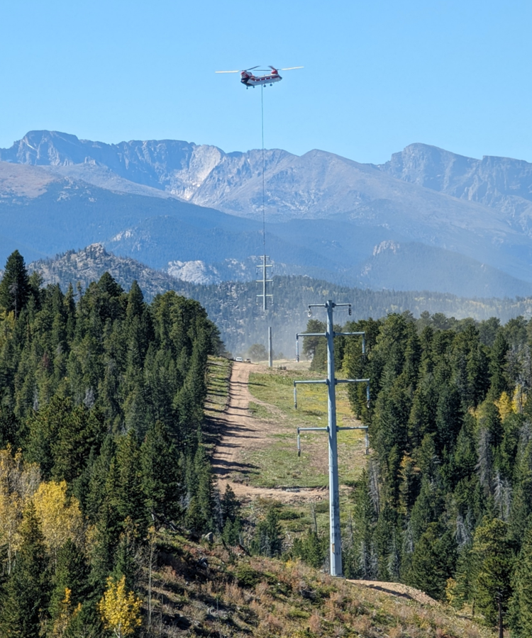
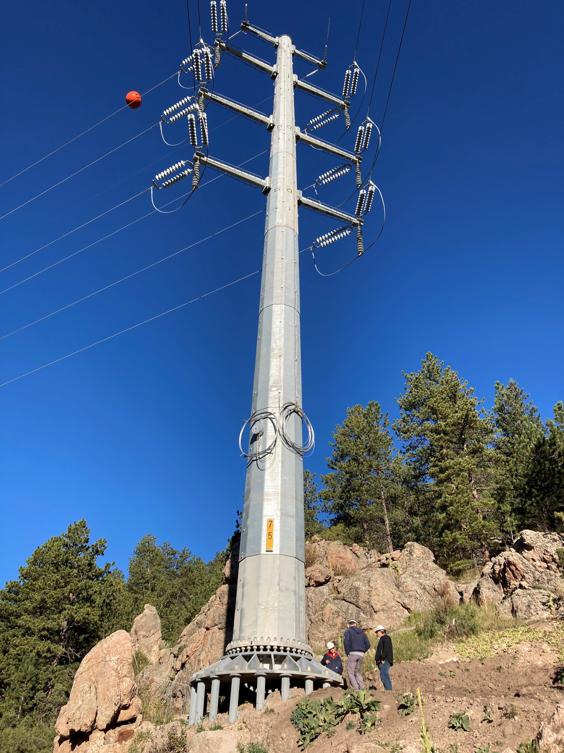
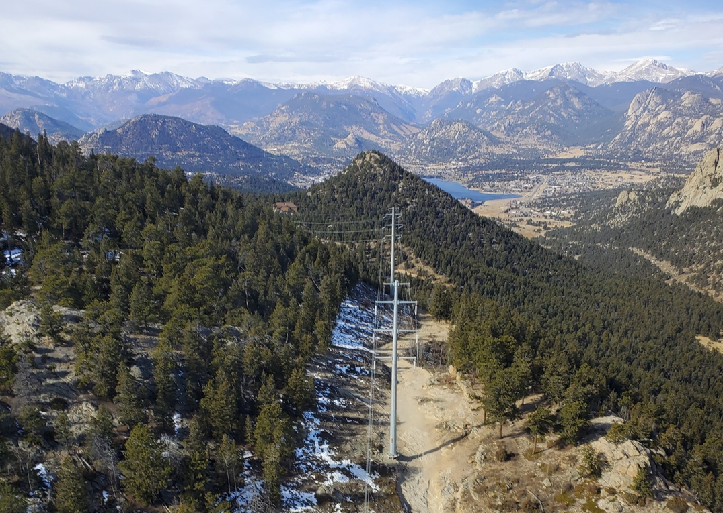
Estes-Flatiron Double Circuit Line Rebuild
Rebuild Estes-Pole Hill-Flatiron and Estes-Lyons 115-kV lines as a double circuit 115-kV line.
  Consolidate two rights-of-way into one.
Anticipated Final Project Cost: $59.2M
Unique blasting work and helicopter
work on this project.
Contractor has finished; will be back in
the spring for warranty work.

Slide 16
Barton V. Barnhart
barnhart@wapa.gov
(970) 461-7201

