Slide 1
Mid-West Electric Consumers Association
Annual Meeting
NRECA Policy Update
Denver, CO
Ian Lyle, Legislative Affairs Director

Slide 2
NRECA Update Mid-West Electric Consumers Association
Hydropower
NEPA
ESA
Wildfire
Appropriations
WRDA
Outlook

Slide 3
Hydropower
Hydropower is America’s oldest and most reliable source of renewable energy.
Accounts for nearly 37 percent of renewable electricity generation in the United States and more than 7 percent total U.S. electric generation.
Largest source of energy storage in the U.S., making up approximately 93 percent of all commercial storage capacity.
Demand for energy is expected to grow by about 30% from 2020 to 2035, and an additional 34% from 2035 to 2050.
Meeting this demand will require the development and deployment of new renewable and dispatchable energy resources.
Including resources owned by the federal government. It will also require the protection of existing hydropower resources

Slide 4
Hydropower
The Community and Hydropower Improvement Act (Daines/Cantwell)
Expedite the FERC permitting process: two-year process to grant licensing to add hydropower to qualifying non-powered dams.
Clarifying the scope of environmental effects that may be considered in hydropower relicensing.
Direct FERC to create a three-year process for completing the licensing process for closed-loop and off-stream pumped storage projects.
Coordinate federal decision making - joint schedule to permit the timely completion of all federal authorization decisions.
Provides mandatory conditioning authority to federally recognized Indian tribes with respect to projects located on trust lands.
Habitats: Directing FERC, other resource agencies, and Tribes to evaluate possible benefits that fish passage or downstream environmental improvements may have on fish species and reasonably foreseeable hydrological changes during the license term. Including environmental considerations for species protected under treaty obligations with Tribes.

Slide 5
Hydropower
Hydropower Clean Energy Future Act
Legislation introduced by Congresswoman Cathy McMorris Rodgers, Chair of the Energy and Commerce Committee
Amend the Energy Policy Act of 2005 to include hydropower under the definition of Renewable Energy.
Reform the Federal Energy Regulatory Commission (FERC) licensing process: 2-year licensing process for next generation hydropower resources, exempt small hydropower (under 40 megawatts), exempt closed-loop pumped storage projects that do not utilize federal land or impound navigable waters)
Extending the time by which a project must commence construction after receiving its license to account for delays related to the COVID-19 pandemic.( for projects issued a license under the Federal Power Act before March 13, 2020 start of construction can be extended an additional 4 years)

Slide 6

Hydropower
Protect Existing Resources

Slide 7
NEPA Phase 2 Rule
On July 28, 2023, CEQ announced a Phase 2 Notice of Proposed Rulemaking to revise its regulations for implementing the procedural provisions of the National Environmental Policy Act (NEPA).
The proposed rule will expand on last year’s NEPA Phase 1 rule and purports to include implementation of the amendments to NEPA passed by Congress as part of the Fiscal Responsibility Act of 2023.
NRECA believes the proposal is not fully consistent with the letter or intent of NEPA as amended by the Fiscal Responsibility Act of 2023 and will jeopardize affordable, reliable, safe electricity by complicating and slowing federal environmental reviews for essential electric infrastructure projects and increasing litigation risk. On September 19, 2023, NRECA filed comments highlighting concerns.

Slide 8
NEPA Phase 2 Rule
Among other key comments, NRECA opposed proposed changes that would:
Improperly transform NEPA from a procedural statute to a substantive one
Favor certain types of projects and disfavor others by elevating certain considerations – climate change-related effects and environmental justice – above all other considerations
Require adoption of mitigation measures and monitoring and compliance plans
Layer on additional requirements that make application of categorical exclusions less efficient and more burdensome
Suggest agencies should consider factors beyond the scope of an action to determine the significance of effects

Slide 9



Endangered Species Act
Endangered Species Act Working Group
House Natural Resources Committee
Congressional Western Caucus
Focus on ESA:
Implementation
Impacts
Role of litigation
How define success
Goal publish policy recommendations to improve the Act and its implementation.
Appropriations Riders
Northern Long Eared Bat
Lesser Prairie Chicken
Sage Grouse

Slide 10




Wildfire
Over 90,000 miles of electric transmission and distribution lines cross land managed by the United States Forest Service (USFS) and the Department of the Interior.
Over the last 20 years the total number of acres burned by wildfires across the United States has more than doubled. Most of the acres burned by these fires are owned and managed by the federal government.
Today more than 100 million acres of federal lands are at elevated risk of wildfire, this is a threat to electric reliability.
NRECA supports efforts to modernize the permitting and approval processes for vegetation management, work to address strict liability and insurance challenges, and funding to improve forest health while protecting communities and hardening the grid.
Fire Safe Electrical Corridors Act (S.2269/ H.R. 6012)

Slide 11

Water Resources Development Act
U.S. Senate
U.S. House
Requests concluded
Hearings ongoing
Further along
Request period open
Hearings should resume soon
Speaker race
WRDA 2024 potentially Q3 or Q4 of 2024

Slide 12



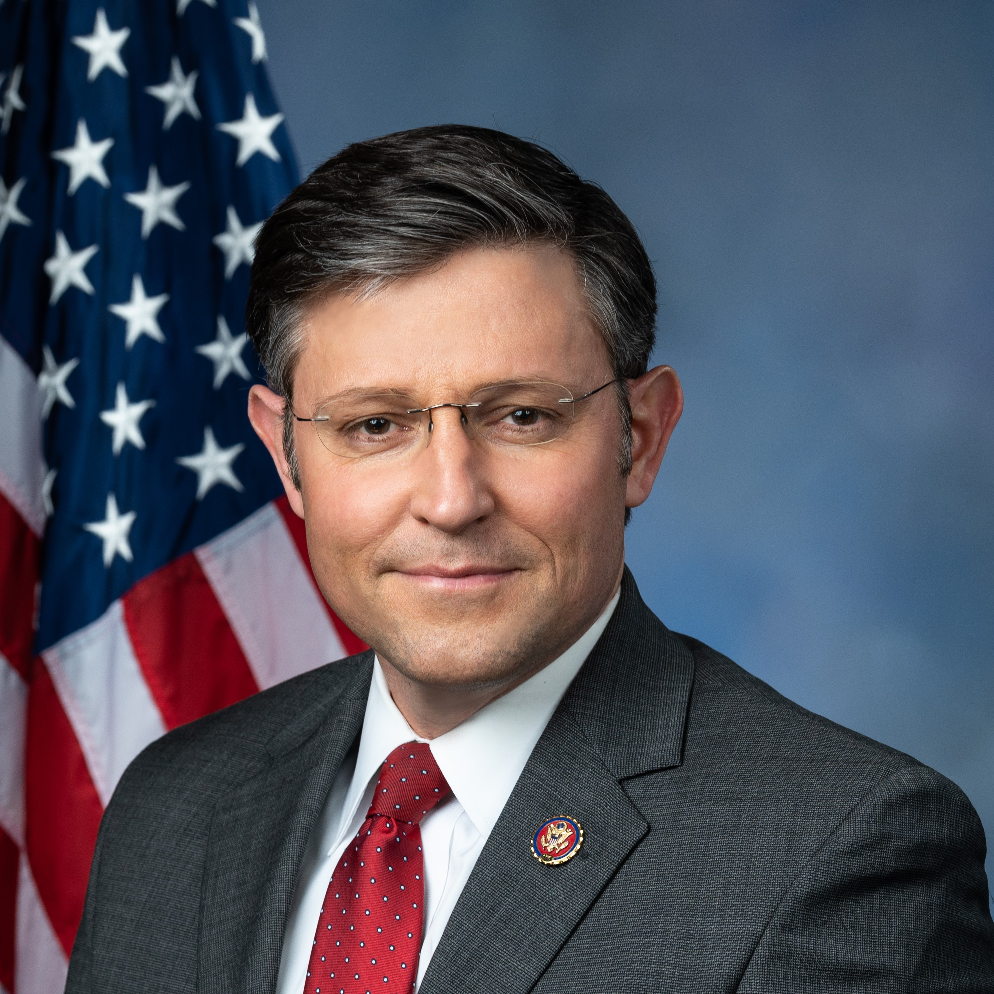
Appropriations
Speaker Mike Johnson’s laddered funding approach
On November 14, the House passed another continuing resolution to fund government programs at fiscal 2023 spending levels through two separate deadlines, with some program funds expiring on January 19th, and others on February 2nd
The bill passed 336-95, with 93 Republicans voting against it because the bill lacks federal spending cuts; two Democratic dissenters wanted increased funding for Ukraine
The goal of the laddered funding deadlines is to give Congress time to negotiate full appropriations bills and avoid having to pass an omnibus bill
Laddered continuing resolution
January 19, 2024
Expiring on Jan. 19 is energy and water, military and veterans’ affairs programs, agricultural and food agencies, and the departments of Transportation and Housing and Urban Development
February 2, 2024
All other funding is set to expire on February 2nd, such as the, Interior, State, Defense, Commerce, Labor, and Health and Human Services departments
Farm bill: the bill includes a one-year extension of the 2018 farm bill
I’m one of the arch-conservatives, OK, and I want to cut spending right now, and I would like to put policy riders on this… But when you have a three-vote majority, as we do right now, we don’t have the votes to be able to advance that right now.”
– Mike Johnson (R-LA-4), Speaker of the House
Notable exclusions
Excluded from the measure is funding for Israel and Ukraine, the border wall, WIC funding, and spending cuts desired by the more conservative Republican members
SOURCE Washington Post, Agripulse, Clerk of the US House of Representatives, Hotline, Rollcall.
PRESENTATION CENTER 11/15/23

Slide 13
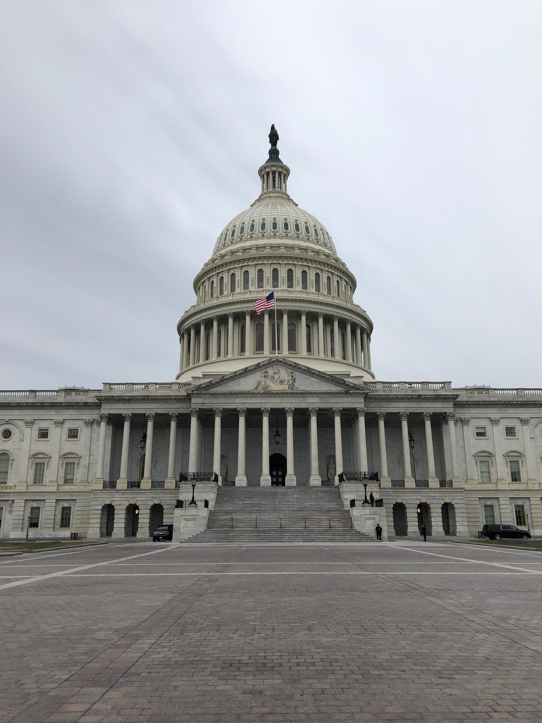
Congressional Outlook

Slide 14
Cook Political Report 2024 House race ratings
2024 HOUSE RACES IN-DEPTH
For more insight on the 2024 House races, visit The Cook Political Report with Amy Walter.
As of September 27, 2023, ratings have been released for all 435 House districts.
Solid Republican
Likely Republican
Lean Republican
Toss Up
Lean Democrat
Likely Democrat
Solid Democrat
SOURCE The Cook Political Report with Amy Walter.
SLIDE LAST UPDATED ON 10/11/23
Notes:
Source:
“2024 House Race Ratings,” The Cook Political Report with Amy Walter, September 27, 2023, https://cookpolitical.com/ratings/house-race-ratings

Slide 15
Cook Political Report 2024 Senate race ratings
2024 SENATE RACES IN-DEPTH
For more insight on the 2024 Senate races, visit The Cook Political Report with Amy Walter.
As of November 9, 2023, ratings have been released for all Senate seats up for election in 2024
Solid Republican
Likely Republican
Lean Republican
Toss Up
Lean Democrat
Likely Democrat
Solid Democrat
Senate seats
Senate majority gained beyond 50 seats
Dem seats not up for reelection (28)
Dem-held seats up for election (23)
GOP-held seats up for election (11)
GOP seats not up for reelection (38)
SOURCE The Cook Political Report with Amy Walter.
SLIDE LAST UPDATED ON 11/20/23
Notes:
Sources:
“2024 Senate Race Ratings,” The Cook Political Report with Amy Walter, updated November 9, 2023, https://www.cookpolitical.com/ratings/senate-race-ratings

Slide 16
Thank You!
Ian Lyle
ian.lyle@nreca.coop
571-369-7904

