Slide 1
2023 Annual Report
Mid-West Electric
Consumers Association
Jim Horan, Executive Director

Slide 2
Mid-West Value
Lobbying
Regulatory Advocacy
Legal Representation
Mid-West advocates on issues important to federal power customers with legislators in 9 states.
Mid-West engages with federal agencies & represents federal power customers on basin restoration efforts.
Mid-West engages in the federal administrative law process on behalf of federal power customers.

Slide 3
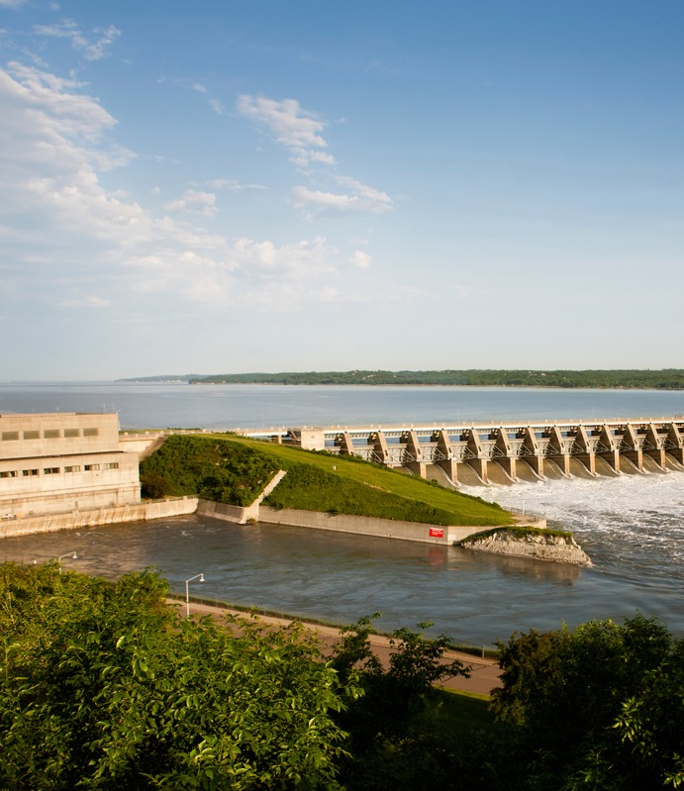
2023 Highlights
Informal WAPA Rate Process
Purchase Power and Wheeling
Federal Funding
Basin Restoration Efforts
Dam Safety Modification Cost

Slide 4
Announced on a Mid-West Call
Informal discussions at least monthly with Mid-West Water and Power Committee.
Meeting with WAPA leadership, finance and rates teams as well as with USBR and USACE.
Informal discussions allow for the greatest direction, feedback, and counsel from customers to the agencies.
WAPA Rate Process

Slide 5
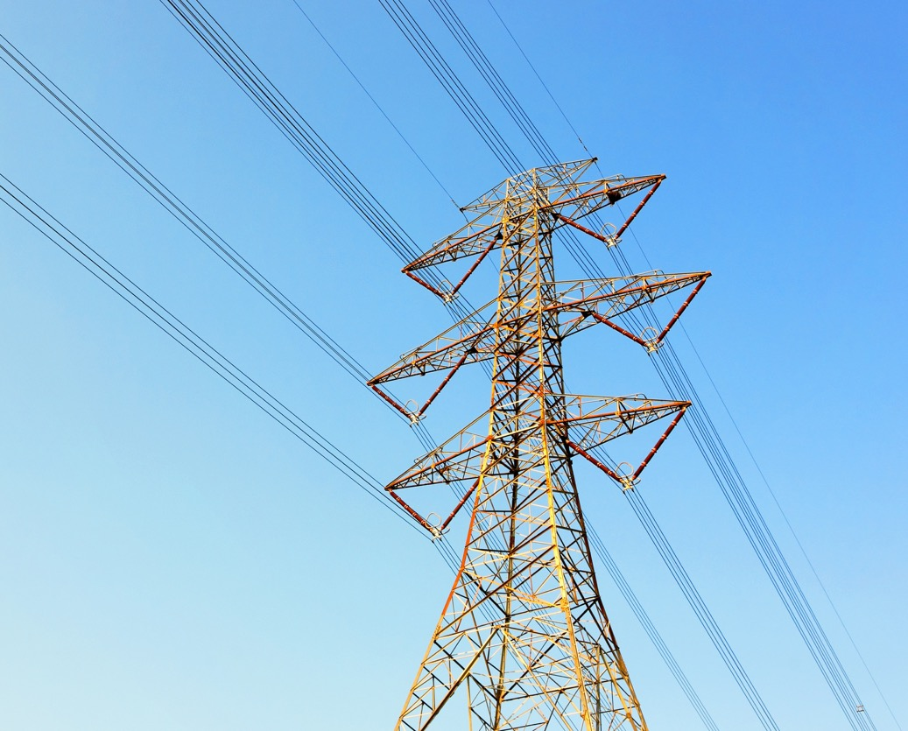
Increased PP&W costs are driving rate increase.
PP&W scoring issues needs to be resolved before significant drought impact.
Mid-West leading the push for a permanent fix.
Short term success and progress with CBO, OMB and Budget Committees
Purchase Power and Wheeling (PP&W)

Slide 6
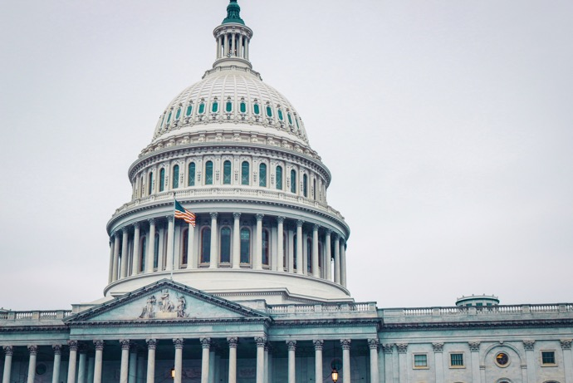
Federal Funding
Pushed USACE leadership on joint cost accounting, dam safety modification cost allocation, and infrastructure spending.
Reduced appropriations strain budgets and challenge customer advanced funding.
Water Resource Development Act (WRDA) and Ear Marks (Congressionally Directed Spending)

Slide 7
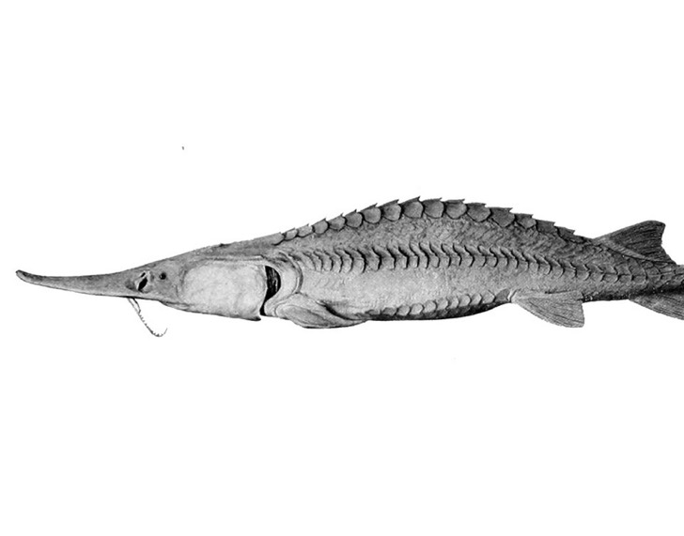
Test Flows
Focused on controlling cost for power customers
Aggregate cumulative impact on region
Continued engagement with USACE and USFWS
Basin Restoration
Sedimentation
Priority at Gavins Point and Lewis and Clark Lake
Not a high enough priority with federal partners
Concern over potential cost share
Missouri River Recovery Implementation Committee
Re-elected Vice-Chair of MRRIC last week.
Value of stakeholder process vs. litigation.
Grand Lake Clarity
Working with Northern Water, WAPA and USBR.
Cost shift and operational concerns.

Slide 8
Dam Safety Modifications
- Garrison spillway modification
Mid-West advocating with Congress and USACE leadership for reduced cost share allocation
Future investments and needs

Slide 9
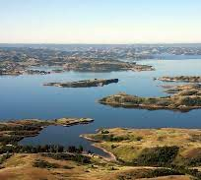
THREATS TO HYDROPOWER
Lower Snake River Dams
Glen Canyon Dam
Externality Costs
Strategically Undermining the Value of Hydropower
Climate Change Arguments
Endangered Species
Methane Emissions from Reservoirs

Slide 10
2024 Priority Resolutions
Federal Power Marketing Administrations
Net Zero Appropriations
Diversion of Federal Power Revenues
Pick-Sloan Rates
Pick-Sloan Ultimate Development
Colorado-Big Thompson Water Quality

Slide 11
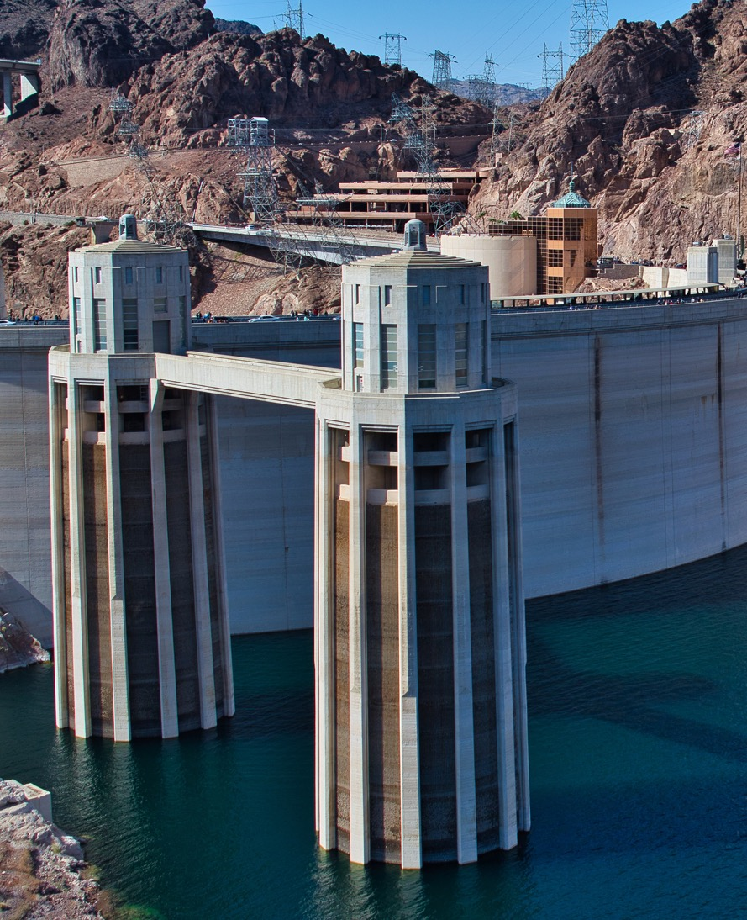
Federal Power Marketing Administrations
Mid-West vigorously opposes the sale of the federal power marketing administrations or divestiture of their power and transmission facilities.
We reaffirm our support for the longstanding congressionally approved standard of cost-based rates for electric power generated at federal projects.
We will work to improve the efficiency of federal power operations, protect the contractual federal power supply rights of its members, and resist any unjustifiable increases in electric rates to the ultimate consumers.

Slide 12
Net Zero Appropriations
Mid-West Electric Consumers Association (Mid-West) supports the Congressional budget scoring that allows a “net zero” appropriation for the annual expenses of the Western Area Power Administration (WAPA).
MID-WEST ELECTRIC CONSUMERS ASSOCIATION

Slide 13
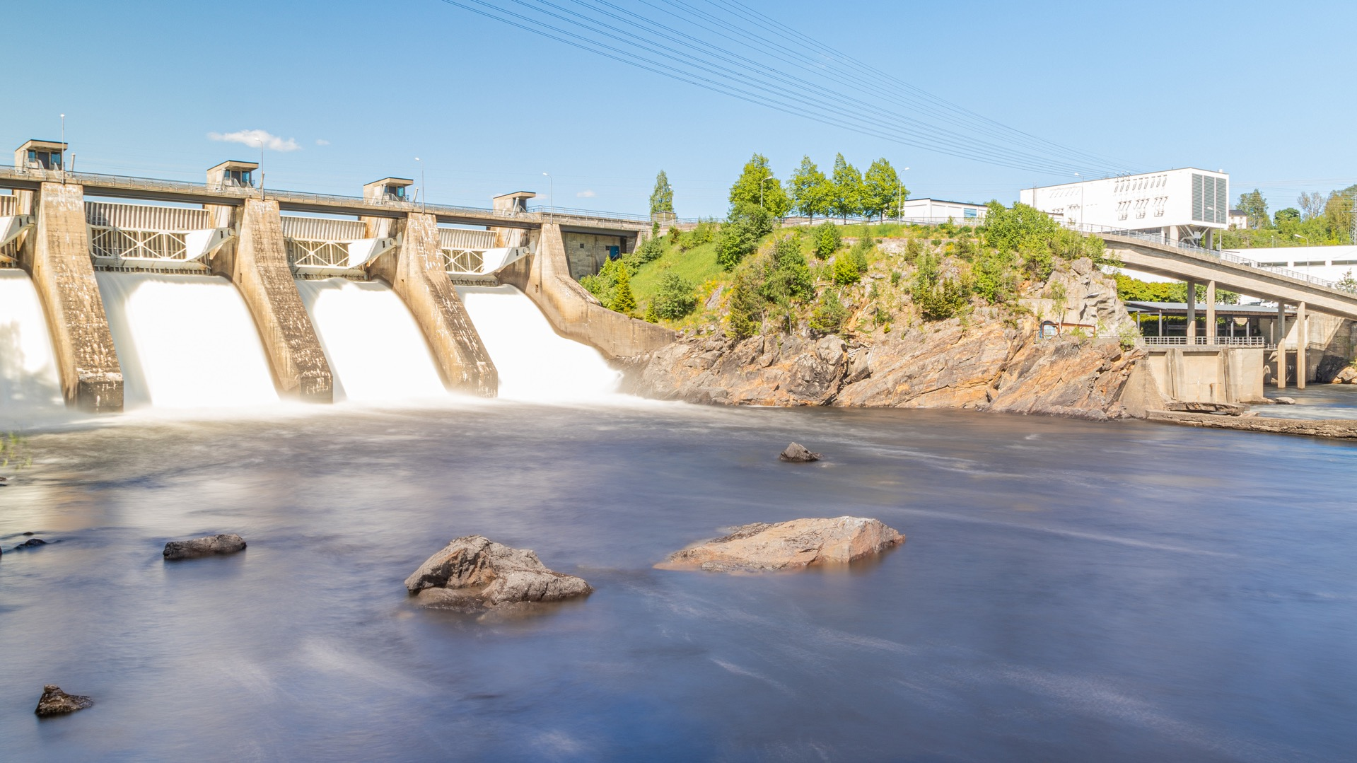
Diversion of Federal Power Revenues
Mid-West urges Congress and the Executive Branch to adhere to principles and policies of federal law governing designation of project uses, allocation of costs and irrigation assistance repayment for existing and future federal projects

Slide 14
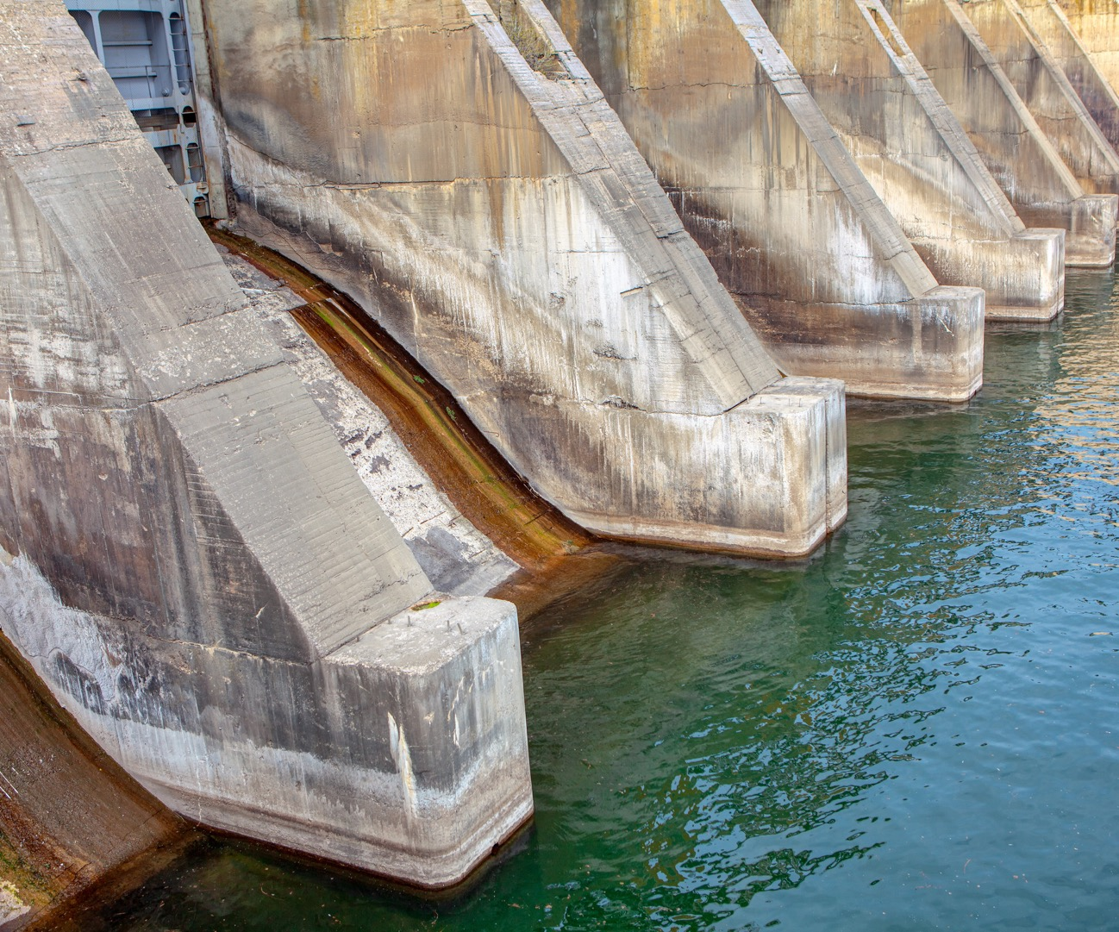
Pick-Sloan Rates
Mid-West supports collaborative efforts between the federal power customers, the Western Area Power Administration, the Corps of Engineers, and the Bureau of Reclamation to provide timely and standardized financial reports. We also support setting Pick-Sloan hydroelectric rates at levels sufficient to assure repayment of responsibilities to the U.S. Treasury and payment of appropriate annual operating expenses while recognizing the long-term effects of varying hydrologic conditions. We urge each of the federal agencies that are funded from Pick-Sloan revenues to aggressively pursue cost containment strategies.

Slide 15
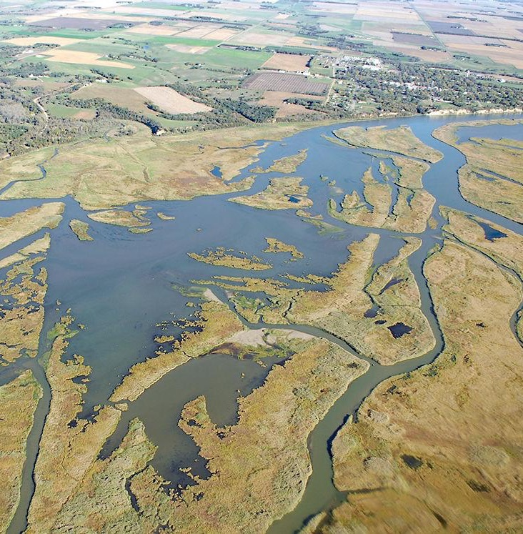
Pick Sloan Ultimate Development
Mid-West is committed to the regional benefits and cost-sharing of the “ultimate development” concept defined by the Pick-Sloan Missouri Basin Program (Pick-Sloan), including cost-based hydroelectric rates, and federal control, ownership and marketing of hydroelectricity according to preference laws.
Mid-West opposes any proposal to “cherry pick” repayment of the Pick-Sloan investment through reallocation of irrigation costs to power customers and insists that Congress continue to honor the “ultimate development” concept cost allocations by resisting all suggestions that portions of the federal investment be repaid before they are scheduled.

Slide 16
Mid-West calls upon the U.S. Bureau of Reclamation to accurately assess the impacts of lost hydroelectric generation from the Colorado-Big Thompson Project (C-BT), including the potential increases in carbon dioxide output resulting from replacing that lost C-BT generation, and to reject alternatives for increasing the clarity of Grand Lake that could result in the reduction of electric generating capacity from the C-BT Project.
Colorado-Big Thompson Water Clarity

Slide 17
WE NEED YOUR ENGAGEMENT
JOIN A COMMITTEE
ENGAGE
GIVE US FEEDBACK
Water and Power
&
Resolutions
Invitations Welcome
Ask Questions
Promote Mid-West Issues
What info do you need?
What issues should we focus on?
What do you like/dislike about the Annual Meeting?

Slide 18
Join me in thanking
ROSALIE HATHAWAY
&
BOB GALE

Slide 19
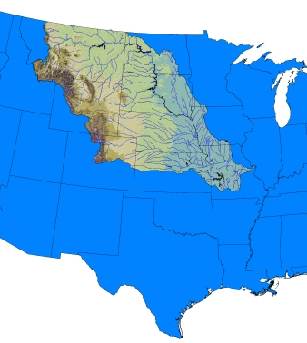
Thank you!
Jim Horan
jimbhoran@meconsumers.com
Cell: 303-748-3170
We hope to see you all next year!

