Slide 1

Interest Rates and Economic Outlook
December 2023

Slide 2
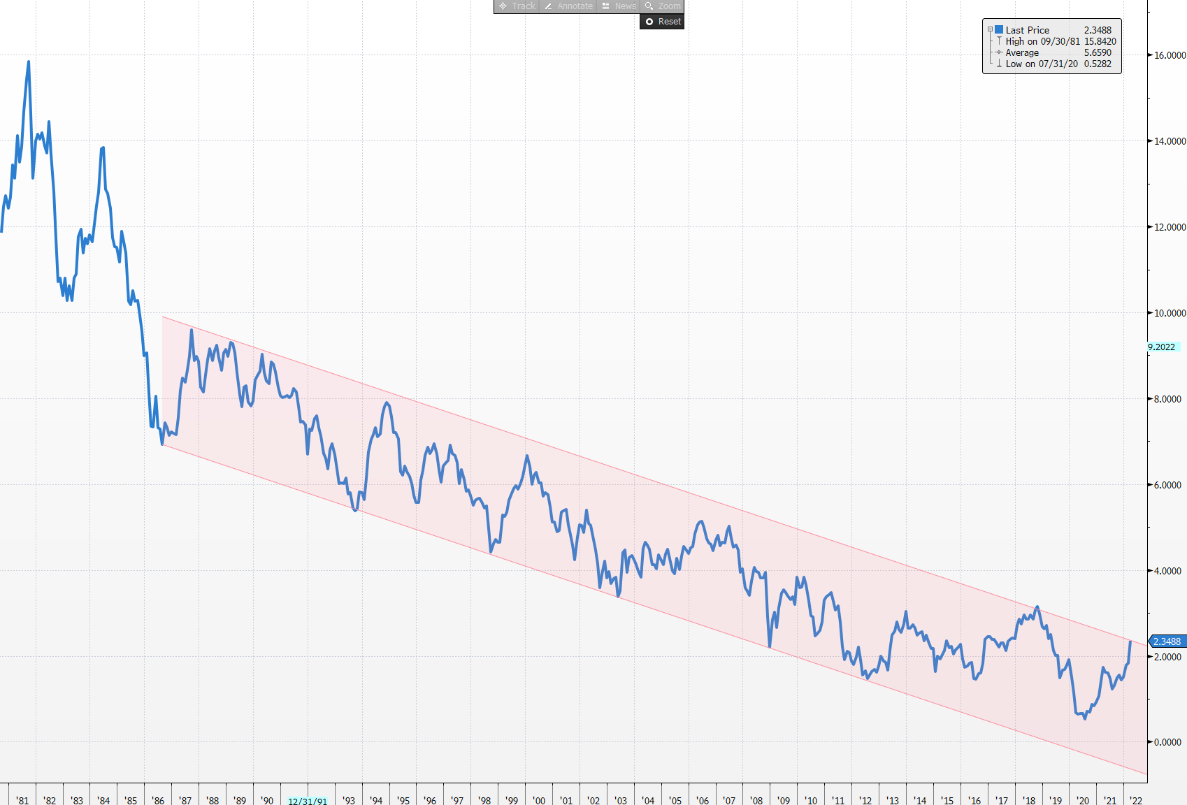
Four Decade Long Secular Bond Bull Market
10 Year Treasury Yield
Volker beats inflation
Fiscal Discipline
Globalization / Exodus of Manufacturing from the USA
Cold War ends
Budget Surplus
Great Financial Crisis
Period of Free Money
Reagan fires striking air traffic controllers
China joins WTO
PANDEMIC

Slide 3
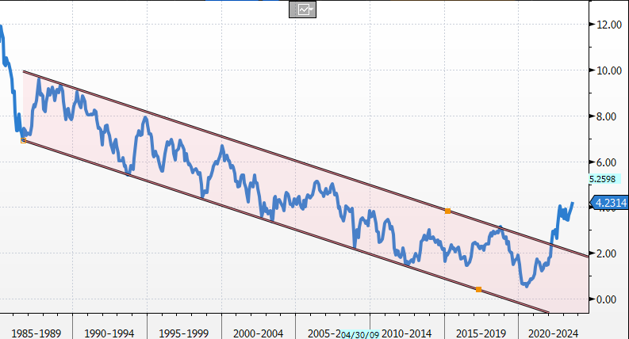
A Shift in Secular Trend?
Past is Prologue ?

Slide 4
Past is Prologue
Cold War 2.0
Bargaining power shifting to workers
Deglobalization / Near-Shoring / Slow-balization / Friend-Shoring
Inflation is back – Globally
Free money policies are ending
Fiscal Situation is a mess – Deficits galore

Slide 5
Current Economic Situation

Slide 6
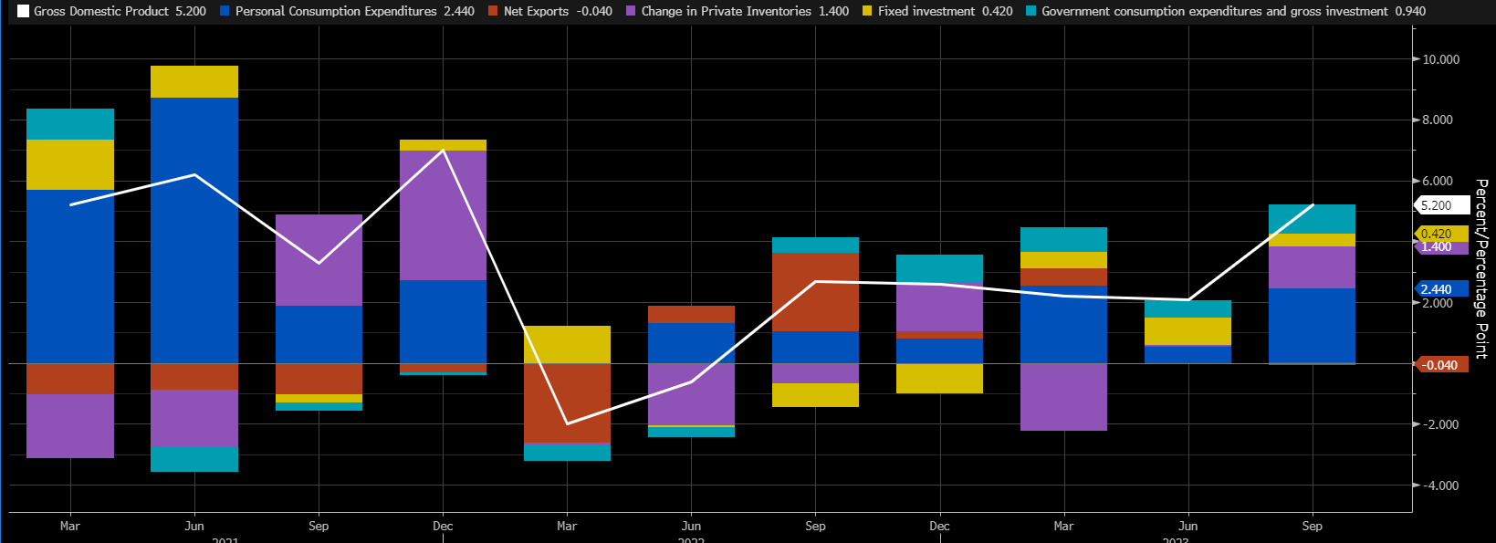


GDP
5.2%

Slide 7
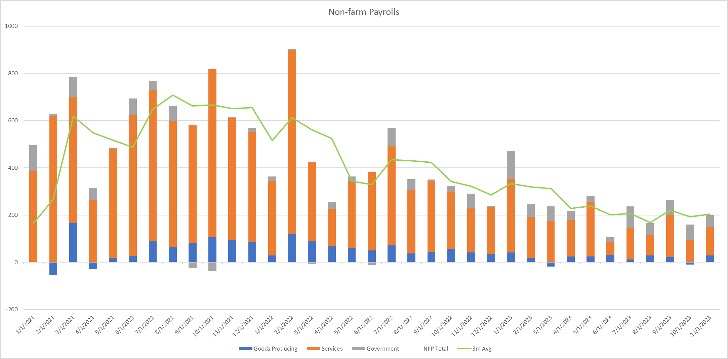
Employment

Slide 8
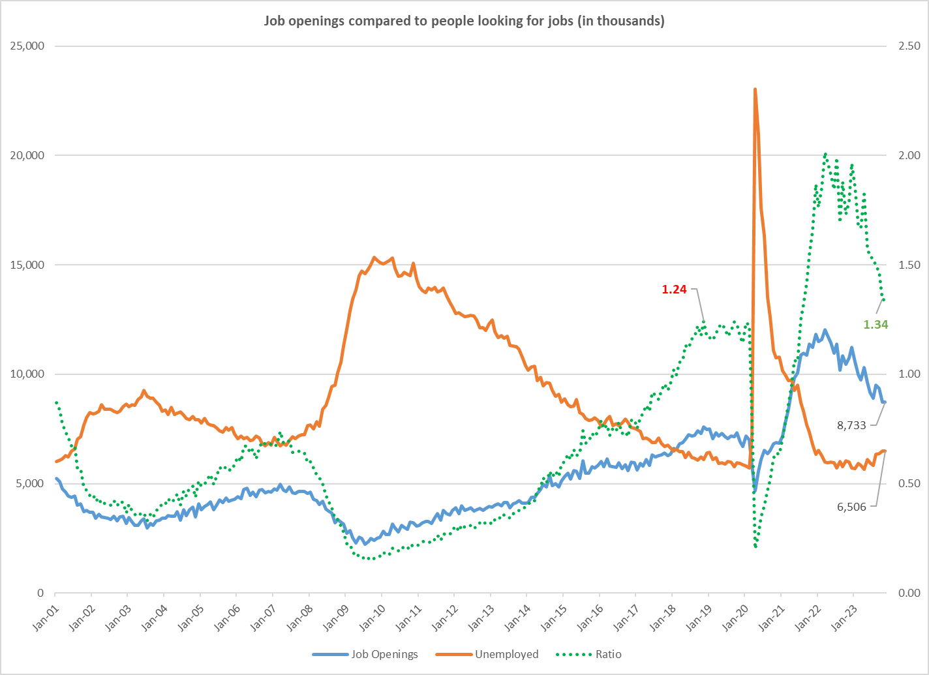
Labor Market Continues to Equilibrate

Slide 9
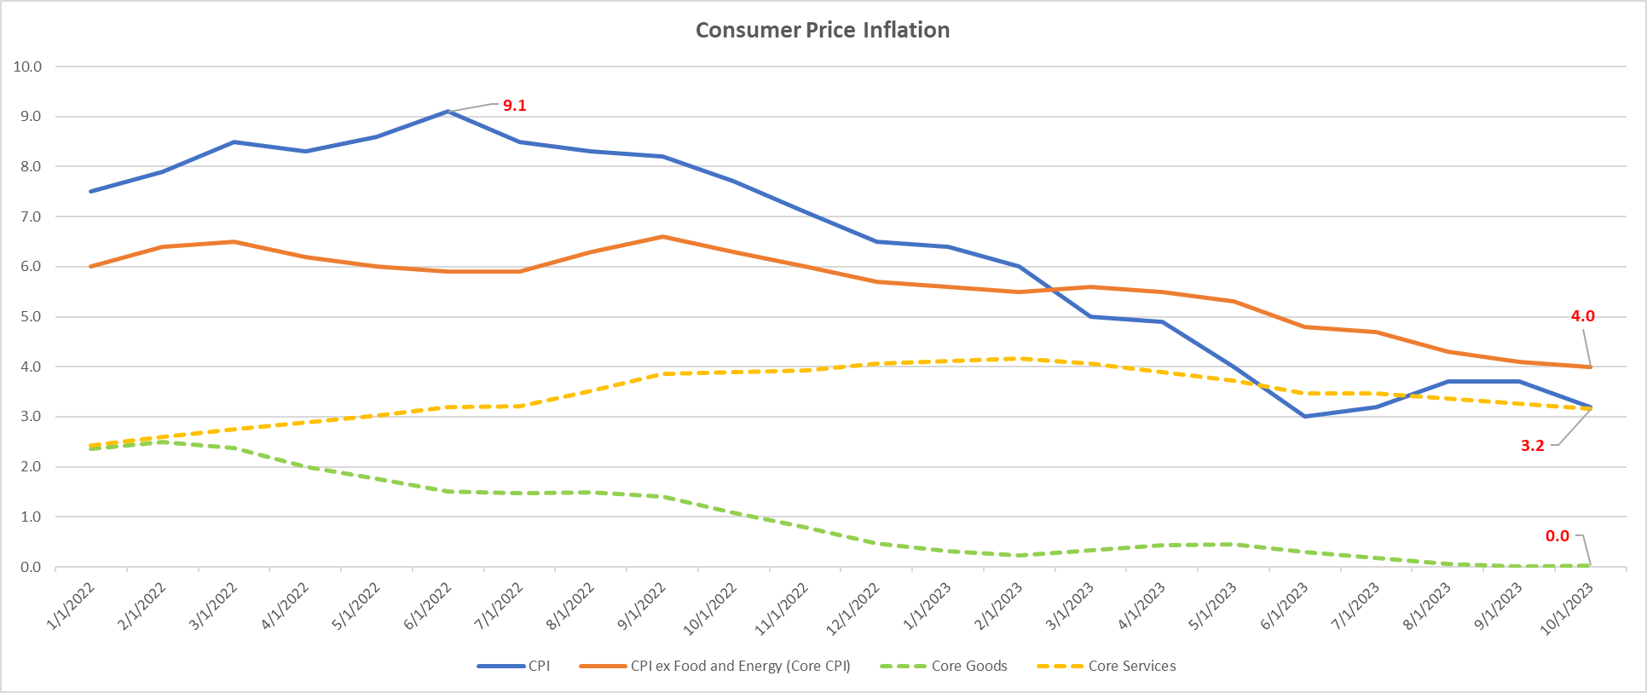
Inflation is Moderating

Slide 10
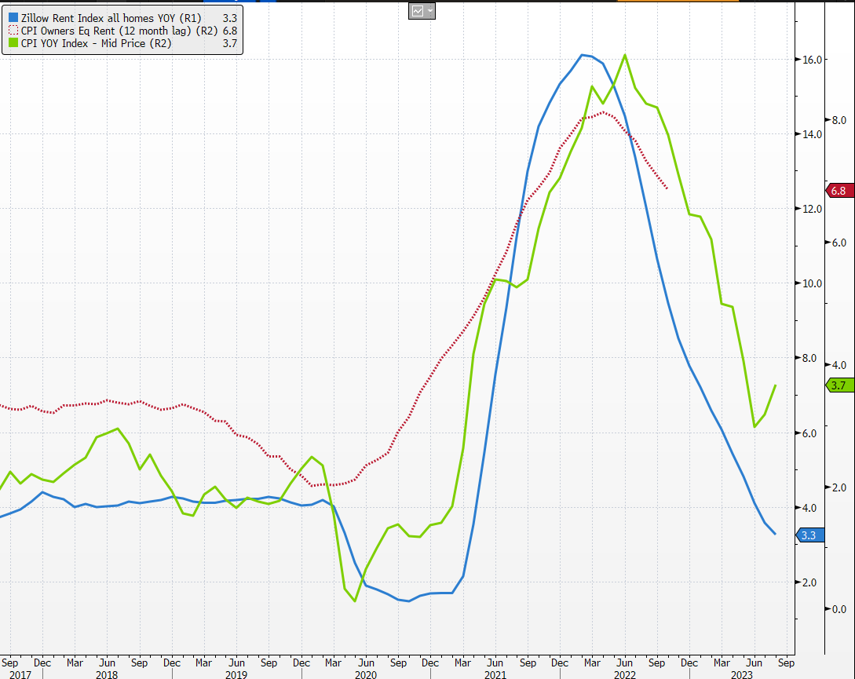
CPI – Disinflation in the pipeline
CPI YOY
CPI OER
(12 month lag)
Zillow Rent Index

Slide 11
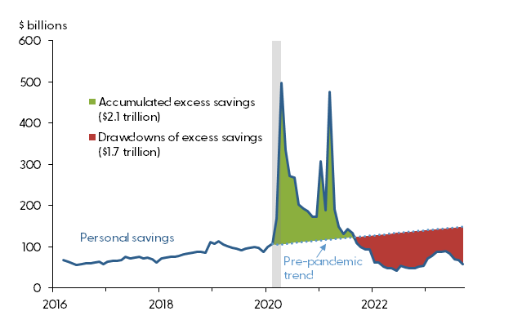
Consumer Savings Running Off

Slide 12
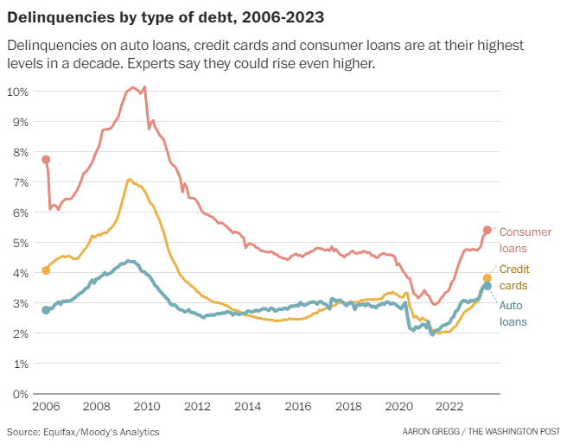
Delinquencies Picking Up

Slide 13
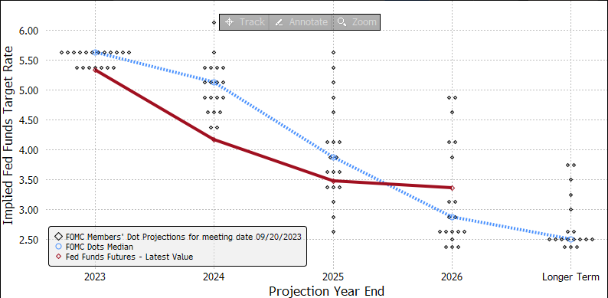
Monetary Policy – Markets Expecting Rate Cuts

Slide 14
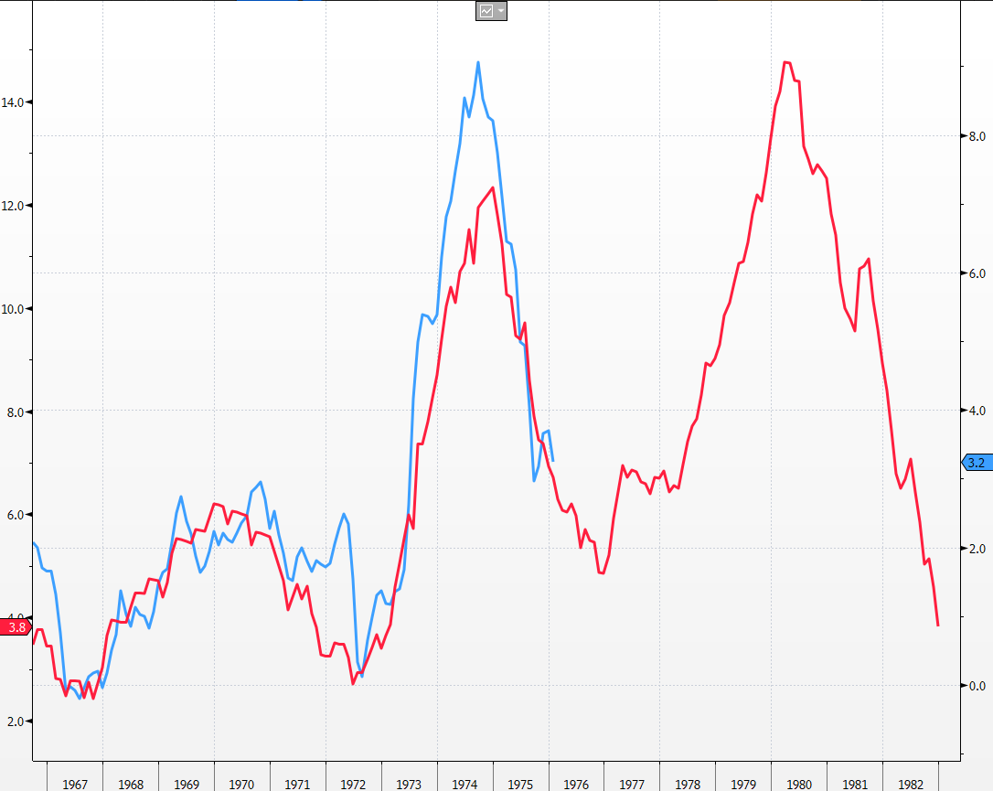
Lesson of the 60s/70s

Slide 15
Structural Challenges

Slide 16
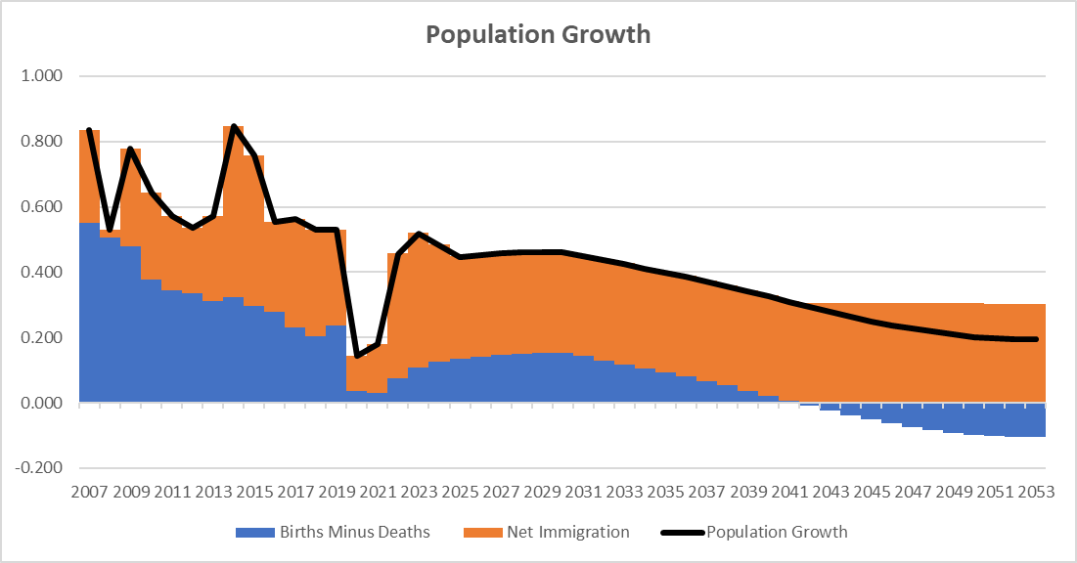
Demographics
Deaths exceed births in 2042

Slide 17
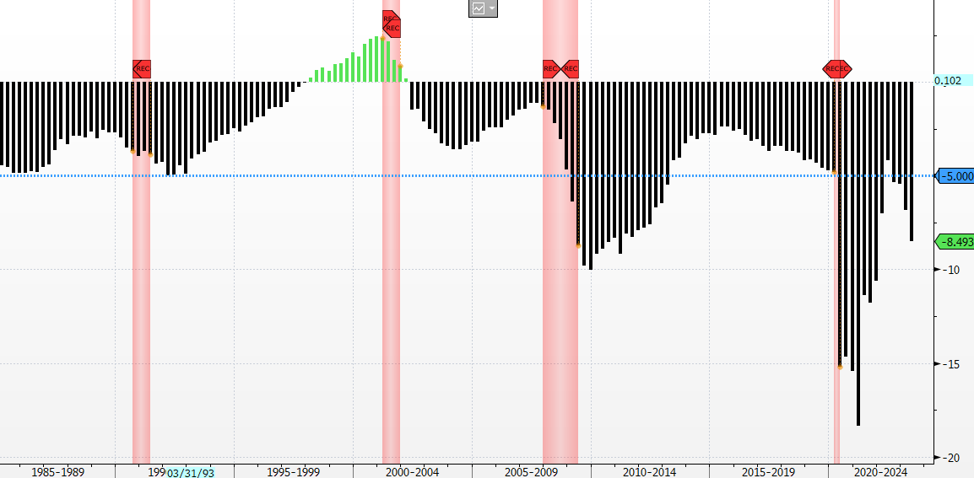
Deficits
- Recession

Slide 18
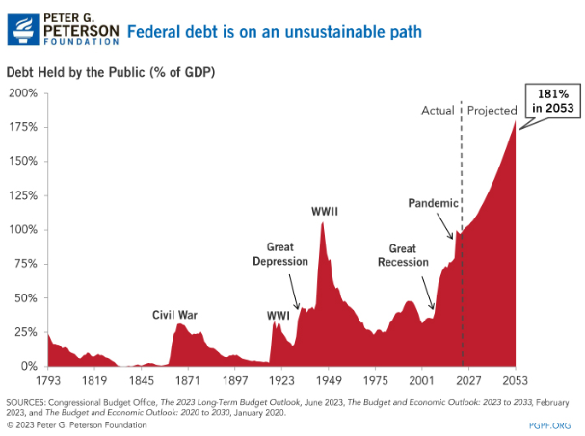
Fiscal Situation

Slide 19
Outlook for Interest Rates

Slide 20
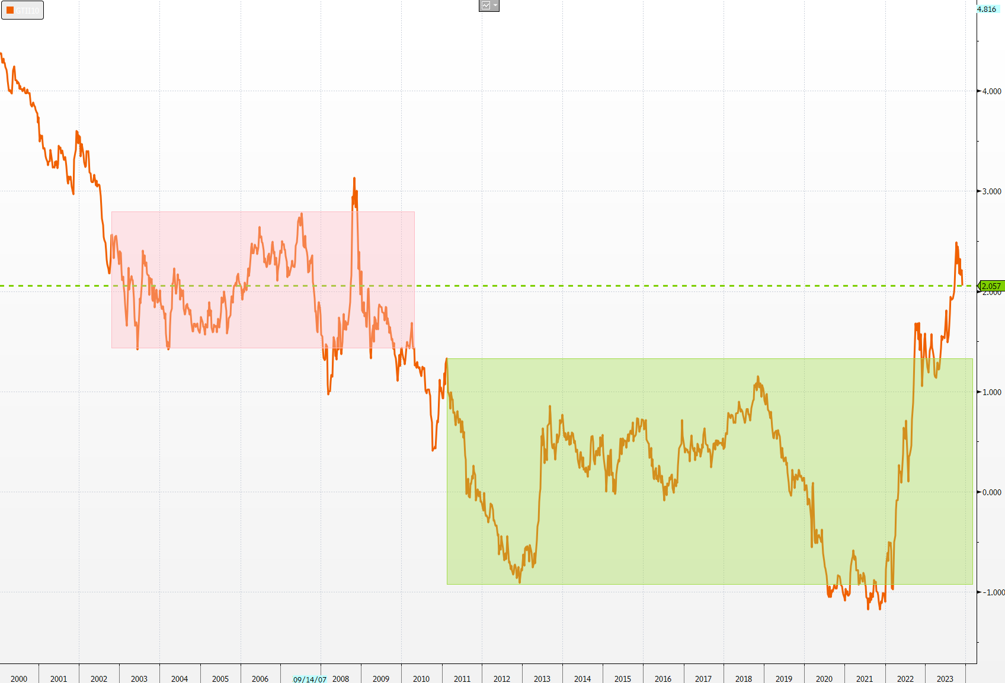
Real Yields – 10 Years

Slide 21
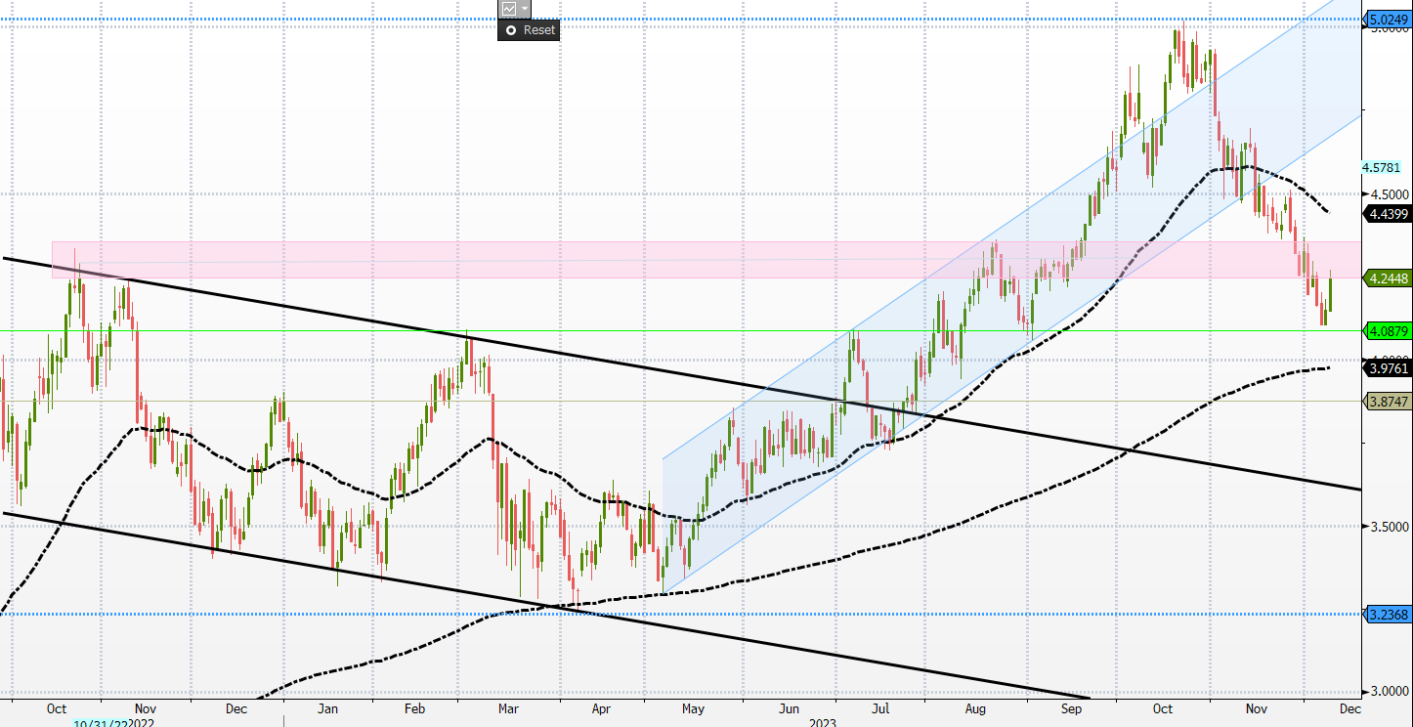
10 Year Treasury Yields
5.02%
4.44%
4.25%/4.35%
3.97%

Slide 22
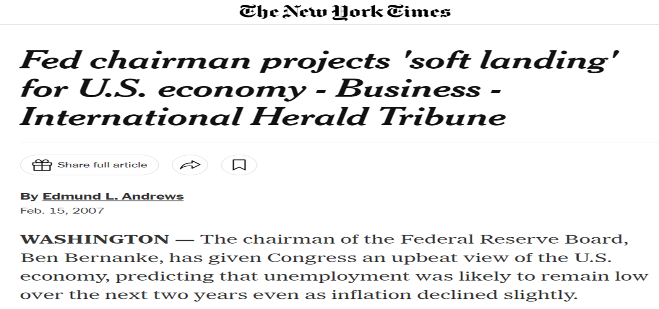
Questions?

