Slide 1
Upper Great Plains Regional Update
Lloyd A. Linke
SVP and UGP Regional Manager
Midwest Electric Consumers Association
Annual Meeting – December 12, 2023

Slide 2
Agenda
Rate
Purchases and Sales
Water
Maintenance Items

Slide 3
Potential Rate Increase
Final Pick-Sloan Power Repayment Study in early CY 24
Generation forecasts
Initial snowpack info
FY23 Financial document
Current work plans
WAPA O&M 31% of Power Repayment Study annual expenses
Labor and support contracts 20% of PRS annual expenses
Aid to Irrigation
Studying different repayment strategies

Slide 4
SPP Purchases and Sales
Final FY23 purchases exceed sales by $54.1 million
FY22 it was $61.4 million
As of the end of November sales exceed purchases by $4 million
At this time in FY23 purchases exceeded sales by $4 million

Slide 5
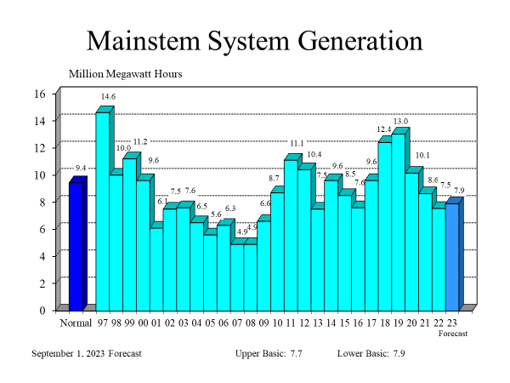
Mainstem System Generation

Slide 6
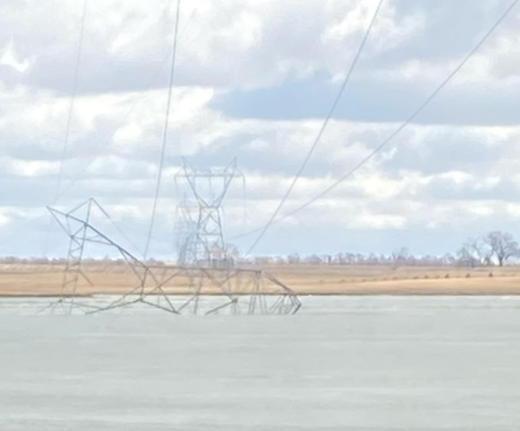
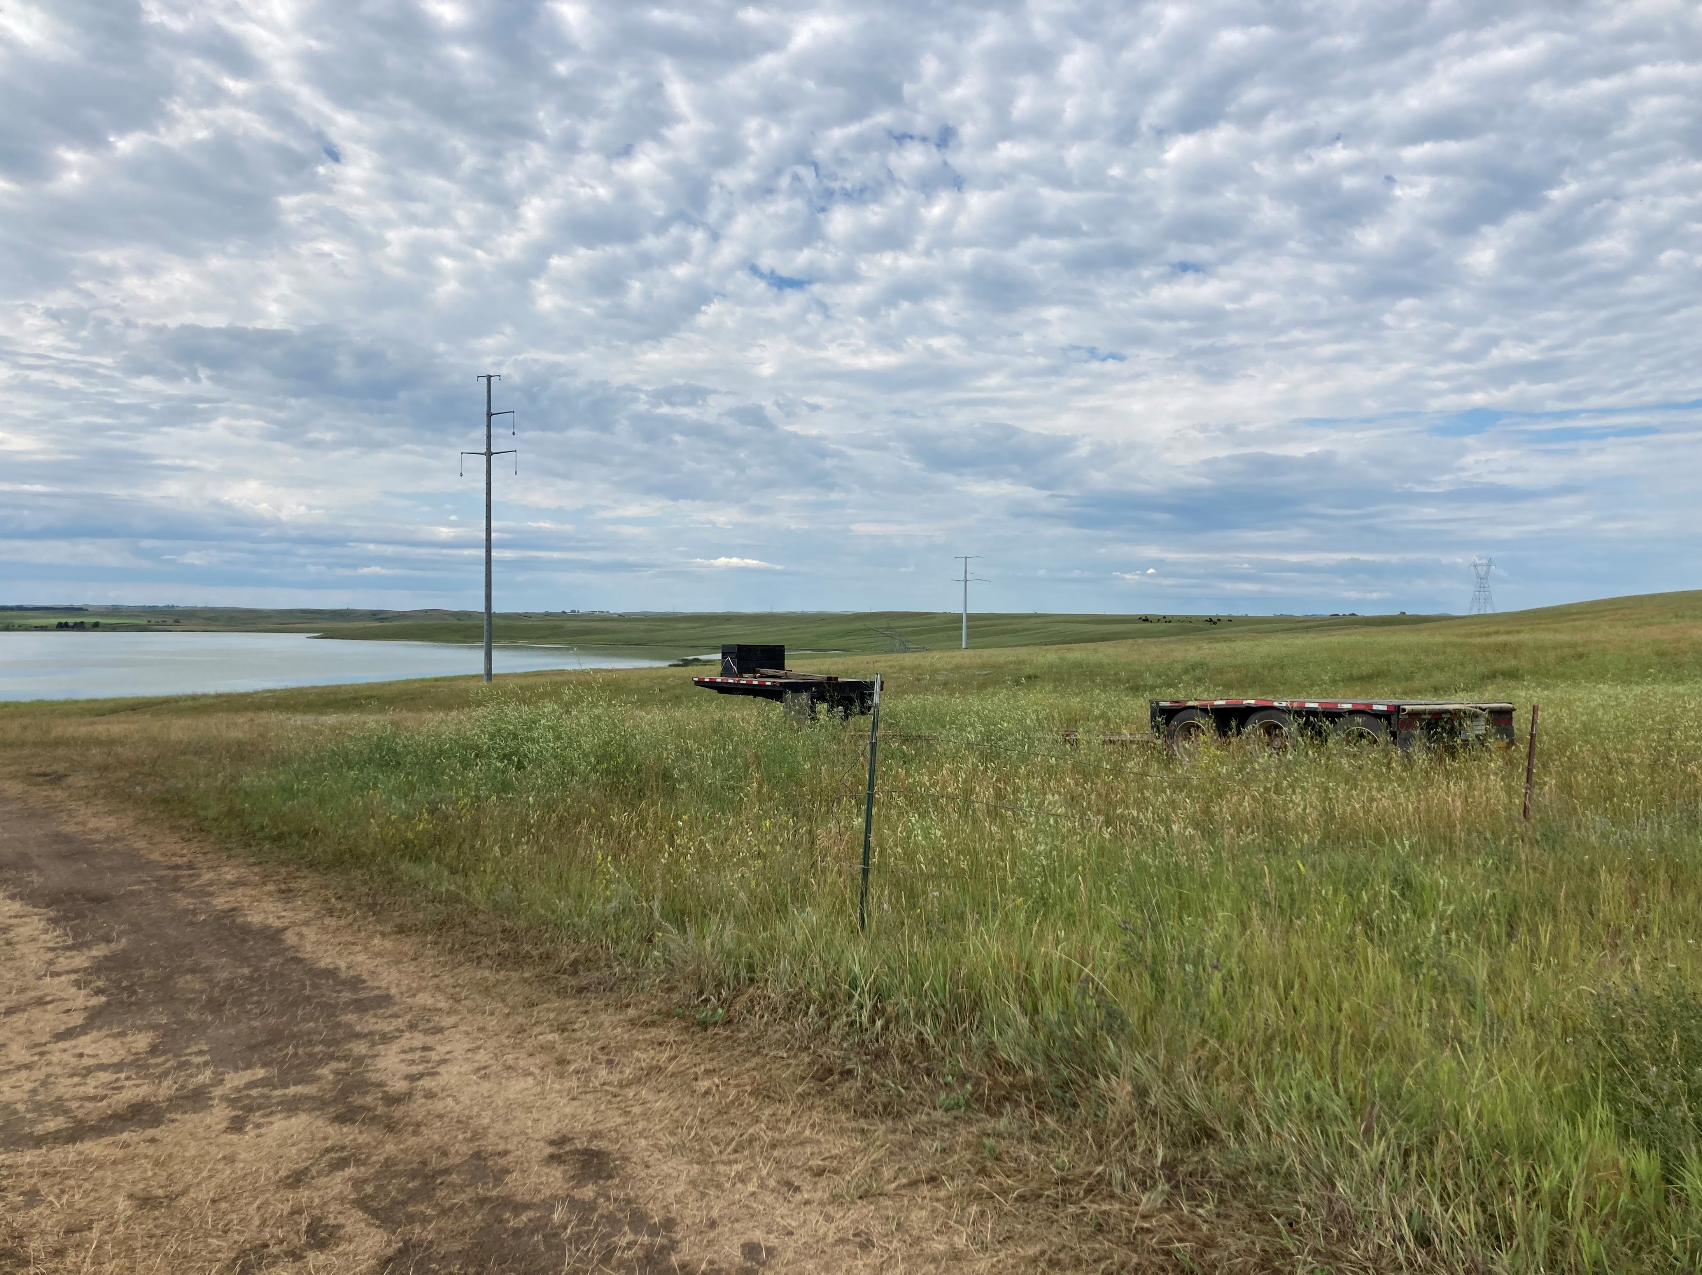
Other Water Issues
In spring of 2022 we had a steel lattice structure on BS-JT #2 fail due to ice
Completed reroute this year

Slide 7
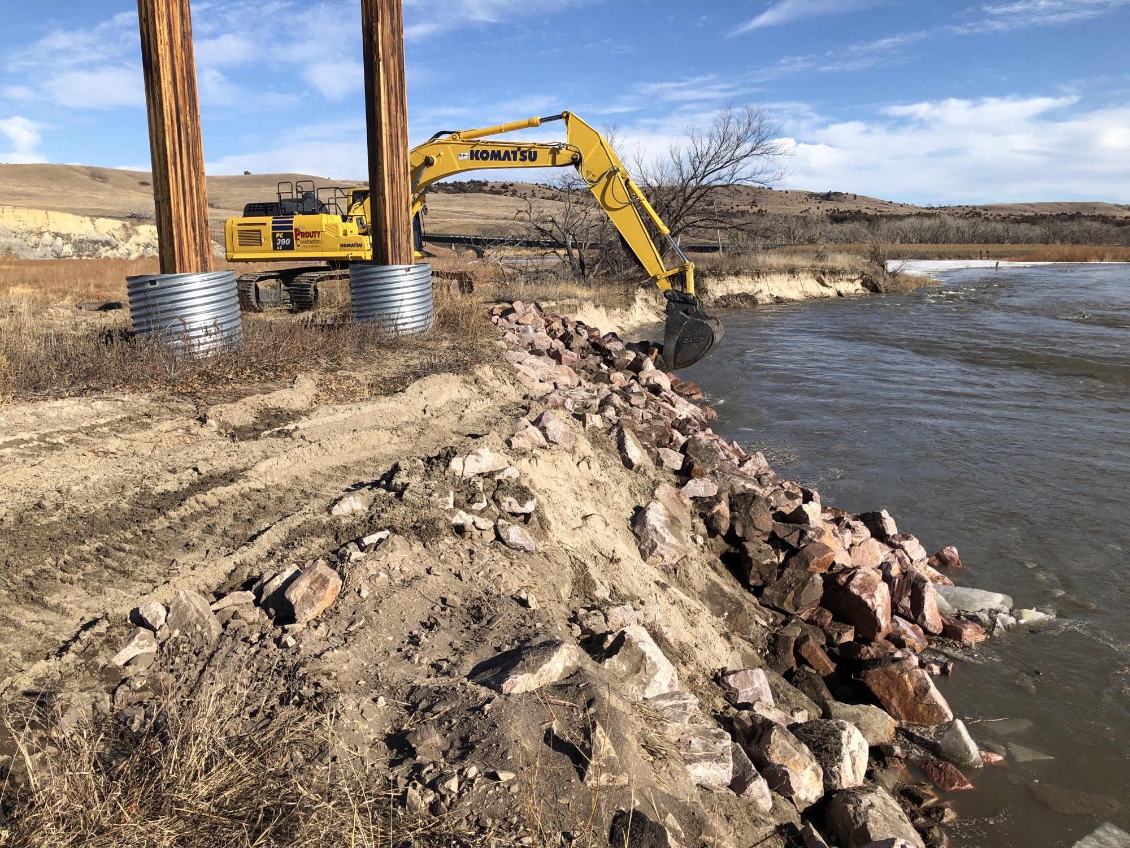
Additional Water Issues
Continued erosion issues on the Niobrara River in Nebraska

Slide 8
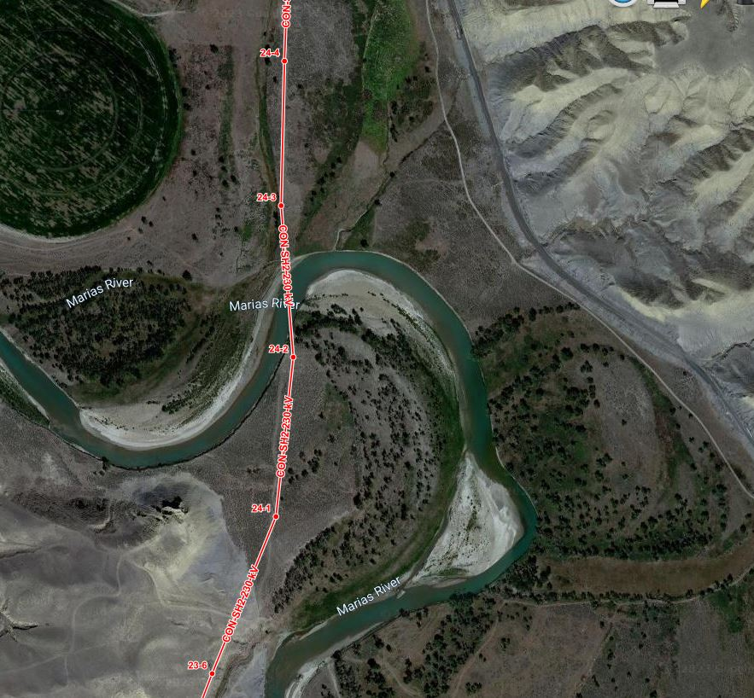
More Water Issues
Marias River Encroachment Shelby 2 to Conrad 230-kV line. Working Bureau of reclamation on reroute location.

Slide 9
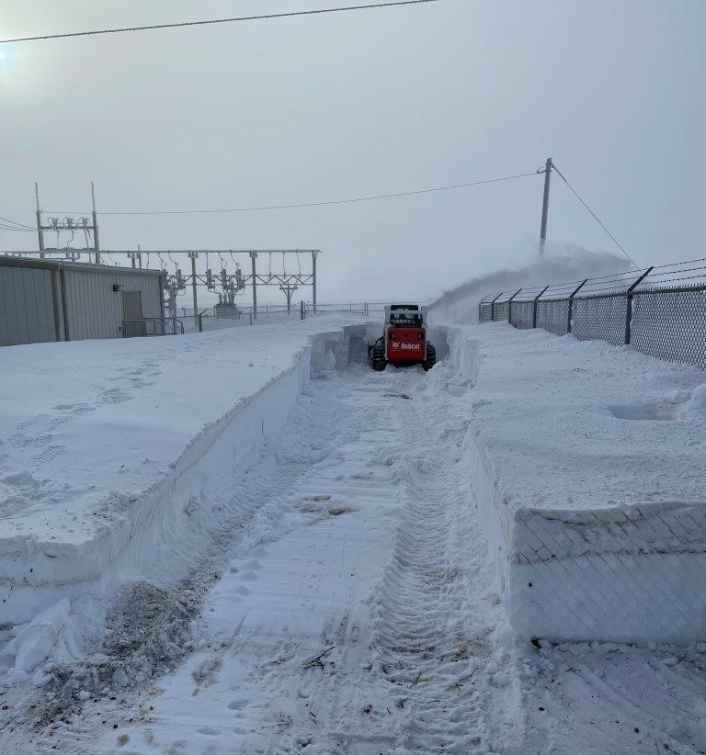
Different Kind of Water Issue
Snow levels at our Custer Trail Substation in North Dakota

Slide 10
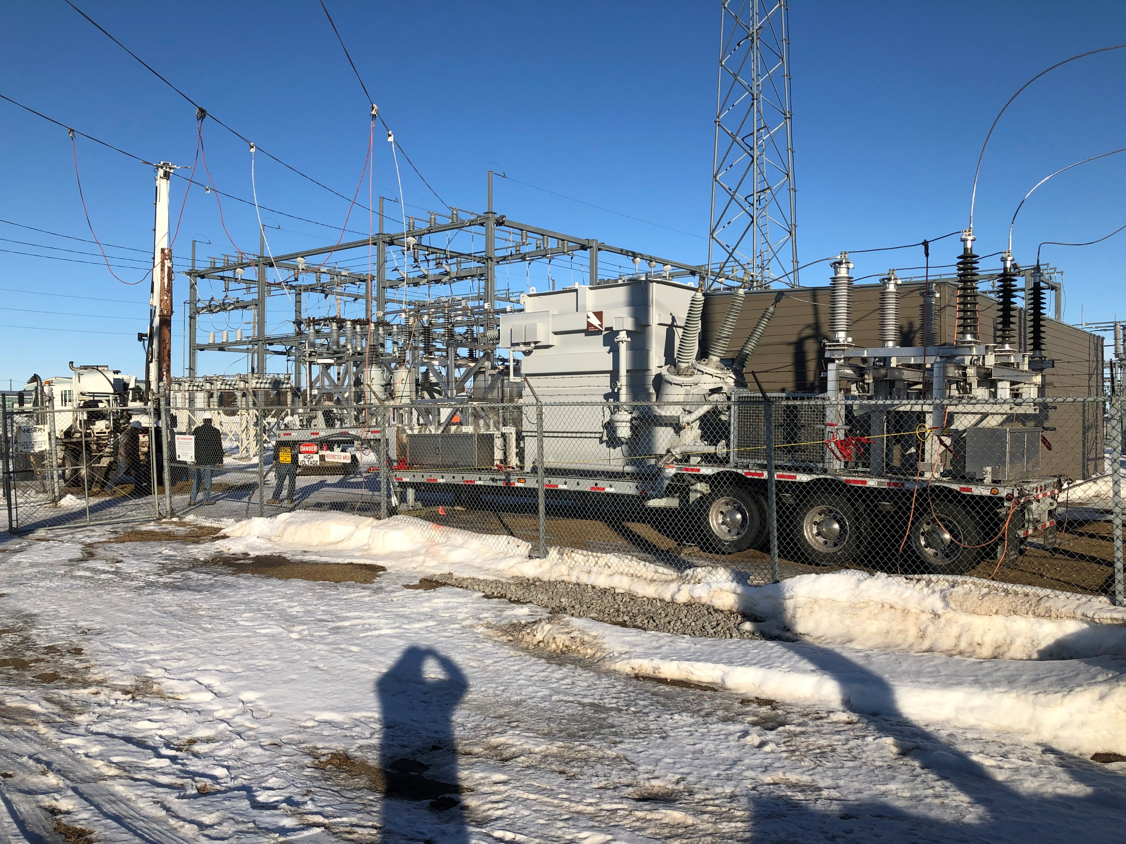
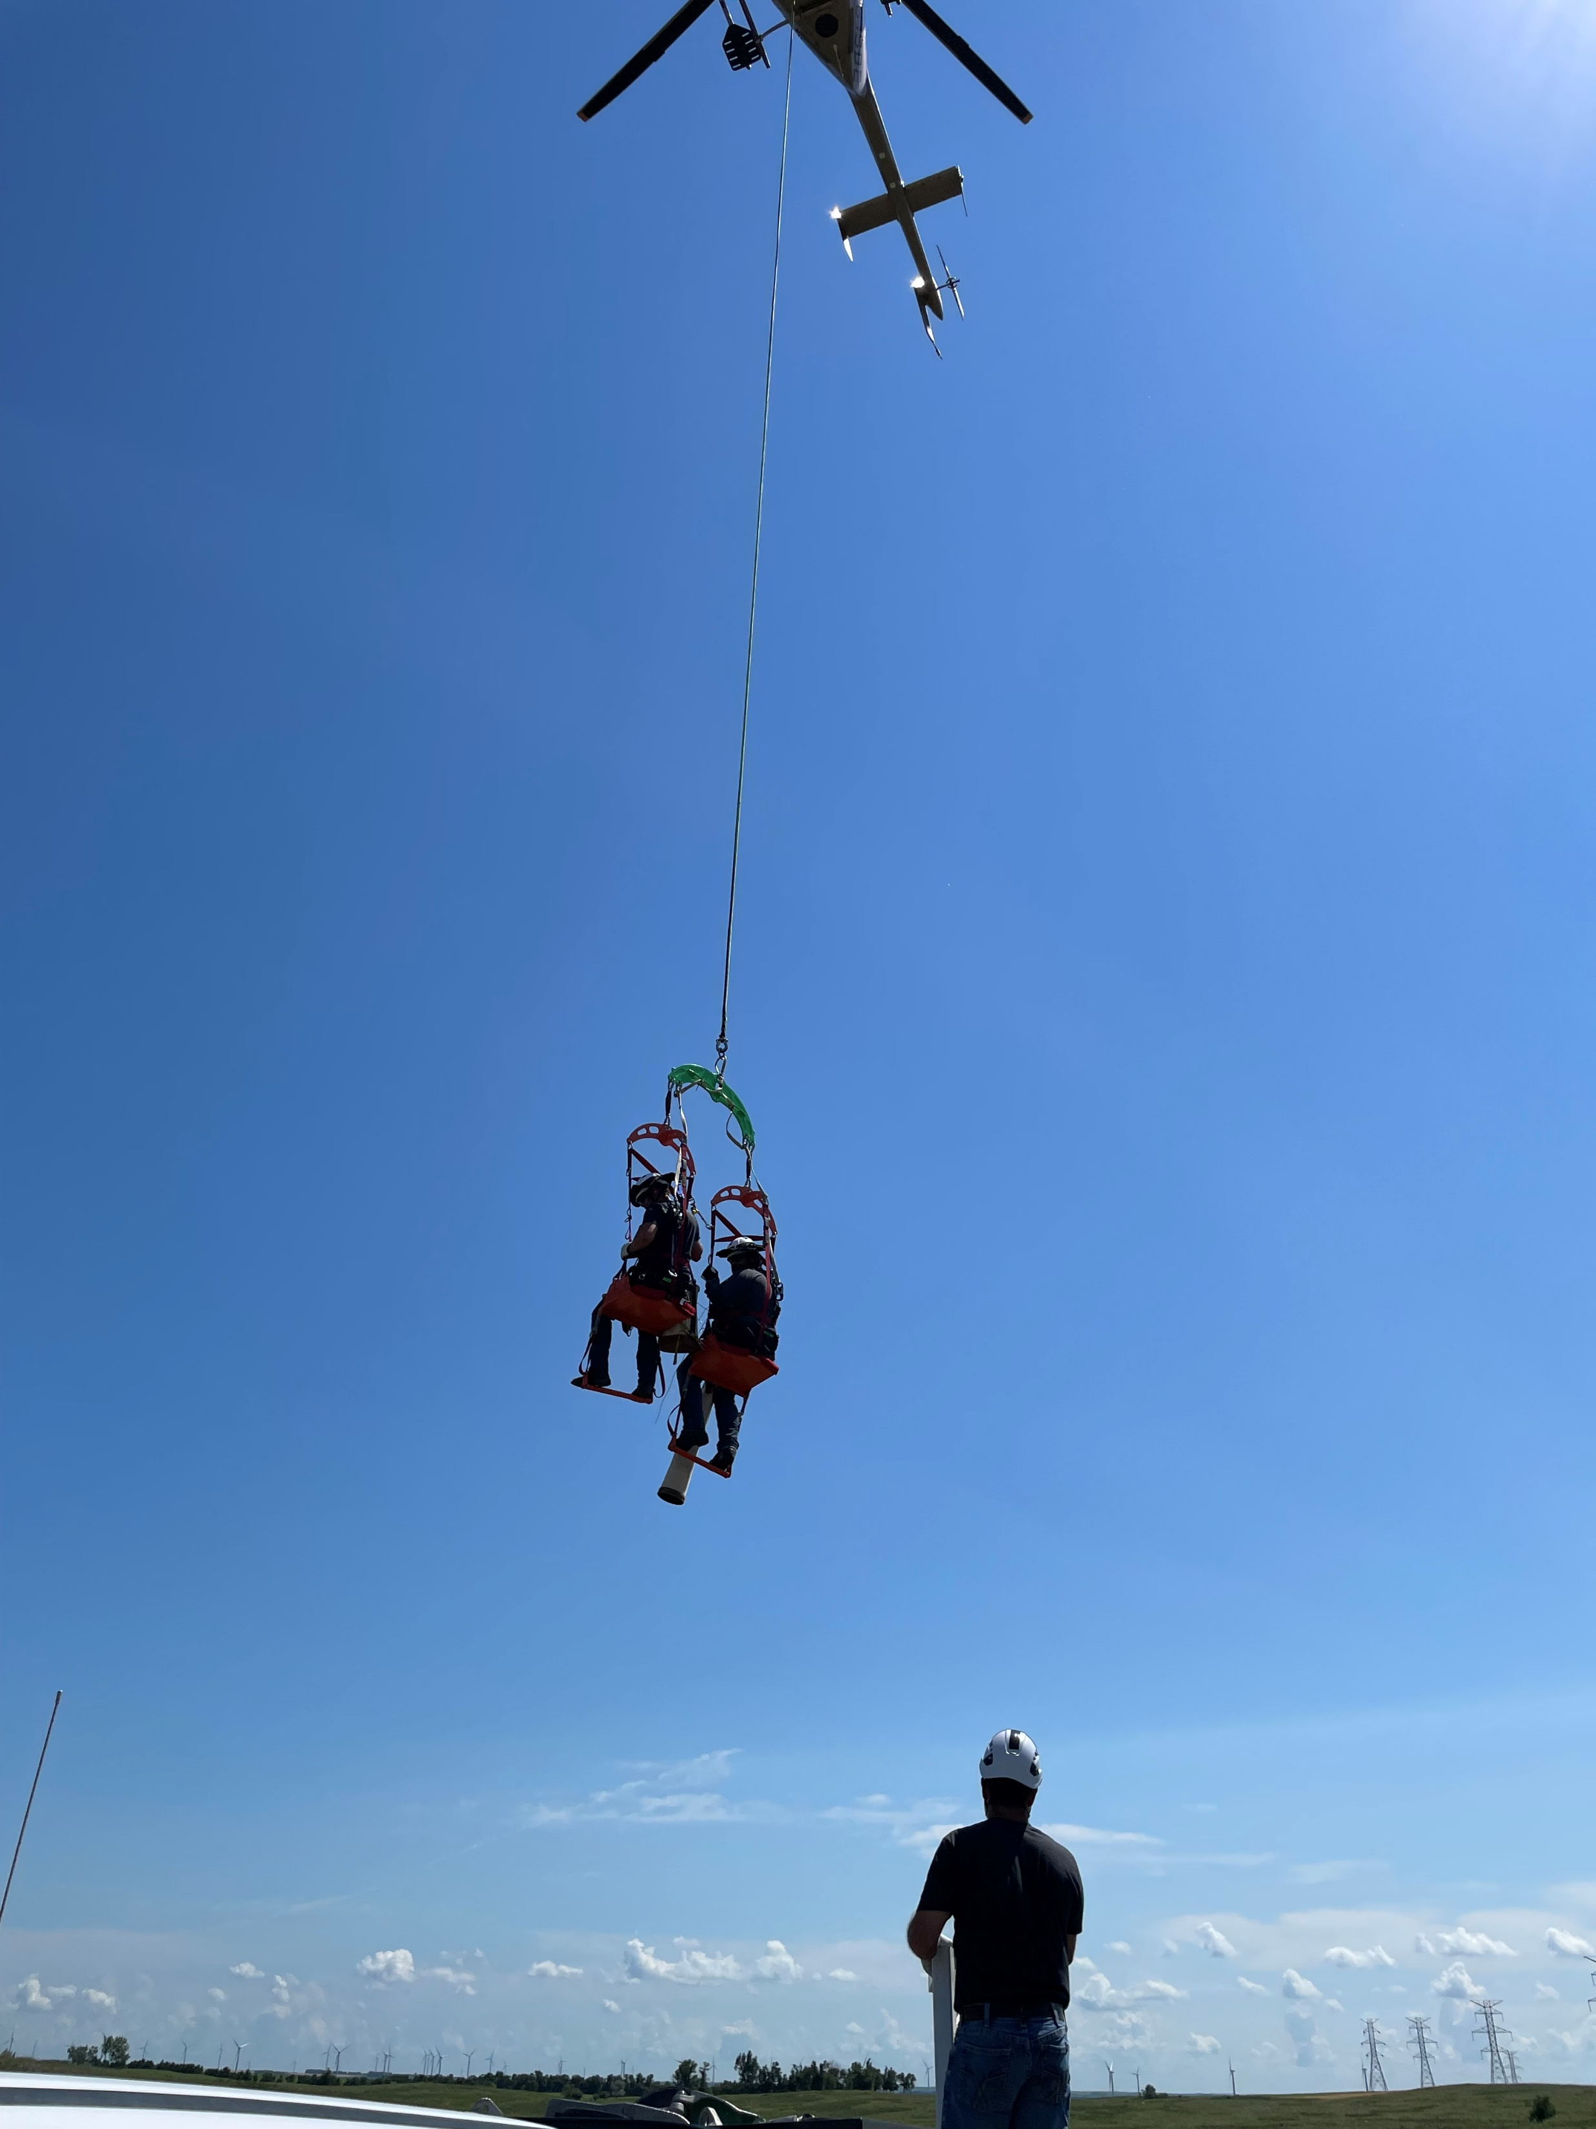
Normal Maintenance Activities ????????
Carrington mobile transformer install after a failure this last year and upcoming commissioning of a new transformer.
Expansion of Human External Cargo (HEC) work to including working on the complete replacement of dampers on the Belfield to Charlie Creek transmission line.

Slide 11
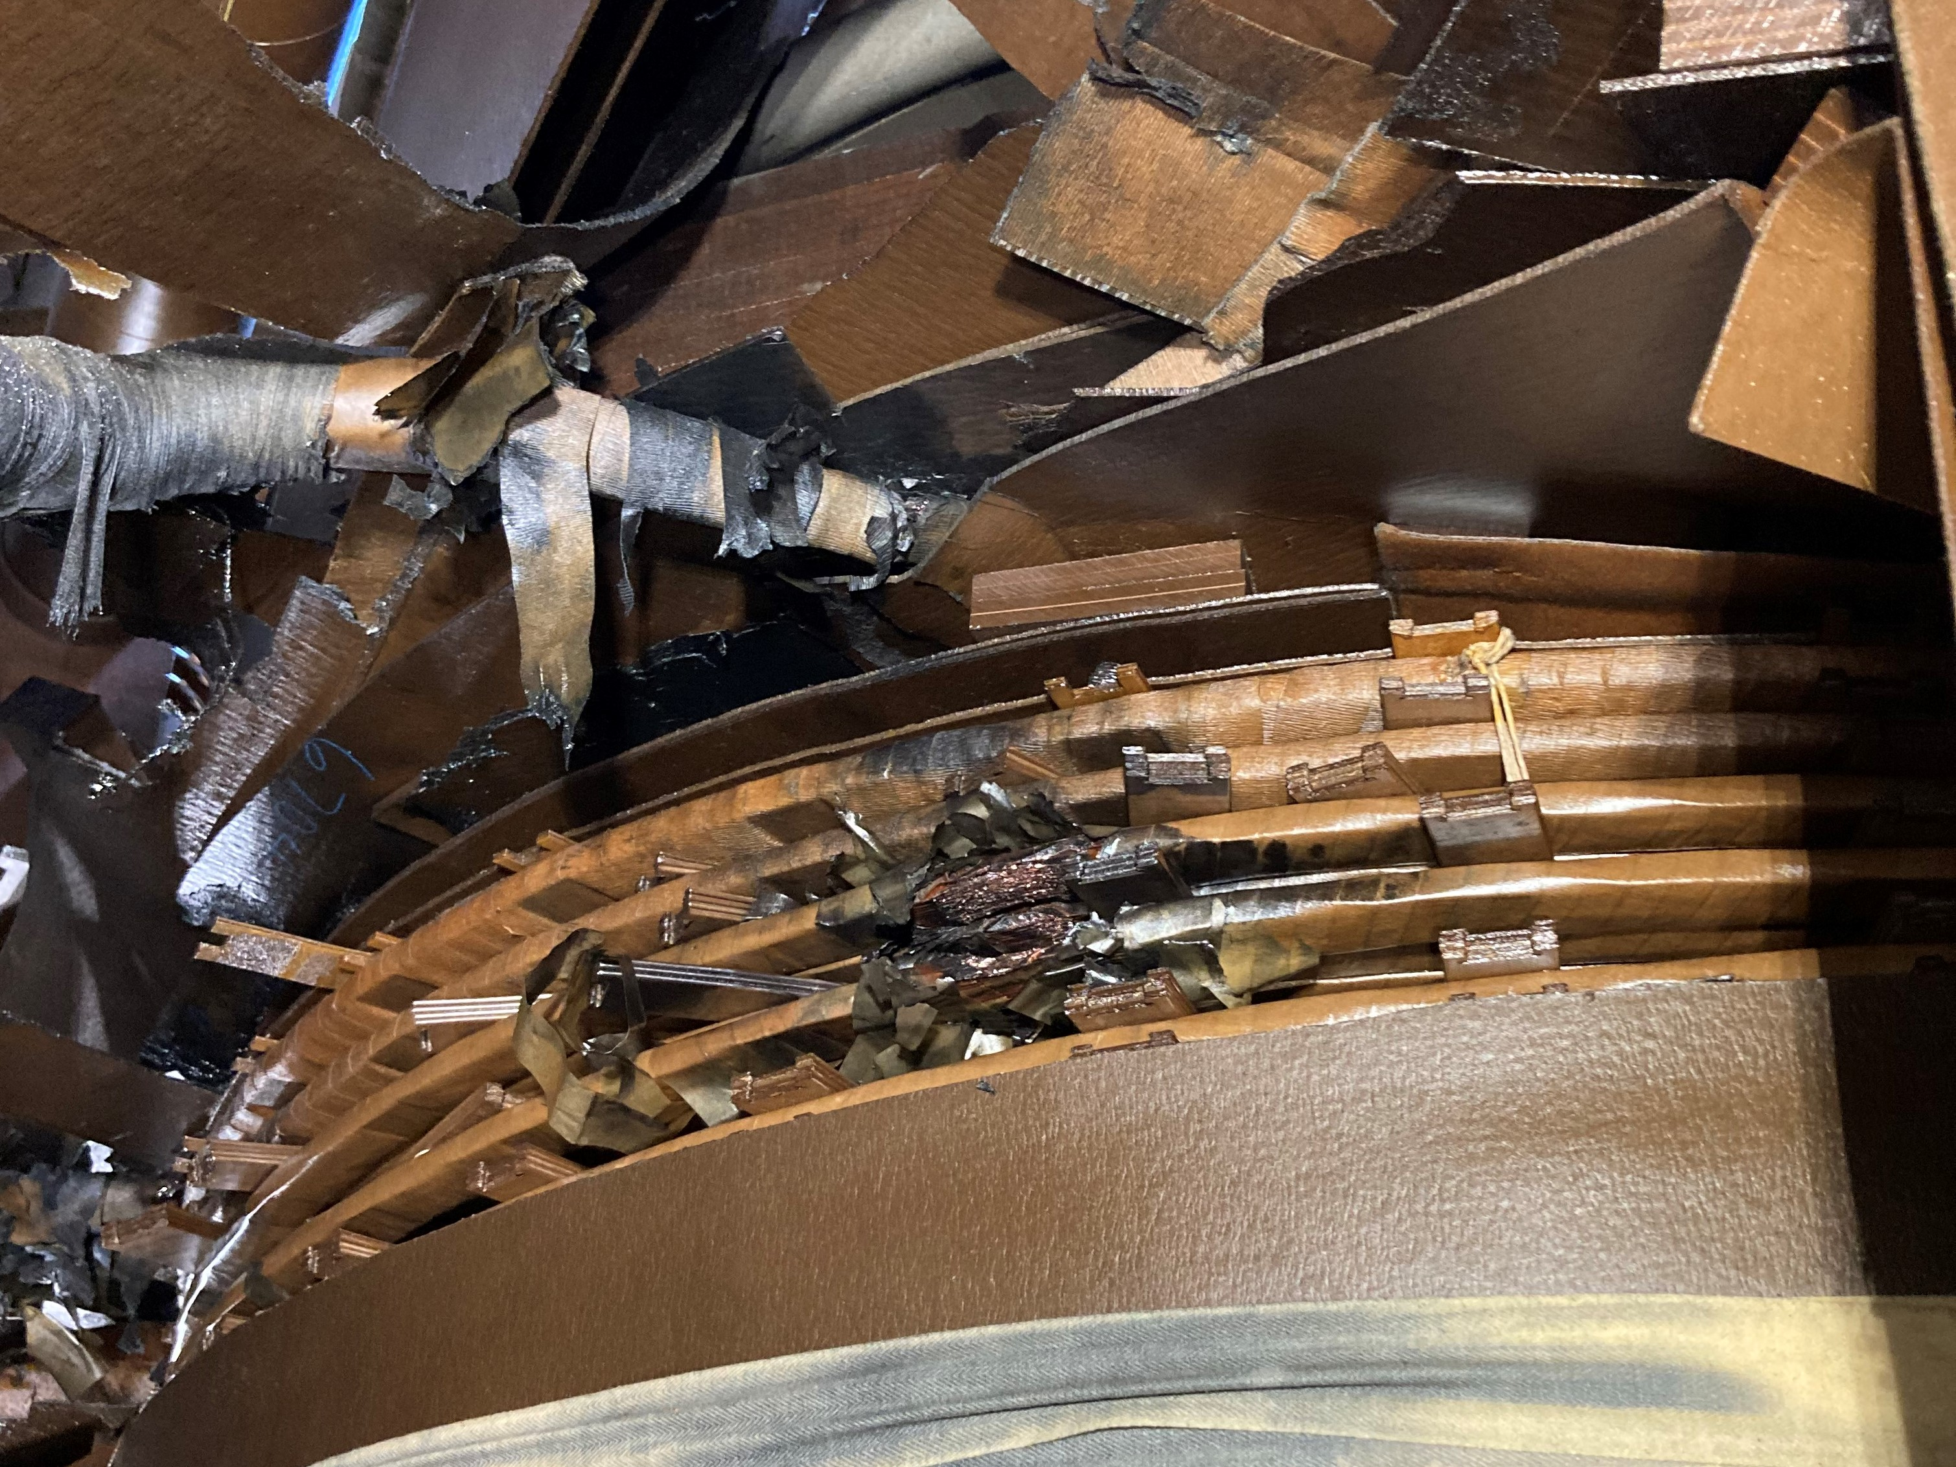
Crossover Phase Shifting Transformer
Supply Chain issues
New transformer would likely take 3+ years
Looking at other options

Slide 12
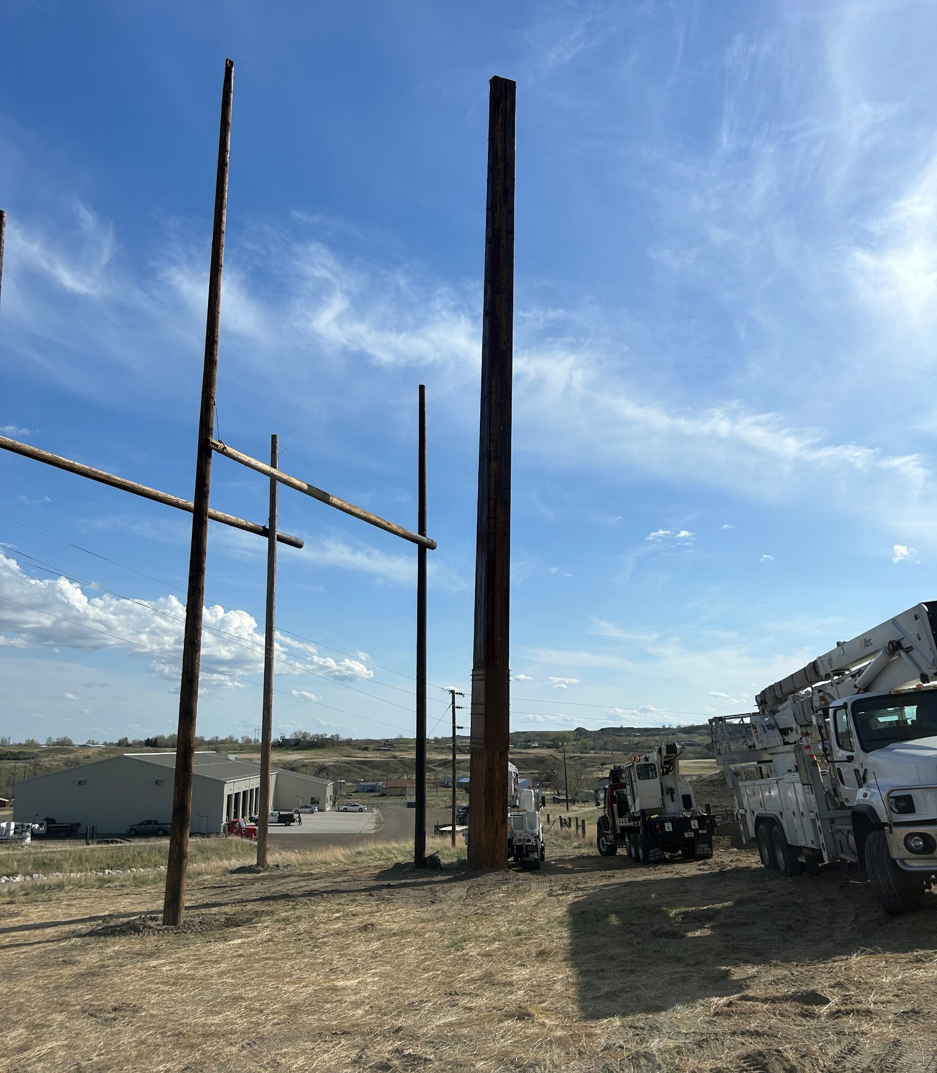
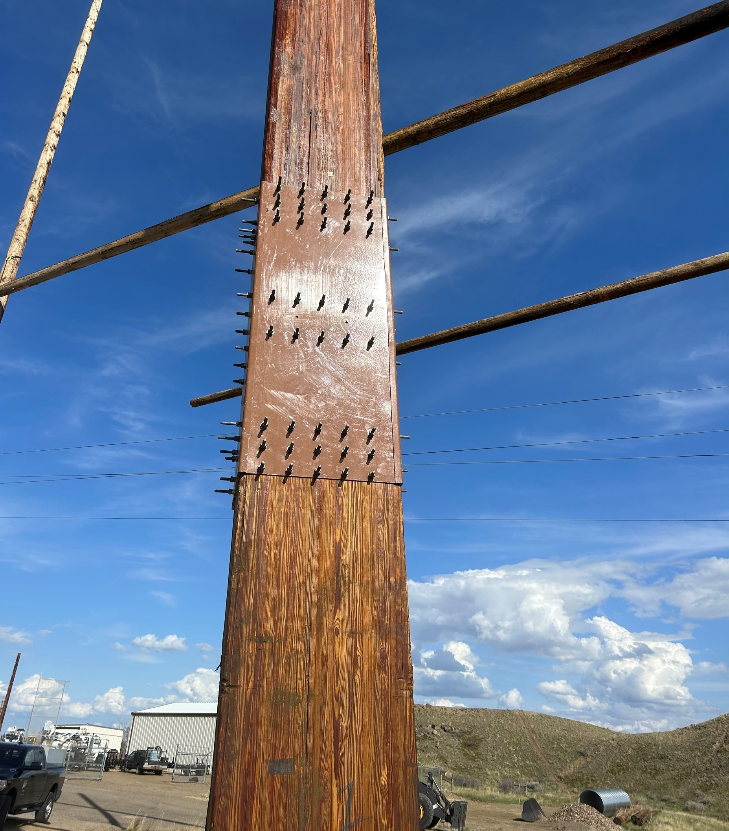
Circle-Dawson County 115 kV line Final Phase Completed

Slide 13
Contact WAPA
Lloyd A. Linke
406-255-2800
Lloyd@wapa.gov

