Slide 1
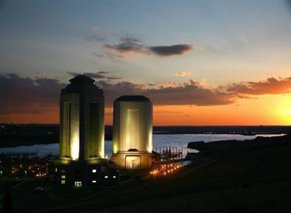

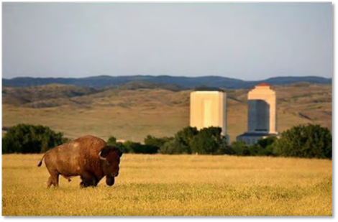
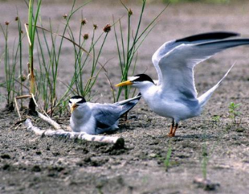
Mid-West Consumer Electric Meeting
66th Annual Meeting
December 13, 2023
Customer Funded Hydropower Program and Missouri River Initiatives
Kayla Eckert Uptmor, PMP
Chief, Civil Works
Omaha District Congressional Liaison
Omaha District

Slide 2

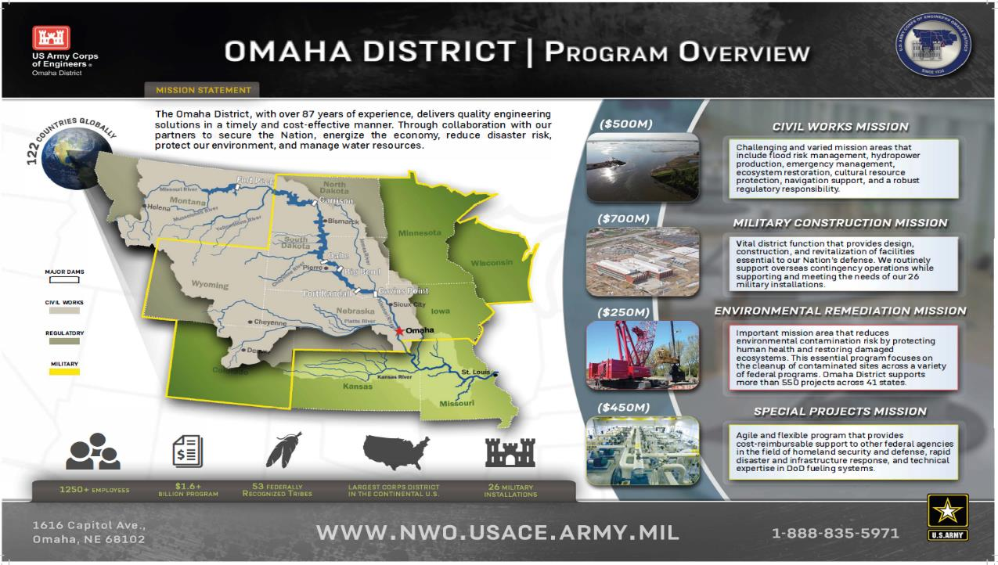
2

Slide 3
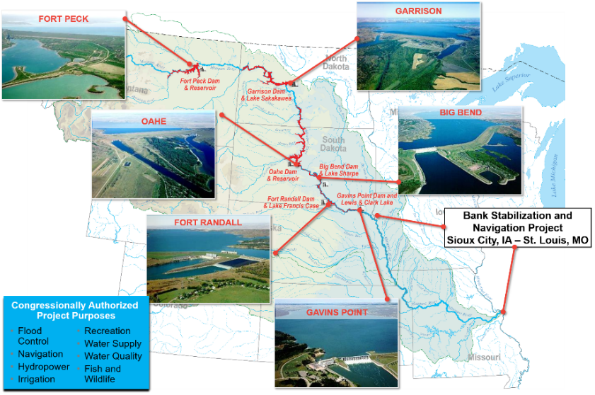
Missouri River System Operations
  529,350 Square Miles
    1/6 of CONUS
  2,341 Miles Long
  10 States, 2 Canadian Provinces
  River of Thirds
    1/3 Channelized
    1/3 Impounded
    1/3 Natural State
  279,480 mi² Regulated by Mainstem Projects
  83,800 mi² Regulated by Tributary Projects
  165,070 mi² Unregulated
Notes:
It is helpful to consider the MO River in thirds.
1. The BSNP reach from Sioux City to St Louis,
2. the more natural riverine reaches downstream of Ft. Peck, Garrison, Ft. Randall,
3. and Gavins Point dams, and the six reservoirs.

Slide 4



Missouri River Basin – runoff above Sioux City, IA
Average Annual Runoff ~ 25.8 million acre-feet
Forecast 2021 Runoff (1 June) ~ 17.9 million acre-feet
  Snowmelt and Rainfall Driven
  Runoff Season Generally Begins Around 1 March
  Three Primary Runoff Periods
    March-April, Plains Snowpack and Rainfall (~25%)
    May-July, Mountain Snowpack and Rainfall (~50%)
    August-February, Rainfall and Base Flow (~25%)
  Runoff – Highly Variable
    Year to Year
    Month to Month
Plains Snowpack
Mountain Snowpack
Rainfall
+ Rainfall
+ Rainfall
March & April
May – July
August – February
~ 25% annual runoff
~ 50% annual runoff

Slide 5
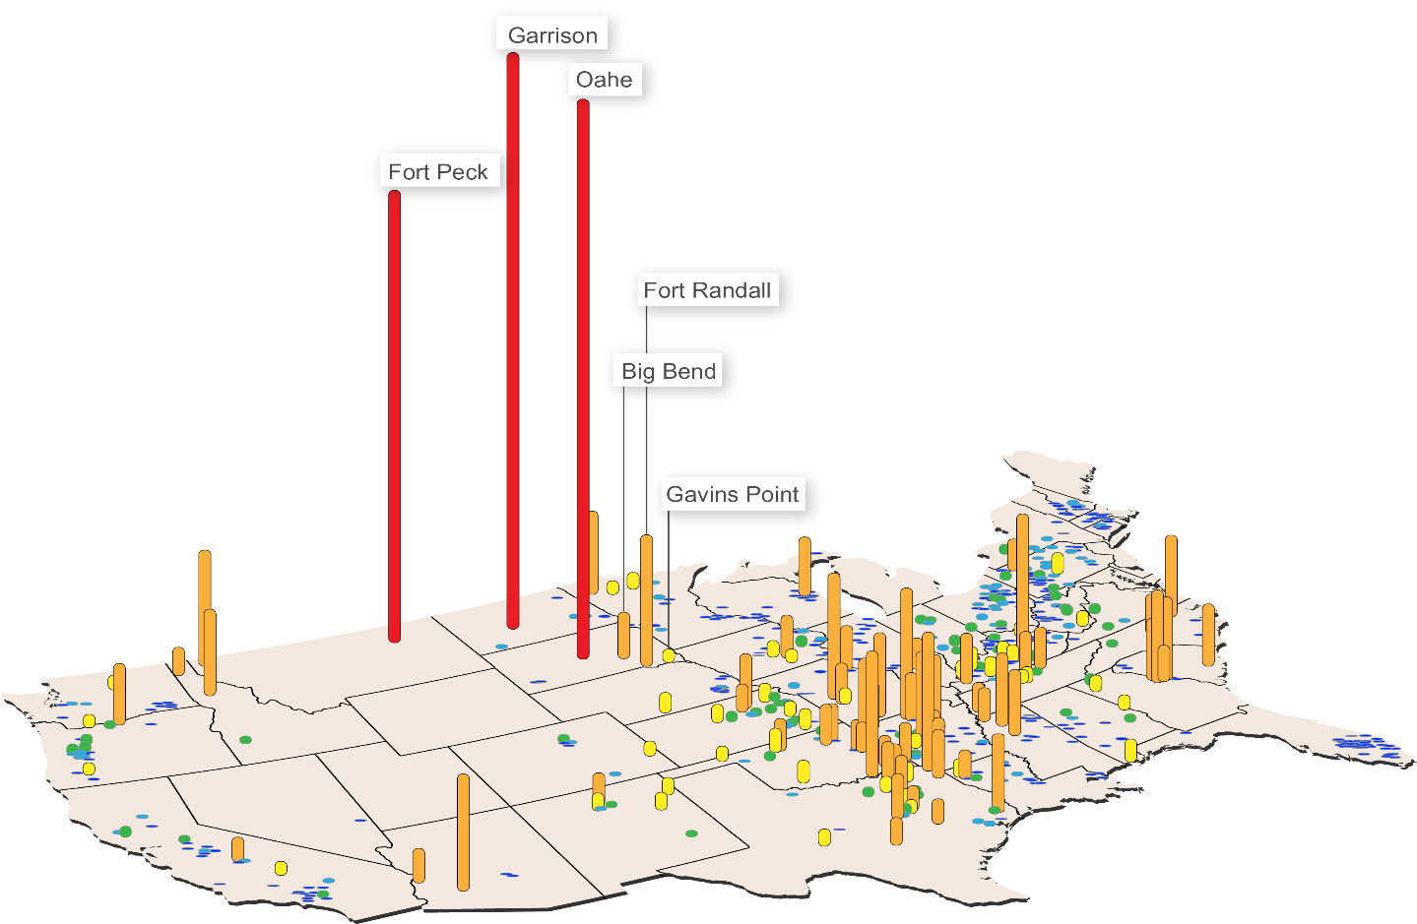
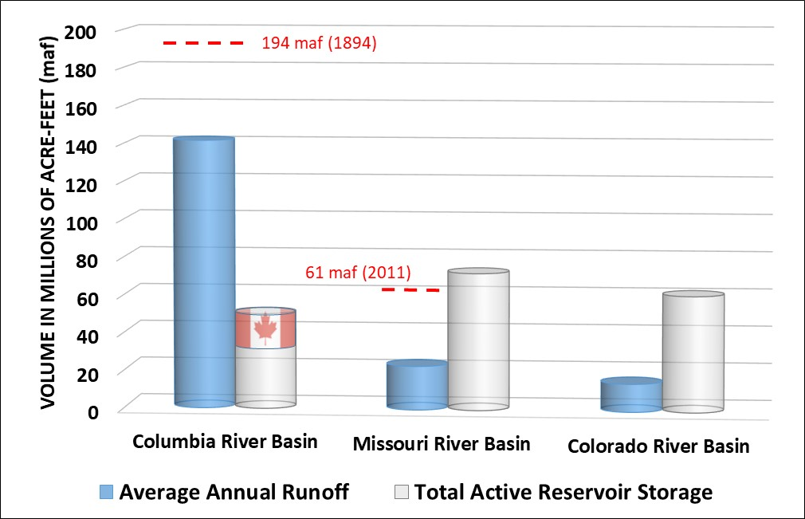
Missouri River Mainstem Reservoir System
USACE Reservoir Storage Capacity
Largest Reservoir Storage System in North America (72.4 MAF)
Garrison, Oahe and Fort Peck are the 3rd, 4th, and 5th Largest Storage Reservoirs in the Federal Inventory
Total Storage ~ 3 x Ave Runoff
(see below)
1 Acre-Foot ~ 1230 M²
Height Indicates Relative Volume (acre-feet) | > 10 Mil
 | < 10 Mil to > 1 Mil
 | < 1Mil to > 500 K
 | < 500 K to > 250 K
 | < 250 K to > 100 K
 | < 100 K

Slide 6
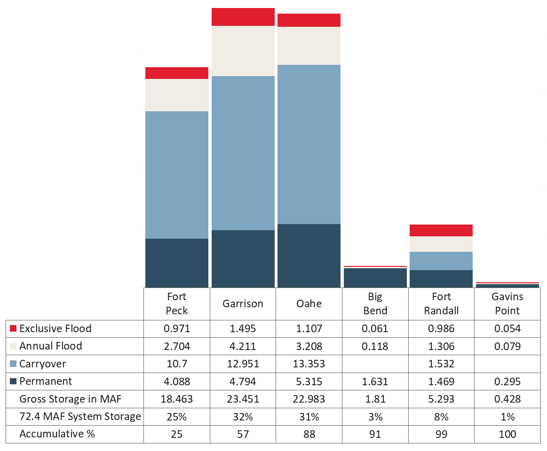
Mainstem Projects - Storage
  Upper Three Projects (Big 3) Drive the System
  88% of Total Storage
  85 % of Flood Control Storage
  96% of Carryover Multiple Use Storage
  Big Bend, and Gavins Point are Re-Regulation Projects (do not fluctuate)
  Fort Randall Provides Winter Storage/Hydropower, and Local Flood Control
  Big Bend, Fort Randall and Gavins Point are Relatively Un-effected by Drought

Slide 7








History of MRRP formation to Present day
1912
BSNP construction begins
~1980
BSNP
Complete
Mitigation Track
1986
WRDA authorizes BSNP
Mitigation
1990
BSNP Mitigation Reaffirmation Report
1991
Completion of 1st BSNP
Mitigation Site, Grand Pass, MO
1970s
Notching of structures for environmental and other reasons begins
1999
WRDA expands BSNP
Mitigation
2003
SEIS for expanded BSNP
Mitigation
2005
MRRP formed
2008 MRRIC Charter Signed
2007 WRDA authorizes Intake
1990
Pallid Sturgeon
Endangered
BiOp
2018
BiOp
1933-1964 Construction of 6 Mainstem Reservoirs- System fully operational in 1967
1986
Piping Plover Threatened
1989
Master Manual Revision Launched
1979
Master Manual Revised
2021
Least Tern
De-listed
2000
BiOp
2003
Amended
BiOp
2004
Master Manual Completed
ESA Track
1985
Least Tern
Endangered
1986
Spring releases modified for nesting birds
Notes:
In addition to the ESA requirements shown in the lower timeline on this slide (which I will talk about more in a minute), the Corps also has a requirement to mitigate for habitat lost due to BSNP construction (shown in the upper timeline on this slide). The mitigation requirement relates back to a previous slide showing an estimated loss of 522,000 acres of fish and wildlife habitat when the river was channelized. These tracks have distinct legal requirements, but they are related at times and the MRRP was created in 2005 to provide one program to provide consistent/efficient and complementary implementation of the two requirements. Another key event on this timeline is the formation of the Missouri River Recovery Implementation Committee in 2008 to provide stakeholder input to implementation of the MRRP and recently reconsultation with USFWS and a new BiOp in 2018.

Slide 8
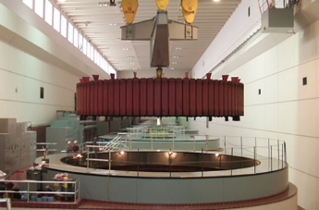
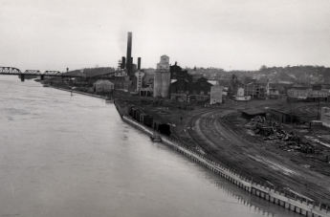
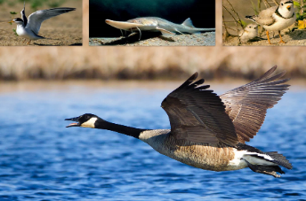
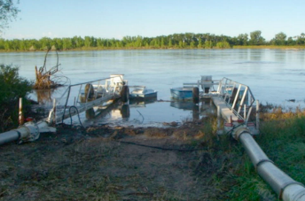
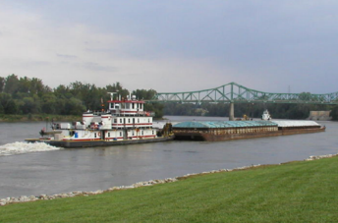
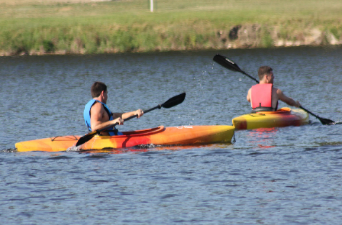

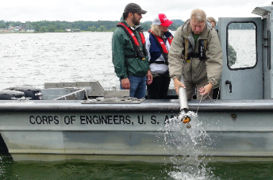
authorization/mission
HYDROPOWER
FLOOD CONTROL
Eight Authorized Purposes
      Flood Control – Requires Empty Space
      Navigation
      Water Supply
      Hydropower
      Water Quality Control
      Recreation
      Irrigation
      Fish and Wildlife
Purpose = Priority: One priority is life safety.
Runoff Driven System – The runoff drives system releases and is managed on an annual basis. We do not carryover water in the flood control zones
Basically operate for flood control or meeting downstream targets (navigation, Water Supply)
Must comply with all laws (e.g. ESA*, CWA, etc.)
* - As Hydrologic Conditions Allow
FISH & WILDLIFE
IRRIGATION
NAVIGATION
Requires Access to Water or Releases
RECREATION
/
WATER SUPPLY
WATER QUALITY CONTROL
Notes:
Flood Control: Requires empty space in reservoirs, water captured during high runoff events and metered out through remainder of the year to serve authorized project purposes, evacuate all stored flood water by start of next year’s runoff season (1 March), provides significant flood damage reduction, but cannot eliminate all flooding (unregulated runoff), ability to reduce downstream stages depends on timing of peak and distance from control point
Navigation: Navigation channel extends from Sioux City, IA to St. Louis, MO, flow support provided by releasing water from the reservoirs to meet target flows along the river, self scouring navigation channel constructed with dikes and revetments, not a series of “locks and dams”, flow support dependent on total volume of water in the reservoir system on two dates; March 15 – determine the “Service Level” for the first half of the navigation season, and July 1 – determine the “Service Level” for the second half of the navigation season and the “Season Length”
Hydropower: Power marketed by Western Area Power Administration (WAPA), Corps determines:
Daily generation total
Maximum/minimum generation
Plus/minus tolerance on generation
Hourly generation schedule during nesting season
Restrictions
Winter (ice)
Tern and plover nesting season
Special operations
Irrigation – Recreation – Water Supply – Water Quality Control: All require access to water, users located on the reservoirs, on the river reaches between the reservoirs, and on the river below the reservoir system
Access affected by
Lack of water (low pools or low downstream stages)
Too much water (high pools or high downstream stages)
Ice jams
Fish and Wildlife: Rising reservoir levels during forage fish spawn (rotate emphasis is runoff is insufficient to keep all 3 upper reservoirs rising)
Minimum Releases
Below Fort Peck for trout fishery
Minimize hours of zero releases from Fort Randall for invertebrates
Cold Water Habitat at Garrison - Adjust operations to minimize loss of cold water from reservoir during droughts for fishery
Threatened and Endangered Species:
Habitat Construction / Channel Modification
Propagation / Hatchery Support
Research, Monitoring, and Evaluation
Adaptive Management
Public Involvement
Flow Modifications – As hydrologic Conditions Allow - Release adjustments for nesting birds from May through August (Primarily Garrison and Gavins Point)

Slide 9
Program overview: why do we have the Missouri river recovery Program (MRRP)?
Allows USACE to meet environmental compliance requirements to operate and maintain the Missouri River Mainstem Reservoir System and the Bank Stabilization and Navigation Project (BSNP) for their authorized purposes
Three components of MRRP
ESA Compliance – Actions to comply with the “No Jeopardy” 2018 Biological Opinion (BiOp) and associated EIS & Record of Decision – pallid sturgeon and piping plover
  Ft. Peck Test Flow EIS completed with ROD signed Nov.12, 2021
Fish and Wildlife Mitigation – BSNP Fish and Wildlife Mitigation Project
Missouri River Recovery Implementation Committee (MRRIC) – WRDA 2007
  USACE - coordinated Stakeholder Committee (FACA Exempt)
  Represents States, Tribal Governments, User Groups, etc.
  Critical in developing 2018 Management Plan EIS & associated Proposed Action for ESA compliance
Notes:
Not enough water in Ft Peck to implement in 2022 or 2023 but storage level in Ft Peck now likely to be sufficient.

Slide 10
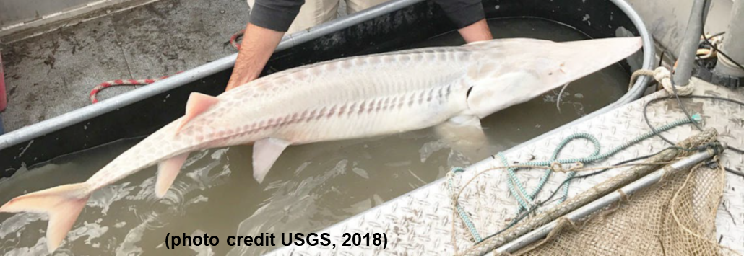
Current pallid sturgeon range
Pallid Sturgeon Recovery Plan, USFWS 2014
This presentation will focus on
management actions, particularly Ft Peck test flows, to benefit pallid sturgeon
in this section of MO River/Yellowstone
River
Notes:
Need to briefly mention the other actions to understand role of test flows but test flows is the focus of this presentation

Slide 11
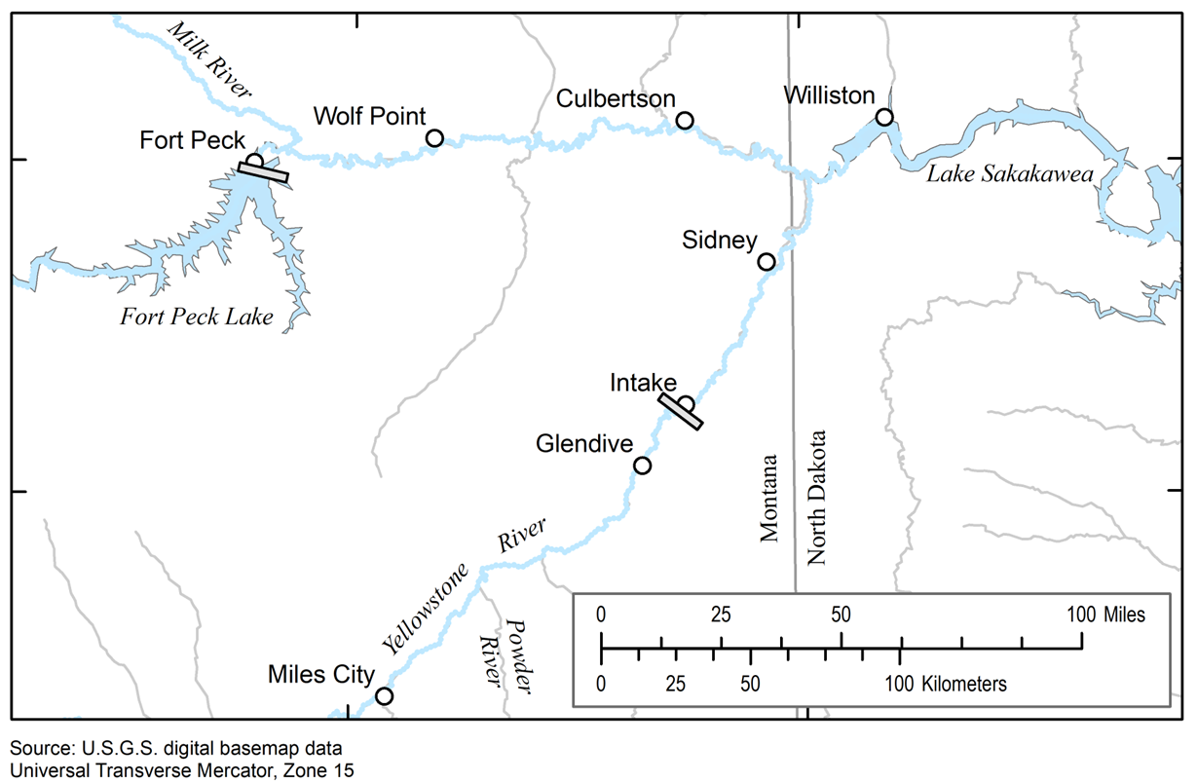
What’s the status of pallid sturgeon in this reach of Missouri/Yellowstone Rivers?
USACE project
USBOR project
(USACE authorization in WRDA 2007)
Notes:
Currently, we have a strong population of hatchery fish which are reaching sexual maturity and a small, aging population of wild fish. Until recently, most spawning occurred on the lower Yellowstone, too close to Lake Sak and therefore to natural recruitment of young fish to the population for decades. The change is occurring on the Yellowstone side as we now have fish spawning in the Powder and Tongue Rivers indicating the bypass at Intake is a big success. The big question now is whether those spawning events, which we expect to continue, will result in successful recruitment of young fish to the population. It is too early to tell but ongoing monitoring will pick up these young fish in coming years if they are there.

Slide 12
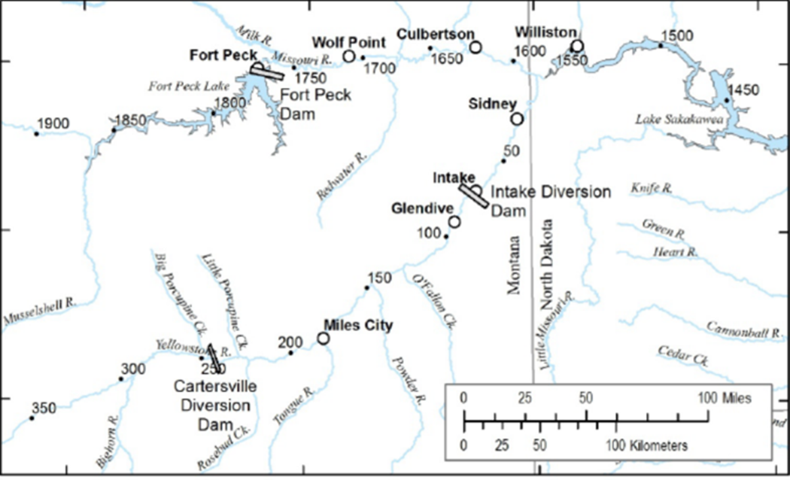
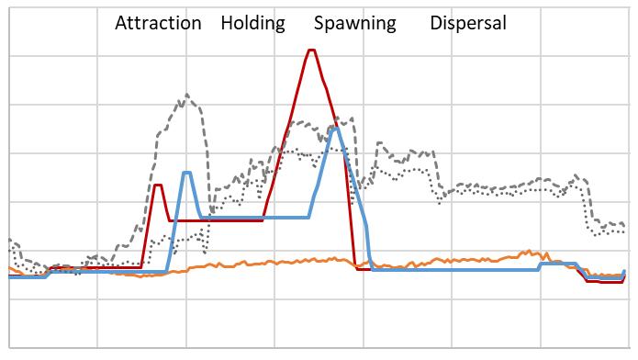
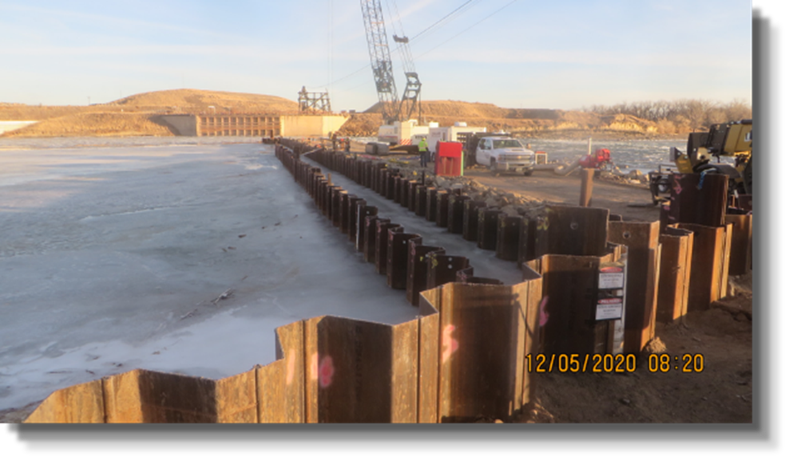
Pallid sturgeon actions – upper basin
1. Pallid sturgeon propagation
2. Completion of Intake fish bypass
3. Ft. Peck test flows
4. Monitoring/research
Notes:
Bypass opened early April, 2022 and functioning since then. Pallid sturgeon in both spawning migrations since have passed Intake and proceeded upstream on the Yellowstone, Powder, and Tongue.

Slide 13
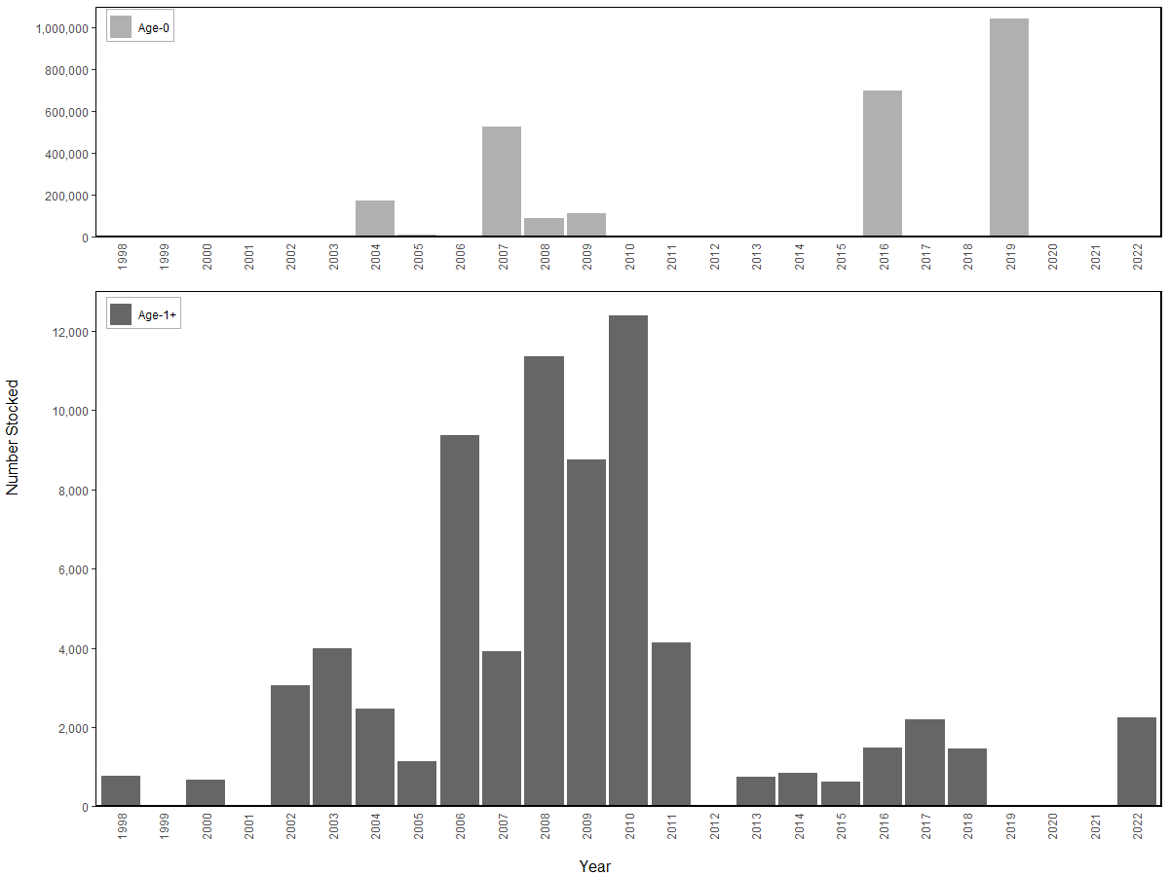
Number stocked
Year
Stocking history in the upper MO River downstream of Ft. Peck Dam, 1998-2022
Notes:
Stocking has been very successful resulting in good numbers of hatchery fish which are now just beginning to reach sexual maturity. As a result, we expect the number of spawning fish to be increasing in coming years. Numbers of stocked fish have been curtailed with a focus now on genetic diversity.

Slide 14
WRDA 2007
SEC. 3109. LOWER YELLOWSTONE PROJECT, MONTANA. The Secretary may use funds appropriated to carry out the Missouri River recovery and mitigation program to assist the Bureau of Reclamation in the design and construction of the Lower Yellowstone project of the Bureau, Intake, Montana, for the purpose of ecosystem restoration.

Slide 15
Intake Diversion Dam status
New irrigation structure and fish screen completed in 2012
New weir on Yellowstone completed in 2021
Fish bypass channel completed in early April 2022 potentially providing fish access to over 160 miles of additional river miles
Successfully passing fish resulting in upstream spawning as hoped
Monitoring to determine spawning locations, production of drifting embryos, recruitment to age-1 and beyond
Requires significant coordination among several entities working on both the Yellowstone and Missouri Rivers
Many related science presentations by USGS, USBOR, and USACE occurred during MRRP Fall Science Webinars

Slide 16
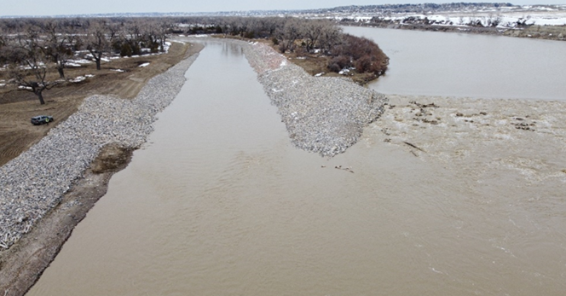
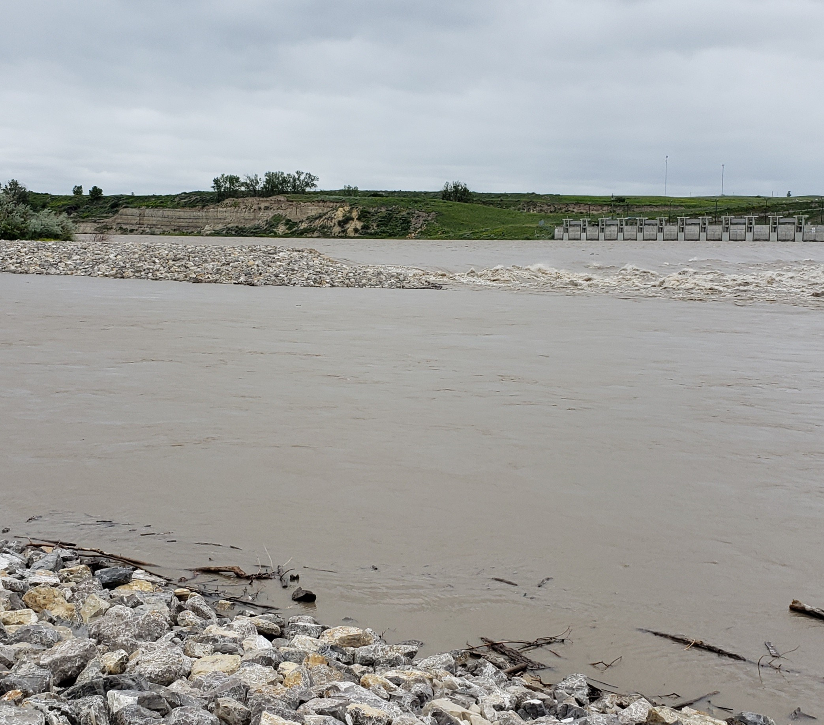
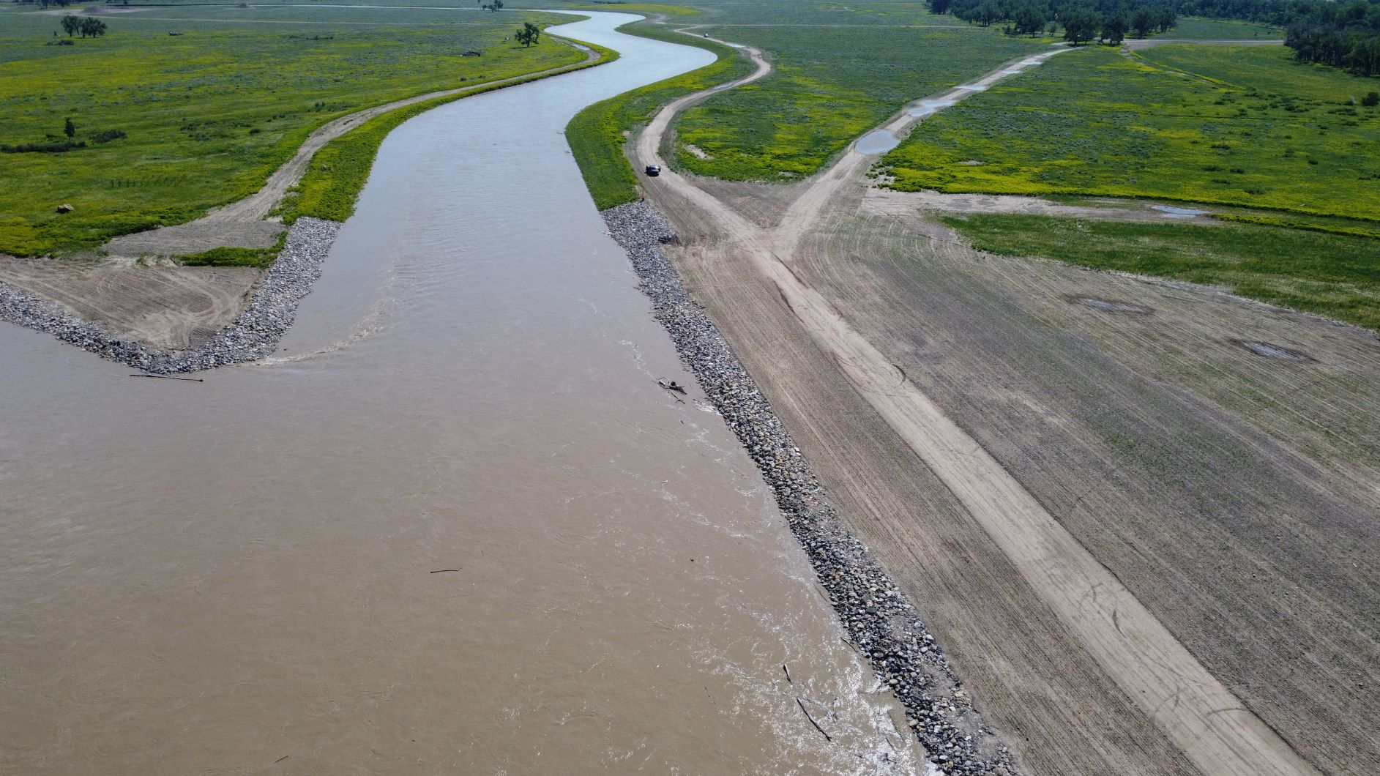

Main channel
Irrigation canal
Intake Dam
Flow
Intake Dam
Fish bypass channel
(downstream entrance)
Flow
Fish bypass channel
(upstream looking downstream)
Intake dam
Main channel

Slide 17
What will result from successful passage upstream of Intake Dam?
Notes:
USACE has an ESA responsibility at Ft Peck, BOR has an ESA responsibility at Intake (thus the bypass). Assisting BOR with Intake does not alleviate USACE responsibilities at Peck. If in the future, however, successful natural recruitment is occurring changing the status of the population, this could have an impact on actions required at Ft Peck.

Slide 18
Ft Peck test flow overview
Complying with the Endangered Species Act (ESA) is a requirement for the operation of the Missouri River Mainstem Reservoir System which is operated to support eight authorized purposes
3 to 5 flow tests from Fort Peck Dam over 5 to 15 years is a current ESA requirement
The tests will investigate responses of pallid sturgeon adults and survival of young fish to flow, temperature, and turbidity and validate assumptions in the EIS about HC effects.
While the EIS defines the operational space for the flows, a given test flow designed to assess one or more of the desired responses and assumptions regarding HC effects may be more limited.
Looking to find implementation pathways that are sensible and sensitive to the range of concerns expressed
Implementation of the test flow would occur through a Master Manual deviation request that would be coordinated through Missouri River Basin Water Management biannual public meetings. This ensures the test flow is incorporated in the Annual Operating Plan and the public is informed.

Slide 19
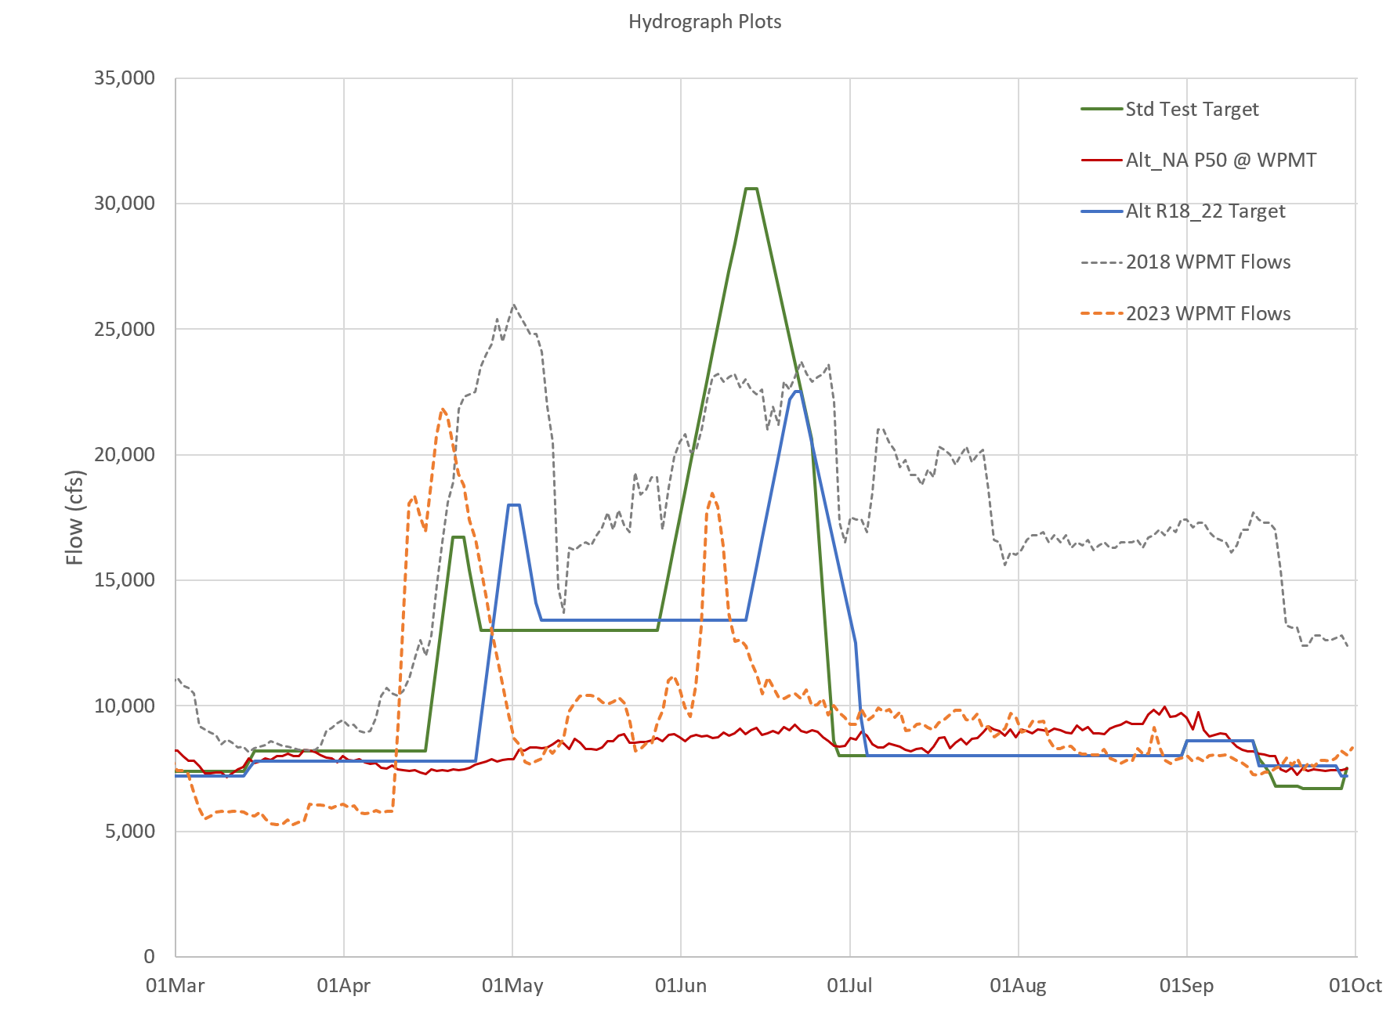
2024 flow release design
Per EIS (typical)
2018 Actual
2023 Actual
Proposed 2024 (example)
Median Year
Notes:
The proposed initial test flow is shown in blue in the figure. The targeted hydrograph that guided the selected alternative is shown in green. Note that these flows are targets at Wolf Point, Montana, and that the releases from Fort Peck are generally lower than these values to account for inflows between Fort Peck Dam and Wolf Point. Actual flows at wolf point in 2018 are shown with the dashed Gray line while releases from Fort Peck that year are shown with the dotted Gray line. You'll note a significant difference between the two at the end of April due to high inflows from the Milk River.
The proposed initial test flow uses most of the same criteria as were employed for the selected alternative in the EIS. Key differences are that
the spawning peak is lowered from a maximum of 35,000 CFS for the selected alternative to 22,500 CFS for the test flow
The timing of the flows are as late as allowed while remaining within the range identified in the EIS. The later flows or used because of the temperature concerns describe previously.
Potential for impacts significantly reduced with this approach including impact to hydropower. The flows which occurred naturally in 2023 (orange line) were nearly identical in terms of peak discharge (with peak flipped) to the proposed test flow. This should give stakekolders some confidence in what to expect because we just saw something similar. This peak discharge equates to about a 1 in 3 to 4 year event (compared to the full selected alternative shown in green) which is roughly a 1 in 20 year event. Essentially we are proposing a test with commonly seen peak discharge and attempting to adjust timing and shape to get a pallid response. The Milk contribution will have a significant effect on the pallid response most likely.

Slide 20
Notes:
I use this slide to explain that anything released at Peck over the powerhouse capacity of roughly 14.5K cfs would be released over the spillway providing somewhat warmer water which is a positive. You can also point out that water from Peck is clear, water from the Milk is turbid and this along with temperature are which pallids are attracted to the Milk when it is flowing. Easy to see difference it photo

Slide 21
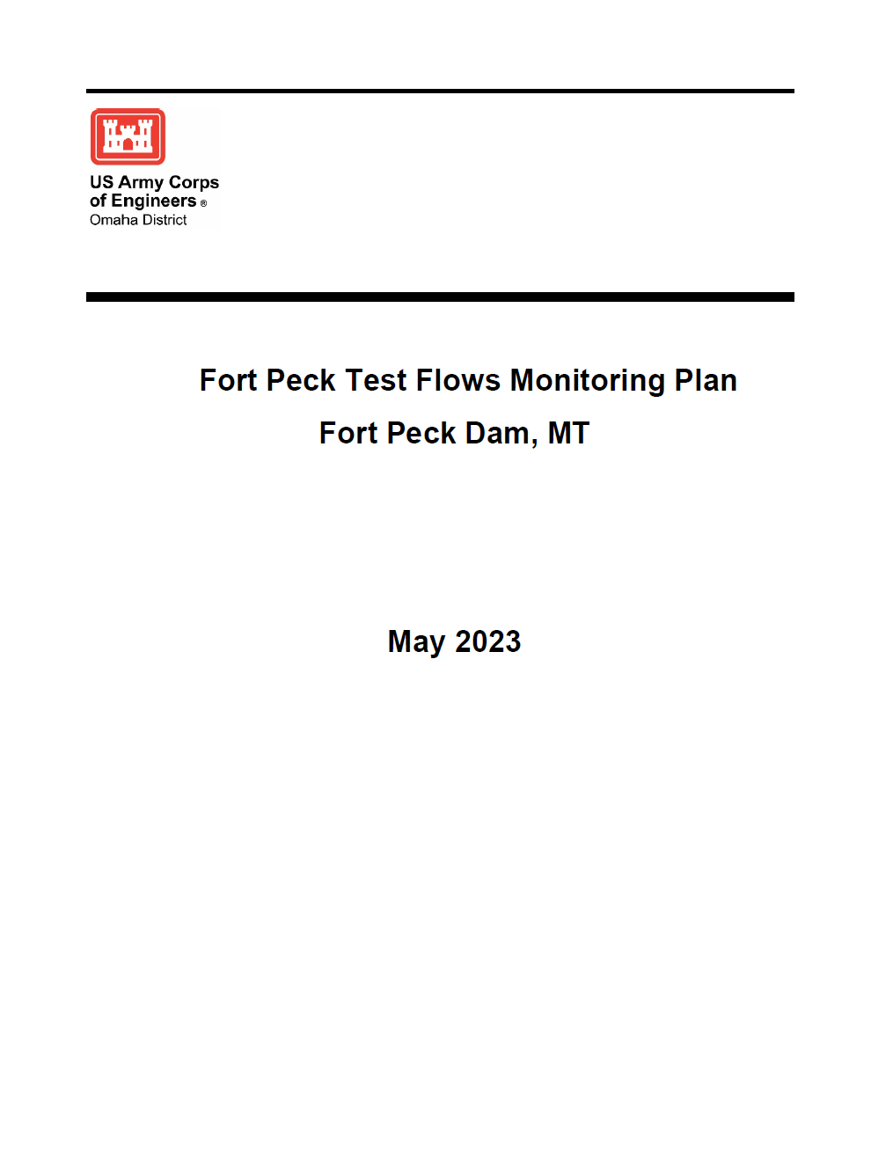
Fort Peck Test Flows Monitoring Plan
Monitoring will include:
Pallid sturgeon monitoring (which has been ongoing)
Bank erosion
Water intakes
Spillway
Cultural resources
Water quality
Notes:
NOTE: It is anticipated that overall adverse impacts to Missouri River hydropower would be small compared to the No Action Alternative. During implementation, USACE would coordinate with the Western Area Power Administration and test flows could be halted if it is determined that significant hydropower impacts are occurring or anticipated to occur in a given test flow year. Risk of hydropower impacts is further reduced with a reduced peak of 22,500 cfs.

Slide 22
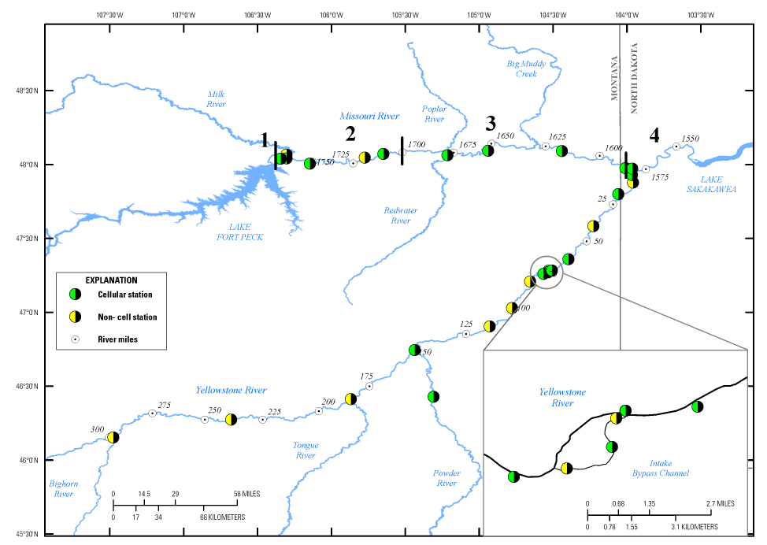
Passive telemetry stations for assessing pallid sturgeon movements
Notes:
This slide just shows the high level of effort we have put into tracking of these fish so that we can evaluate the effects of these actions. The circles represent passive telemetry stations which can detect pallids as they pass.

Slide 23
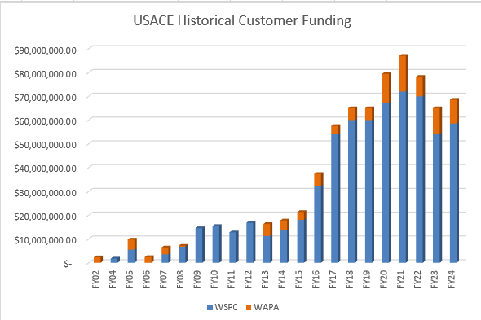
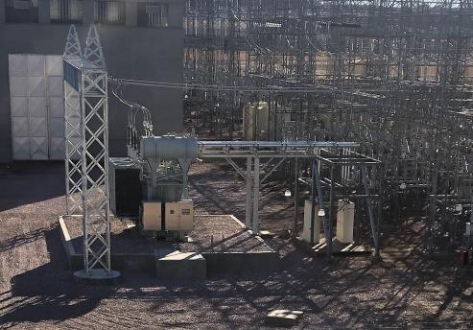
Hydropower Program Evolution
Hydropower Customer Funding execution moved to Planning, Programs, and Project Management Division in 2014
515% increase in customer funding between 2014 and 2024
Inaugural Hydropower Master Plan issued in 2016
  Update in development – May 2024
Executed $154M in completed projects in the past decade.
PM staffing increased from 4 to 6 Project Managers and full time Program Manager
  Currently 57 active projects
  $562,070,914
Fort Randall GSU Transformer Replacement

Slide 24
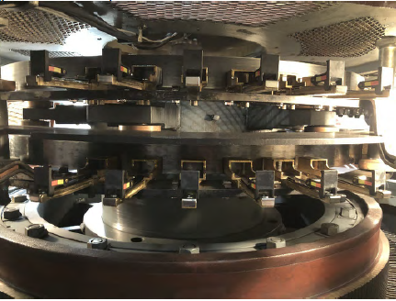
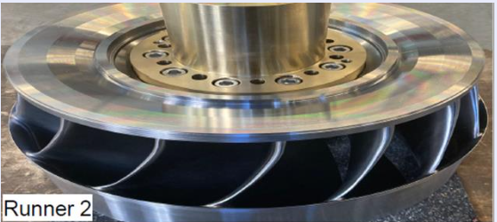
Hydropower Major Unit Rehabilitation
Future work will be more complex/longer duration projects
  $50M Oahe/Ft Peck Transformer Replacements
  Ft. Randall/Oahe Major Turbine and Generator Replacement Projects
Fort Randall GSU Transformer Replacement
Ft Randall Major Unit Rehabilitation
  $280M total project estimated cost
  8-Units, 11-year duration
  Oahe Major Unit Rehabilitation
      $380M total project estimated cost
      7-Unit, 11-year duration

Slide 25
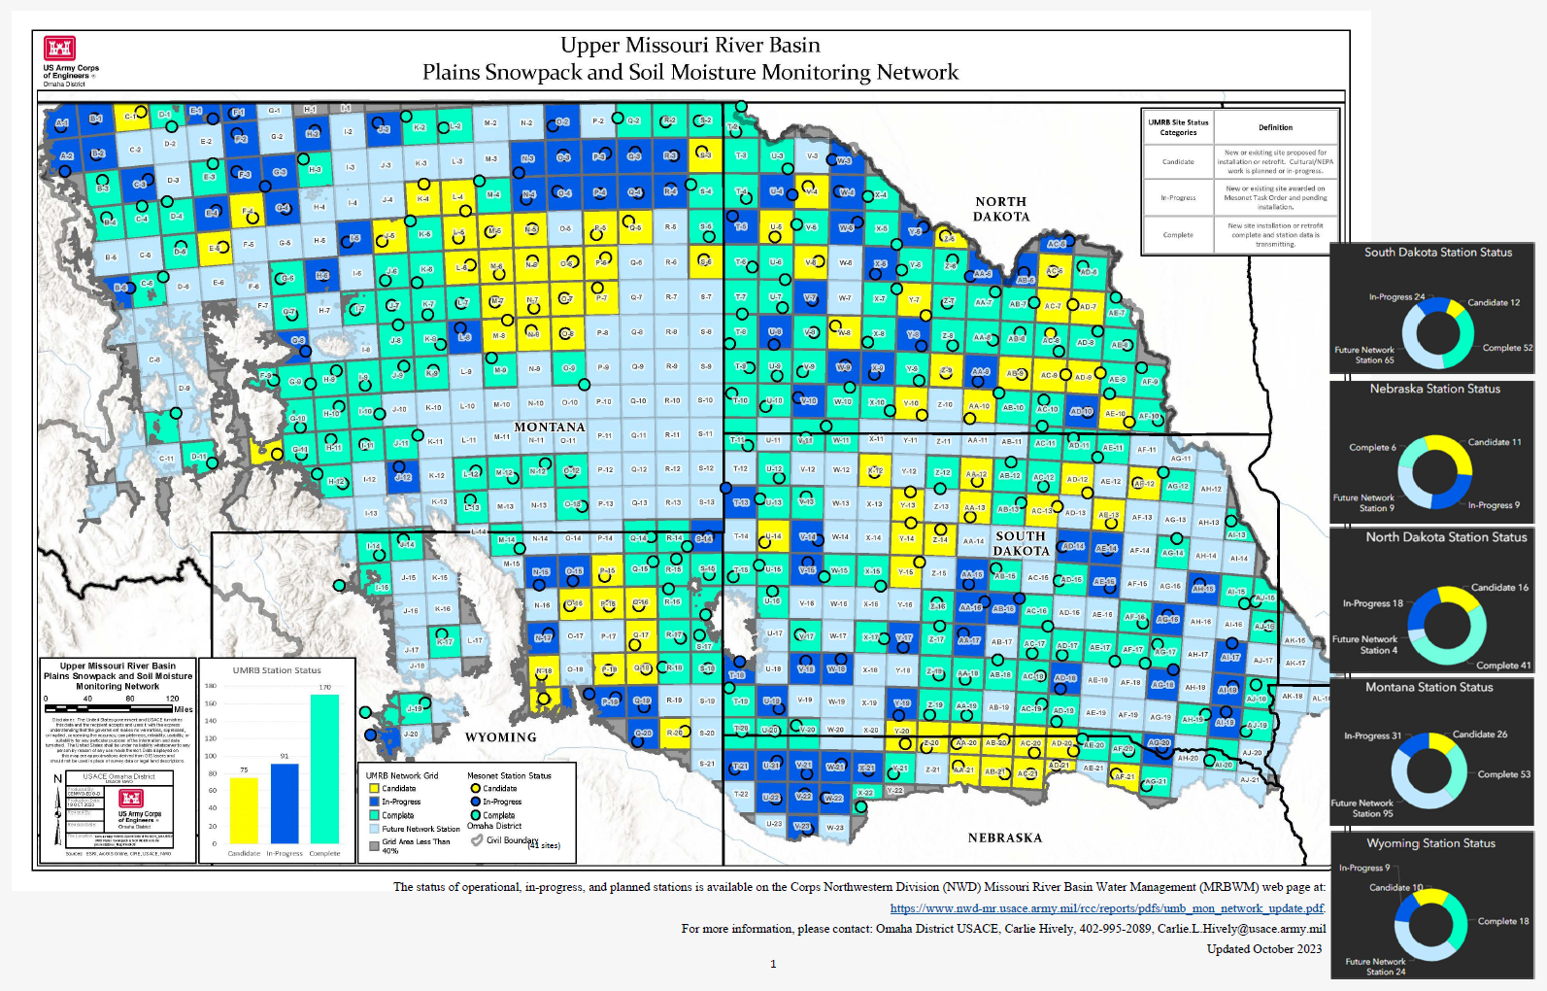
Notes:
Talking Points
After the historic 2011 Flood, and in response to one of the six recommendations from the Independent Review Team, the U.S. Army Corps of Engineers (Corps) and various basin agencies developed a framework (2013 Recommendation) for the establishment of an Upper Missouri River Basin Soil Moisture and Plains Snow and Soil Moisture Monitoring Network (UMRB Monitoring Network). The Corps is collaborating with federal, state, and tribal partners to implement the 2013 recommendation.
The Corps uses plains snowpack and soil moisture data in its runoff forecasting for reservoir operations. The Corps and other federal agencies have found limitations in this data. For example, the independent technical review panel, which assessed the Corps operation of the Missouri River mainstem reservoir system during the 2011 flood, found that modeled information on snow water equivalent is available, but observational data is sparse and not always representative of basin-wide conditions. WRRDA 2014 included a requirement that the Secretary of the Army, in coordination with other specified agencies, carry out snowpack and soil moisture monitoring in the Upper Missouri Basin. WIIN 2016 Section 1179(b) designated the Corps as the lead agency for this effort.
The plains area of the UMRB (above Sioux City, IA) in the U.S. totals 270,000 square miles and experts agreed that a soil moisture and plains snow monitoring station should be installed in every watershed (see Figure 1) at a density of 1 in every 500 square miles (540 monitoring stations total).
A monitoring station includes all sensors – soil moisture and temperature, snow depth, wind speed and direction, solar radiation, relative humidity, precipitation, and air temperature.

Slide 26
Joe Bonneau
MRRP Program Manager
CIVIL WORKS BRANCH
Kayla Eckert Uptmor, Chief
& Omaha District Congressional Liaison
Bert Matya
MEGA Program Manager - Adams and Denver County
Civil Works Project Management
& Strategic Engagement Section A, Chief
Colleen Horihan
Supervisor/Cong Liaison Support
John Hucko
Administrative Assistant
Hydropower Program Management & Other Civil Works Section B, Chief
Robin Puskar
Supervisor
Project Manager
Vacant
SRT PM, Sect 120 PM
Project Manager
Randy Sellers
MRRP NWO Imp PM
Project Manager
Jay Ling
Ft. Randall MR & Hydro
Project Manager
David Lagrone
Hydropower & Sec 595
Project Manager
Carlie Hively
Dam Safety, UMRB PM
Project Manager
Shelley McPherron
MRRP ESH & MRRIC PM
Project Manager
Ryan Brockman
Hydropower & Sec 594
Project Manager
Ron Beyer
Hydropower PM
Project Manager
Jerry Self
SRT O&M
Project Manager
Vicki Verdoni (P/T)
Project Support
Project Manager
Jonathon Hensel
Hydropower
Project Manager
Brooke Sparrow
Project Support

Slide 27

Omaha district online
Internet: www.nwo.usace.army.mil/
Facebook: www.facebook.com/OmahaUSACE Google+: plus.google.com/+OmahaUSACE Twitter: www.twitter.com/OmahaUSACE
Flickr: www.flickr.com/OmahaUSACE YouTube: www.youtube.com/OmahaUSACE DVIDS: www.dvidshub.net/unit/OmahaUSACE

Slide 28
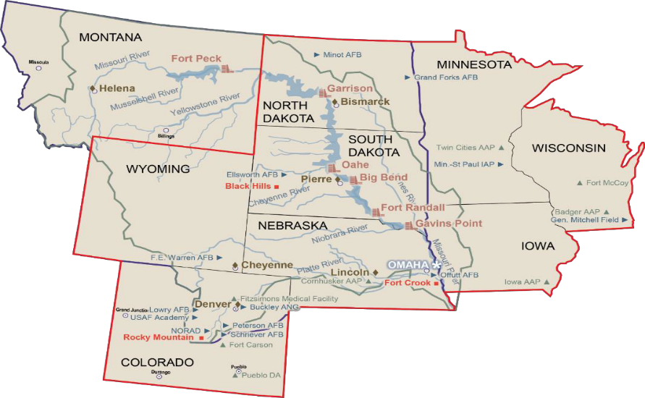
Questions?
28

