Slide 1
Sedimentation Management Plan Update
Lewis and Clark Lake to Fort Randall Dam
Mid-West Electric Consumer Association Annual Meeting
December 13, 2023
Scott Kostal
Executive Director
Missouri Sedimentation Action Coalition
Notes:
Good morning, I am Scott Kostal, Executive Director of the Missouri Sedimentation Action Coalition (MSAC). Thank you for the opportunity to update you on MSAC and our current focus area.
MSAC is 501(c)3 organization whose goal is to educate & promote action to address sedimentation. Sustaining our nation’s reservoirs for future generations takes a shift in thinking. MSAC wants to join stakeholders & river managers in building a broad, holistic plan that looks upstream & downstream taking into account a truer picture of actual costs & benefits.
MSAC’s membership and stakeholders are a broad cross-section of federal, tribal, state, and local government entities, commercial groups, non-profit river focused organizations, and individuals.
In November of 2022 I joined Sandy Stockholm as MSAC returned to an Executive Director and Communications Coordinator structure. This comes at a crucial time as we enter continue coordination with USACE-Omaha.
In the next few minutes I will update you on our progress.

Slide 2
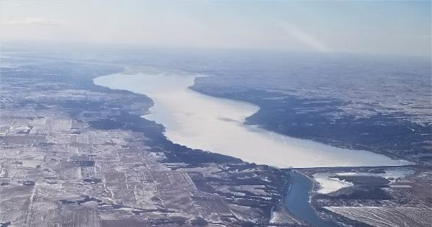
Current Focus Area
Lewis and Clark Lake and reaches to Fort Randall Dam Sediment Management Plan study
  WRDA 1974 Section 22 – Planning Assistance to States (PAS) program
  MSAC is the primary sponsor
  Output is a Sediment Management Plan
  Three ‘phase’ project
  Currently completing phase 2 with phase 3 scoping meetings initiated
  Phase 3 expands on selected options from phase 2 report
  Expected 2-year process
Looking upstream from Gavins Point Dam, Feb. 2021.Photo courtesy Ted Streckfuss, USACE.
Notes:
MSAC’s current focus area is the Lewis and Clark Lake area and its upper reaches of the Missouri River. This area, formed by Gavins Point dam, is bordered by South Dakota on the north and Nebraska on the south. Included in this area is the 39-mile section of the Missouri National Recreational River and the Santee Sioux Indian Reservation.
Lewis and Clark Lake was created with the closure of the Missouri River at Gavins Point Dam, near Yankton, SD, in 1955. At its height, the lake stretched nearly 25 miles to the towns of Springfield on the South Dakota side and Santee on the Nebraska side.
This stretch of the Missouri River supports irrigation, drinking water, and a robust and growing recreational economy. A diverse fauna and flora environment exists, but recent infestations of invasive species, particularly zebra mussels and phragmites, are changing the environment. Sedimentation issues support these invasive species to the detriment of native land and aquatic wildlife.
To this day, no cohesive plan has been put forth to support the future life of Gavins Point dam and the area stretching to Fort Randall dam that support its operation. MSAC took on the challenge of sponsoring the work to change this vacancy.
In 2018, MSAC working with USACE-Omaha submitted for a Section 22 study with the end product being a Sediment Management Plan for this stretch of Missouri River. As the most threatened stretch, Gavins Point dam’s future usefulness is in danger due to the unchecked sedimentation problem created by the closure of the natural flowing river.
The study is completing the Phase 2, or research, portion and starting the Phase 3, or production, portion of the project. An initial Phase 3 occurred in August with a second planning meeting scheduled for January 2024.
Completion is expected in 2 years, with the output of a Sedimentation Management Plan. The plan, while not a funding source, will provide a cohesive document with goals, technologies, and actions that work together to reduce the sediment load in the area and maintain, and in fact, extend the useful power production, flood control, and navigation support life of Gavins Point dam while maintained the maximum amount of useful water for Lewis and Clark Lake..

Slide 3
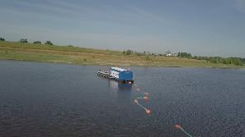
USACE Section 22 Study
Phase 2 research completed, report at final review stages
Four options from workshop considered
  Dredging, Sluicing with Augmentation, Watershed Sediment Management improvement, Niobrara River Sediment Collection
Additional options from Bureau of Reclamation Guardians of the Reservoir Competition
  D-Sediment autonomous vacuum dredge system
MSAC recommendation
  Bedload collector on Niobrara R.
  D-Sediment dredge system
  Improved/Increased watershed management across entire study area
Notes:
Update to the current Section 22 study
-Phase 2 report at final review level
Dredging
Addresses a problem, not the cause(s)
Sluicing with Augmentation
Requires Gavins Point Dam modification
Watershed Sediment Management improvement
Multiple different items across the river management spectrum
Niobrara River Sediment Collection
Needs a Beneficial Use(s) of Sediment in the collection area
-Bureau of Reclamation
Mazdak International: Sediment Compression Pump
3D Dredger: partially autonomous
D-Sediment: autonomous vacuum dredge system
- MSAC recommendation from Phase 2 is D-Sediment autonomous dredge system, Sediment collector on Niobrara R. and improved/increased watershed management across the entire study area.

Slide 4
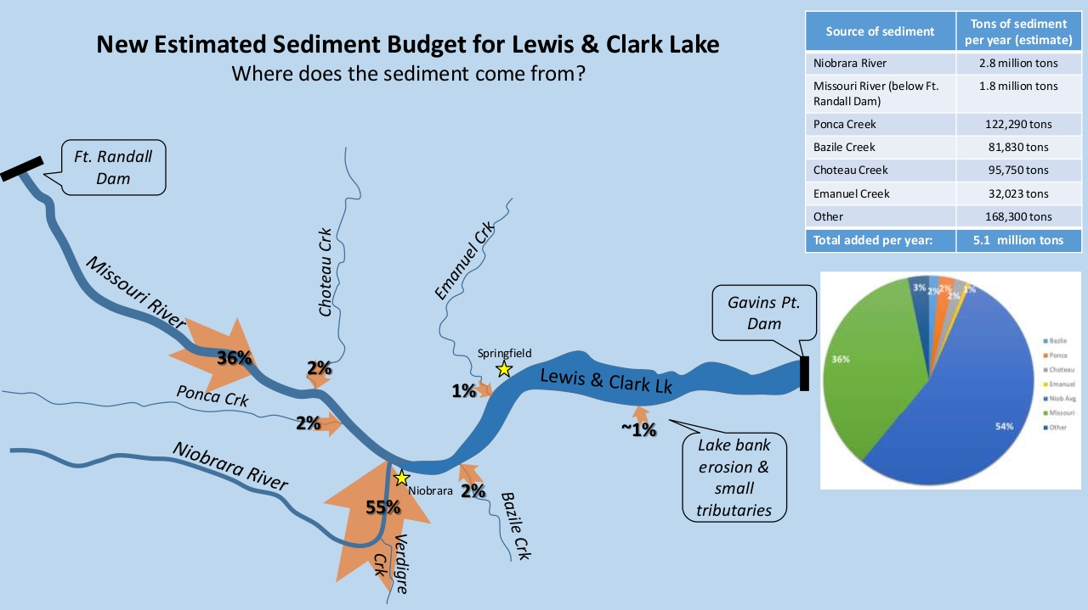
Where does L&C Lake sediment come from?
Courtesy South Dakota Geological Survey
2023 update
Notes:
Updated L & C Lake sediment sources from SD Geological Survey. This information is from 2023, prior information was from 2012.
Tributary creeks are showing reduced sediment input. Collectively, the four creeks (Ponca, Bazille, Choteau, and Emanual) drop from 30% estimated input budget to 7%.
Erosion and other, smaller tributaries drops from ~10% to 1%
The Niobrara River (w/Verdigre Creek) is increased from 50% to 55% of sediment budget
The big change – Missouri River from Ft Randall - increased by 26%, from 10% estimated to 36% estimated sediment budget!
Increased knowledge of where the sediment comes from assists in determining methods and locations to help reduce the load from entering into the reservoir system.
Further research into what causes the sediment to enter into the system is needed to assist in watershed management strategies and programs.

Slide 5
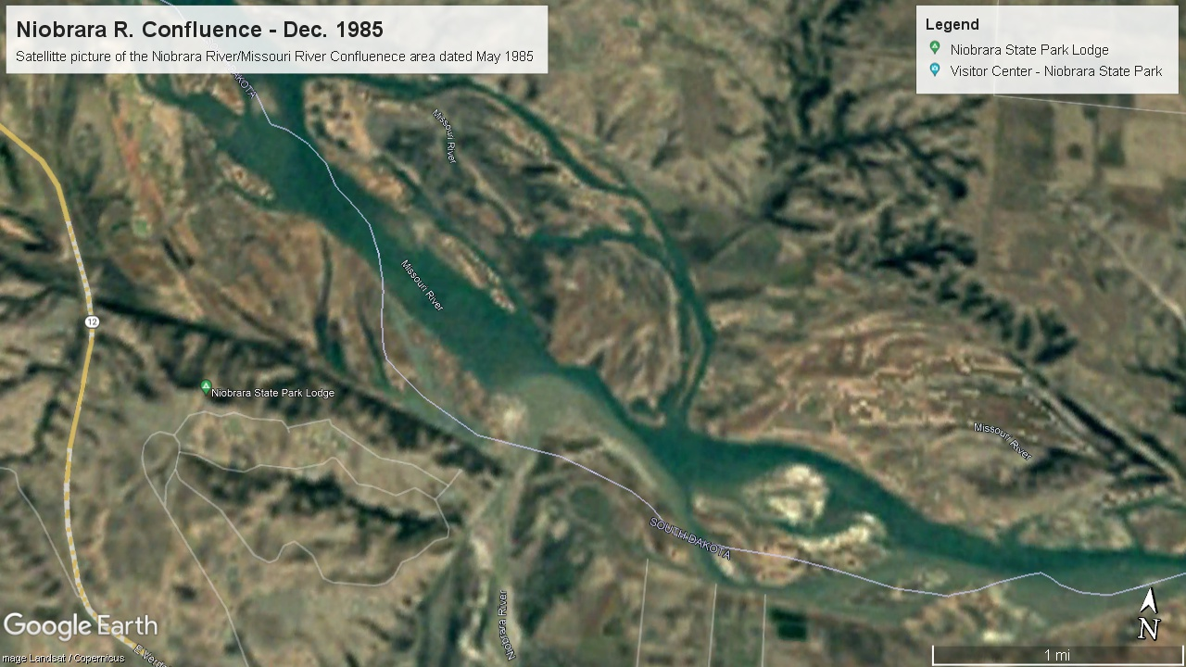
Sedimentation in Action
December 1985
Missouri R.
S. Dakota
1.2 miles
Niobrara R.
Nebraska
At confluence, river was open for full recreational navigation. Distinct color showed the amount of sedimentation entering the Missouri River from the Niobrara River.
Notes:
Satellite image from Google Earth dated December of 1985. Note the sandy colored water flowing from the Niobrara R.. River navigation is still becoming affected. The Running Water to Niobrara ferry boat had ended service in 1984 as the route was being impacted even for low draft vessels. Recreational boat was possible into the mouth of the Niobrara R. to the old railroad bridge that ran on the lowland below the bluffs.
This stretch of the river is also a passage point for pallid sturgeon during their reproductive cycles and was a key point in netting to harvest roe for hatchery efforts.

Slide 6
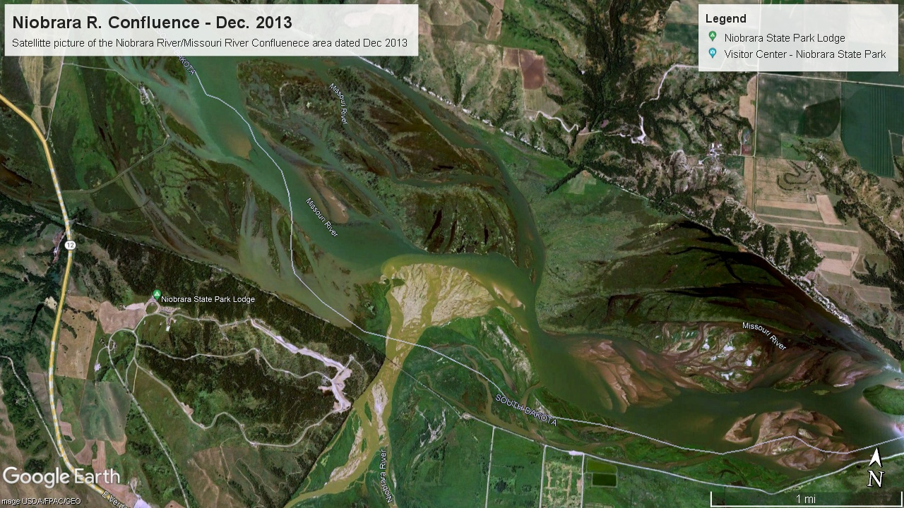
Sedimentation in Action
December 2003
Missouri R.
S. Dakota
1.2 miles
Niobrara R.
Nebraska
At confluence, recreational navigation is becoming severely restricted. Growing sediment deposits – mostly sand – are creating a damming effect, a second delta is forming upstream.
Notes:
Satellite image from Google Earth dated December of 2003. Recreational navigation is reduced to small boats. The sandbar has taken hold and is now creating a damming effect. This is creating a second delta upstream from the confluence. In this delta, the current backs up and the surface level rises, causing flooding of low lands on the river banks. This delta continues to grow today.

Slide 7
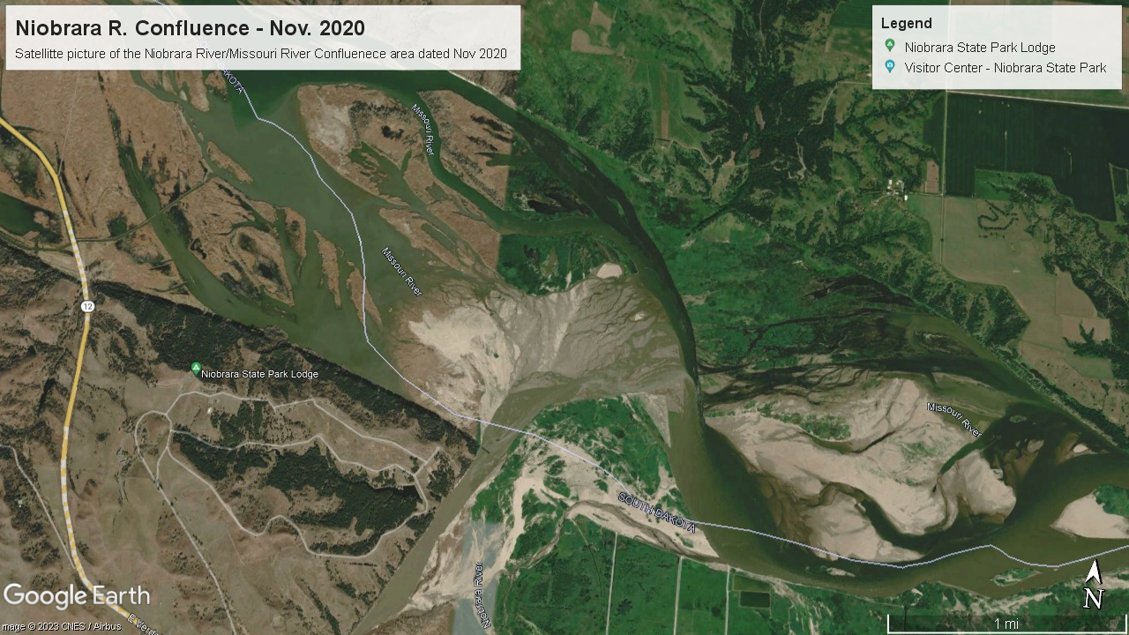
Sedimentation in Action
November 2020
Missouri R.
S. Dakota
1.2 miles
Niobrara R.
Nebraska
At confluence, river is now severely restricted to recreational navigation and fish movement. River currents are altered and plant life is taking root.
Notes:
Satellite image from Google Earth dated November or 2020. The river is now almost completely constricted at the confluence. Only recreational fishing boats with shallow drafts can pass. The sedimentation problems are pronounced for the next several miles downstream of this location. Vegetation is well established in the summer months. It is estimated nearly 90% of the sediment load passes through this area, either from the Niobrara R. (~55%) or coming from upstream (~36%).
This is the target area for sediment reduction efforts to extend the useful life of Gavins Point Dam and Lewis and Clark Lake. It is desired to capture and remove some percentage of sediment from this area. Finding Beneficial Use(s) of Sediment is key, removing and stockpiling sediment is not sustainable into the future.

Slide 8

Questions and Conclusion
Questions
MSAC strives to educate and create collaborative relationships to address the sediment issues impacting the useful life of upper Missouri River dams.
Visit us at MSAC online
Website - www.msaconline.com
Thank You for this opportunity
Notes:
That concludes my presentation. Are there any questions on this or other MSAC areas?
MSAC is an education and partnership organization. The cost of continued, unchecked sedimentation on Lewis and Clark Lake and other areas of the upper reaches of the Missouri River is already impacting the useful life of the dam/reservoir system. This is a complex issue but the people, resources, and knowledge is there to make a positive impact in reducing the sediment loads to levels the living river can manage.
Thank You for your time and attention and for providing MSAC this opportunity to update your organization.

Slide 9
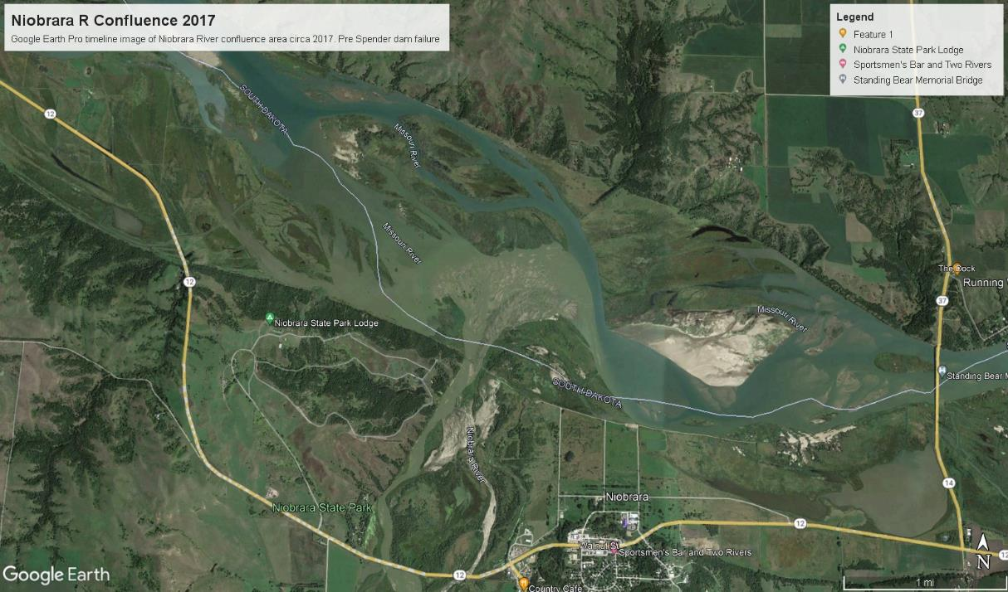
Niobrara R. Confluence –
Pre Spencer Dam failure
Notes:
This image is from 2017, approximately 2 years before the failure of the Niobrara River dam at Spencer (NE).

Slide 10
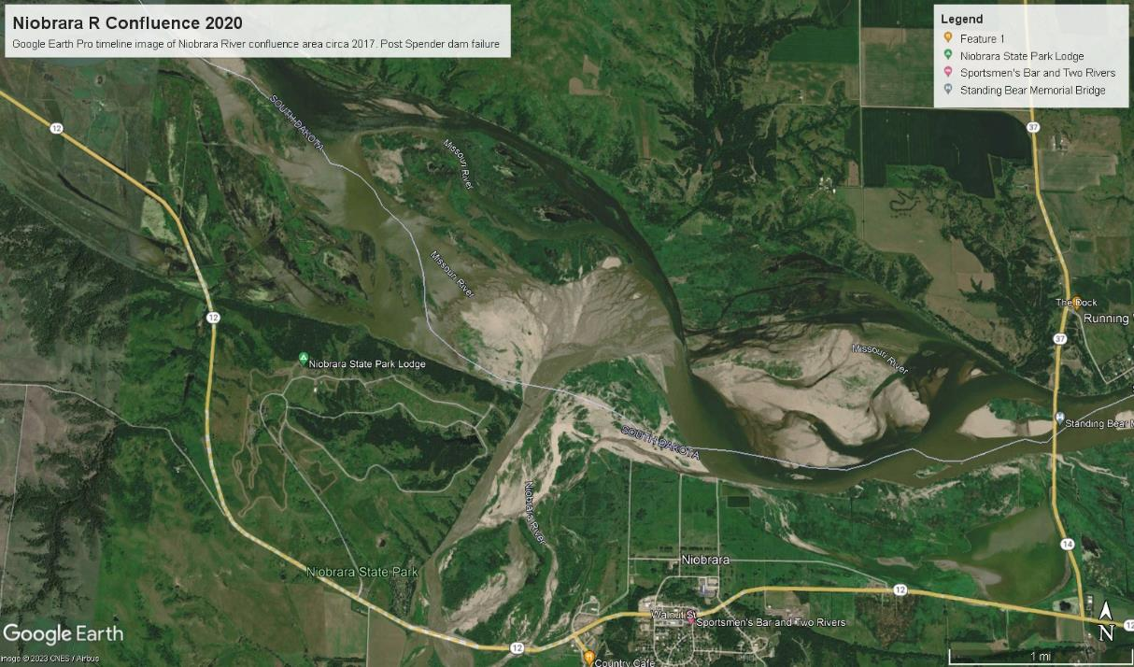
Niobrara R. Confluence –
Post Spencer Dam failure
Notes:
This image is from 2022, approximately 1 year after the failure of the Niobrara River dam at Spencer (NE).

