Slide 1
The Challenges with and the Need for Market Expansion
Neil Lindgren
UGP Energy Management and Marketing Office, Watertown SD
December 12, 2023

Slide 2
Topics
Markets in North America
Electricity market constructs
WAPA in markets
Energy Imbalance
RTO
Day ahead

Slide 3
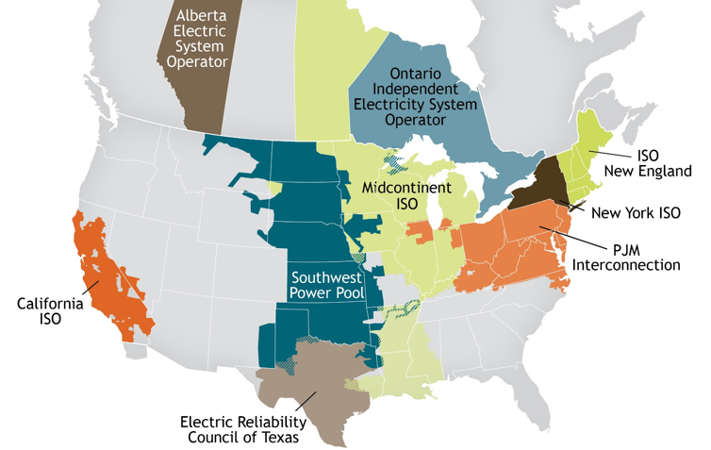
North America electricity markets
There are nine Regional Transmission Organizations (RTOs)/Independent System Operators (ISOs) in North America. Combined, they serve approximately 2/3 of electricity demand.
The majority of the Western Interconnection is not in an RTO/ISO. Similar dynamic in the Southeast, albeit at a smaller scale.
WAPA’s Upper Great Plains has been in the Southwest Power Pool (SPP) RTO in the Eastern Interconnection since 2015.
Sierra Nevada is not in the California Independent System Operator (CAISO) footprint, but approximately 50% of its energy is delivered into the CAISO.
Graphic Source: Federal Energy Regulatory Commission (FERC)

Slide 4
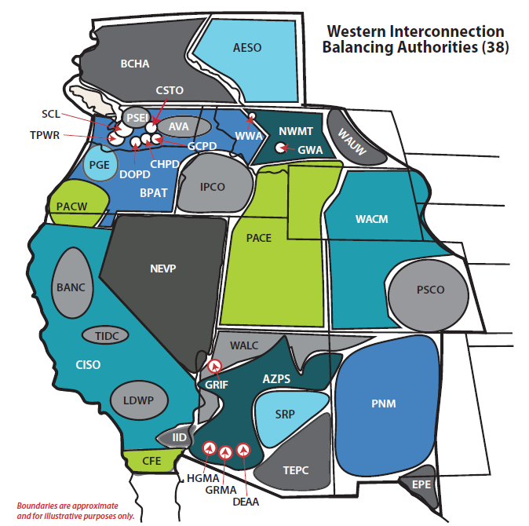
The West is different
38 Balancing Authorities (BAs) operate some but not all generation and transmission in their respective footprints. Can only “see” a limited distance beyond the BA Area (BAA) boundary.
WAPA operates three BAs and one sub-BA (WACM, WALC, WAUW, and WASN)
A large percentage of transmission sales are contract path, which does not align with how the system physically operates.
Unscheduled flow, loop flow, and transmission congestion management are complicated, expensive, and a risk to reliability.
Electricity sales are predominantly bilateral. Price transparency and liquidity are poor. Hourly markets do not match the fundamental characteristics of renewable generation resources.
Graphic Source: Western Electricity Coordinating Council (WECC)

Slide 5
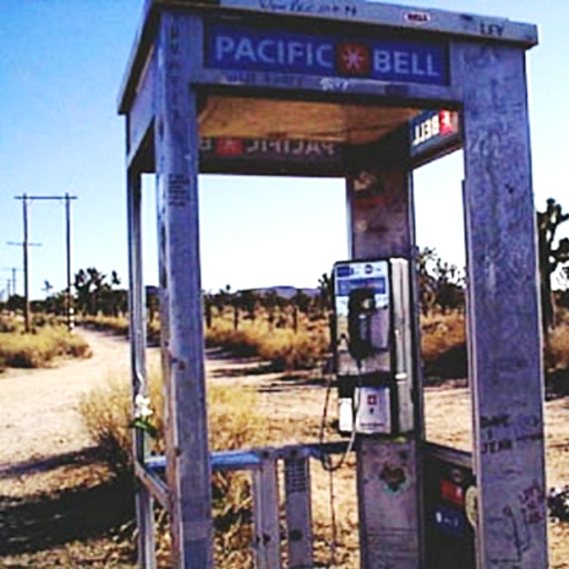
Drivers for market participation
Retirement of dispatchable generators and implications for BA operations.
Increasing penetration of wind and solar, which require different system management approaches and a greater focus on geographic diversity.
Increasing need to reach diverse generation resources further from load – without excessive transmission rate pancaking.
Customer compliance with renewable energy policies.
Drought and potential for reduced availability of hydropower generation.
Generalized resource adequacy considerations.
Reductions in bilateral trading partners as neighboring entities join centralized markets.
Need for advanced tools to manage transmission congestion.
“If you don’t like change, you’re
going to like irrelevance even less.”
General Erick Shinseki, Secretary of Veterans Affairs
Notes:
XXXX

Slide 6
Electricity Market Constructs

Slide 7
Electricity market constructs
Bilateral markets
Most of the energy transactions in the West are bilateral. One party sells directly to the other. This includes both generation and transmission.
Energy imbalance/real-time markets
Real-time energy sold through a centralized market. About 15% of total energy transactions. CAISO EIM and SPP WEIS in the West. The market uses all transmission that is available in real-time.
Day-ahead markets
Being proposed by CAISO and SPP as significant additions to the current energy imbalance markets. Many details to be worked through in proposals.
Estimated economic benefits of $500 to $750 million per year (incremental to energy imbalance)*
Full Regional Transmission Organization (RTO)
Real-time, day-ahead, ancillary services, consolidated balancing authorities, transmission tariff, resource adequacy, reliability coordination, transmission planning and transmission cost allocation. Two-thirds of US population served by RTOs/ISOs.
Estimated economic benefits for the West of $1.4 to $2 billion per year.*
* Benefits as estimated in the DOE-Funded State Led Market Study. July 2021
Notes:
Traditionally in the West, we have transacted both energy bilaterally. This means entities buy and sell directly from one another mostly on an hourly basis. From a generation perspective, this is too slow, it’s inefficient, and it leads to poor transparency in electricity prices – all of which can result in increased costs for our customers. From a transmission perspective, what we fundamental do is sell transmission by contract path versus the physical flow of electrons. Physics wins. Every time. The combination of these dynamics will become an increasing challenge for our Balancing Authority operations as both supply and demand continue to change. As a check in, WAPA operates three Balancing Authorities and one sub-balancing authority.
In an energy imbalance market – which we have two of in the West – real time energy is transacted by a centralized market operator in five-minute increments. The market operator runs complex calculations to dispatch the least-cost generation in real-time while respecting the physical limitations of the generators and the transmission system. This is a big first step to supporting system reliability and to managing increases in electricity prices. However, energy imbalance is only about 5-15% of total energy and the imbalance markets by their very nature are limited in the benefits they can offer.
A new development in the West is the consideration of layering day-ahead markets on top of the energy imbalance markets already in place. This would pick up a significantly greater volume of energy transactions. A recent study estimated economic benefits of $500 to $750 million per year (incremental to energy imbalance). It’s worth noting thought that there are not any centralized day ahead markets in the US that are not part of RTOs. We don’t know yet if this model will work. Things like governance, transmission access, transmission compensation, and market design are complicated. Federal Energy Regulatory Commission (FERC) approval is uncertain. Entities in the Midwest tried something similar a number of years ago and failed. But we have a much more compelling need and a much better understanding of what it might take to make this construct viable. There is very significant interest across the West in consideration of day-ahead market options.
Then we have full Regional Transmission Organizations or RTOs. RTOs includes real-time, day-ahead, ancillary services, consolidated balancing authorities, transmission tariff, resource adequacy, reliability coordination, transmission planning and transmission cost allocation. Two-thirds of US population is served by RTOs/ISOs. Estimated economic benefits in the West are $1.4 to $2 billion per year. This does not include the value RTOs provide in terms of much greater support for reliability along with transmission planning and development.

Slide 8
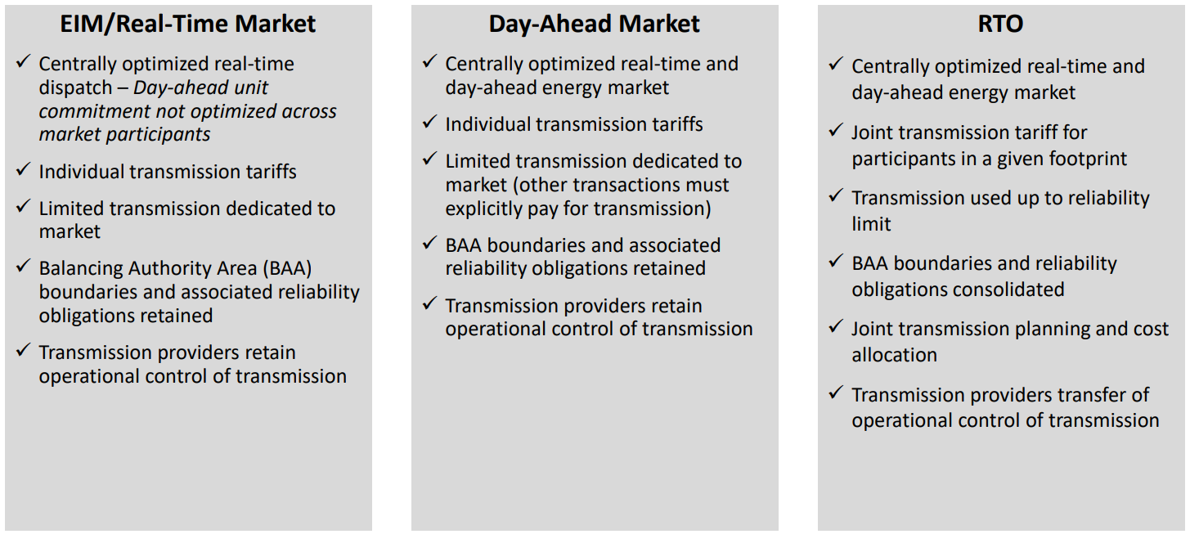
Compare and contrast market constructs
Graphic Source: Energy Strategies DOE-Funded State-Led Market Study
Notes:
This is a side-by-side comparison of the EIM, day-ahead, and RTO market constructs. Each involves the utilities and states giving up more control in exchange for more benefits. Details like governance, market design, and transmission are incredibly important.
With an EIM, there is centralized real-time dispatch. Day-ahead unit commitment and dispatch are not optimized across market participants. Electricity providers maintain their individual transmission tariffs, limited transmission is dedicated to the market, BA boundaries and reliability obligations are retained, and transmission providers retain operational control of their systems.
In a day-ahead market, we add day ahead unit commitment and dispatch to be optimized across market participants. Everything else stays the same.
With RTOs, there is a big shift. The market engine optimizes real-time, day-ahead, and ancillary service sales. There is a joint transmission tariff (also referred to as a common tariff), BAs are consolidated, transmission planning and cost allocation are coordinated across a broad footprint, and operational control of the transmission system is centralized.

Slide 9
Incremental progress
Energy imbalance markets are in place across the majority of the West.
Entities across the West are evaluating layering a day-ahead market on top of the existing energy imbalance markets.
WAPA and others are in final negotiations to expand the existing SPP RTO into the Western Interconnection.

Slide 10
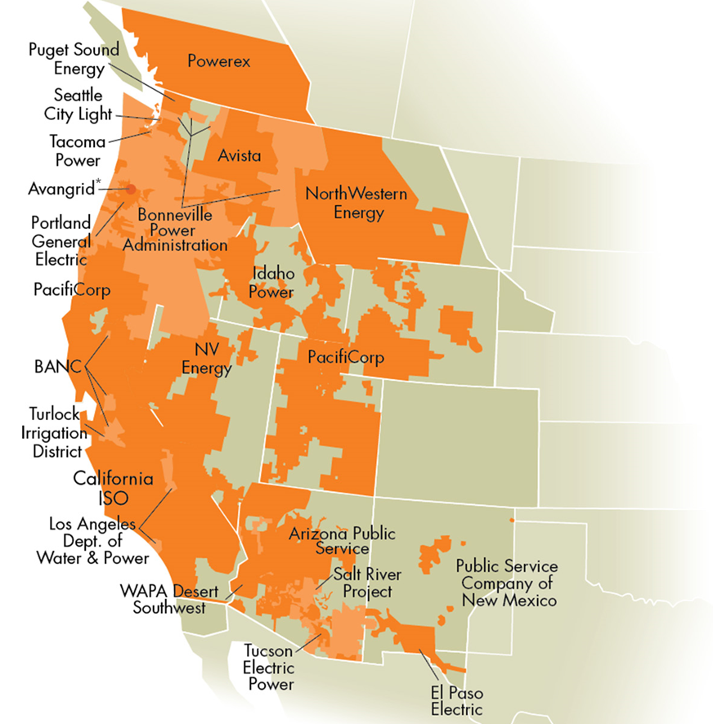
Operational: CAISO Western Energy Imbalance Market (WEIM)
Launched in 2014
$4.66 billion in cumulative gross benefits through Q3 2023
EI is approximately 5% of total transactions
Graphic Source: CAISO

Slide 11
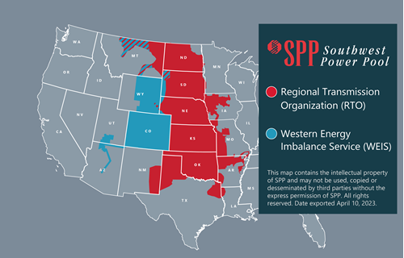
Operational: Southwest Power Pool Western Energy Imbalance Service (WEIS)
Launched February 2021
Participants:
Basin Electric Power Cooperative
Black Hills Energy
Colorado Springs Utilities
Deseret Power Electric Cooperative
Municipal Energy Agency of Nebraska
Platte River Power Authority
Tri-State G&T
WAPA CRSP, RMR, and UGP
Xcel Energy
Net benefits for WEIS participants of $31.7 million in 2022. Benefit-to-cost ratio of 7-to-1.
Graphic Source: SPP

Slide 12
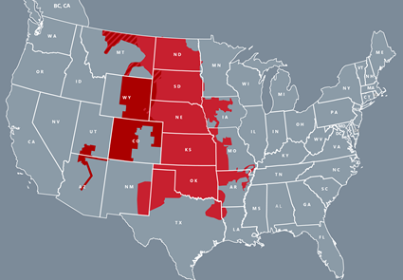
In process: SPP RTO expansion into the West
Existing RTOs
SPP RTO Expansion
Graphic Sources: FERC and SPP
Notes:
SPP RTO – GO Live * Spring of 2026 (April Fools Day 2026)

Slide 13
Proposed: Day-ahead market initiatives
Day-ahead market initiatives
SPP Markets+
CAISO Extended Day Ahead Market (EDAM)
Fundamental principle: Layer day-ahead market options on top of the existing energy imbalance options.
Magnitude:
Energy imbalance is approximately 5% to 15% of energy transactions.
Day-ahead is 85% to 95% of energy transactions.
Key issues:
Governance
Transmission use and compensation
Preservation of OATT rights
Operating across multiple BAAs
Market to market seams, potential market fragmentation
GHG integration into the market design
This would be a first of it’s kind market construct. FERC approval is not a given.
Notes:
SPP Markets+ GO Live October 2026
CAISO EDAM – GO Live Spring 2026

Slide 14
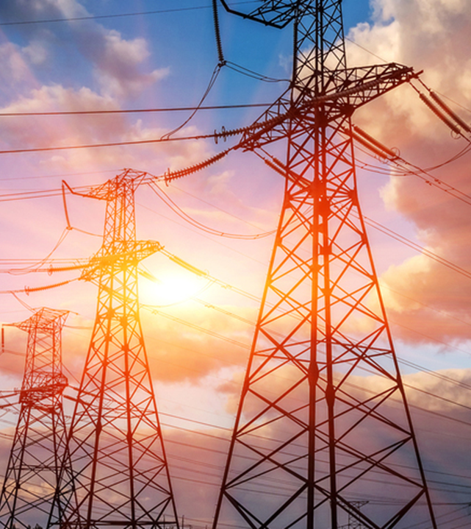
Market constructs concluding points
Energy imbalance, day-ahead markets, and RTOs are all mechanisms to support the ongoing reliability and economic performance of the electricity system amid a changing generation mix and changing demand patterns.
Reliability is much more challenging to quantify than economics, but equally if not more critical.
Each advancement in market type increases benefits and complexity.
For day-ahead markets without RTO, transmission use and compensation are particularly tricky.
Governance is always a challenge.

Slide 15
Discussion
Neil Lindgren, CPT| Manager, UGP EMMO
Western Area Power Administration | Watertown, SD
218-205-0570 | lindgren[at]wapa.gov

