Slide 1
WAPA’s Transmission Infrastructure Program
Mid-West Annual Meeting
Paul Schwabe, SVP and TIP Manager
December 12, 2023

Slide 2

WAPA’s Three lines of business
Market 10,504 MW of power from 57 plants
Buy and sell power to provide firm electric service
Federal Hydropower
Transmission
System & Service
17,000+ miles of transmission lines
Operate 3 balancing areas
15-state operating region
Transmission
Infrastructure Program
Independent $3.25 B borrowing authority
Projects must facilitate renewables
Projects must have a nexus in WAPA’s footprint
Notes:
WACM – Western Area Colorado Missouri Balancing Authority
WALC – Western Area Lower Colorado Balancing Authority
WAUW – Western Area Upper Great Plains West
WASN – Western Area Sierra Nevada (sub BA in BANC)
25,000 GW

Slide 3
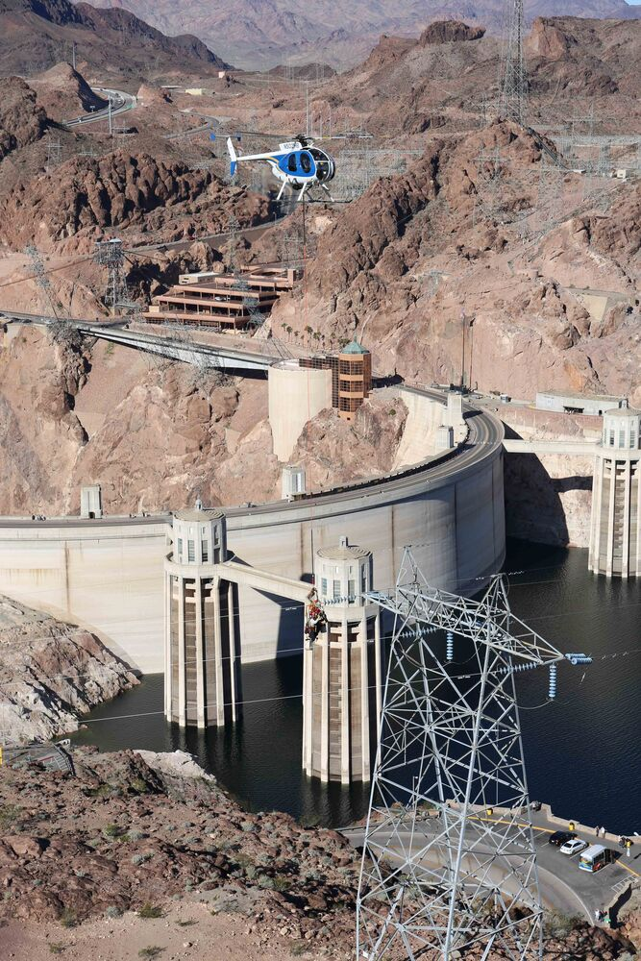

Transmission Infrastructure
Program (TIP)
WAPA’s Transmission Infrastructure Program (TIP) launched in 2009 with authority to construct, finance, facilitate, plan, operate, maintain or study construction of new or upgraded transmission and related facilities, that facilitate renewables, with at least one terminus in WAPA’s service territory.
WAPA can borrow and lend up to $3.25 billion for these purposes.
3
Notes:
The program provides two types of assistance; Financing (primary goal of the program) and Development assistance for projects as needed.
TIP is self-funded through advance funding provided by Project Developers and does not use ratepayer funds to resource operations. Project proponents pay for all costs associated with their project development or project financing effort.

Slide 4
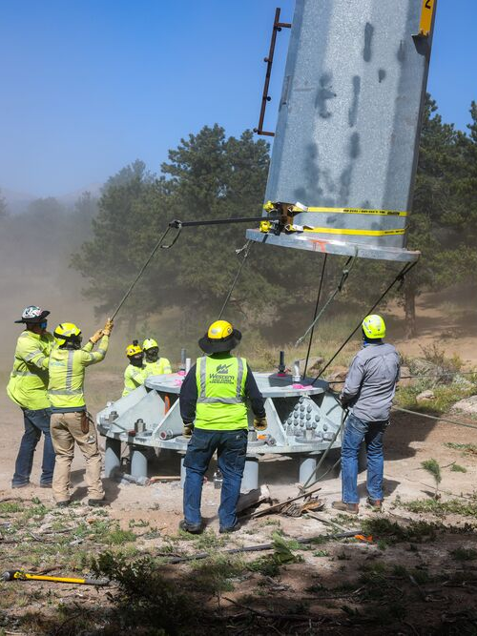


Program Assistance
Available
Financing
Eligible construction-ready projects may apply to TIP to borrow capital to construct new or upgrade existing grid infrastructure
Project Development
Prior to a loan application, eligible projects can request technical assistance on typical development activities. Applicants provide advance funding to cover costs.
4
Notes:
The program provides two types of assistance; Financing (primary goal of the program) and Development assistance for projects as needed.
TIP is self-funded through advance funding provided by Project Developers and does not use ratepayer funds to resource operations. Project proponents pay for all costs associated with their project development or project financing effort.

Slide 5
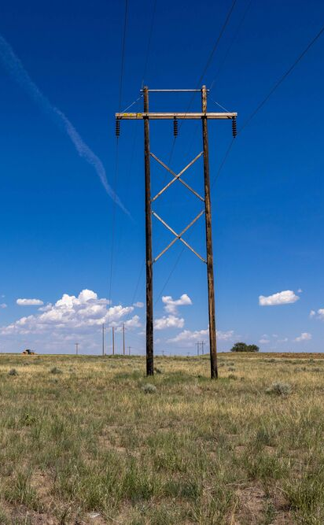

Statutory TIP Eligibility Criteria
What makes a project eligible for financing or development assistance?
Has one terminus within WAPA’s 15-state service territory
Facilitates the delivery of renewables
Demonstrates reasonable expectation of repayment
Will not adversely impact transmission system reliability or operations
Is found to be in the public interest
5

Slide 6
TIP’s Value Proposition: The Three Cs
Customers
Capital
Commercialization
  700+ public power customer connections and potential trusted partners
  Experienced and knowledgeable in local, regional and customer-specific opportunities and perspectives
  Facilitator and liaison to state and federal agencies and other partners
  TIP estimates 2- 3% (200-300 bps) lower cost advantage over private capital
  Early development stage lending (preconstruction and construction loans)
  Up to 30-year loan tenor
  Lead or co-lead in required environmental reviews
  Experienced and expert transmission owner and operator (i.e. engineering, path ratings, maintenance, power marketing)
  Lands and permitting support
6

Slide 7
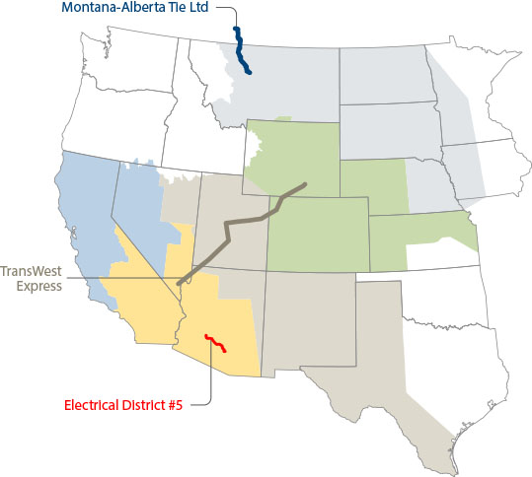
TIP Loans Repaid or in Repayment
  Electrical District 5 – Palo Verde Hub:
  $91M loan, In service January 2015; Loan in Repayment. 110-mile transmission line in solar rich Arizona serves customers in Arizona, S. California and Nevada.
  Montana Alberta Tie:
  $161M loan, In service 2013; construction loan fully repaid. 214-mile, 230-kV transmission line to deliver wind energy to interconnected markets.
  TransWest Express:
  $25M loan, Under development; development loan repaid April 2019. Proposed 725 mi 500kV HVDC transmission line from Wyoming to Nevada. 3000MW capacity.
7

Slide 8




Power Forward 2030
STRATEGIC GOALS
Safeguard a Sustainable Energy Future
Modernize
the Grid
Invest in
Our Employees
STRATEGIC OBJECTIVES
Customer
Prepare and adapt to a changing energy landscape
Provide excellent
customer service
Preserve
hydropower value
Leverage strategic
partnerships
People/Culture
Embrace inclusion
and diversity
Cultivate our value-based,
high-performance culture
Grow skills
and expertise
Integrate strategic
workforce management
Resource Stewardship
Optimize investments
in system reliability
Improve cost
efficiency
Facilitate transmission
solutions
Internal Process
Mature governance,
risk management and compliance
Optimize service
delivery
Notes:
Power Forward 2030 establishes three strategic goals that define our future trajectory to safeguard a sustainable energy future, modernize the grid and invest in our employees. Our goals ensure that WAPA enhances the value we provide to those we serve well into the future. This includes our value as a trusted source of affordable and reliable energy and transmission services, an innovative contributor to grid resilience, an engaged partner, and a supportive employer.
The strategic objectives define how we will achieve these goals through various improvements and initiatives that address critical aspects of our business– customer service, people and culture, resource stewardship and our internal processes. Each of the objectives align and work together to achieve the strategic goals.

Slide 9
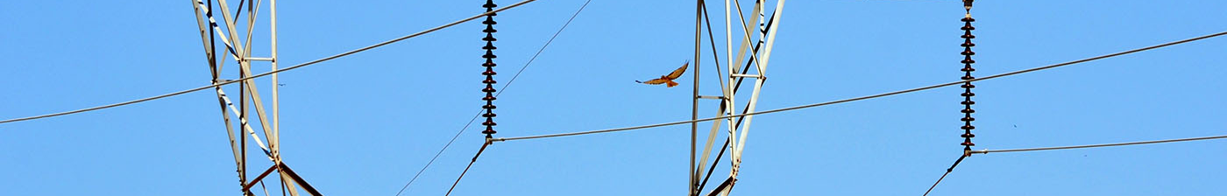

Power Forward 2030: Resource Stewardship (TIP)
Objective
3.3
We leverage federal and non-federal financial and technical resources to expand and modernize the grid.
Intended Results:
Through the Transmission Infrastructure Program, we provide low-cost capital through WAPA’s
$3.25 billion borrowing authority to facilitate the delivery of renewables to the grid.
We facilitate development of new and upgraded transmission lines and related facilities to strengthen the grid.
Our expertise and experience contribute to effective transmission solutions for the West.
Facilitate
transmission
solutions.
Key Strategic Initiative:
We target and facilitate the development of transmission and related facilities, including energy storage, that directly support the grid and customer needs.
  Initiative Champion: Transmission Infrastructure Program Manager
    Initiative Support: Desert Southwest Regional Manager
Red-tailed hawk near Rogers-Coolidge line, AZ
Photo by Becky Hopkins
Environmental Specialist
9

Slide 10
Mead Substation

Slide 11
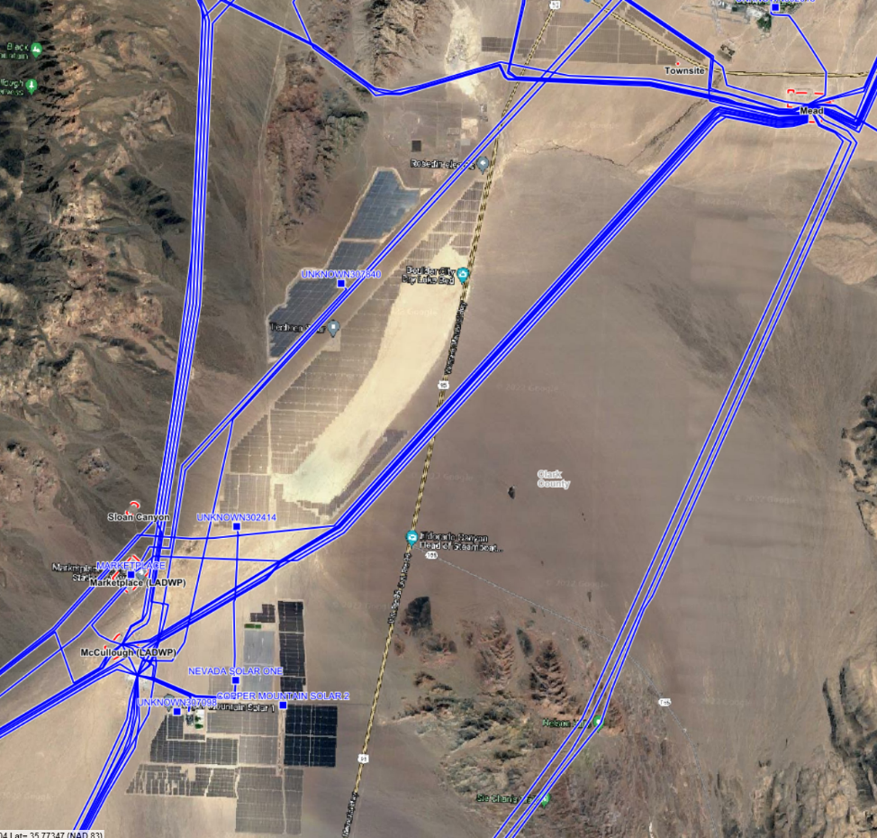
El Dorado Valley
A hotbed of solar and transmission:
Solar Projects: Boulder, Copper Mountain, Nevada One, Techren, Townsite, and more
Substations: Eldorado, Marketplace, Mead, McCullough, and Sloan Canyon
Northern System of Path 46
11

Slide 12
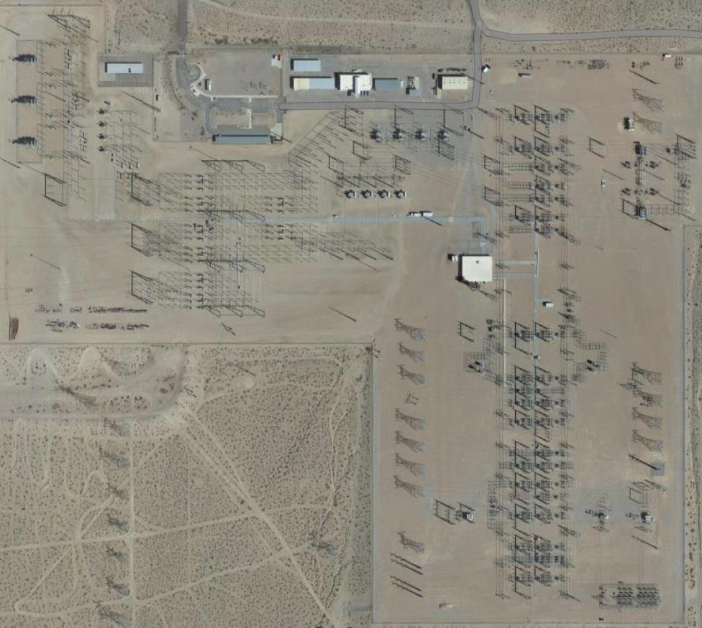
Mead Substation
Constructed in 1968 with expansions in 1990s
125 acres on 4,000 acres of Federal land
69-kV, 230-kV, 345-kV, and 500-kV
30 points of interconnection 230-kV and above
Primary and secondary connections to more than 150 utilities
12

Slide 13
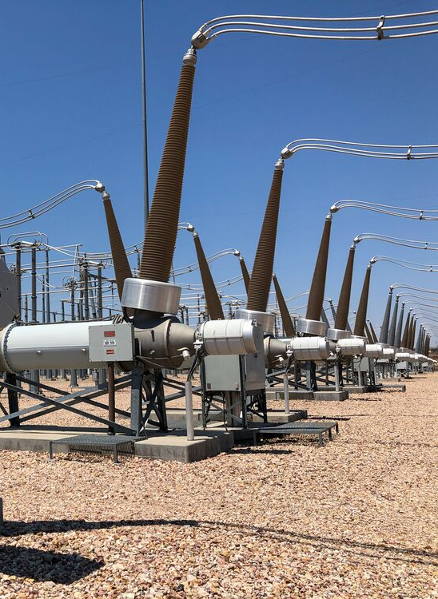
Mead Substation Exploratory Expansion Concepts
Enhance regional transfer capability and renewable resource development through any combinations of:
A new substation(s) interconnected to and operated as a hub with Mead Substation
New transmission lines and/or upgrades of existing transmission lines
Battery storage connected to Mead Substation or its transmission lines

Slide 14
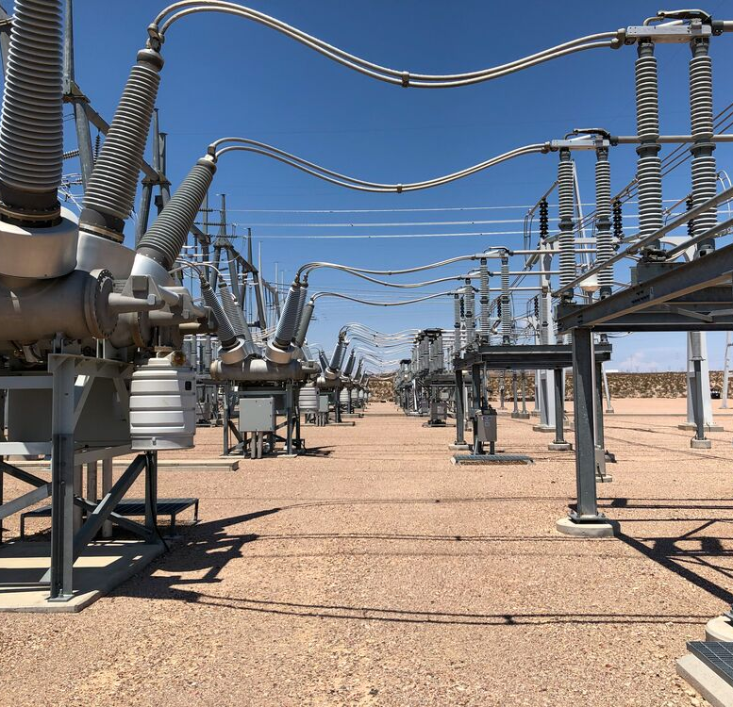
Our Vision & Collaboration
TIP’s Mission: Anticipate and address future energy needs.
Collaboration with GridLiance: Expertise and commitment to tackle Mead’s challenges.
Goal: Expand Mead for additional sustainable energy delivery.
WAPA’s Role: Together, shaping a brighter, sustainable energy future.
14

Slide 15
Contact
Paul Schwabe
Senior VP and TIP Manager
720-962-7709
Schwabe@wapa.gov
Erin Green
Attorney-Advisor
720-962-7016
egreen@wapa.gov
Stacey Harris
Project Manager
720-962-7714
sharris@wapa.gov
www.wapa.gov
TIP@wapa.gov | 720.962.7710 | www.wapa.gov/transmission/TIP

Slide 16
Customer Service Territory
Any projects must have a terminus within WAPA’s service territory – it is not required that a project be entirely within WAPA’s service territory.
It is also not required that a project interconnect to WAPA’s system.

