Slide 1
Regional Transmission expansion in the west
Mid-West Electric Consumers Association Annual Meeting

Slide 2
THIS ISN’T OUR PARENTS‘ ELECTRIC GRID
Electrification
Smart meters
Advanced technologies
Generator retirements
Environmental constraints
Compliance
Cybersecurity
Microgrids
Wind
Energy efficiency
Prosumers
Evolving grid
Electric vehicles
Fuel prices
Battery storage
Solar
Consumer demand
Distributed generation
Demand response
Extreme weather events
PLANNING FOR AN UNCERTAIN FUTURE
Notes:
Future grid will look very different from today’s grid

Slide 3
North American Independent System Operators (ISO) and Regional Transmission Organizations (RTO)
Notes:
This map depicts the 9 Independent System Operators and Regional Transmission Organizations in the United States and Canada.

Slide 4
WEST/EAST DC Ties
1,320 MW transfer capability between Eastern and Western Interconnections

Slide 5
217,155 gWh YTD Generation AS OF OCT. 1, 2023

Slide 6
Our Evolving Energy Mix
Coal and gas use has decreased, while wind has increased
Notes:
Our energy mix is changing

Slide 7
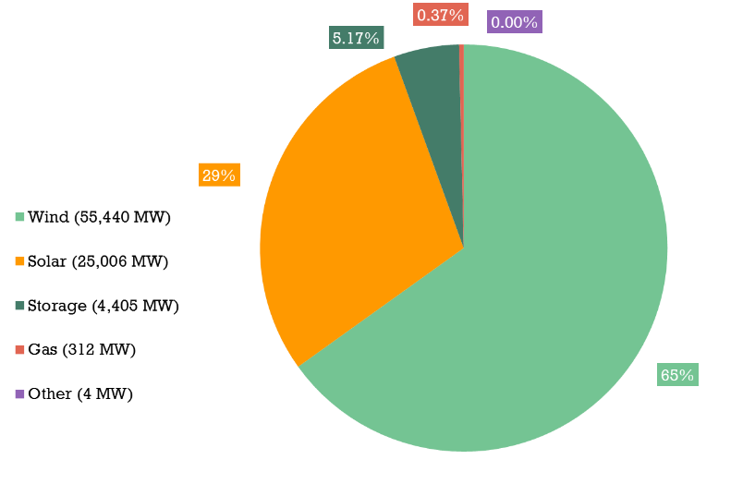
139.8 GW Generator Interconnection Requests under Study As of Nov. 1, 2023

Slide 8
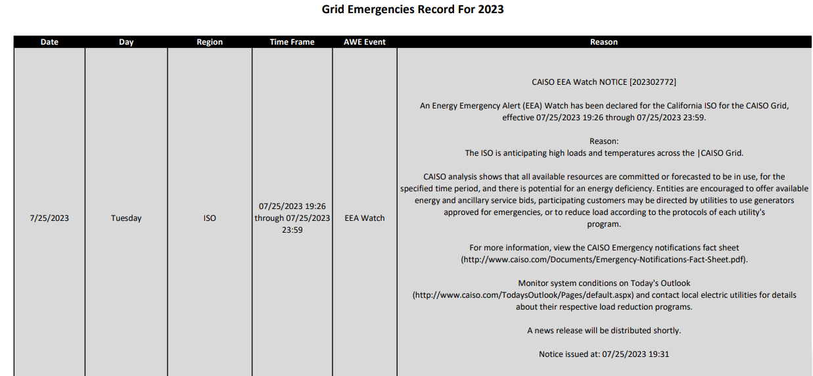
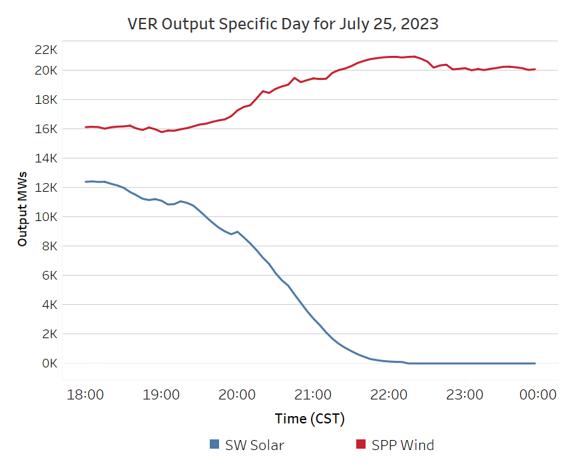
Leverage Regional Diversity
CAISO EEA Watch 7/25/23
Midwest wind and southwest solar across the ties dynamically could bolster regional security.

Slide 9
Spp markets
Transmission Service Participants buy & sell use of transmission lines owned by different parties
Integrated Marketplace Participants buy & sell wholesale electricity in day-ahead & real-time
Day-Ahead Market commits cost-effective & reliable generation for region
Real-Time Balancing Market economically dispatches generation to balance real-time generation & load while ensuring reliability
Consolidated Balancing Authority operates as a single region
Western Energy Imbalance Service Market Contract-based, real-time balancing market in Western Interconnection
As of Feb. 1, 2021
Congestion Hedging Market provides hedge against transmission congestion
Coming Soon!
Markets+
Notes:
9
9

Slide 10
Differences in SPP Offerings and RTO
 | WEIS | Markets+ | RTO Membership
Real-time balancing | ✓ | ✓ | ✓
Day-ahead unit commitment |  | ✓ | ✓
Reserve Sharing |  |  | ✓
Regional planning |  |  | ✓
Consolidated Balancing Authority |  |  | ✓
Reliability Coordination |  |  | ✓
Resource Adequacy |  |  | ✓
Transmission Service Provider |  |  | ✓

Slide 11
Western Energy Imbalance Service (WEIS)

Slide 12
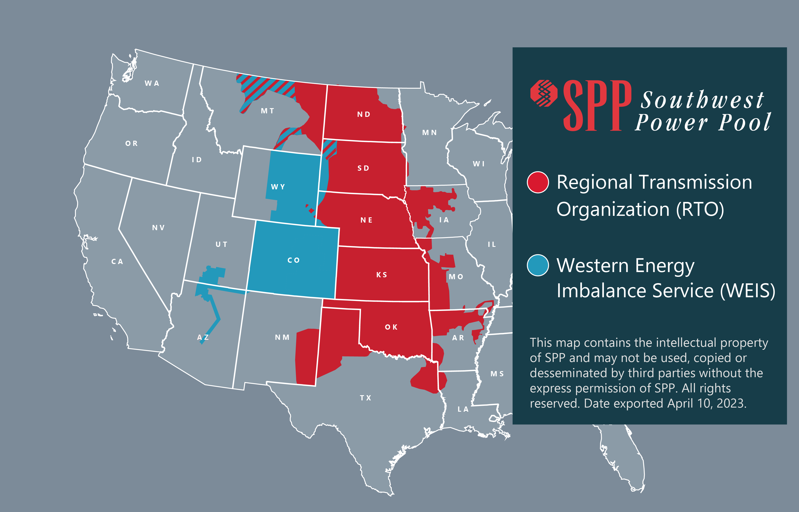
12
12

Slide 13
WEIS Market growth
February 2021
August 2022
April 2023
WEIS market launches with six participants
Total Load = 4GW
Colorado Springs Utilities joins WEIS market
Total Load = 5GW
Public Service Company of Colorado, Platte River Authority and Black Hills Energy Colorado will join WEIS market
Total Load = 13.5GW

Slide 14
SPP RTO Western Expansion

Slide 15
Basin Electric Cooperative
Colorado Springs Utilities
Deseret
MEAN
Platte River Power Authority
Tri-State G&T
WAPA - Upper Great Plains
WAPA - Rocky Mountain Region
WAPA – Colorado River Storage Project
15

Slide 16
RTO Expansion into the western Interconnect
In Nov. 2020, SPP received letters of commitment from original seven WEIS entities to investigate RTO membership and expansion in Western Interconnection.
Development of tariff changes has begun with FERC filing target of May 2024
Between July and October 2023 received commitment agreements from nine entities to move forward with RTO integration
Terms and Conditions approved in three stages in 2021 and 2022 with goal to place Western facilities under the RTO with minimal changes
Current information at spp.org/western-services/rto-west/
Notes:
Basin Electric
Deseret Power
MEAN
Tri State
WAPA CRSP, RMR UGP

Slide 17
RTO Expansion into the western Interconnection
Two Balancing Authority Areas
Eastern Interconnection
Western Interconnection
Single market solution optimized across DC ties
510 MW of bi-directional DC tie capacity
Current RTO governance structure with necessary expansion to be inclusive of members in Western Interconnection

Slide 18
WEST/EAST DC Ties
1,320 MW transfer capability between Eastern and Western Interconnections

Slide 19
One Market
One Integrated Marketplace
Co-optimizing energy over the DC ties
Economically committing and dispatching all resources
Each BAA clearing their own operating reserves
One market for TCR market and process

Slide 20
SPP RTO WEST expansion Timeline
Jan. – July 2021
Technical Discussions
Terms and Conditions Review – Members Forum
Feb. – May 2021
Governing Document and Tarff Review
July 2021
Terms and Conditions – Members Forum, MOPC
July 2022
DC Tie T&C approved by West Interested Parties and SPP Board of Directors/ Regional State Committee
October 2022
WAPA-CRSP requests additional terms and conditions
July 1 2023
Execution of Membership Commitment Agreement by the West Interested Parties
Q3 – 2023
SPP Staff Begins Tariff Updates
January 2023
SPP Board Approval of updated Terms and Conditions for WAPA-CRSP
Q2 – 2024
File Tariff Modifications with FERC to implement the RTO on the West
Q4 – 2025
FERC Tariff Approval
July 2021
Policy Level Agreement - approved by West Interested Parties and SPP BOD/RSC
Q2 – 2025
Member Testing Begins
BA Certification
April 1st 2026
GO LIVE
Market Development Begins
Q1/Q2 2023
WAPA initiates FRN process
We are here
Notes:
FRN = Federal Register Notice

Slide 21
Markets+

Slide 22
Participation phases – Incremental approach
Phase 0: Exploration
2022
SPP facilitated webinars and face-to-face meetings on possible Markets+ design elements
Published Markets+ Service Offering in November 2022
Requested parties sign Phase 1 agreements to participate in Tariff and Protocol development by April 2023
Phase 1:Tariff and Protocols
2023-2024
Establish Markets+ governance proposed in Service Offering as much as practical
Facilitate development of Markets+ Tariff and Protocols with voting participants and stakeholders
Leverage “boilerplate” day-ahead and real-time features and focus on completing unique Markets+ items
Phase 2: Implementation
2024+
Upon FERC approval, SPP acquires/modifies necessary software, hardware and related processes
Participating entities commit to fund implementation efforts
Entities integrated into the system

Slide 23
Markets+ Phase One Participants
Pattern Energy Powerex Corp.
Public Generating Pool
Public Power Council
Xcel Energy Colorado (PSCo) PUD No. 2 of Grant County
Puget Sound Energy
Renewable Northwest
Salt River Project Sierra Club
Snohomish Pubic Utility District
Tacoma Power (City of Tacoma)
The Energy Authority
Tri-State
Tucson Electric Power Company WAPA Desert Southwest
Western Energy Freedom Action Western Power Trading Forum
Western Resource Advocates
Advanced Power Alliance American Clean Power Association
Arizona Electric Power Cooperative, Inc.
Arizona Public Service Basin Electric Power Cooperative
Black Hills Colorado Electric, LLC
Black Hills Power, Inc.
Bonneville Power Administration Calpeco Electric Liberty Utilities
Chelan (PUD No. 1 of Chelan County)
Cheyenne Light, Fuel and Power Company
Clean Energy Buyers Association Colorado Independent Energy Association
Interwest Energy Alliance
Municipal Energy Agency of Nebraska
Natural resources Defense Council Northwest & Intermountain Power Producers Coalition
NV Energy, Inc. NW Energy Coalition
Reflects agreements executed by May 1st.

Slide 24
Vision for the Future

Slide 25
Spp’s markets vision
WEIS continues for period of time
Imbalance market a great introduction to markets
Short-term solution for market participants
RTO development
Provides long-term solution to market needs
Consolidated BA, Regional Planning, Unit Commitment
Markets+ development
Possible long-term solution to meet some market needs

Slide 26
Western Markets Roadmap
Western Interconnection
Eastern Interconnection
CAISO
SPP RTO
Standard approach with import/export bids
or
Market-to-market optimized transfers (preferred)
SPP Markets+
EIM
WEIS
(RT Only)
(DA and RT)
(RT Only)
Ideally a single co-optimized unit commitment and dispatch under a robust governance framework with an independent board

Slide 27
Questions?

