Slide 1
Mid-West Electric Consumers Association
US Army Corps of Engineers
Status Update
Gary Hinkle
Chief, Maintenance Engineering & Management Support Branch
2021 Water Year Recap
COVID Impacts
Zebra Mussel Update; GP, FR, BB, OA
Supplemental Funding Bills
Fort Randall Rehab Award Status
Gavins Point Stator Repair Recap
23 September 2020

Slide 2
Missouri River Mainstem System
Annual Runoff above Sioux City, IA
2021
Million Acre-Feet
Historic Drought Periods
35.2 MAF
10%
U.D.
30.9
25%
U.Q.
24.7
50%
Med.
19.5
75%
L.Q.
16.2
90%
L.D.
Year
Notes:
2019 was the 2nd highest runoff in 122 years of record keeping.
1st – 2011; 61MAF
2nd – 2019; 60.9 MAF
3rd - 1997; 48MAF
4th – 2018; 41.3MAF
5th – 1978; 41MAF
6th – 2010; 38.5MAF
7th – 1927; 37MAF

Slide 3
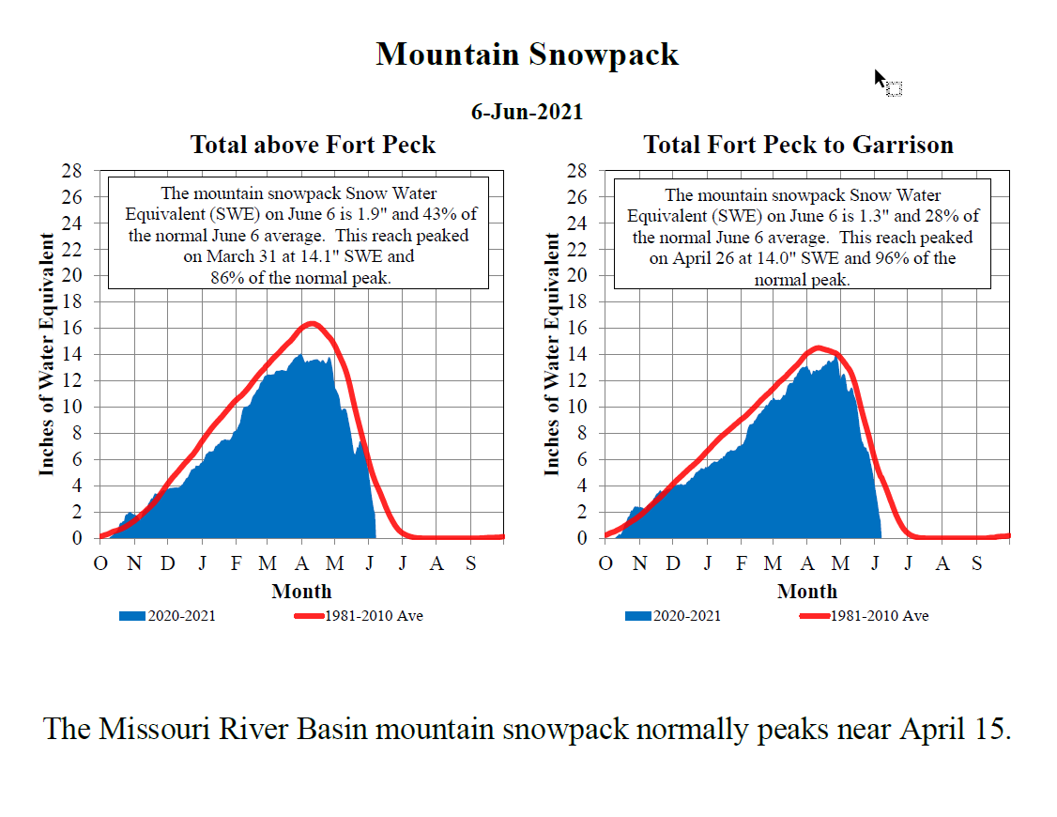

Slide 4
CY 2021 Missouri River Runoff
Above Sioux City, Iowa
Million Acre-Feet
December 1, 2021 Forecast – 15.0 MAF – 58%
Average: 25.8 MAF

Slide 5
Missouri River Mainstem System
Forecasted Energy Generation
Energy in GWh
Upper Basic: 8,600 GWh
Basic: 8,600 GWh
Lower Basic: 8,600 GWh

Slide 6
Missouri River Mainstem System storage zones and allocations
Storage
In MAF*
Historic max - 2011
72.8
72.4
Exclusive Flood Control 6%
67.7
Annual Flood Control & Multiple Use 16%
Dec 1, 2020
56.3
56.1
48.3
Carryover Multiple Use 53%
Dec 1, 2021
Historic min - 2007
33.9
*Storages updated in August 2013 based on reservoir surveys.
17.6
Permanent Pool 25%
0
Notes:
Base of Flood Control Pools in Mid to Late February at which point the 2018 runoff will have been entirely evacuated.

Slide 7
Current reservoir levels – December 1, 2021
Elevation in feet msl
Garrison
Elevation in feet msl
Fort Peck
1854
Exclusive Flood Control
2250
Exclusive Flood Control
1850
Annual Flood Control & Multiple Use
2246
Annual Flood Control & Multiple Use
2234
1837.5
2226.6
Carryover Multiple Use
1829.5
Carryover Multiple Use
Permanent Pool
2160
Permanent Pool
1775
2030
1673
7.4 feet below base of Flood Control zone
10.6 feet lower than December 1, 2020
8.0 feet below base of Flood Control zone
9.4 feet lower than December 1, 2020
Oahe
Elevation in feet msl
Fort Randall
Elevation in feet msl
Exclusive Flood Control
1620
Exclusive Flood Control
1375
Annual Flood Control & Multiple Use
1617
Annual Flood Control & Multiple Use
1365
1607.5
1350
1596.3
Carryover Multiple Use
1336.9
Carryover Multiple Use
Permanent Pool
1540
Permanent Pool
1320
11.2 feet below base of Flood Control zone
10.5 feet lower than December 1, 2020
1415
13.1 feet below base of Flood Control zone
0.9 feet lower than December 1, 2020
1240

Slide 8
Mainstem System Generation
Million Megawatt Hours
Forecast
December 1, 2021 Forecast Upper Basic: 8.6 Lower Basic: 8.6

Slide 9
Missouri River Basin 2021 Water Year
Projected power production of 8.6 BKWH, 9% lower than the 9.5 BKWH average
Gavins Point Winter Release (December thru February)
  September 1 storage check (52.1 MAF) results in a Gavins Point winter release of at least 12,000 cfs for all three conditions.
Navigation Service Levels (Mar 15 and Jul 1 System Storage Check)
  July 1 system storage check was 55.2 MAF. 1.5 kcfs below full service for the second half of the season.
Current Water-Year Balancing – At the end of February 2022:
  Basic – Below the base of flood control. System storage at 47.9 MAF (8.2 MAF blw base of FC)
  Fort Peck – 2221.7 ft (12.3 ft blw base of FC)
  Garrison – 1827.4 ft (10.1 ft blw base of FC)
  Oahe – 1597.1 ft (10.4 ft blw base of FC)
Lower Basic – Below the base of flood control. System storage at 47.4 MAF
Upper Basic - Below the base of flood control. System storage at 48.7 MAF.

Slide 10
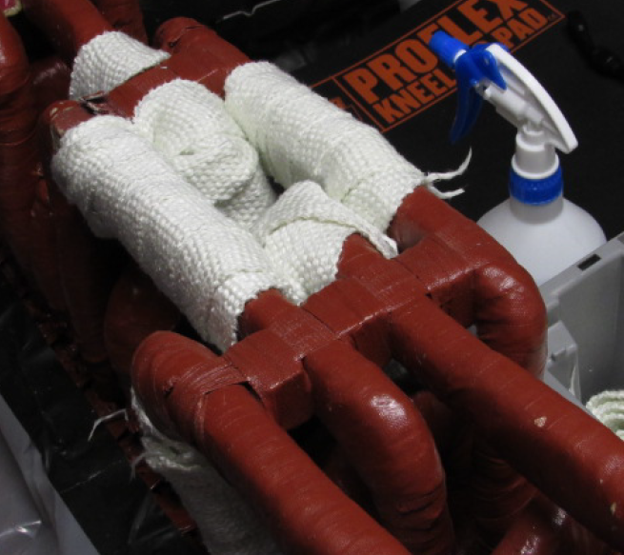
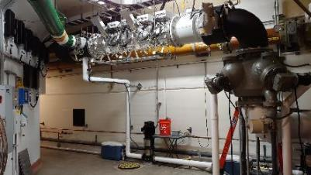
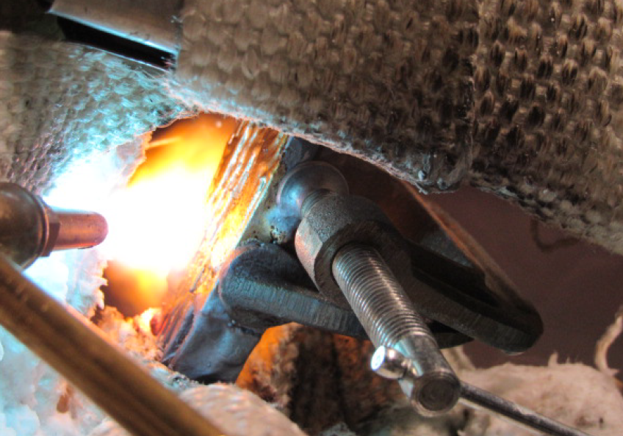
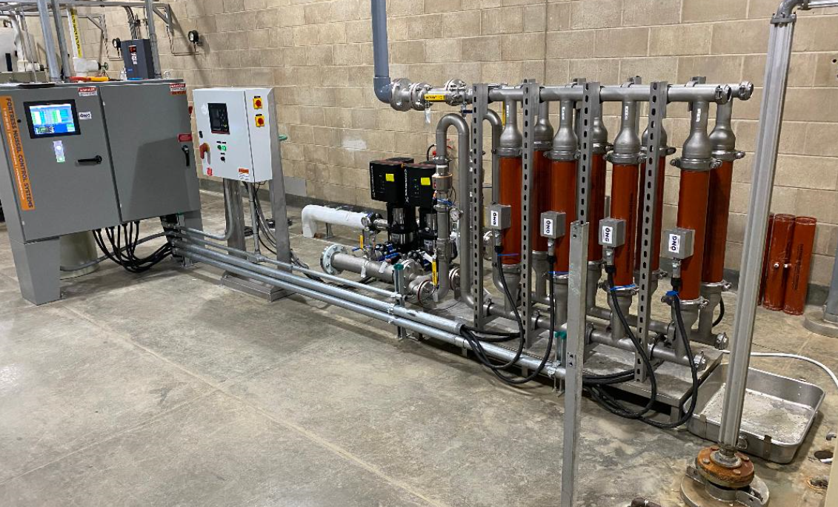
Items of Interest
COVID Impacts
Zebra Mussel Update; GP, FR, BB, OA
Infrastructure Investment & Jobs Act (IIJA) 2022
Disaster Relief Supplemental Appropriations Act (DRSAA) 2022
Fort Randall Rehab Award Status
Gavins Point Stator Repair Recap

Slide 11
Questions?

