Slide 1
Midwest Energy Consumers Association
Board Meeting
LES EV Study – Demand Response Pilot
Preparing for a plug-in future
Tom Davlin
Manager, Projects Engineering
December 8, 2021

Slide 2
LES Fact Sheet
Municipal, vertical integrated, electric utility serving Lincoln, Ne
  Service area: 200 Sq. Mi.
  144,000 customers (88% residential)
  278 mi. transmission, 2,131 mi. distribution circuits, 26 mi. fiber
  38 substations, 21,936 distribution transformers
  1057 MW of generation, 35% N.G., 34% renewable (127 MW WAPA), 31% coal
  Peak Summer Load: 786 (2011), 769 MW (2021), Energy: 3 B kWh
  500 employees (local people serving local people)
Governed by 9-member Board
Member of SPP
Net zero carbon goal by 2040

Slide 3
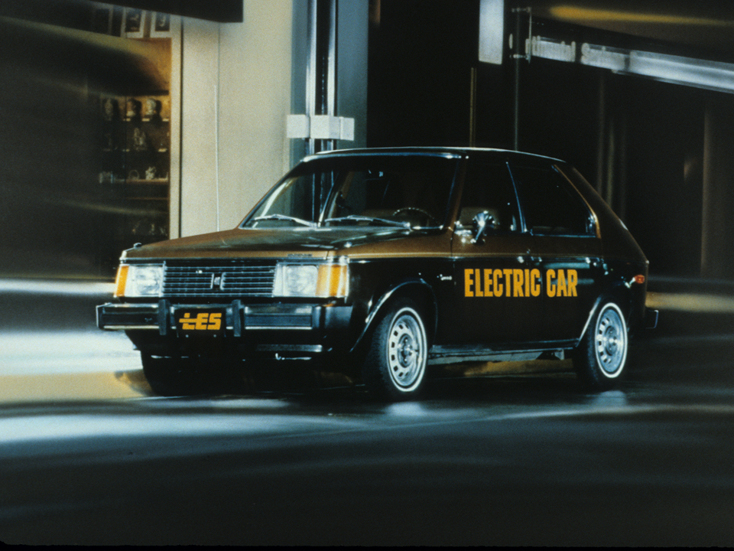
LES EV Research
Preparing for a plug-in future in 1980
Notes:
1980 Plymouth Horizon EV
Today, over 70% of LES’ passenger car fleet is either a hybrid, plug-in hybrid or all electric vehicle.

Slide 4
2019 Customer Charging Data
July Weekdays
“Typical” Summer Peak Hours

Slide 5
2019 Customer Charging Data
July Weekdays
“Typical” Summer Peak Hours

Slide 6
2019 Customer Charging Data
January Weekdays
“Typical” Winter Peak Hours

Slide 7
2019 Customer Charging Data
January Weekdays
“Typical” Winter Peak Hours

Slide 8
Customer Charging Location Data (Jan 2019 – Sep 2019)
LES Service Area

Slide 9
Customer Charging Data
Jan 2019 – Dec 2019, BEV, Home charging only
Average Lincoln air conditioner load ~ 3 kW

Slide 10
Customer Charging Data
Jan 2019 – Dec 2019, PHEV, Home charging only
Average Lincoln air conditioner load ~ 3 kW

Slide 11
2021 EV Demand Response Pilot
Months | January – February, June – September
Maximum Events | 5/month (30 total)
Customer Notice | Day before event via text/email to customer
Annual Incentive | $10/month ($60 total)
Opt-Outs | Allowed, but monthly incentive only awarded if customer complies with all DR events/month.
Enrollees | 66
Participating Vehicles | 61
Chevrolet Bolt
Chevrolet Volt
Chrysler Pacifica PHEV
Ford C-Max Energi
Ford Fusion Energi
Kia Soul EV
Mitsubishi i-MiEV
Nissan Leaf
Smart Fortwo ED
Tesla Model 3
Tesla Model S
Tesla Model X
Toyota Prius Prime

Slide 12
Demand Response Event Curtailment Rates
Compliance with all 5 events/month

Slide 13
Demand Response Event Curtailment Rates
Compliance/event

Slide 14
Winter Morning Events
8:00 am – 10:00 am: Tue 2/16/21 & Wed 2/17/21
Morning events not as impactful due to typically lower charging levels.
SPP rolling outages due to Winter Storm Uri on 2/16
Notes:
SPP instructed rolling outages from 6:44 am – 10:07 am on 2/16.
LES’ 2020 winter peak occurred on Feb 15.

Slide 15
Winter Evening Events
6:00 pm – 8:00 pm: Sat 2/6/21 & Sat 2/13/21
Evening events more impactful due to typically higher charging levels.

Slide 16
Summer Evening Events
4:30 pm – 6:30 pm: Fri 8/6/21, Tue 8/10/21, Wed 8/11/21, Thu 8/12/21 & Tue 8/24/21
LES annual peak of 769 MW on 8/24

Slide 17
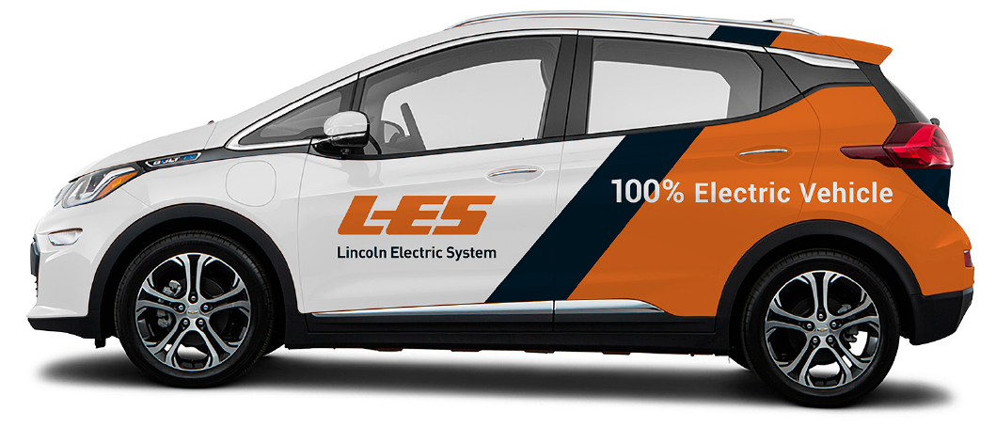


Questions?
Electric vehicle study platform made possible in part through grant funding from:

