Slide 1
Barbara Tyran, Director
Mid-West Annual Meeting
December 8, 2021

Slide 2
Macro Grid Vision Statement
Expanding and upgrading the nation’s transmission network will deliver jobs and economic development, a cleaner environment, and lower costs for consumers.

Slide 3
Overview
The Macro Grid Initiative seeks to expand and upgrade the nation’s transmission network to deliver job growth and economic development, a cleaner environment, and lower costs for consumers
The initiative operates as a partnership between ACORE and the Americans for a Clean Energy Grid (ACEG)
Through a transmission Macro Grid, high renewable resources can be connected to high electricity demand to enhance grid resiliency, reduce consumer costs, and decrease carbon emissions

Slide 4
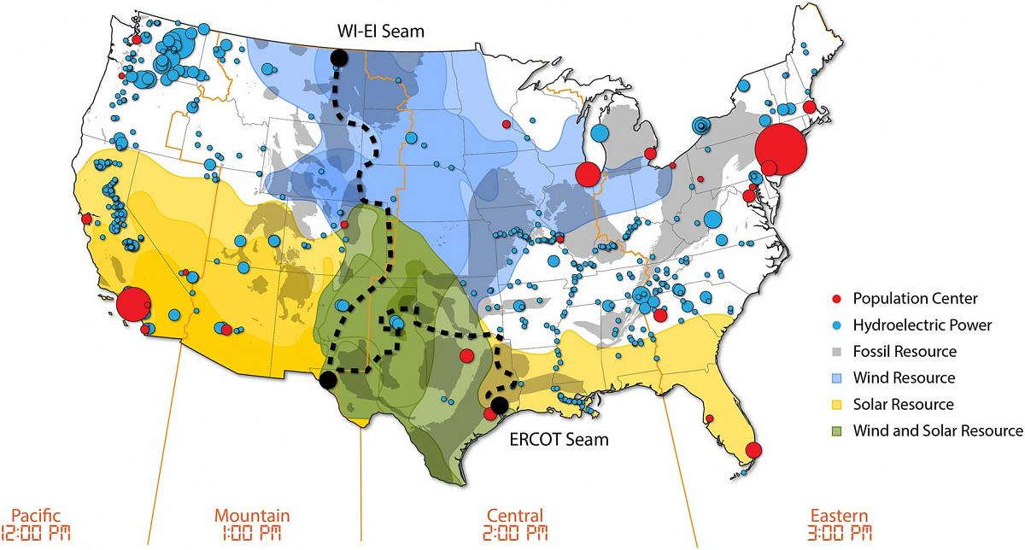
US Domestic Resources
Source: National Renewable Energy Laboratory, Interconnection Seams Study
Notes:
The Macro Grid Initiative, is a partnership between the American Council on Renewable Energy and Americans for a Clean Energy Grid that seeks to build support for investing in the transmission needed to enable decarbonization.
America’s largest renewable resources are located far from energy load centers and need transmission to connect them.
Fifteen states between the Rockies and the Mississippi River account for 88% of the country’s wind technical potential and 56% of the country’s utility-scale solar technical potential but account for only 30% of projected electricity demand by 2050. These resources cannot be developed without a plan for building interregional transmission that can deliver the power to population centers.
The dotted line represents the “seam” between the eastern and western grids. The U.S. bulk power grid is further sub-divided into regions. This balkanized, antiquated grid presents an obstacle to the development of renewable energy.

Slide 5
Vision
America’s centers of high renewable resources and high electric demand sometimes fall within different grid regions
The 15 states between the Rockies and Mississippi account for 88 percent of the nation’s wind technical potential and 56 percent of solar technical potential
This region is home to only 30 percent of expected 2050 electricity demand
Source: NREL Interconnections Seam Study
Notes:
The 15 states between the Rockies and Mississippi account for 88 percent of the nation’s wind technical potential and 56 percent of solar technical potential. However, this region is home to only 30 percent of expected 2050 electricity demand.
The general finding of regional and national studies of high renewable penetration show the consumer benefits of expanded and upgraded transmission – studies which we'll feature on a new section of the ACORE website, which will share a link to at the end of this presentation. To cite two quick examples:
The NREL "Seams" study found that increased transmission development at the “seams" between regions could save consumers more than $47 billion and return more than $2.50 for every dollar invested.
While recent modeling found that a nationwide, high-voltage direct current (HVDC) network, optimized for the nation's best wind and solar resources, could deliver 80 percent carbon emission reductions from the grid by 2030 without adding costs to consumers’ electricity bills.
So building off that work....

Slide 6
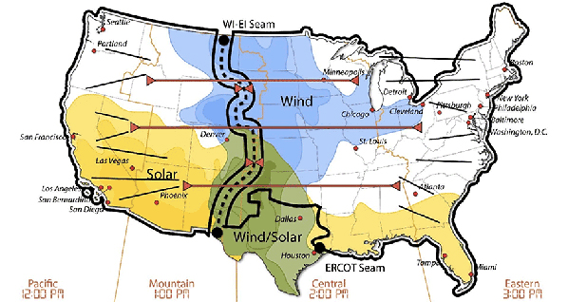
High-Voltage Interregional Transmission Benefits
Enables the integration of vast amounts of clean energy
Improves flexibility
Improves resilience
Lowers costs for consumers
Source: National Renewable Energy Laboratory, Interconnection Seams Study
Notes:
By building transmission across the seams, not only promotes the development of renewable resources, it allows electric system operators to balance loads with available resources across the country. Interregional transmission improves the system as a whole.
Access to other resources in other regions improves resiliency and flexibility.
In addition, interregional transmission can lower costs for consumers by opening up access to low-cost resources.

Slide 7
Building the Macro Grid
Expanded and upgraded interregional transmission lines would help electric utilities, corporate and institutional buyers, and other consumers meet carbon and clean energy goals by affordably and reliably integrating low-cost renewable resources
Increased transmission development at the “seams" between regions could save consumers up to $47 billion annually and return more than $2.50 for every dollar invested
Source: NREL Interconnections Seam Study, Scenario 2b

Slide 8
Objectives
The Macro Grid Initiative seeks to build public and decision-maker support for a new policy and regulatory environment that recognizes the substantial nationwide benefits of new regional and interregional transmission. Priority areas include:
Increasing Congressional support for building and upgrading transmission systems
Educating local/state/regional stakeholders on regional and interregional transmission planning and resulting benefits
Engaging in the new Federal Energy Regulatory Commission (FERC) transmission planning, cost allocation, and generator interconnection rulemaking

Slide 9
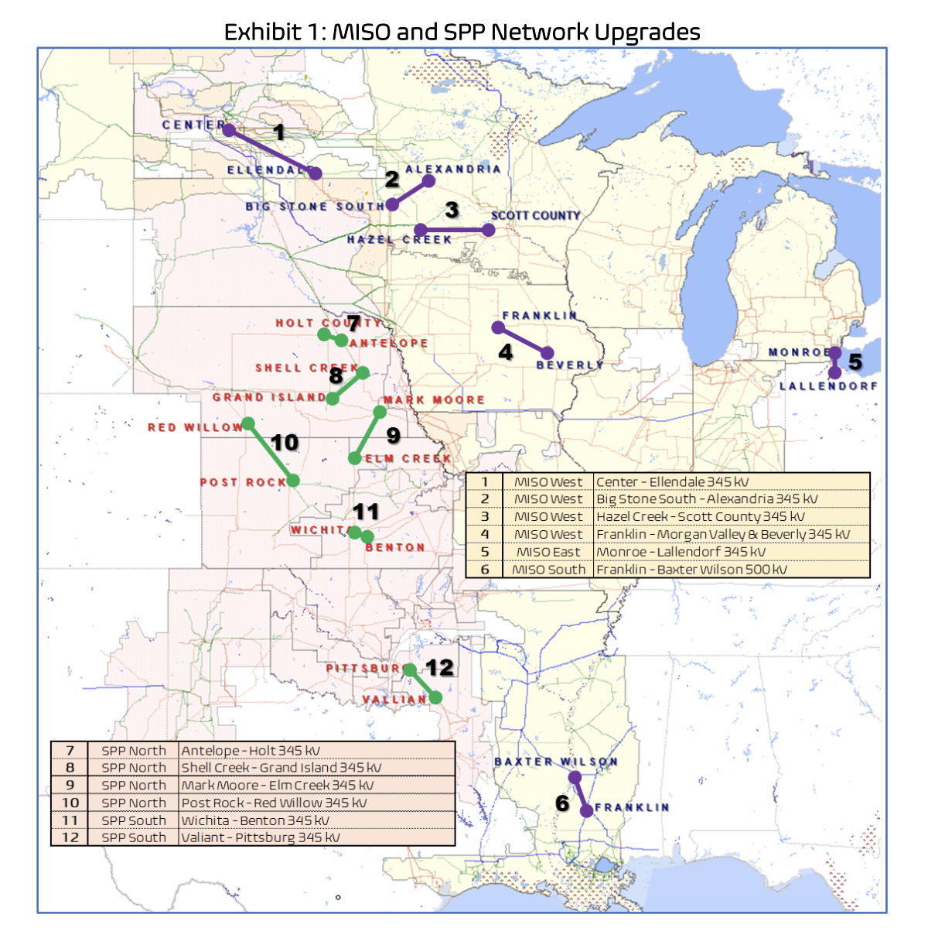
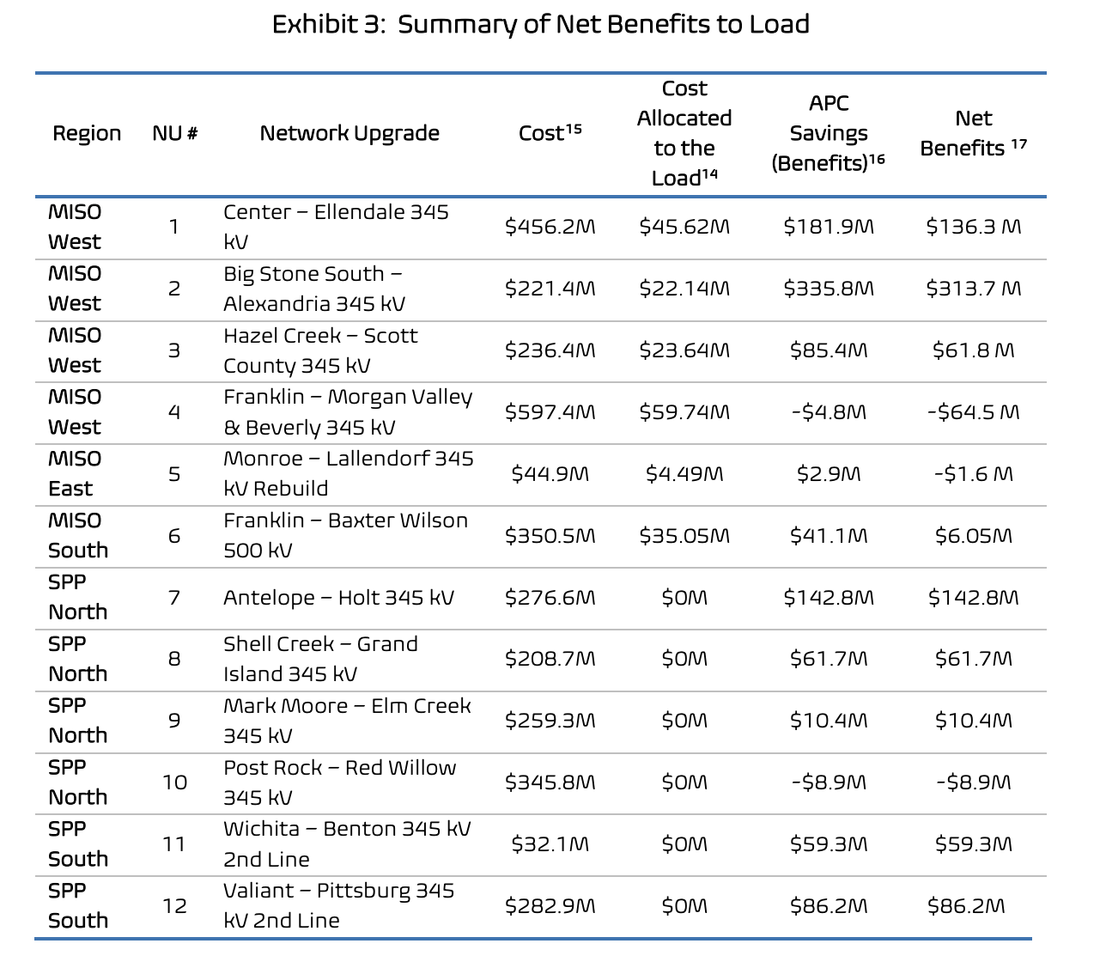
New Research
Just & Reasonable? Transmission Upgrades Charged to Interconnecting Generators Are Delivering System-wide Benefits
Notes:
Just and Reasonable study, by ICF on behalf of ACORE, focused on a representative sample of significant network upgrades assigned to new generation trying to connect to the grid in MISO and SPP.
Under current SPP rules, new generation connecting to the grid has to pay 100 percent of the costs, even if the existing system receives benefits. In MISO, there is a 90/10 split where new generation pays 90% of upgrade costs when connecting to the grid. These policies are increasingly keeping new low-cost generation from coming online.
ICF replicated the SPP and MISO system modeling to demonstrate that the MISO and SPP regions were often benefitting from significant transmission upgrades, although new wind and solar projects are asked to pay entire bill. The chart on the right shows that even using very conservative assumptions, of the twelve upgrades studied, 75 percent, or 9/12 delivered significant systemwide benefits.
As a result, in both markets, the cost of transmission network upgrades has become a significant hurdle for the integration of low-cost new renewable generation. For customers, a lack of sufficient long-range planning has meant that otherwise cost-effective new wind and solar generation is either getting delayed – raising costs – or cancelled.

Slide 10
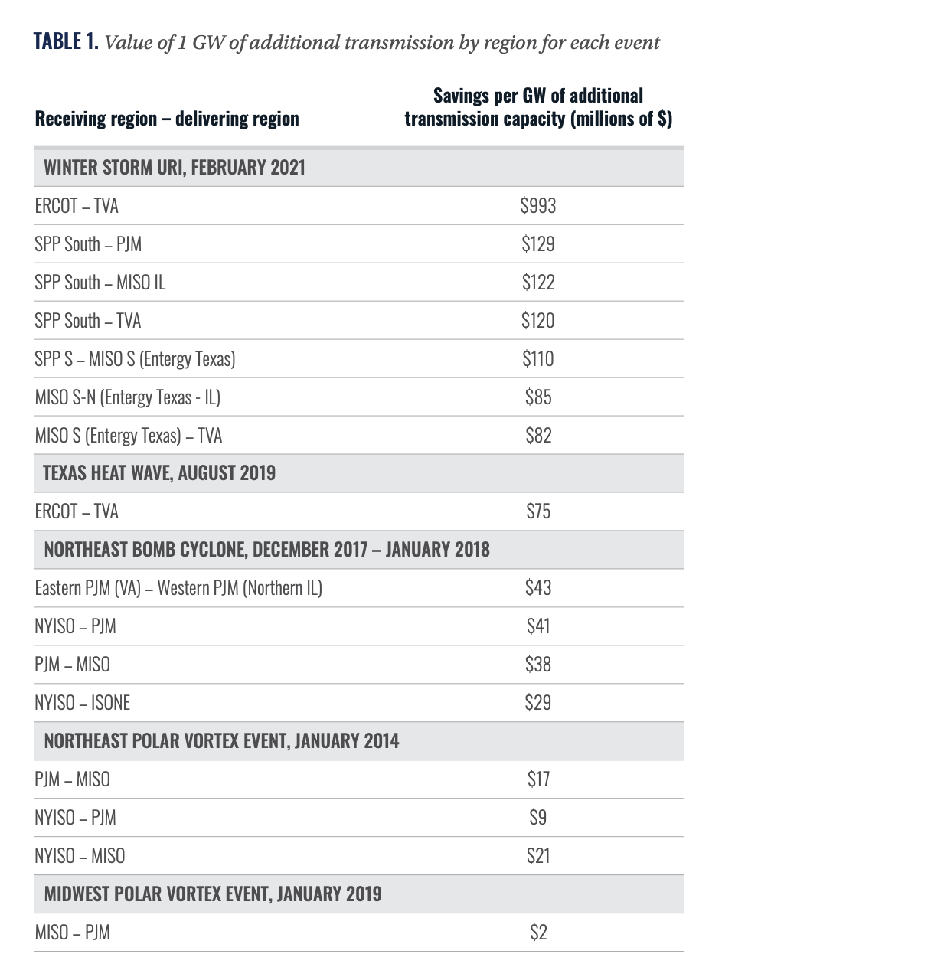
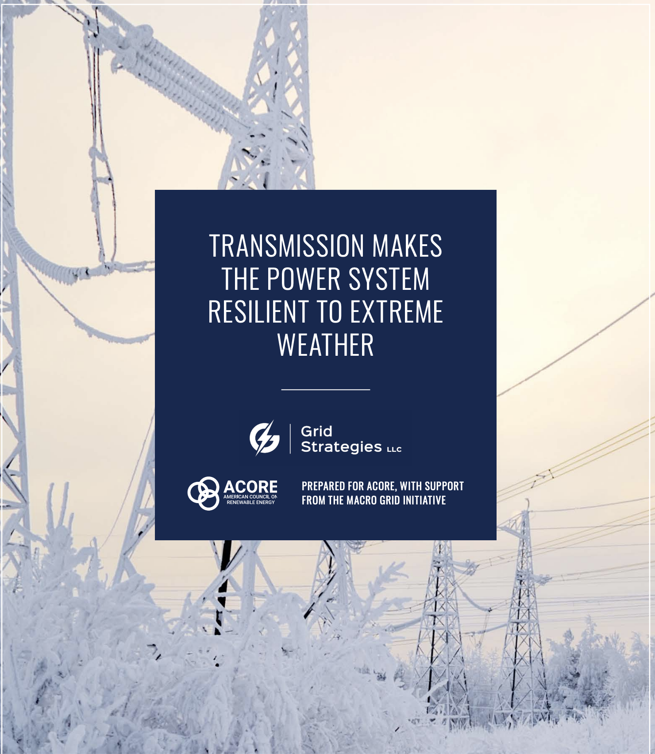
New Research
Notes:
Quantifies the value that interregional transmission would have added during five severe weather events in TX, NE, and MidWest over past decade.
In Texas during Winter Storm Uri, each GW transmission capacity connecting with SE would have resulted in $1B savings and 200,000 homes with energy.
During the same event in SPP, consumers would have saved $100M per extra GW of transmission connecting to PJM, MISO, TVA, or MISO S.... in short better connections to the neighboring grid regions could have dramatic cost savings benefits.

Slide 11
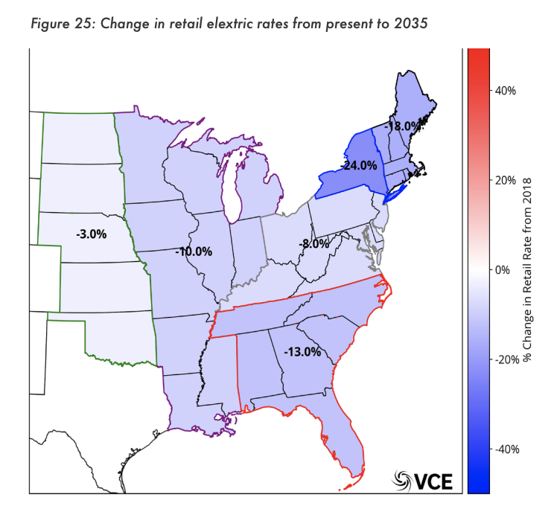
New Research
Notes:
Vibrant Clean Energy & Grid Strategies – studying showing the benefits of interregional transmission lines in the Eastern interconnection.
Optimizing the Eastern interconnection for transmission build could result in massive consumer savings, job creation, and new investment.

Slide 12
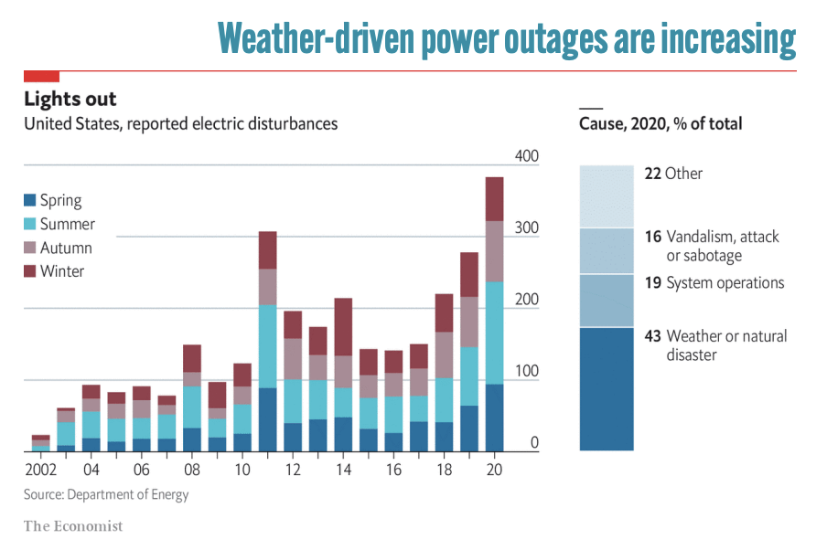
New Research
Ensures US military bases and emergency services remain fully operational during extreme weather
Switching to EVs will reduce dependence on global oil markets, but will require new transmission to bring lowest-cost new power generation online
National Security Depends on a Robust Transmission Grid

Slide 13
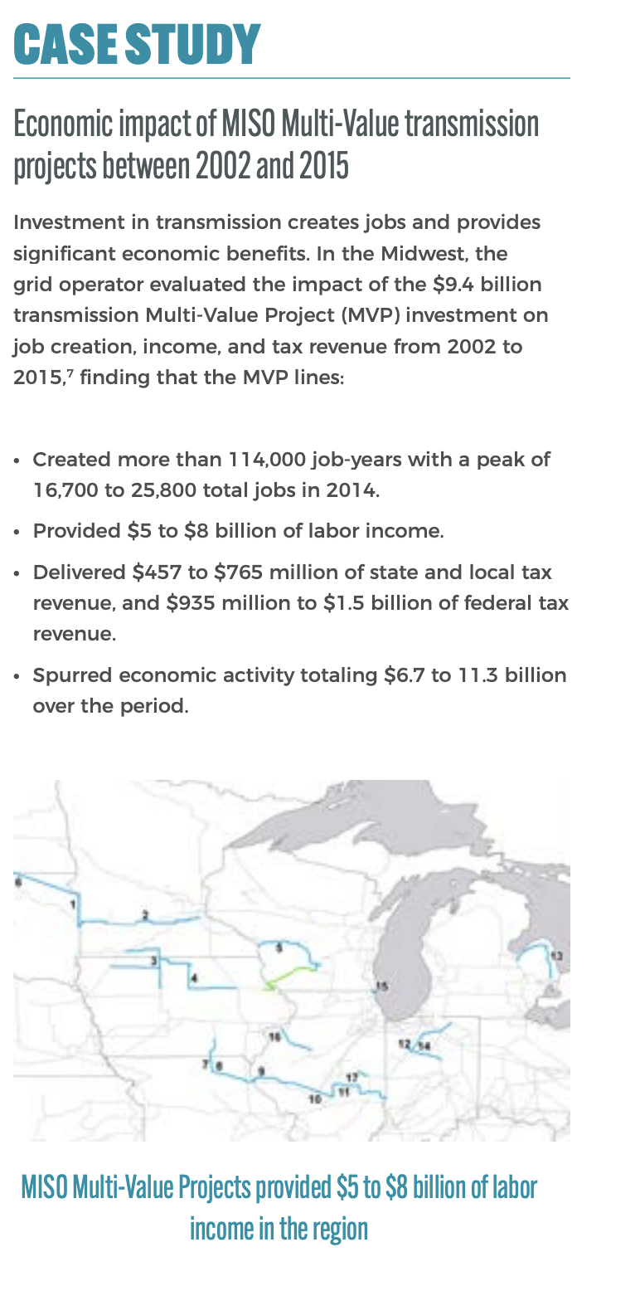
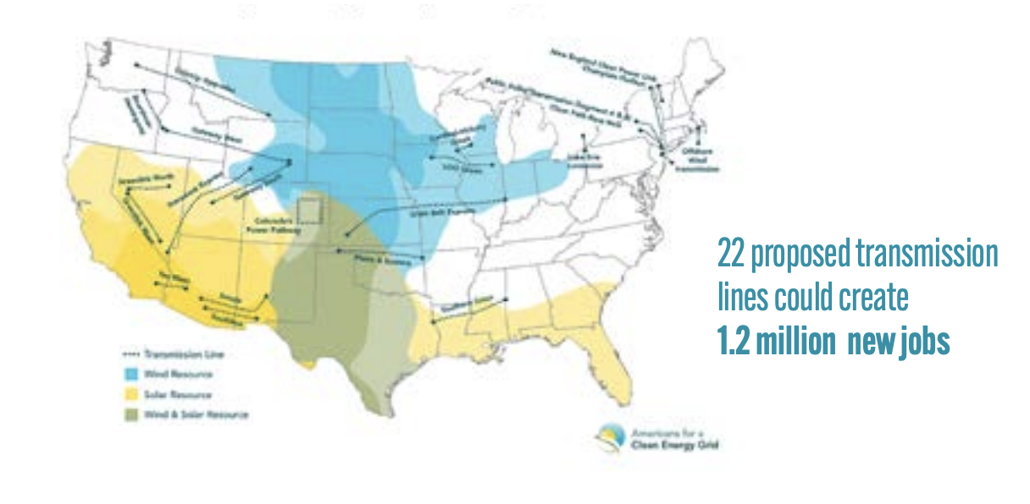
New Research
Upgrading and Expanding High Voltage Transmission Creates Well-Paid Jobs, Drives Economic Growth
Notes:
Building the 22 high-voltage transmission projects that are ready for near-term construction would create 600,000 jobs,
MISO Case study: MVP lines delivered a huge economic boost to the region.
And perhaps, more importantly, during a recent MISO Board meeting, MISO President Clair Moeller stated that the Multi-Value Project transmission lines that his organization has built over the last decade, at a cost of around $6.5 billion,22 provided around $18 billion in benefits across three days of Winter Storm Uri. (SOURCE: Value of Transmission in Extreme Weather report)

Slide 14
Broad Perspectives
Transmission expands access to lower-cost domestic energy
Aggressive procurement goals require new transmission
A Macro Grid enhances the nation’s transmission system for the long term and extreme weather events
Diverse perspectives are new to the transmission discussion, so outreach is timely and critically important
Engage stakeholders at the federal, state and regional levels
Visit www.acore.org/macro-grid-initiative/

Slide 15
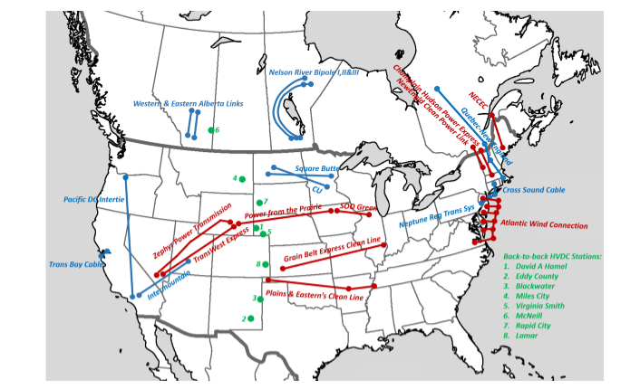
Existing and planned HVDC transmission in North America
U.S. has excellent opportunities for Macro Grid development
Notes:
Existing and planned HVDC facilities in North America (blue: existing lines; red: planned or proposed lines; green: existing back-to-back converters)
Of the four nations comprising North America, the US stands out because of its geographical centrality and size, its high electricity consumption, the benefits likely to accrue from interregional transmission development, and the fact that it has both north-south and east-west opportunities that appear attractive. In regard to the characteristics necessary for successful development of interregional transmission, there is both precedent and existing features that suggest they are largely in place. The seven RTOs of today provide a regional force having no profit motivation, trusted for their knowledge and experience, providing a familiar and collaborative environment within which entities may engage and negotiate. The Federal Energy Regulatory Commission (FERC) and the Department of Energy (DOE), represent federal capability that could have significant influence on developing interregional transmission should federal policy swing in that direction. Indeed, FERC Order 1000 [8] already requires RTOs to consider interregional transmission, and the DOE has a track record which includes establishing successful collaborative mechanisms.

Slide 16
Supporters
Advanced Power Alliance
American Wind Energy Association
BlueGreen Alliance
Clean Grid Alliance
GridLab
Natural Resources Defense Council
ITC Holdings
R Street Institute
Solar Energy Industries Association
Union of Concerned Scientists
WIRES Group
“We learned in the 2000-2001 California/Western power collapse and the 2003 North American power blackout that power markets REQUIRE robust infrastructure. Today, that means strong electrical ties between and across all the power regions. I welcome the refreshed focus on this issue: without a strong national power grid, we won’t come anywhere close to the low-cost, low-carbon grid customers demand — and deserve.”
- Pat Wood III, Former FERC Chairman; Former Chairman of the Public Utility Commission of Texas; CEO, Hunt Energy Network

Slide 17
Thank you!
Barbara Tyran
Director, Macro Grid Initiative
ACORE
1150 Connecticut Ave NW
Suite 401 Washington, DC 20036
Online
tyran@acore.org
www.acore.org/mgi

