Slide 1
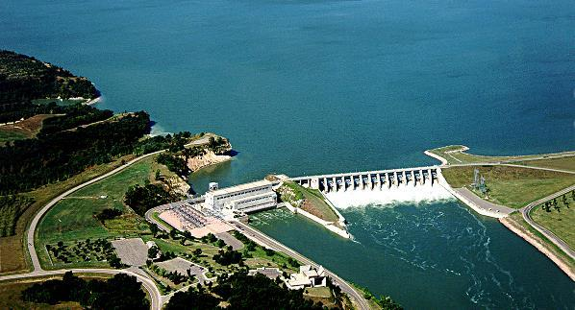
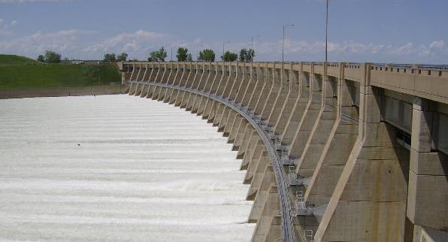
Missouri River Basin
Water Management
Mid-West power users association
John Remus
Chief, Missouri River Basin Water
Management Division
December 12, 2019
Denver, Colorado

Slide 2
Outline/house keeping
  Summarize 2019
  2020 Outlook
  House Keeping (Litigation)
    There are a number of ongoing legal actions in the basin.
    I will not be answering questions or commenting on any ongoing litigation.
    The court’s opinions/decisions are not final, and as such, commenting on any ongoing litigation is against Corps policy.
    The Corps will continue to meet our statutory obligations to operate the Missouri River Mainstem System for its authorized purposes.

Slide 3
MISSOURI RIVER MAINSTEM RESERVOIR SYSTEM

Slide 4
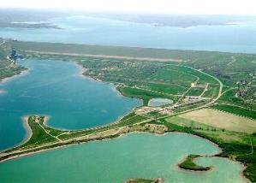
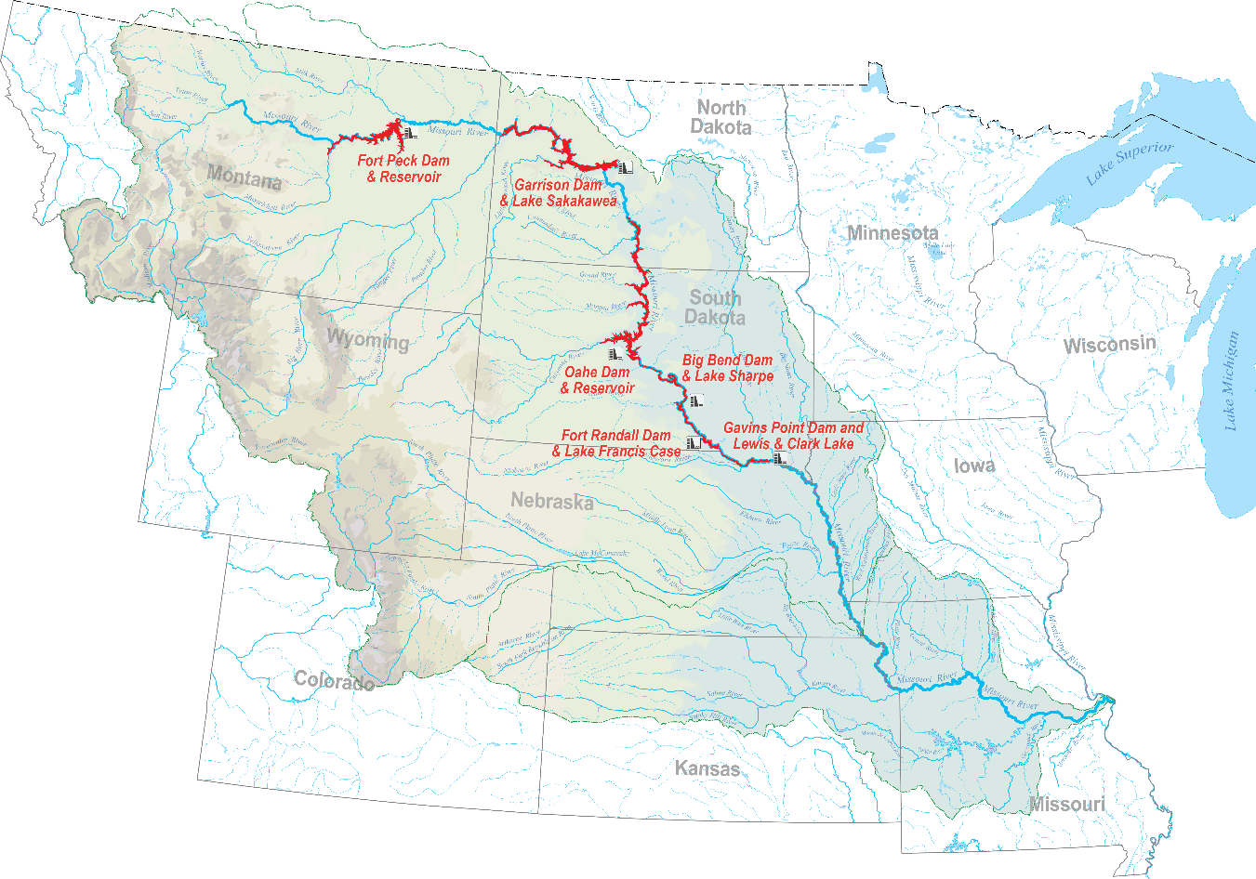
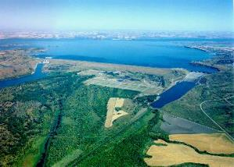
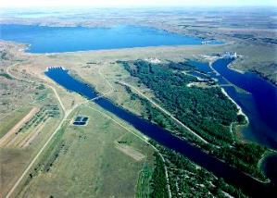
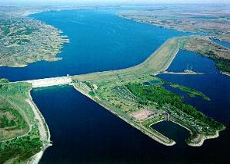
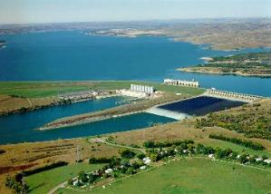
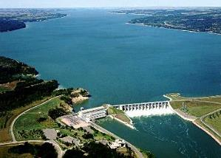
Missouri river mainstem reservoir system
FORT PECK
GARRISON
OAHE
BIG BEND
FORT RANDALL
GAVINS POINT

Slide 5
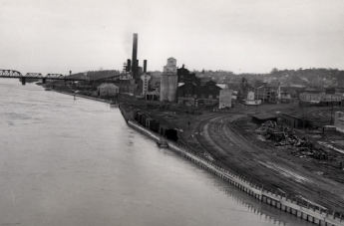
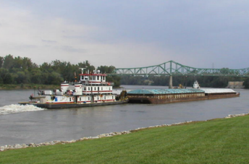

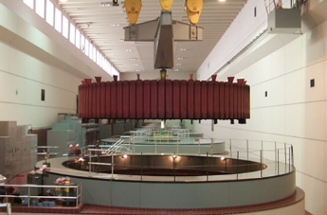

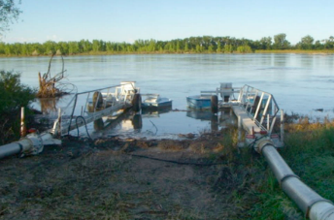

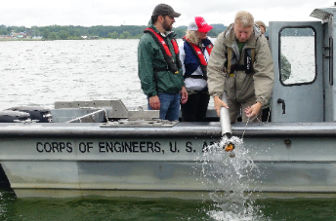
Our mission
Regulate Missouri River Mainstem Reservoirs
  Priority: Life and Safety
  Operational Decisions: Driven by Annual Runoff Conditions
  Water captured in System flood control storage zones each year must be evacuated prior to the start of the following year’s runoff season.
  Master Manual: Storage and release decisions designed significantly around Flood Control, Navigation & Water Supply purposes
  Authorized Purposes:
  Authorized Purposes:
FLOOD CONTROL
NAVIGATION
WATER SUPPLY
HYDROPOWER
FISH & WILDLIFE
IRRIGATION
RECREATION
WATER QUALITY CONTROL
Flood Control | Navigation | Hydropower | Water Supply | Fish & Wildlife | Irrigation | Water Quality Control | Recreation
Federal Laws: The Corps complies with all federal laws.

Slide 6
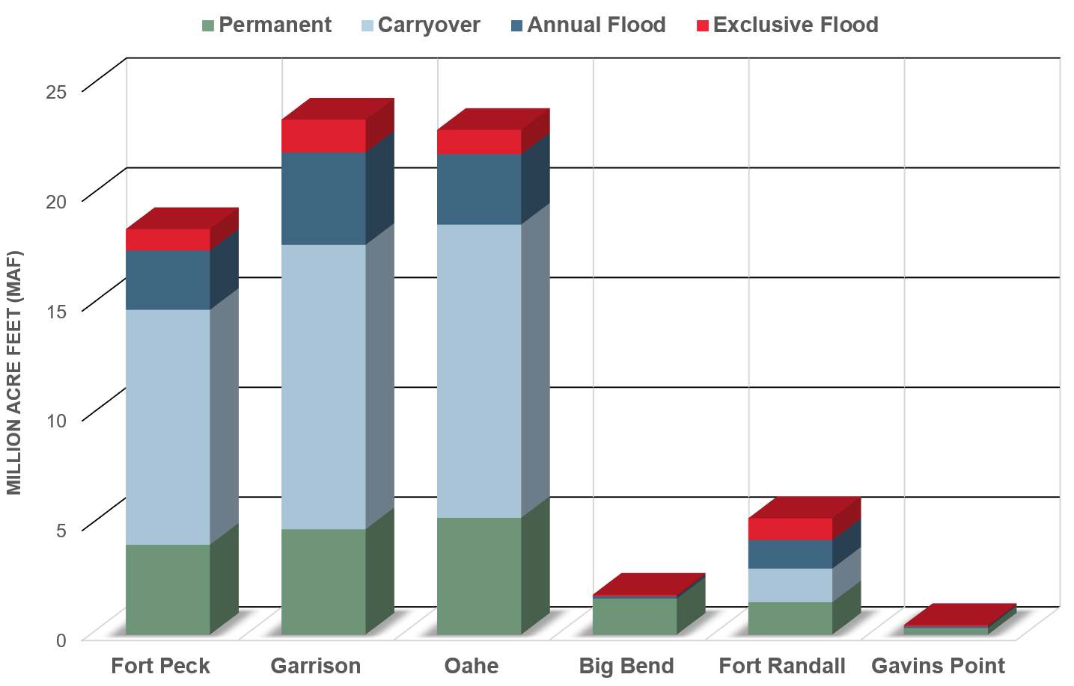
Mainstem Reservoir Storage Capacity

Slide 7
Missouri River Mainstem System
Storage Zones and Allocations
Historic max - 2011
72.8
STORAGE IN MILLION ACRE FEET (MAF)
EXCLUSIVE FLOOD CONTROL 7%
72.4
ANNUAL FLOOD CONTROL &
MULTIPLE USE 16%
67.7
WE ARE HERE
DEC 3, 2019 – 57.4
CARRYOVER MULTIPLE
USE 53%
56.1
Historic min – 2007
33.9
PERMANENT
POOL 24%
17.6
0

Slide 8
2019 summary

Slide 9
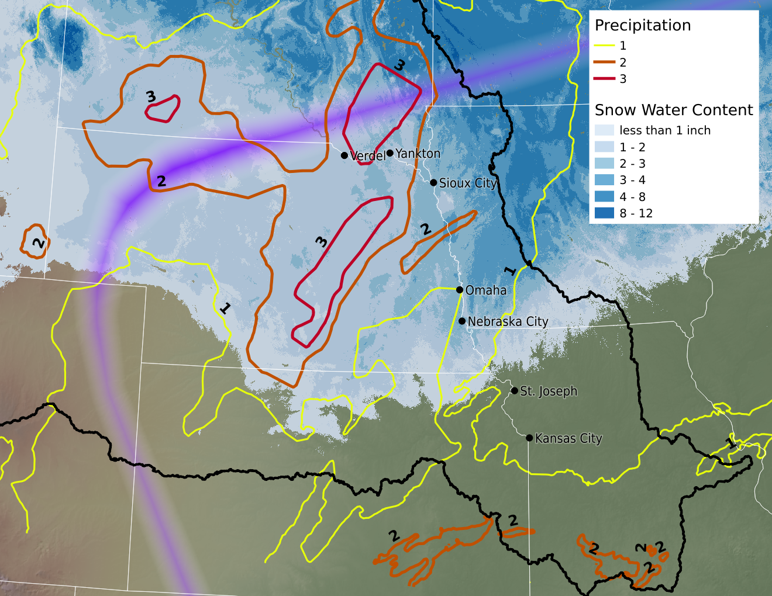
NATIONAL WEATHER SERVICE
Rain-on-Snow Event of March 12th-14th 2019
Rain-Snow line
Notes:
NOHRSC SWE as of 11 March, overlaid by rain-on-snow event starting roughly midnight of 12th-13th, and concluding early on 14th. Add to that deeply frozen ground with perhaps an 85% runoff to precip/melt ratio. That’s a guess as to ratio.
Basically, you had widespread 2 inch rain over widespread 2-4 SWE. So a 2 inch rainstorm becomes a 5-inch rainstorm (and with frozen ground and no infiltration, it may be like a 7-8 inch rainstorm).

Slide 10
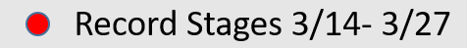
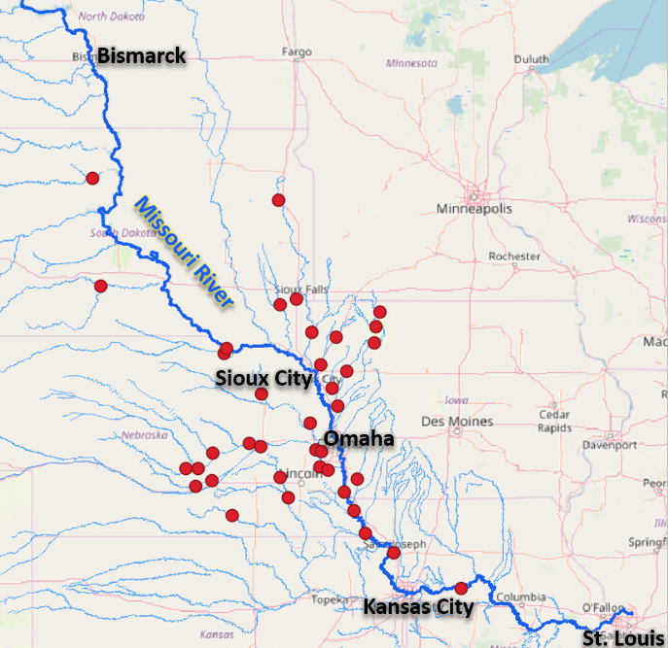
NATIONAL WEATHER SERVICE
Mid-March 2019 Event
Notes:
Set over 40 new records (provisional, not officially declared yet)

Slide 11
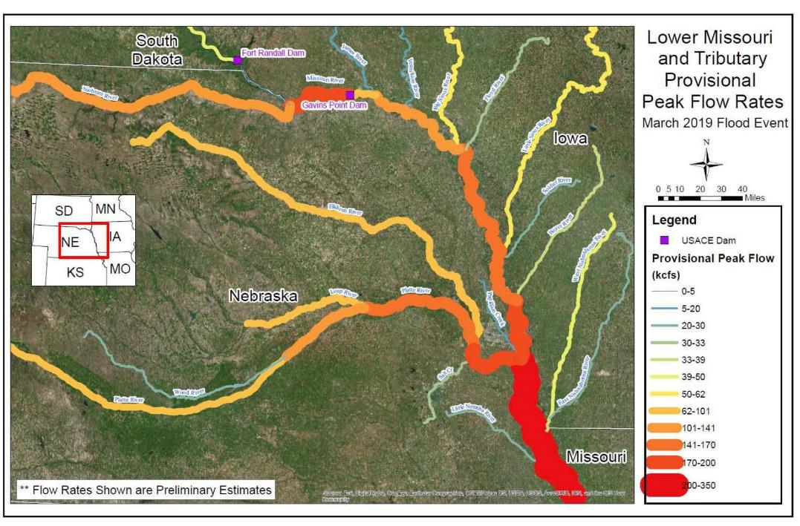
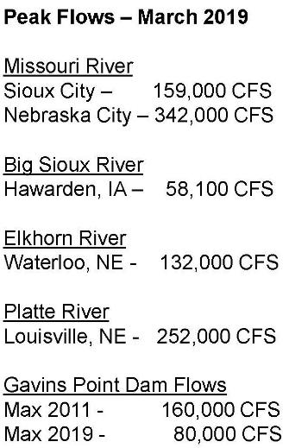
ESTIMATED PEAK FLOWS
Mid-March 2019 Event
Notes:
Set over 40 new records (provisional, not officially declared yet)

Slide 12
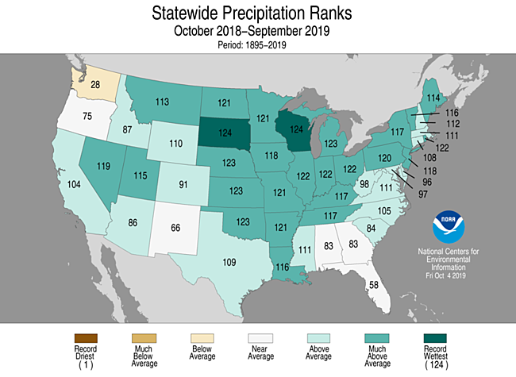
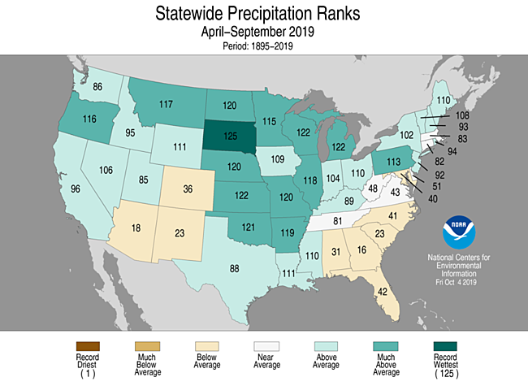
precipitation
Source: NOAA National Centers for Environmental Information

Slide 13
Monthly Runoff above Sioux City, IA
Forecast
Average
Observed

Slide 14
Annual Runoff above Sioux City, IA
2019 Forecast
Historic Drought Periods
U.D.
U.Q.
Median
L.Q.
L.D.

Slide 15
Fall / Winter Releases
  Gavins Point Dam releases will be reduced to winter rate by mid-December (includes 10-day extension)
  Corps will closely monitor channel/ice conditions between reservoirs and downstream of Gavins Point Dam
  Above-average winter releases needed to complete evacuation of stored flood waters
  Expected releases (in 1000 cfs):
 |  | Dec | Jan | Feb
Fort Peck |  | 13.0 | 13.0 | 13.0
Garrison Oahe |  | 21.3 33.8 | 24.5 27.4 | 24.5 26.3
Gavins Point |  | 32.6 | 25.0 | 25.0

Slide 16
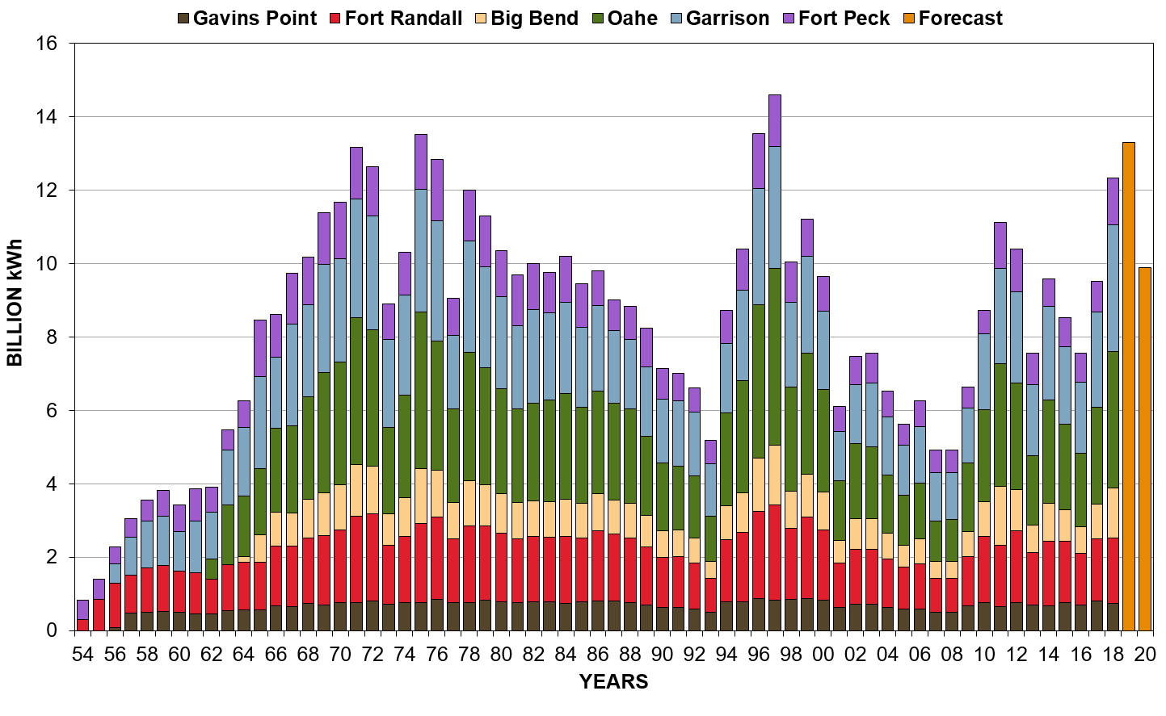
Hydropower production

Slide 17
202o OUtlook

Slide 18
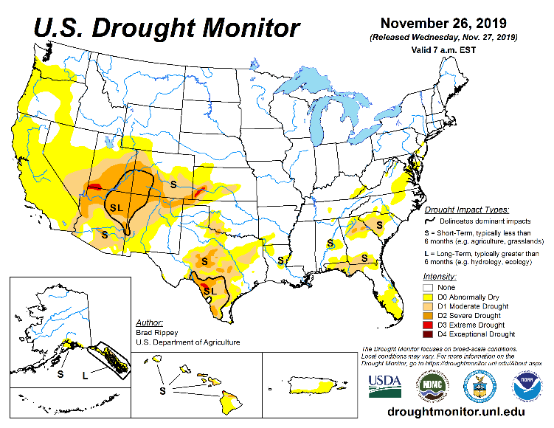
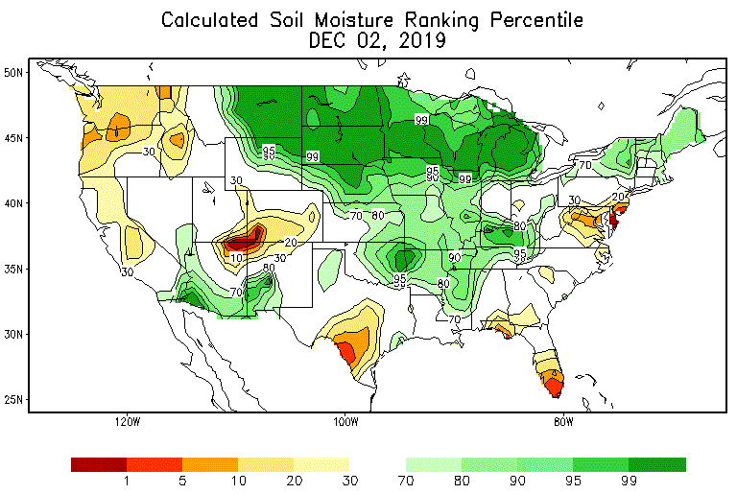
Drought Conditions and soil moisture
No drought conditions in the Missouri River Basin.
Source: National Drought Mitigation Center
VERY wet soil conditions, particularly in the upper Missouri River Basin.
Source: NWS Climate Prediction Center

Slide 19
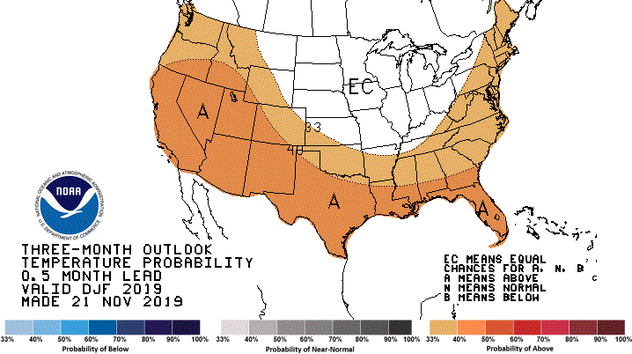
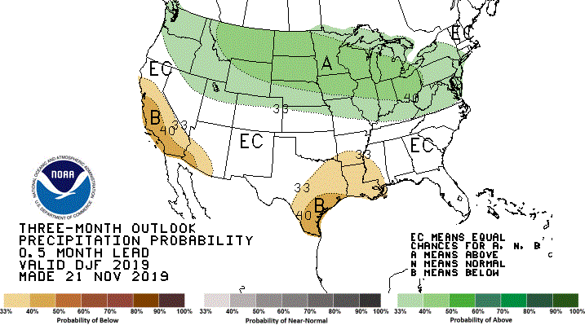
Temperature and Precipitation Outlooks
Dec-Jan-Feb
Temperature
Equal chances for warmer-average-colder temperatures in most of the Basin.
Precipitation
Source: NWS Climate Prediction Center
Increased chances for wetter-than-average precipitation in most of the upper Basin.

Slide 20
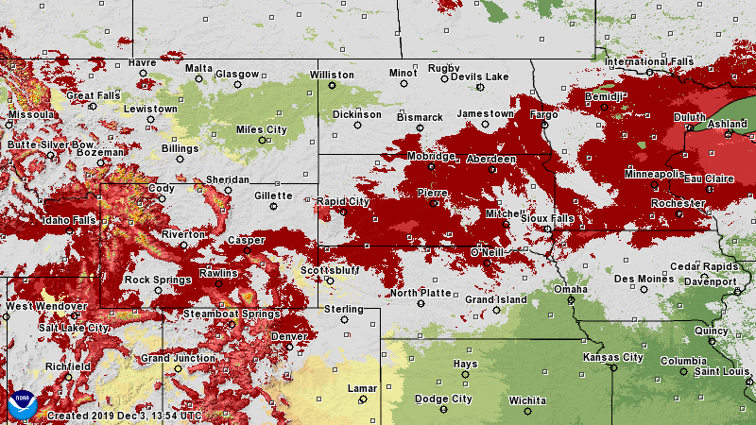
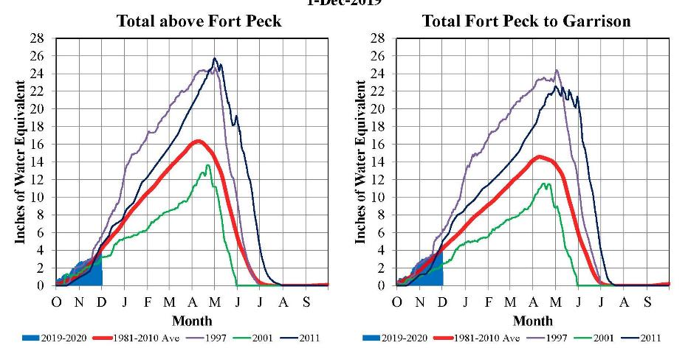
snowpack
Plains Snowpack (Dec 3)
Source: National Hydrologic Remote Sensing Center Center
Mountain Snowpack
Source: USDA, Natural Resources Conservation Service

Slide 21
System Storage - 2019-2020 Draft AOP
System Storage Check
Median
Top of Exclusive Flood Control – 72.4 MAF
Upper Decile and Lower Decile
Base of Exclusive Flood Control – 67.7 MAF
Base of Annual Flood Control – 56.1 MAF
2019
2020
2021

Slide 22
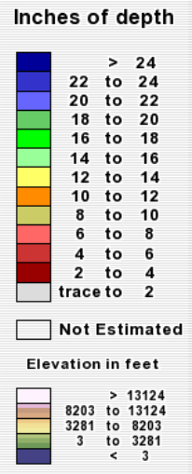
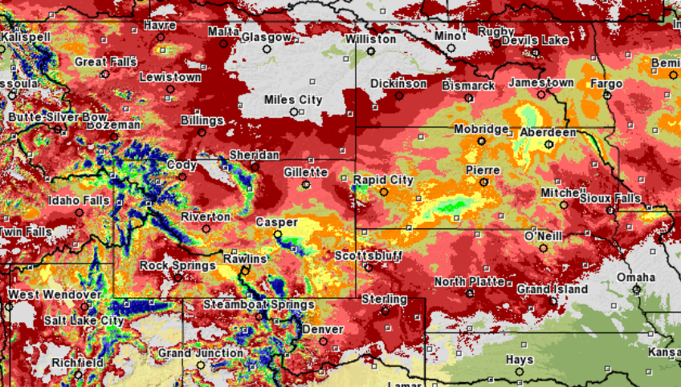
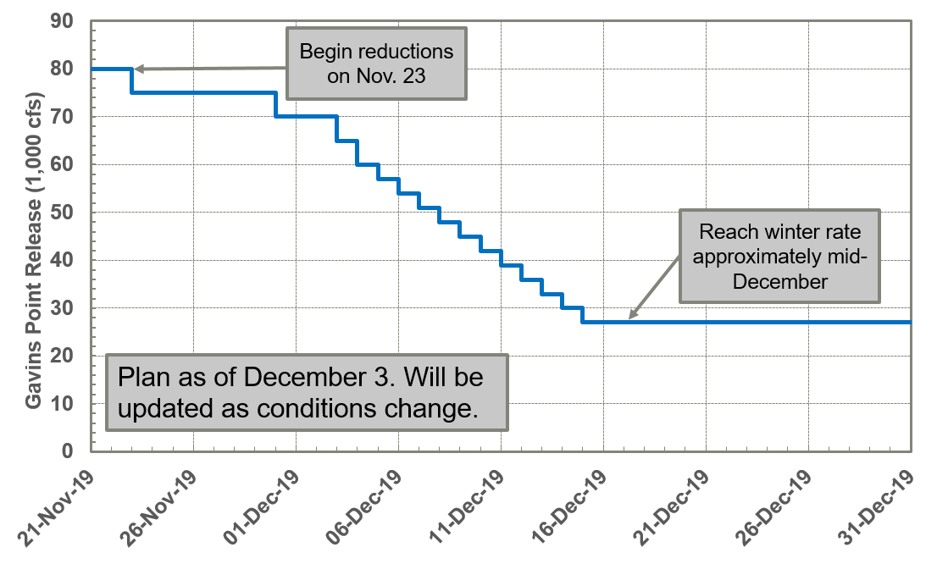
http://www.nwd-mr.usace.army.mil/rcc/reports/pdfs/weeklyupdate.pdf
Missouri River Basin – Update – 3 December 2019
Mainstem Reservoir Status:
System storage is 57.4 MAF; 1.3 MAF of the 16.3 MAF of flood control storage is occupied, and will be evacuated before the start of the 2020 runoff season.
A snowstorm over the weekend led to accumulated plains snowpack over much of the upper basin (upper right graphic). Mountain snowpack is also accumulating at near average rates (click here).
Gavins Point releases are currently 70,000 cfs, and will be reduced to 65,000 cfs today, and further reduced by 3,000 cfs every day until the release rate of 27,000 cfs is reached. Releases may be reduced to 25,000 cfs in January. The drawdown schedule is shown in the bottom right quadrant. Basin and river conditions will continue to be monitored, and System regulation will be adjusted as necessary.
The 2019 calendar year runoff forecast above Sioux City, updated on December 2, is 60.4 MAF (238% of average).
Refer to the 3-Week Forecast (click here) for the most up-to-date System information – pool levels, inflows and releases.
The Gavins Point release schedule and forecasted Missouri River flows and stages can be found here:
Plains Snowpack
December 1, 2019
Click Here for Missouri River releases, flows & stages
*Source: https://www.nohrsc.noaa.gov
Current Reservoir Levels
Gavins Point Release Reduction Schedule
Fort Peck
Elevation in feet msl
Garrison
Elevation in feet msl
Exclusive Flood Control
2250
Exclusive Flood Control
1854
Annual Flood Control & Multiple Use
2238.6
2246
Annual Flood Control & Multiple Use
1839.0
1850
2234
1837.5
Carryover Multiple Use
Carryover Multiple Use
Permanent Pool
2160
Permanent Pool
1775
2030
1673
4.6 feet above the base of flood control.
1.5 feet above the base of flood control.
Oahe
Elevation in feet msl
System Storage
Storage in MAF
Exclusive Flood Control
1620
Exclusive Flood Control
72.4
Annual Flood Control & Multiple Use
1609.1
1617
Annual Flood Control & Multiple Use
57.4
67.7
1607.5
Current Storage
56.1
Carryover Multiple Use
1540
Carryover Multiple Use
17.6
Permanent Pool
Permanent Pool
1415
0
1.6 feet above the base of flood control.
1.3 MAF above the base of flood control.
Click Here for Latest 3-Week Forecast
Click Here for Comparison Plots

Slide 23
Thank You!
John Remus, P.E. | john.i.remus@usace.army.mil | 402.996.3840
Kevin Grode, P.E. | kevin.r.grode@usace.army.mil | 402.996.3870
Mike Swenson, P.E. | michael.a.swenson@usace.army.mil | 402.996.3860
Email: | Missouri.Water.Management@usace.army.mil
Website: | www.nwd-mr.usace.army.mil/rcc/ nwd.usace.army.mil/MRWM
Search: | Corps Missouri River on Google
Social Media: | Facebook: nwdusace #MissouriRiver Twitter: nwdusace #MORiver #MissouriRiver

