Slide 1
FERC and Transmission John McCaffrey Senior Regulatory Counsel American Public Power Association Mid-West Electric Consumers Association Annual Meeting December 7, 2021 – Denver, CO

Slide 2
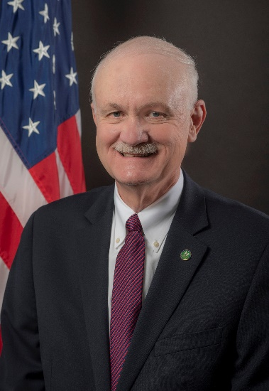
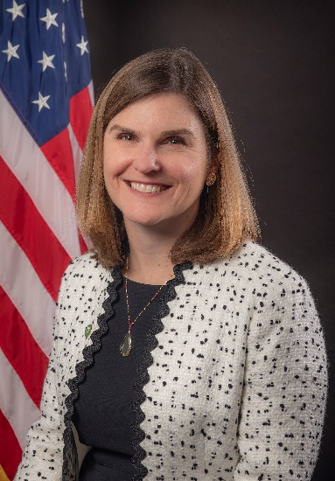
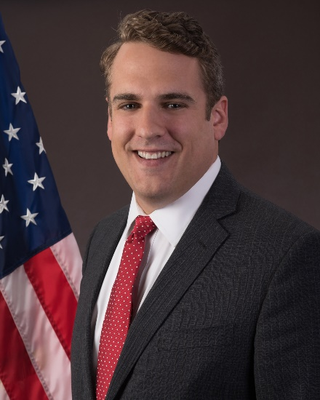
FERC in Transition
Chairman Glick (D)
Term: 6/30/2022
Comm’r Christie (R)
Term: 6/30/2025
Comm’r Clements (D)
Term: 6/30/2024
Comm’r Danly (R)
Term: 6/30/2023

Slide 3
New FERC Commissioner
On Nov. 16, the Senate confirmed President Biden’s nomination of Willie L. Phillips, Jr. (D) as a FERC Commissioner
Previously the Chairman of the District of Columbia Public Service Commission
Other jobs include positions with North American Electric Reliability Corp. (NERC) and law firm private practice
Returns FERC to a full complement of five Commissioners
Gives Democrats a 3-2 majority
Source: DC Public Service Commission

Slide 4
Transmission is a FERC Priority
I don't think the transmission grid has ever received as much attention as it is today. We have never heard the President of the United States and Secretary of Energy speak so passionately especially about the importance of investments in transmission. That is because the electric sector is in the midst of a dramatic transformation that will require substantial additions of transmission capacity to accommodate the significant growth in renewable electric generation.
FERC Chairman Richard Glick – July 15, 2021

Slide 5
Cost is a Concern for Public Power

Slide 6
FERC Transmission ANOPR
Advance Notice of Proposed Rulemaking (ANOPR) issued July 15, 2021
Considering fundamental changes to FERC rules for transmission planning, cost allocation, and generator interconnection – proposing to act under Federal Power Act section 206
Requested comments on hundreds of (overlapping) points
ANOPR is a preliminary step in a potential multi-stage process to change FERC’s rules; FERC would still need to issue proposed rules for further comment
Initial comments filed October 12, 2021
FERC technical conference on November 15, 2021
Reply comments submitted November 30, 2021

Slide 7
FERC-State Task Force
FERC took the unusual step of establishing a joint FERC-State task force on transmission issues
Authorized by FPA section 209(b)
FERC Commissioners and ten state commissioners nominated by National Association of Regulatory Utility Commissioners (NARUC)
Will hold meetings and may make recommendations to FERC on potential modifications to FERC’s regulations
First meeting Nov. 10, 2021 in Louisville, KY

Slide 8
Transmission ANOPR – Key Issues
Focus on planning for “anticipated future generation,” including use of scenario planning and longer planning horizons
Concept of identifying zones for potential renewable resources
Coordination between transmission planning and generator interconnection
Improving interregional planning processes
Cost allocation for regional transmission facilities and for transmission upgrades needed to accommodate generation interconnections
Cost responsibility should follow benefits, but how to define and quantify benefits? Should FERC specify a broader set of benefits to consider?
Maintain participant funding for generator interconnection network upgrades?
Greater transparency and/or oversight of transmission planning process
Independent transmission monitor?
RTO vs. non-RTO regions

Slide 9
Transmission ANOPR – Next Steps?
ANOPR was issued unanimously, but evident differences among FERC Commissioners
Commissioner Phillips may be key
Would FERC proceed on groundbreaking issues by a divided vote?
Chairman Glick has indicated he would like to have a final rule in place by the end of 2022
ANOPR issues may be divided into multiple proceedings, but many interrelated considerations

Slide 10
Reliability and the Evolving Grid
FERC examining electric reliability in the face of extreme weather and climate change
FERC technical conferences on ensuring resource adequacy in various regions
FERC-NERC investigation into February arctic winter storm event
Transmission (or RTOs) as part of the solution

Slide 11
TVA Transmission Petition
Petition filed by several Local Power Companies against Tennessee Valley Authority (TVA) asking FERC to require transmission service from TVA pursuant to section 211A of the FPA
FERC denied the petition on Oct. 21, citing its legal discretion under FPA section 211A
Legal issues largely revolved around whether FERC can apply section 211A to TVA

Slide 12
Other FERC Transmission Matters
Proposed changes to rules for awarding incentives for certain transmission projects
APPA generally opposed
Status is uncertain given changes in FERC leadership and personnel
Proposal to significantly scale back the financial incentive that FERC awards transmission owners for participation in RTOs/ISOs
APPA supported; savings could be significant (~$400 million annually)
Consideration of incentives to promote grid-enhancing technologies to increase the efficiency of existing transmission
APPA is skeptical
Notice of Inquiry on reactive power – comments due January 31, 2022

Slide 13
Questions?
John McCaffrey
jmccaffrey@publicpower.org
202.467.2952

Slide 14
References

Slide 15
References
Transmission ANOPR: Building for the Future Through Electric Regional Transmission Planning and Cost Allocation and Generator Interconnection, Docket No. RM21-17-000, 176 FERC ¶ 61,024 (2021), 86 Fed. Reg. 40,266 (July 27, 2021)
Order on FERC-State Task Force: Joint Fed.-State Task Force on Elec. Transmission, Docket No. AD21-15-000, 175 FERC ¶ 61,224 (2021)
Transmission Incentives Rulemaking: Electric Transmission Incentives Policy Under Section 219 of the Federal Power Act, Docket No. RM20-10-000, 170 FERC ¶ 61,204 (2020), 85 Fed. Reg. 18,784 (April 2, 2020)
Proposal on RTO/ISO Incentives: Electric Transmission Incentives Policy Under Section 219 of the Federal Power Act, Docket No. RM20-10-000, 175 FERC ¶ 61,035 (2021), 86 Fed. Reg. 21,972 (April 26, 2021)

Slide 16
References, cont’d
FPA § 211A proceeding: Athens Utilities Board, Gibson Electric Membership Corporation, Joe Wheeler Electric Membership Corporation and Volunteer Energy Cooperative v. Tennessee Valley Authority, FERC Docket Nos. EL21-40-000 and TX21-1-000, 177 FERC ¶ 61,021 (Oct. 21, 2021)
Notice of Inquiry on Reactive Power: Reactive Power Capability Compensation, Docket No. RM22-2-000, 177 FERC ¶ 61,118 (2021), 86 Fed. Reg. 67,933 (Nov. 30, 2021)

