Slide 1
Upper Great Plains Update
Lloyd A. Linke
Senior VP and Upper Great Plains Regional Manager
Mid-West Annual Meeting
Dec. 8, 2021

Slide 2
Topics
Missouri River numbers
Polar vortex mitigation
Rate process
Renewable Energy Credits

Slide 3
Missouri River Statistics
Yearly runoff forecast at 15.4 MAF
58% of Average 25.8 MAF
Generation forecast at 8,600 GWh
91% of normal 9,500 GWh
Large storage capacity requires multiple low water years before significantly impacting generation

Slide 4
Polar vortex mitigation
Storm Uri February 2021
~$100 million in energy purchases
~$30 million in related market costs
Uses long-standing authority to make bilateral short-term buys
Part of PPW program
Flattens peak, does not save dollars
Spreads cost over more than one year
Depends upon frequency of events
Puts upward pressure on rate
On peak buy during the months of January and February
Exploring 200 MW on peak purchase for January and February 2022

Slide 5
Rate pressures
Booked ~ $110 million deficit at end of FY2021
Receive financial numbers in December
Inflows depend on snowpack
Final numbers in April
Most likely to conduct sensitivities on different PPW amounts
Simulate various water conditions
Frequency of polar vortexes
Mitigation cost

Slide 6
Drought adder charge components
Drought Adder
Adjusted annually, by up to 2 mills, or by public process
Base
Adjusted only by public process

Slide 7
Rate adjustment process
Informal meeting(s); three to six months prior to formal process
Formal process about nine months
Begins with notice of proposed rates published in FRN
90-day comment period begins on FRN publication date
During comment period, WAPA hosts at least one public information forum and one public comment forum
After comment period, draft comment responses and publish final FRN, rate order & rate schedules
Rates temporary until confirmed by FERC

Slide 8
2022 rate adjustment draft schedule
Informal meetings January 2022
FRN Proposal Published Late April 2022
Formal Information and Comment forums June/July 2022
New Rates January 2023
Final FRN November 2022
Final Rate 30 Day Notice NLT December 1, 2022

Slide 9
Renewable Energy Certificate (REC)
Represents “renewable” electricity
One megawatt hour = one REC
Potential use in state renewable portfolio standards (RPS)
WAPA does not guarantee REC compliance
Tracking Systems
Midwest Renewable Energy Tracking System (M-RETS)
Western Renewable Energy Generation Information System (WREGIS)
Notes:
RECs – Renewable Energy Certificates. REC represents all renewable and environmental attributes of one megawatt hour (MWh) of electricity generation from a renewable energy generating unit.
WAPA does not guarantee RECs comply with specific requirements (such as certain State RPS).
M-RETS
WREGIS – Western Renewable Energy Generation Information System, owned by WECC (Western Electricity Coordinating Council)
M-RETS – Midwest Renewable Energy Tracking System

Slide 10
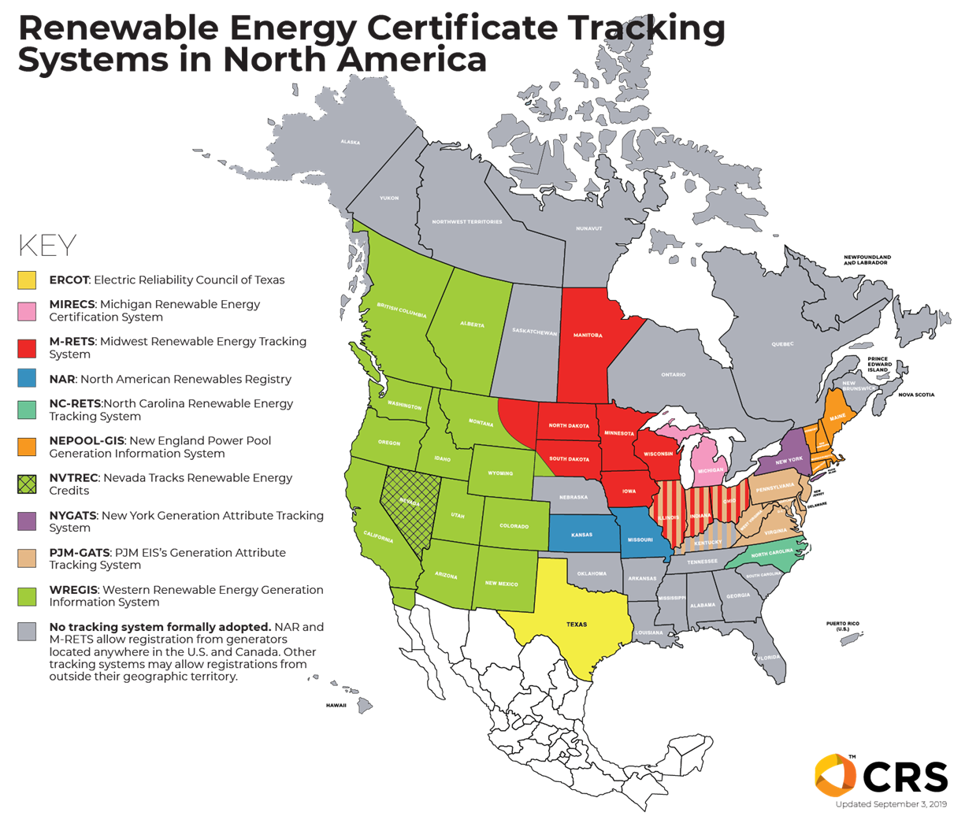
M-RETS
WREGIS

Slide 11
Tracking systems
M-RETS
Widest coverage of UGP footprint
“May” register generators outside service territory
Currently cannot import/export to WREGIS
WREGIS
Within Western Interconnection
Cannot register generators outside of area
Currently cannot imprt/export to M-RETS

Slide 12
Principles
Associated with firm power allocations
Annual delivery
Allocate actual Federal hydropower
Hydropower only, not purchases
High hydropower - up to CROD
Low hydropower - proportional to actual generation
No resale—but CAN be transferred to members and customers
Participants responsible for retiring RECs if needed
Program cost recovery
Administrative and REC costs rolled into rate
Transfer requests and retirement costs responsibility of requestee/customer

Slide 13
Benefits
Environmental attributes
RECs could possibly be used for compliance

Slide 14
Timeline
Develop REC Principles
In Progress- December 2021
Customer Meetings
In Progress- January 2022
Register Generation with M-RETS and/or WREGIS
Early 2022
Upload Generation Monthly
Early 2022
Determine Annual Proportionate Share
Mid 2022
Issue RECs to Customers
January 2023- February 2023
Notes:
Estimated Timeline – subject to change. Option to transfer RECs requires bilateral contracts.

Slide 15
Questions?

