Slide 1
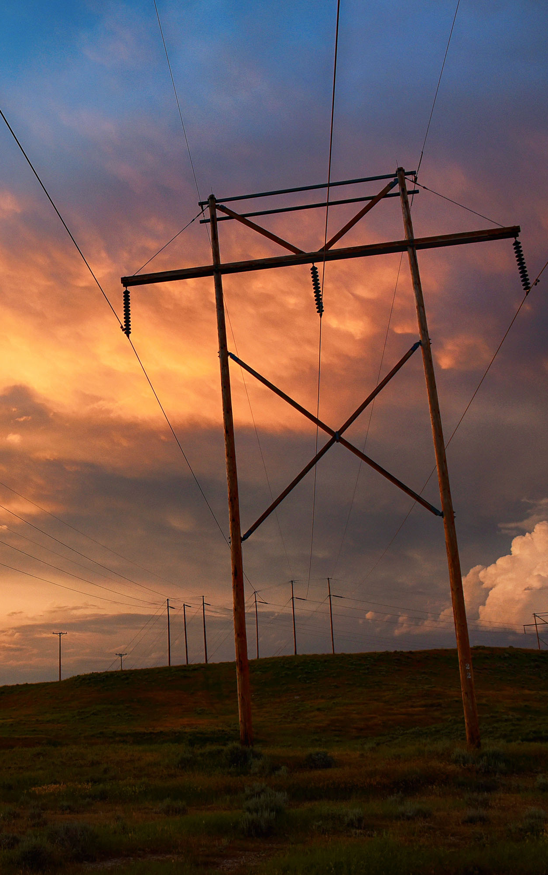
Rocky Mountain Region Update
Barton V. Barnhart
Senior VP and Rocky Mountain Regional Manager
Mid-West Annual Meeting
Dec. 8, 2021

Slide 2
Topics
New Senior VP and Rocky Mountain Regional Manager
Loveland Area Projects Rates
Loveland Area Projects Resource Pool
SPP Markets (WEIS and RTO)
RMR Balancing Authority Changes

Slide 3

"Always bear in mind that your own resolution to succeed is more important than any other one thing."
-Abraham Lincoln
Barton V. Barnhart
      Senior VP and Rocky Mountain Regional Manager
3

Slide 4
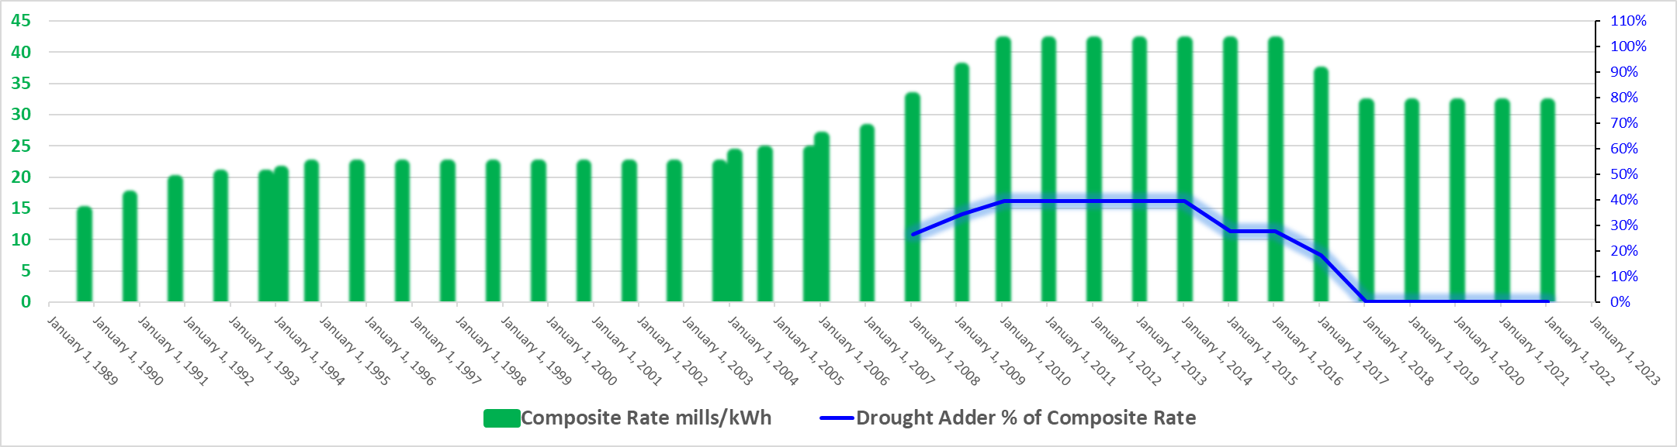
Loveland Area Projects (LAP) Rate
Existing Composite Rate 31.44 mills/kWh (since January 2018)
No composite rate increase since January 1, 2010
Rate adjustment will be needed for January 1, 2023
  – public process will begin Spring 2022
4

Slide 5
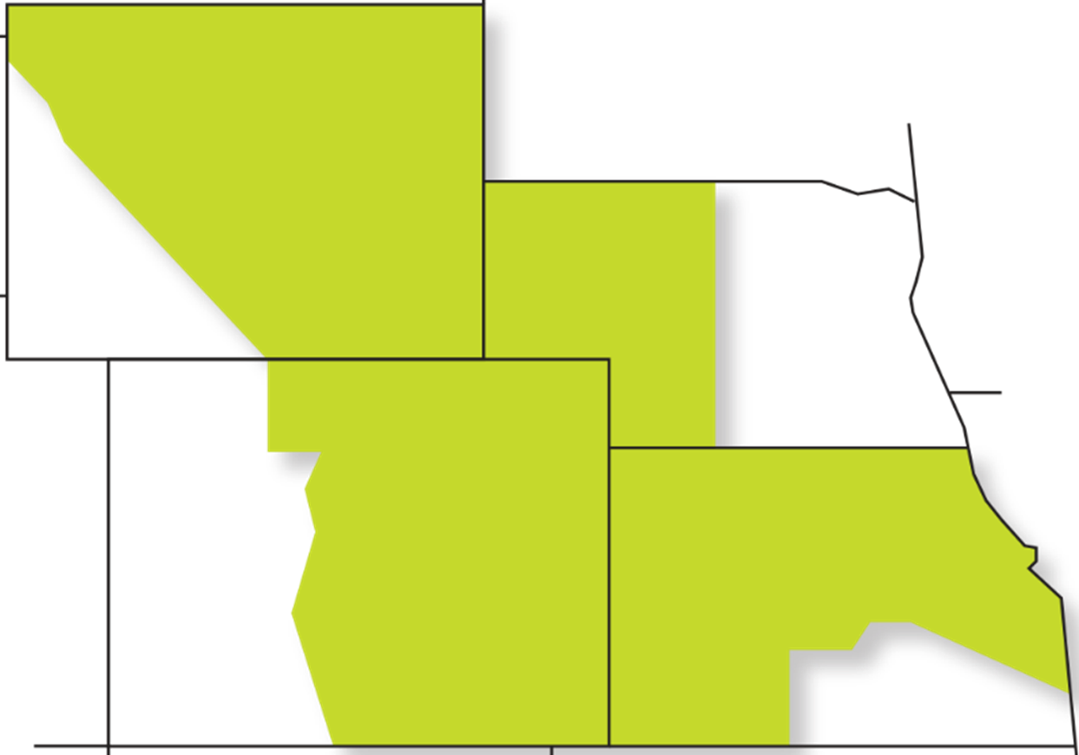
LAP resource pool for new customers
LAP 2025 Power Marketing Initiative resource pools
  Oct. 1, 2024
  Oct. 1, 2034
  Oct. 1, 2044
  Sept. 20, 2021 – FRN on 2025 resource pool criteria and call for applications
  Oct. 6, 2021 – Virtual public information forum held
  Nov. 15, 2021 – 13 applications received by deadline
  Ahead: proposal and final FRN’s in 2022
  Allocations of power to eligible new preference entities effective Oct. 1, 2024

Slide 6
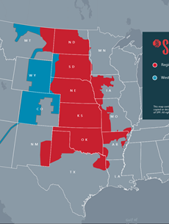
Southwest Power Pool
Western Energy Imbalance Service (WEIS)
  Launched Feb. 1, 2021
RTO expands to RMR/CRSP/UGP-West
  Work began in October 2020
  RMR/CRSP/UGP-West may propose membership; public process in early 2022
  Possible SPP RTO expansion to West by 2024

Slide 7
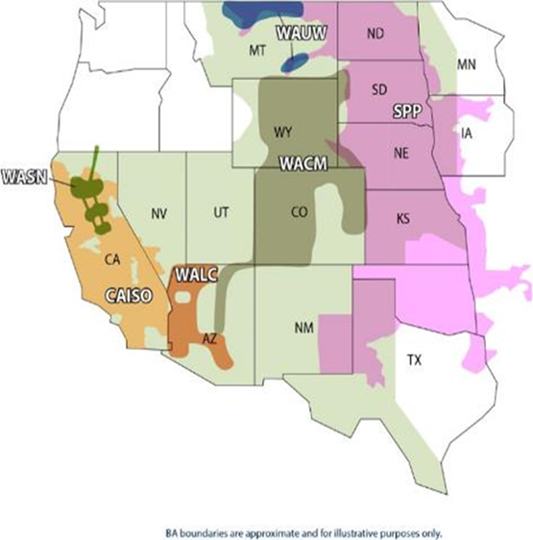
WACM Balancing Authority
CSU returning to WACM
  to join WEIS mid-2022
Expanding new ancillary service options for self provision
609 MW of wind renewables added
  Niyol, Corriedale, Crossing Tails
~355 MW renewables scheduled for 2022
  Wind - Panorama
  Solar - Fall River, Dolores Canyon
  + a few small behind the meter
Metering changes brought new load to WACM (from PSCO)

Slide 8

Questions

