Slide 1
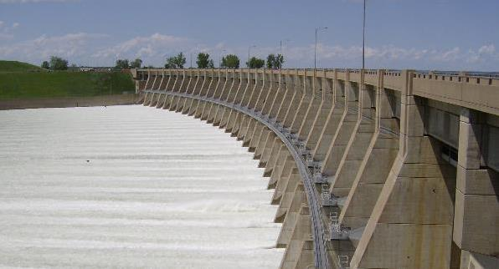
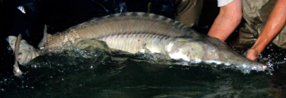
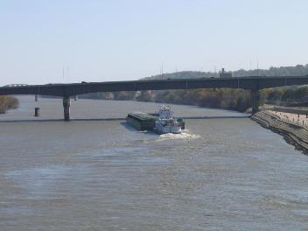
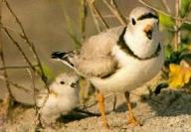
Role of Endangered species Act Compliance in Missouri river Management
Joe Bonneau
Missouri River Recovery Program Manager
Presentation to Midwest Electric
Consumers Association
December 8, 2021

Slide 2
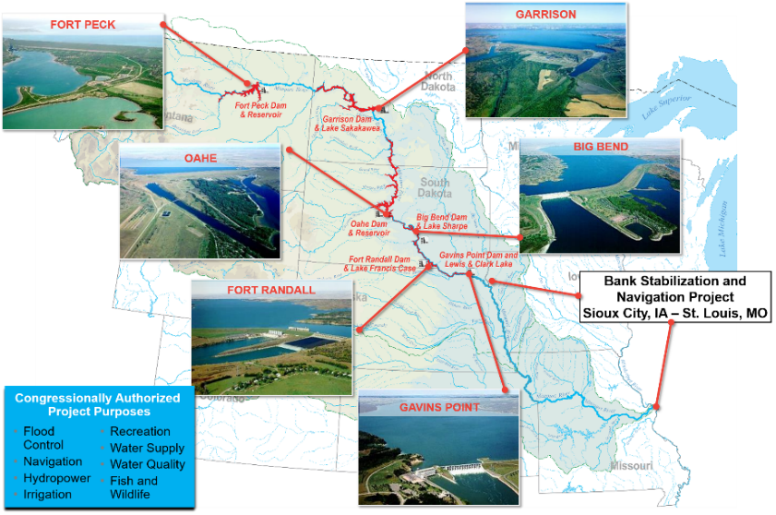
Missouri River mainstem reservoir system
  529,350 square miles
  2,341 miles long
  10 states, 2 Canadian provinces
  Highly diverse
    Geographically/geologically
    Meteorologically/hydrologically
  River of thirds
    1/3 channelized
    1/3 impounded
    1/3 natural state
  279,480 mi² regulated by mainstem projects
  83,800 mi² regulated by tributary projects
  165,070 mi² unregulated

Slide 3
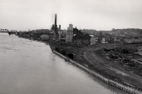
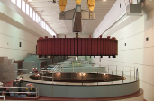
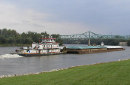
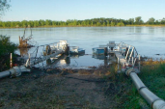

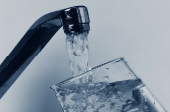
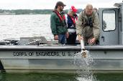
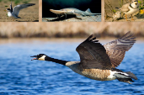
Authorization / mission
Eight Authorized Purposes
      Flood Control – Requires Empty Space
      Navigation
      Water Supply
      Hydropower
      Water Quality Control
      Recreation
      Irrigation
      Fish and Wildlife
Purpose does not equal Priority: One priority is life safety
FLOOD CONTROL
HYDROPOWER
NAVIGATION
IRRIGATION
RECREATION
WATER SUPPLY
WATER QUALITY CONTROL
FISH & WILDLIFE

Slide 4
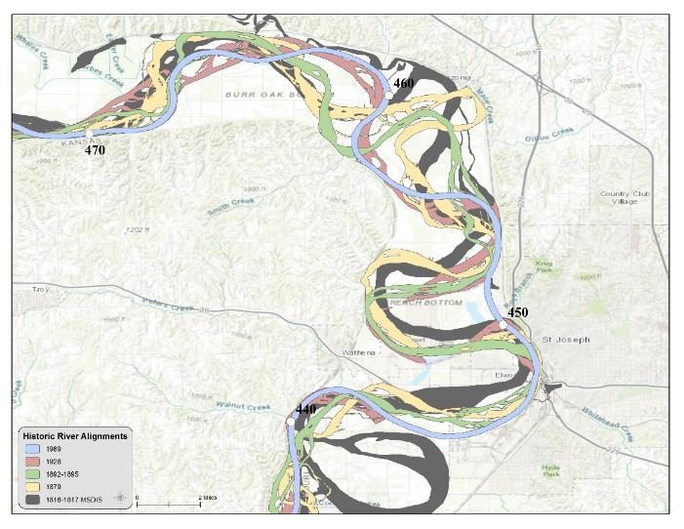
Missouri river before corps projects
Missouri River is a sand bed river that historically changed locations on the floodplain frequently
The Mainstem Reservoir System captures floodwaters and provides reliable flows for navigation and other purposes
The Band Stabilization/Navigation Project (BSNP) structures keep the main river channel stationary to create a self scouring navigation channel; also allowed levee construction

Slide 5
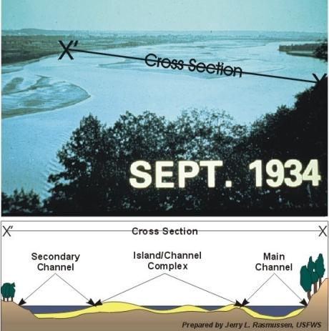
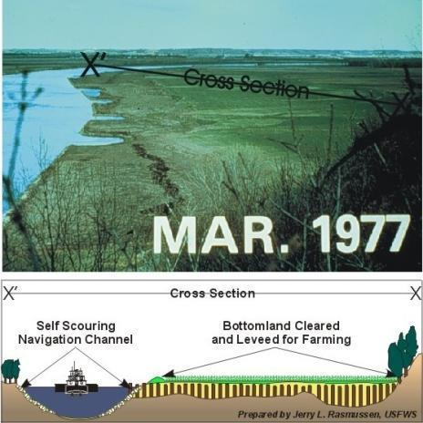
Environmental impacts of corps projects
A 1984 Chief’s Report estimated that approximately 522,000 acres of aquatic and terrestrial habitat were lost by construction of BSNP

Slide 6
Implications
Bank Stabilization and Navigation Project (BSNP) and Mainstem Reservoir System have fundamentally changed the fish and wildlife habitat of the Missouri River and have impacted federally listed species
As a federal agency, USACE must meet its habitat mitigation and ESA requirements in executing its mission on the Missouri River and this is done through the Missouri River Recovery Program (MRRP)
From the ESA of 1973: “Each Federal agency shall, in consultation with and with the assistance of the Secretary, insure that any action authorized, funded, or carried out by such agency is not likely to jeopardize the continued existence of any endangered species…”

Slide 7
Missouri river recovery Program
Allows USACE to meet the environmental compliance requirements of operating and maintaining the Missouri River Mainstem Reservoir System and the BSNP while minimizing impacts to authorized purposes
Three components of the MRRP
Fish and Wildlife Mitigation – BSNP Fish and Wildlife Mitigation Project
    WRDA 86 and WRDA 99 authorized USACE to acquire and develop 166,750 acres of fish and wildlife habitat to offset losses
ESA Compliance – Actions to comply with the “No Jeopardy” 2018 Biological Opinion (BiOp) and associated EIS & Record of Decision (Missouri River Recovery Management Plan)
Missouri River Recovery Implementation Committee (MRRIC) – WRDA 2007
  USACE coordinated Stakeholder Committee (FACA Exempt)
  Represents States, Tribal Governments, User Groups, etc…
  Critical in developing 2018 Management Plan EIS & associated Proposed Action for ESA compliance

Slide 8
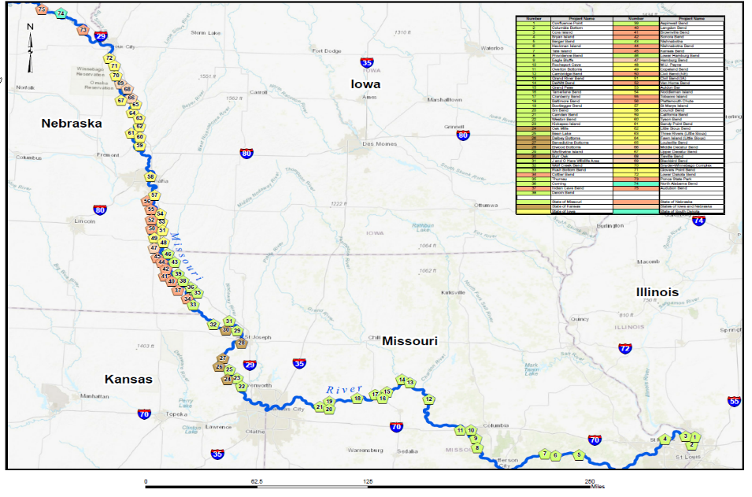
Habitat Mitigation
66,713 of the 166,750 acres required have been acquired to date (40%)
Map of Existing Fish and Wildlife Mitigation Project Locations

Slide 9
Most Recent Biological opinions
Listed species
1. Pallid sturgeon listed in 1990
2. Piping plover listed in 1986
3. Interior least tern listed in 1985 and delisted in 2021
2000 and 2003 Amended Biological Opinions
  Jeopardy opinion for pallid sturgeon with RPA (SWH, spring pulse, propagation, monitoring…)
  No jeopardy opinion for piping plover and least tern
2018 Biological Opinion
  No jeopardy opinion for pallid sturgeon, piping plover, and interior least tern
  Adaptive Management following a detailed Science and Adaptive Management Plan developed in collaboration with stakeholders, Independent Science Panel, and partner agencies was a central component of the USACE proposed action
  Actions implemented in an adaptive management framework, evaluated, and adjusted as needed

Slide 10

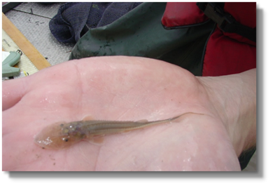
Current ESA compliance requirements
PALLID STURGEON – Lower Missouri River
1. Pallid sturgeon habitat projects
2. Evaluation of natural flows
3. Pallid sturgeon propagation and
stocking
4. Monitoring

Slide 11
Pallid sturgeon habitat projects
Requirement to construct 12 projects in 2018 Biological Opinion at rate of two per year
Site selection for pallid habitat projects
Minimize impacts to authorized purposes and other economic interests
Adjacent to publicly owned land
Outreach and stakeholder coordination
Navigators, Tribes, Agriculture, Commercial sand & gravel dredgers, Levee Districts, Fish and Wildlife interests, other agencies…
Focus on location of projects and project design

Slide 12
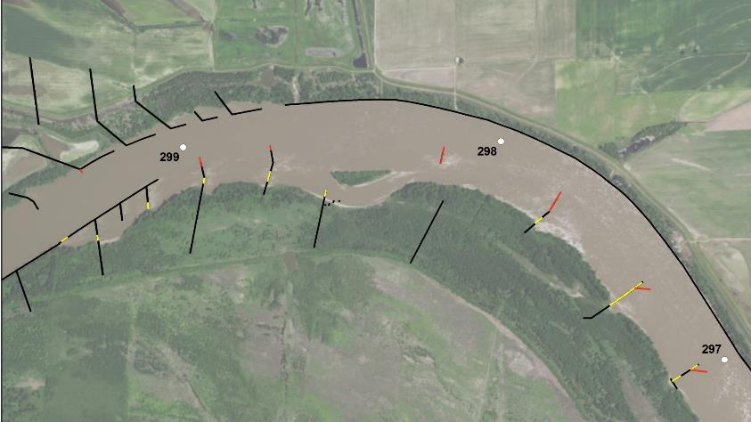
Pallid sturgeon habitat projects
[Interception and Rearing Complexes (IRC)]
Located outside of the navigation channel
Purpose is to benefit young sturgeon
Entail modifications to river structures
Designs are based on extensive modeling
Designed to continue to maintain navigation channel while providing pallid sturgeon benefits
Baltimore Bend (RM 299- 297): Black lines indicate preexisting BSNP rock structures; Red lines indicate raising or adding a dike structure; Yellow lines indicate lowering a dike structure

Slide 13
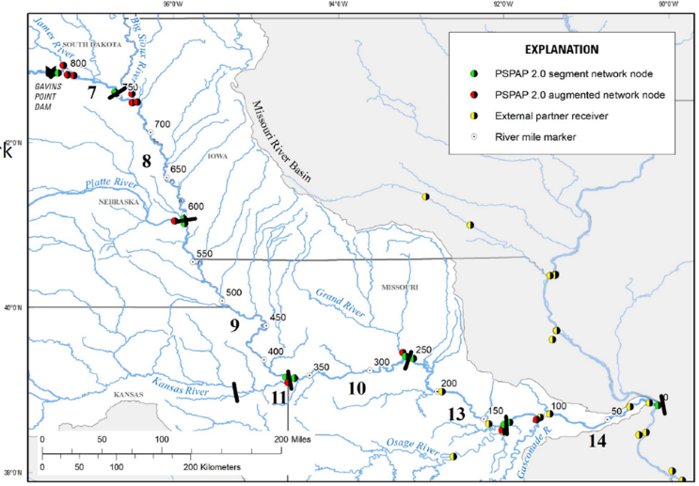
Evaluation of natural flows on lower Missouri River
Currently, the decision is that a spring pulse is not needed from Gavins Point
Evaluation of natural flow events continues
Re-evaluate after 9 years post Record of Decision
The science would need to change to support a managed spring pulse in the future

Slide 14
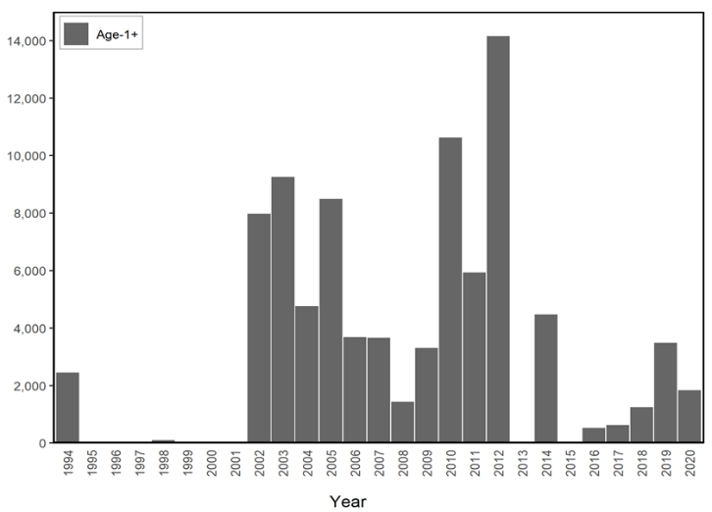
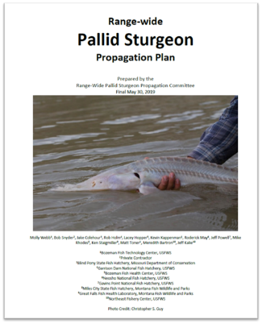
Pallid Sturgeon Propagation
Number stocked
Stocking history of the Lower River downstream from Gavins Point Dam
Source: USFWS National Pallid Sturgeon Database

Slide 15
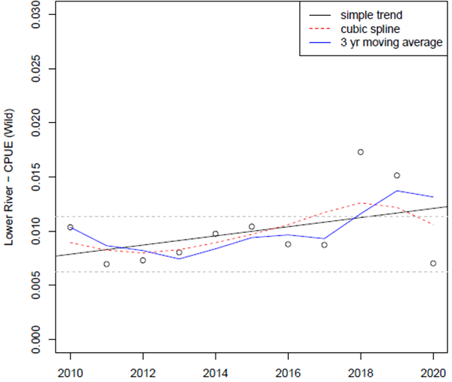
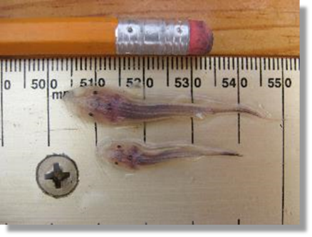
Where are we? Are we seeing progress?
Take will be exceeded if CPUE values are less than the Lower CI for the baseline CPUE for three consecutive years
Trend in wild pallid sturgeon in lower Missouri River.

Slide 16
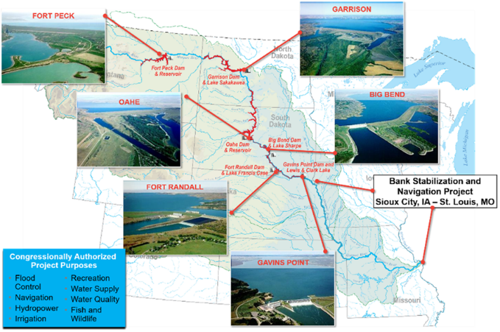
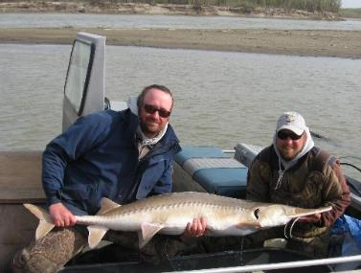
Current ESA compliance requirements
Pallid Sturgeon – Upper Missouri River
1. Ft. Peck test flows
2. Completion of Intake fish bypass
3. Pallid sturgeon propagation
4. Monitoring

Slide 17
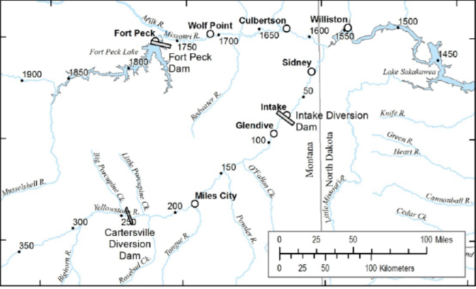
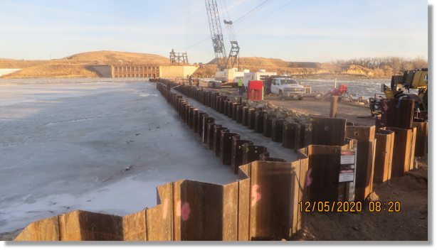
Intake Fish Bypass Project

Slide 18
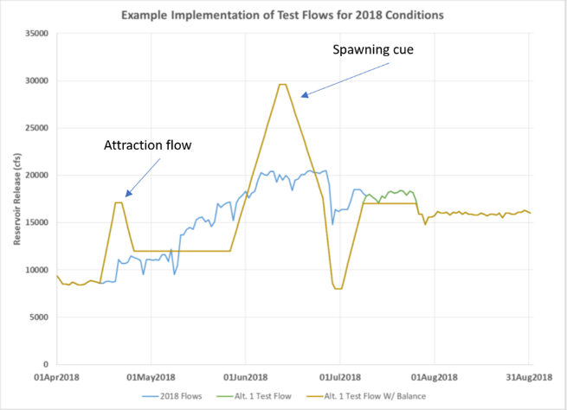
Ft. Peck Test Flow
Increased flow pulse in spring to initially attract fish away from the Yellowstone.
Second pulse to induce spawning near the dam.
Decreased flows following spawning to slow
drift of embryos to Lake Sakakawea
Drift models predict some recruitment in warm years (if pallid sturgeon spawn in new locations farther upstream)
Monitoring to track fish response in real-time
Monitoring for impacts

Slide 19
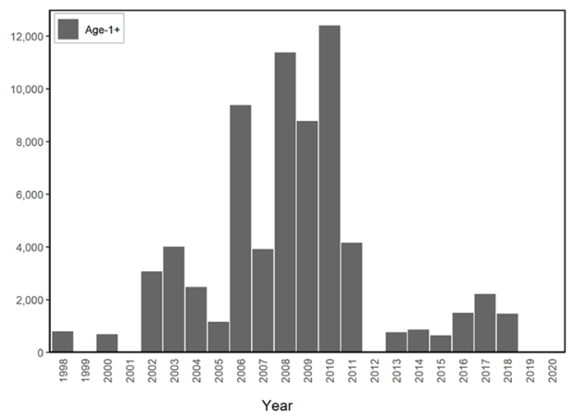
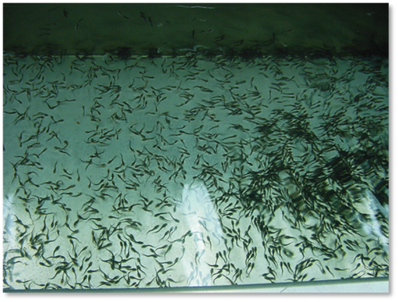
Pallid Sturgeon Propagation
Number stocked
Stocking history of the Upper Missouri River
Source: USFWS National Pallid Sturgeon Database

Slide 20
Where are we?
No natural recruitment has been detected in the upper basin since filling of Lake Sakakawea even though successful reproduction has been documented repeatedly.
Wild sturgeon numbers are declining as the remaining old fish die. Numbers of hatchery fish have increased dramatically and will be maturing in coming years.
Fish passage at Intake and/or fish spawning near Ft. Peck Dam could result in recruitment in some years and maturing hatchery fish will help.

Slide 21
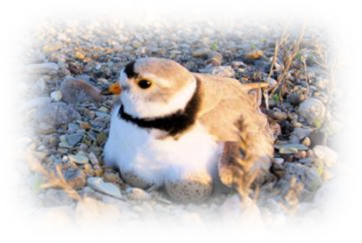
Current ESA compliance requirements
Piping plover– Lower and upper Missouri River
1. Emergent Sandbar habitat (ESH) management
2. sandbar construction when needed
3. Flow management to reduce Incidental take
4. Nest moving, signing, predator management
5. monitoring
*Interior Least terns delisted in 2021

Slide 22
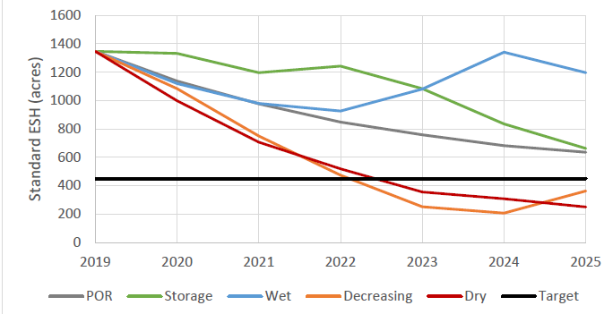
piping plover nesting areas and ESH projections
Northern
Southern

Slide 23
Missouri River Recovery
Implementation Committee (MRRIC)
Authorized by Section 5018 of 2007 WRDA
MRRP-funded forum for basin stakeholders to discuss the different interests
and needs in the basin and provide unified guidance to USACE in implementing
the MRRP
Charter development – July 2008
First meeting – September 2008
Engaged in collaborative efforts with USFWS and USACE in recent Section 7
consultation on the operation and maintenance of the Missouri River System
resulting in a NO JEOPARDY OPINION from the USFWS

Slide 24
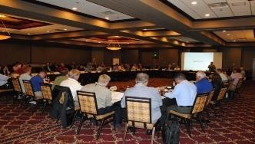
MRRIC Members
29 Tribes
29 Stakeholders (16 categories)
  Agriculture (2) Major Tributaries (2)
  Conservation Districts Navigation (2)
  Environmental/Conservation Orgs (2) Recreation (2)
  Fish and Wildlife (2) Thermal Power (2)
  Flood Control (2) Water Quantity (2)
  Hydropower (2) Water Supply (2)
  Irrigation Water Industries
  Local Government (2) At Large (2)
15 Federal Agencies
  Bureau of Indian Affairs USACE BOR
  BLM USFS NRCS
  USFWS USGS NPS
  WAPA NWS/NOAA EPA
  Fed Hwy Admin Maritime Admin US Coastguard
8 States (IA, NE, KS, MO, MT, ND, SD, WY)

Slide 25

Questions

