Slide 1
Midwest Electric Consumers
Association
Annual Meeting
Leslie James, CREDA
December 7, 2021
Notes:
Good morning, thank you for the opportunity to talk to you today about the drought and the Colorado River Storage Project.

Slide 2

In The Beginning…….
1902 and 1939 Reclamation Acts
1956 Colorado River Storage Project (CRSP) Act
1977 DOE Organization Act (WAPA)
1978 CREDA
Notes:
I’m Leslie James, Executive Director of the Colorado River Energy Distributors Association (CREDA), a non-profit association of firm electric service customers of the CRSP ,

Slide 3
CREDA’s Mission
“To preserve and enhance the availability, affordability, and value of Colorado River Storage Project (CRSP) facilities while promoting responsible stewardship of the Colorado River System.”
CREDA 2022 Strategic Plan
Notes:
Here is CREDA’s mission, and today I will describe how the drought is impacting our ability to achieve that mission.

Slide 4
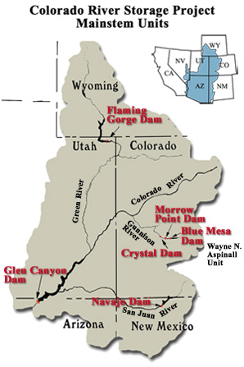
Notes:
Let’s start with an overview of the CRSP generating facilities. The power from all these dams are marketed and operated as an integrated project. Glen Canyon Dam is nearly 80% of the total generation in the CRSP.

Slide 5
CRSP Customers in the West
Notes:
This map displays the wide geographic range of where CRSP power is marketed. All these customers are not-for-profit entities in accordance with federal law.

Slide 6
Who Gets CRSP Power?
(all are not-for-profit entities)
Notes:
Diving down into the TYPE of entities who have entered into 40 year contracts.

Slide 7
CREDA Members
Notes:
This map displays the wide geographic range of where CRSP power is marketed. All these customers are not-for-profit entities in accordance with federal law.

Slide 8
What Makes CRSP Unique?
CUSTOMER BASE: Over 50 Tribal Customers
FINANCES/FUNDING: Relies on a Revolving Fund (the Upper Colorado River Basin Fund – “Basin Fund”) – Not Reliant on Appropriations
OPERATIONS/ESA: Operations are Constrained by Three Significant Records of Decision (RODs)
RELIABILITY CONCERNS: Glen Canyon Dam provides black start capability to Palo Verde Nuclear Generating; Proximity to California !
Notes:
It isn’t just the customers who are directly affected during drought conditions. The electrical power grid as well as societal goals are stressed. Intermittent resources rely on hydropower as backup with the wind isn’t blowing or the sun isn’t shining.

Slide 9
What Do CRSP Rates Include?
“Non-Power” Programs
 |  | FY 2023
Operations & Maintenance (WAPA/BOR) |  | $103.1 M
Transmission |  | $ 8.9 M
States’ MOA funds |  | $ 14.5 M
Salinity Program |  | $ 2.0 M
Irrigation |  | $ 9.2 M
Integrated Projects |  | $ 7.0 M
WAPA-199 Rate Supporting Documents October 29, 2021
Notes:
Drought threatens the revenue stream from hydropower customers. Revenues from CRSP hydropower production ensure repayment of the federal investment, plus interest, as well as “non-power” programs.

Slide 10
What Else Has the Basin Fund Funded?
ENVIRONMENTAL PROGRAMS:
Glen Canyon Dam Adaptive Management Program
-- $11 million/year
Upper Colorado River Endangered Fish Recovery Program
-- $7 million/year
San Juan River Recovery Program -- $3 million/year
Quality of Water & Consumptive Use Studies -- $2 million/year
Experimental Flows – Summer 2000: Low Steady Flow $26 million
Summers 2019, 2020: Bug Flows (TBD, est. $2 million)
Summer 2021 FG Small Mouth Bass Spike (TBD, est. $2 million)
High Flow Experiments (HFEs): 2004, 2008, 2012, 2013, 2014, 2016, 2017, 2018 – (ranges from $.5M to over $2M each)
TOTALING OVER ONE-HALF OF A BILLION DOLLARS!
Notes:
Here is an example of “non-power” programs that have been funded by CRSP power revenues.

Slide 11
What a Difference a Year Makes (November 2020) v. Now
THEN
*CRSP Rate Decrease Effective 10/1/2020
*Basin Fund Year-End $120 Million
*Purchased Power estimated at $18 Million
*Lake Powell storage at 49% of capacity
*Glen Canyon Dam release 8.23 MAF
NOW
*CRSP Rate Increase Effective 12/1/2021
*Basin Fund Estimated Year-End $77 Million (target is $180 Million)
*Purchased Power Estimated at $72 Million 2021; and $97 Million 2022
* Lake Powell storage at 34% of capacity
*Glen Canyon Dam release 7.48 MAF
1-in-3 chance Glen Canyon Dam may be at minimum power pool in 2022 without drought response operations
Notes:
Everyone in this room has been watching with dismay how the 20-21 year drought appears to have accelerated. Comparing just a year ago last month….

Slide 12
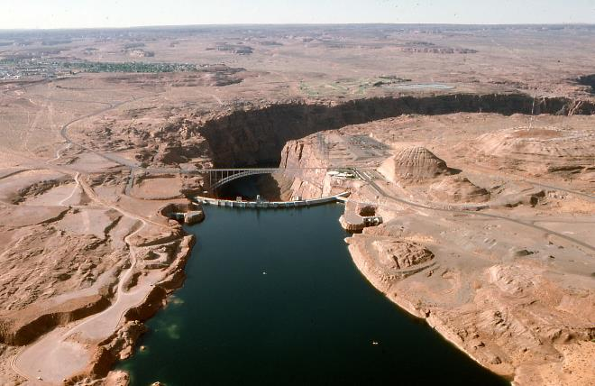
Drought Update – Then and Now
1984 – Glen Canyon Dam
Notes:
Now, let’s talk about drought. Here is a picture from 1984 and then August of this year.

Slide 13
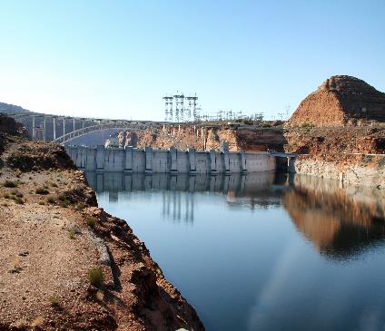
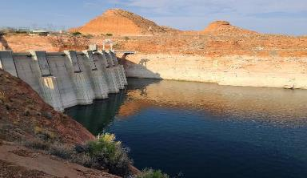
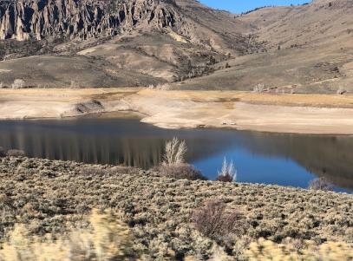
Drought Update – Then and Now
GCD 2011
  GCD and Blue Mesa 2021
Photos courtesy of Reclamation and Carol Ballantine
Notes:
Now, let’s talk about drought. Here is a picture from 1984 and then August of this year.

Slide 14
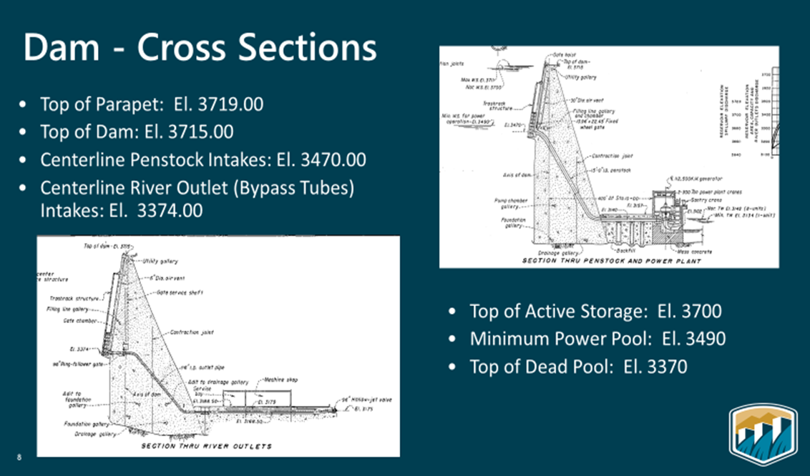
Glen Canyon Dam – By the Numbers
Current Elevation:
3541 ft. (12/2)
Notes:
Now, let’s talk about drought. Here is a picture from 1984 and then August of this year.

Slide 15
The Perfect Storm, AKA History Repeats Itself
Early 2000’s
  Dropping Basin Fund - Large Return to Treasury
  California Energy Crisis – Market/Purchased Power Spikes
  Glen Canyon Dam Experiment - $26 million
  WHAT DID WE/WAPA DO TO AVOID RATE INCREASE?
      Reduced deliveries and WAPA purchased power, stepping back up over 5 years
      Preserved transmission system capacity
      Created Cost Recovery Charge (CRC) – similar to fuel adjuster
Notes:
It isn’t just the customers who are directly affected during drought conditions. The electrical power grid as well as societal goals are stressed. Intermittent resources rely on hydropower as backup with the wind isn’t blowing or the sun isn’t shining.

Slide 16
The Perfect Storm, AKA History Repeats Itself
Early 2020’s
  Dropping Basin Fund – Purchased Power Prices
  Energy “Crisis” - Market/Purchased Power Spikes
  Glen Canyon Dam/Flaming Gorge Experiments – est. $2 million each
  WHAT DID WE/WAPA DO TO REDUCE 75% RATE TO 11%?
      Reduced deliveries; WAPA purchases power only if each customer elects; pass through cost
      Preserved transmission system capacity
Notes:
It isn’t just the customers who are directly affected during drought conditions. The electrical power grid as well as societal goals are stressed. Intermittent resources rely on hydropower as backup with the wind isn’t blowing or the sun isn’t shining.

Slide 17

The Perfect Storm, AKA History Repeats Itself
Early 2000’s Early 2020’s
BASIN FUND DROPPING (Treasury Return) CALIFORNIA ENERGY CRISIS GLEN CANYON EXPERIMENT - $26M SOLUTION? NO RATE INCREASE REDUCE ALLOCATIONS AND WAPA PURCHASED POWER PRESERVE TRANSMISSION CAPACITY
BASIN FUND DROPPING (Purchased Power Prices)
ENERGY “CRISIS” (Purchased Power Prices)
GLEN CANYON/FLAMING GORGE EXPERIMENTS - $2M
SOLUTION? RATE INCREASE 11% (not 75%)
CUSTOMER CHOICE RE WAPA PURCHASES (pass-thru $)
PRESERVE TRANSMISSION CAPACITY

Slide 18
WAPA-199 Rate Details
 | Current Rate 10/1/20-11/30/21 | October 2021 Provisional Rate 12/1/21-12/31/23 | Change
Rate Schedule | SLIP-F11 | SLIP-F12
Firm Energy (mills/kWh) | 11.43 | 12.36 | 8.1%
Firm Capacity ($/kWmonth) | 4.85 | 5.25 | 8.3%
Composite (mills/kWh) | 27.45 | 30.51* | 11.1%
*DETAILS ASSOCIATED WITH KEY CHANGES FROM PROPOSED RATE
Project Use Requirements updated – reduced energy from 5,239 GWH to 4,932 GWH; from 1428 MW to 1422 MW. (CREDA request)
WAPA FY2022 Work Plan data used (instead of FY2023) – reduced total annual revenue requirements from $186,002 to $181,197 ($000) – a savings of $4.8M/year - (CREDA request through 1992 Work Program Letter)
Dropped composite rate from originally proposed $31.60 to $30.51
WRF (WAPA Replacement Firming) process revised from seasonal to quarterly

Slide 19
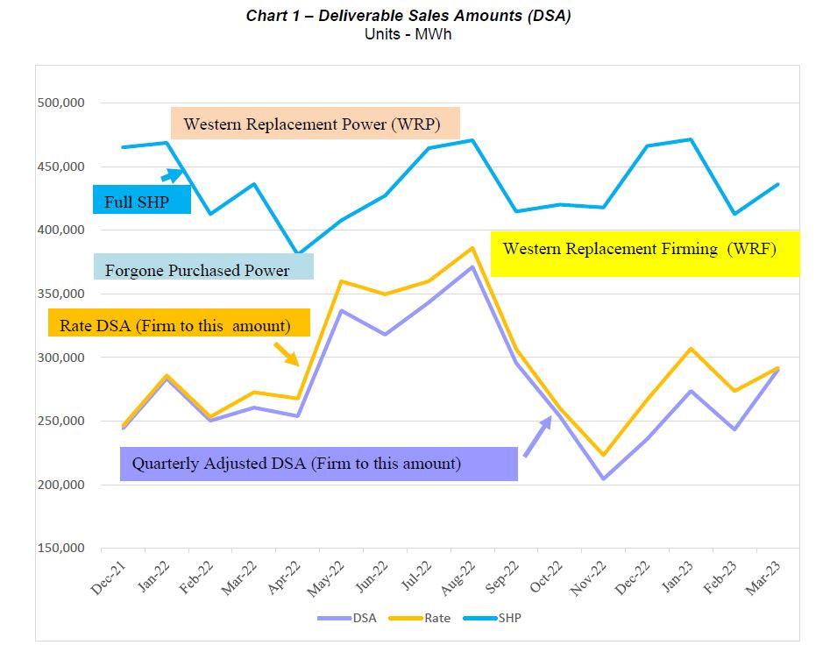
WAPA-199 Rate Case--
Less Energy/Higher Price/More Risk
Notes:
I mentioned earlier the fact that CRSP customers are in the midst of a rate process. This picture displays how the risk of replacing the hydropower resource is shifting from WAPA to the customers. The buff shaded area is what will now be the obligation of customers to provide, or have WAPA purchase on a pass-through cost basis. The red line is the actual hydro. The blue line is the Sustainable Hydropower – what customers signed up for in their 40 year contracts.

Slide 20
What’s Next?
Focus: What To Do WHEN Glen Canyon Dam Generation = 0?
*RATES
*CONTRACTS *FACILITIES/OPERATIONS
*FEDERAL AGENCY ROLE
*MARKETS
*LEGISLATIVE INITIATIVES
Notes:
Here are some upcoming discussions and timing……you will likely receive questionnaires in the future. We need to be sure that all CREDA member concerns and questions are captured and considered, so please be sure to respond.

Slide 21
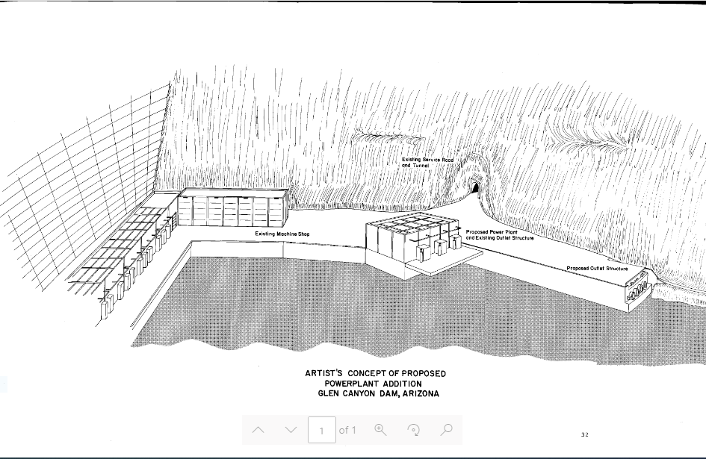
Add Powerplant to Bypass Tubes??
Install 2 Unit powerplant on existing / enlarged bypass tubes
Potential Installed capacity 100 MW to 250 MW
Would extend power generation to El. 3400+/-
Value Planning Study - Scheduled for Q2/FY22

Slide 22

Questions?
Thank you!
Notes:
Any questions? I’d be glad to talk with any of you offline.

