Slide 1
Tools for Hydropower and Hydro Hybrids
W. Hill Balliet - william.balliet@inl.gov
S M Shafiul Alam, Yingqian Lin, Binghui Li, Usama Usman, Thomas M. Mosier

Slide 2
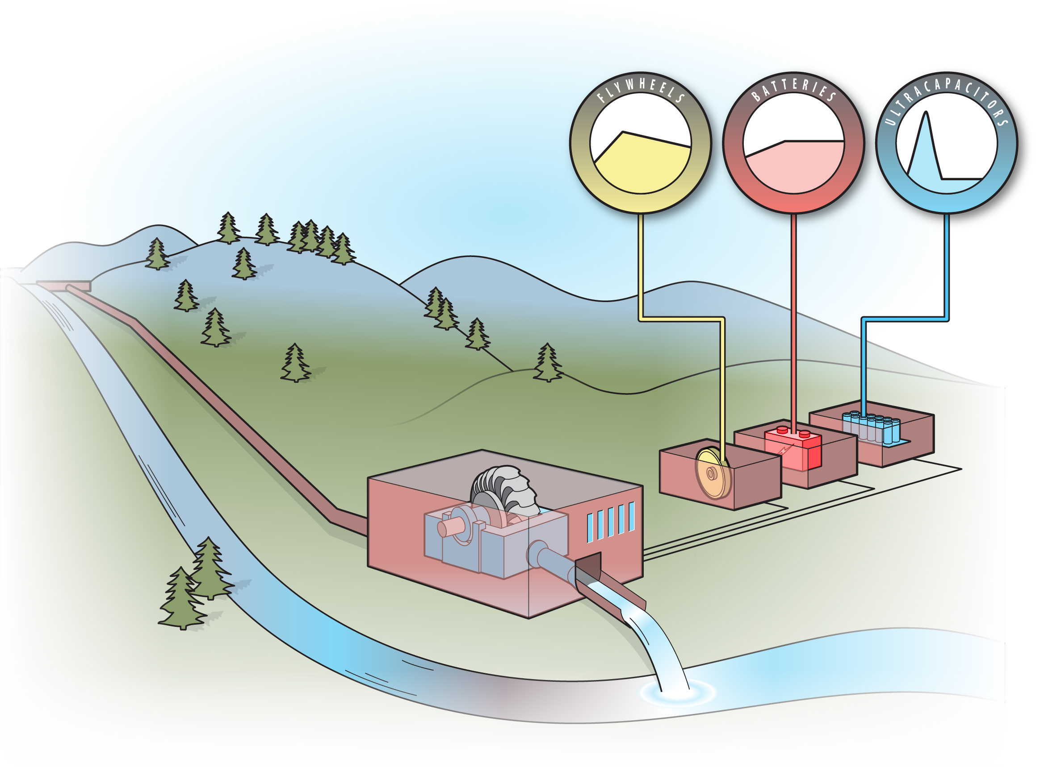
Hydropower Hybrids: Objectives
Hydro Hybrids
Deployment ready technology for powering local loads during emergencies
Tools that lower the barrier to hybridization of existing plants

Slide 3
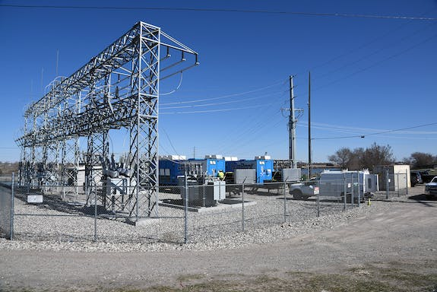
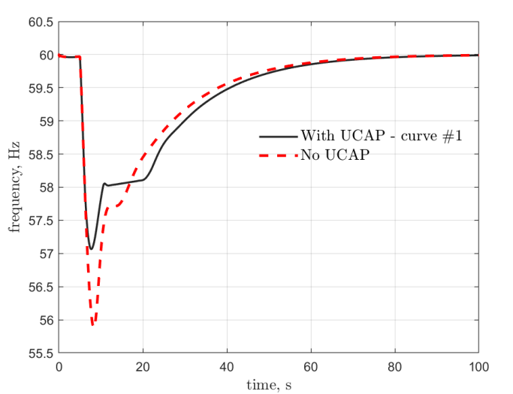
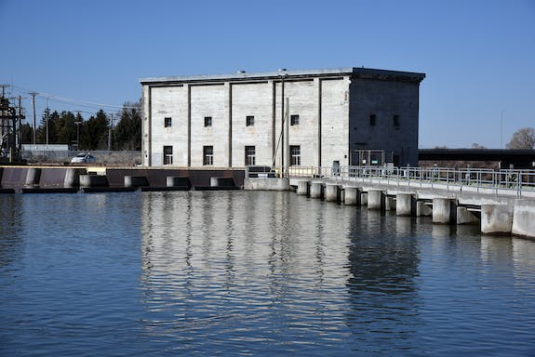
Idaho Falls Power Demonstration
Hydro Hybrids
Tested black start of run-of-river plants with an ultracapacitor
Frequency deviation and load carrying capacity were improved by the ultracapacitor

Slide 4
Potential Further Innovations
Hydro Hybrids
Co-optimization with nearby diesel generator for black start
Automate ultracapacitor recharging during black start process
Co-optimize ultracapacitor and plant response
Automate operation mode-based control changes

Slide 5
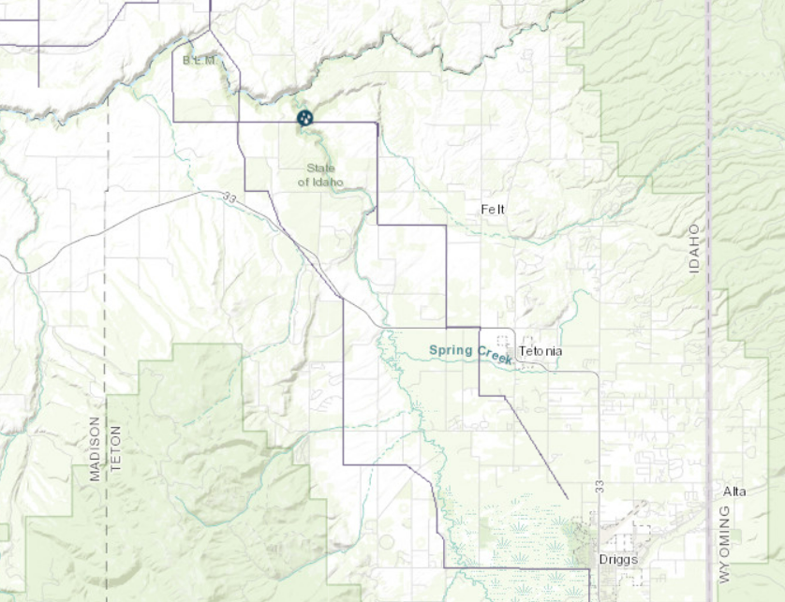
Fall River Electric – Demo Partner
Hydro Hybrids
5.5MW – Felt plant
Francis turbine
Lack of headroom when islanding
Interest in gaining new black start capability
Continuation of IFP demo means we can push RoR hybrid black start to deployment ready

Slide 6
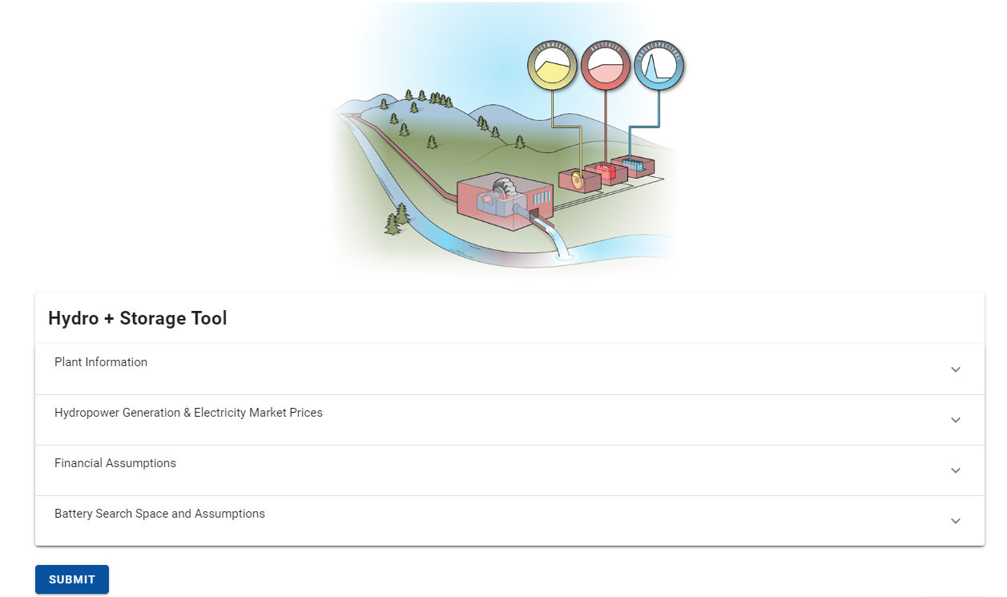
Battery Sizing Optimization Tool
Hydro Hybrids
Online, open-source tool
User friendly, low time commitment process
Battery sizing optimization built in
Provides estimate of results from $250k 1-year process, de-risking hybridization

Slide 7
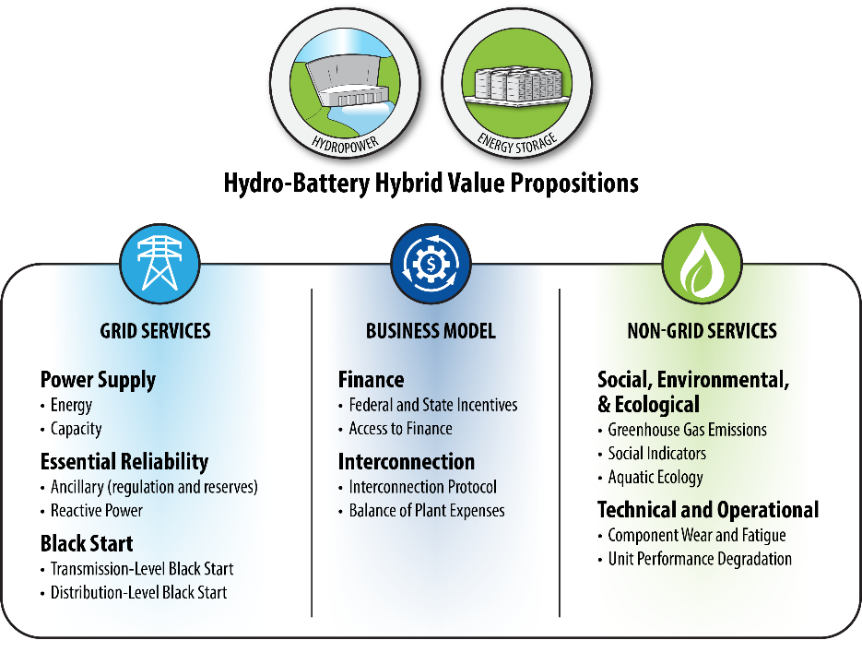
Competing Value Streams
Hydro Hybrids
Review paper identifies value propositions that:
Affect the decision to hybridize a hydropower asset
Affect the operation of hydro hybrid assets
Competing value streams should be pursued situationally
Hydropower owners don’t know all value propositions
Don’t have the tools to dynamically select which to pursue

Slide 8
Energy Flexibility – Environment Tradeoffs: Overview
Flexibility-Environment Tradeoffs
Mapping dam operations to environmental outcomes
Co-optimizing flexibility and environmental performance
Developing a tool to assist in the relicensing process
Determine set of optimal reservoir policy options
Quantify impacts of selected policies
Comparative evaluation of impacts

Slide 9
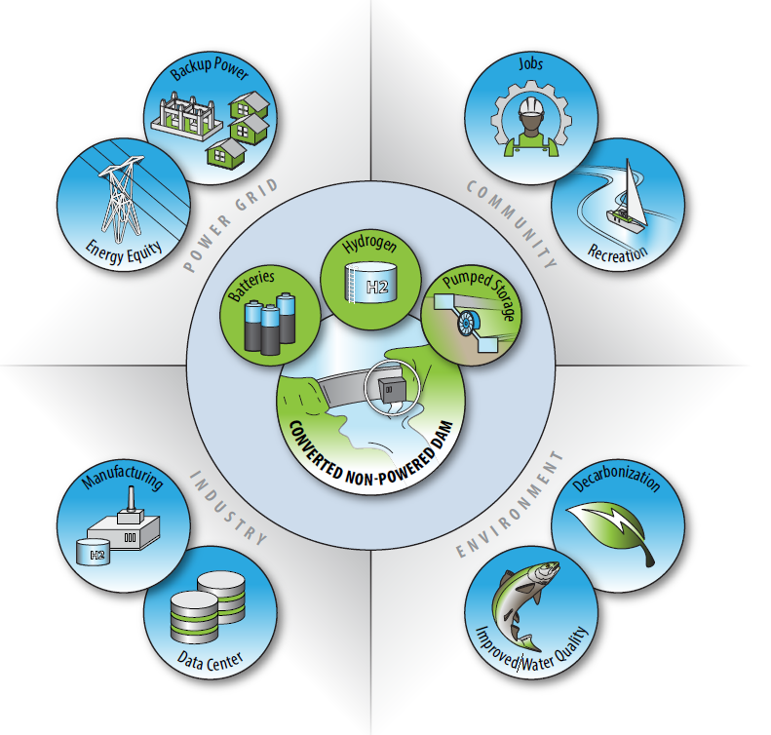
Why this Tool
Non-Powered Dams
Overview of the Tool
Over 80,000 NPDs in the U.S. with over 12 GW potential capacity
Significant cost and time savings from developing existing infrastructure
Energy storage technologies can offer additional benefits
Current NPD retrofitting puts the developer at the center of decisions, rather than the community
Analyzes feasibility of retrofitting NPDs with generation and energy storage technologies
Allows user to prioritize features to define each of the benefits through a user-friendly GUI.
Enables visualization and exploration of wide variety of features
Provides ranking of sites based on user preferences and selected features

Slide 10
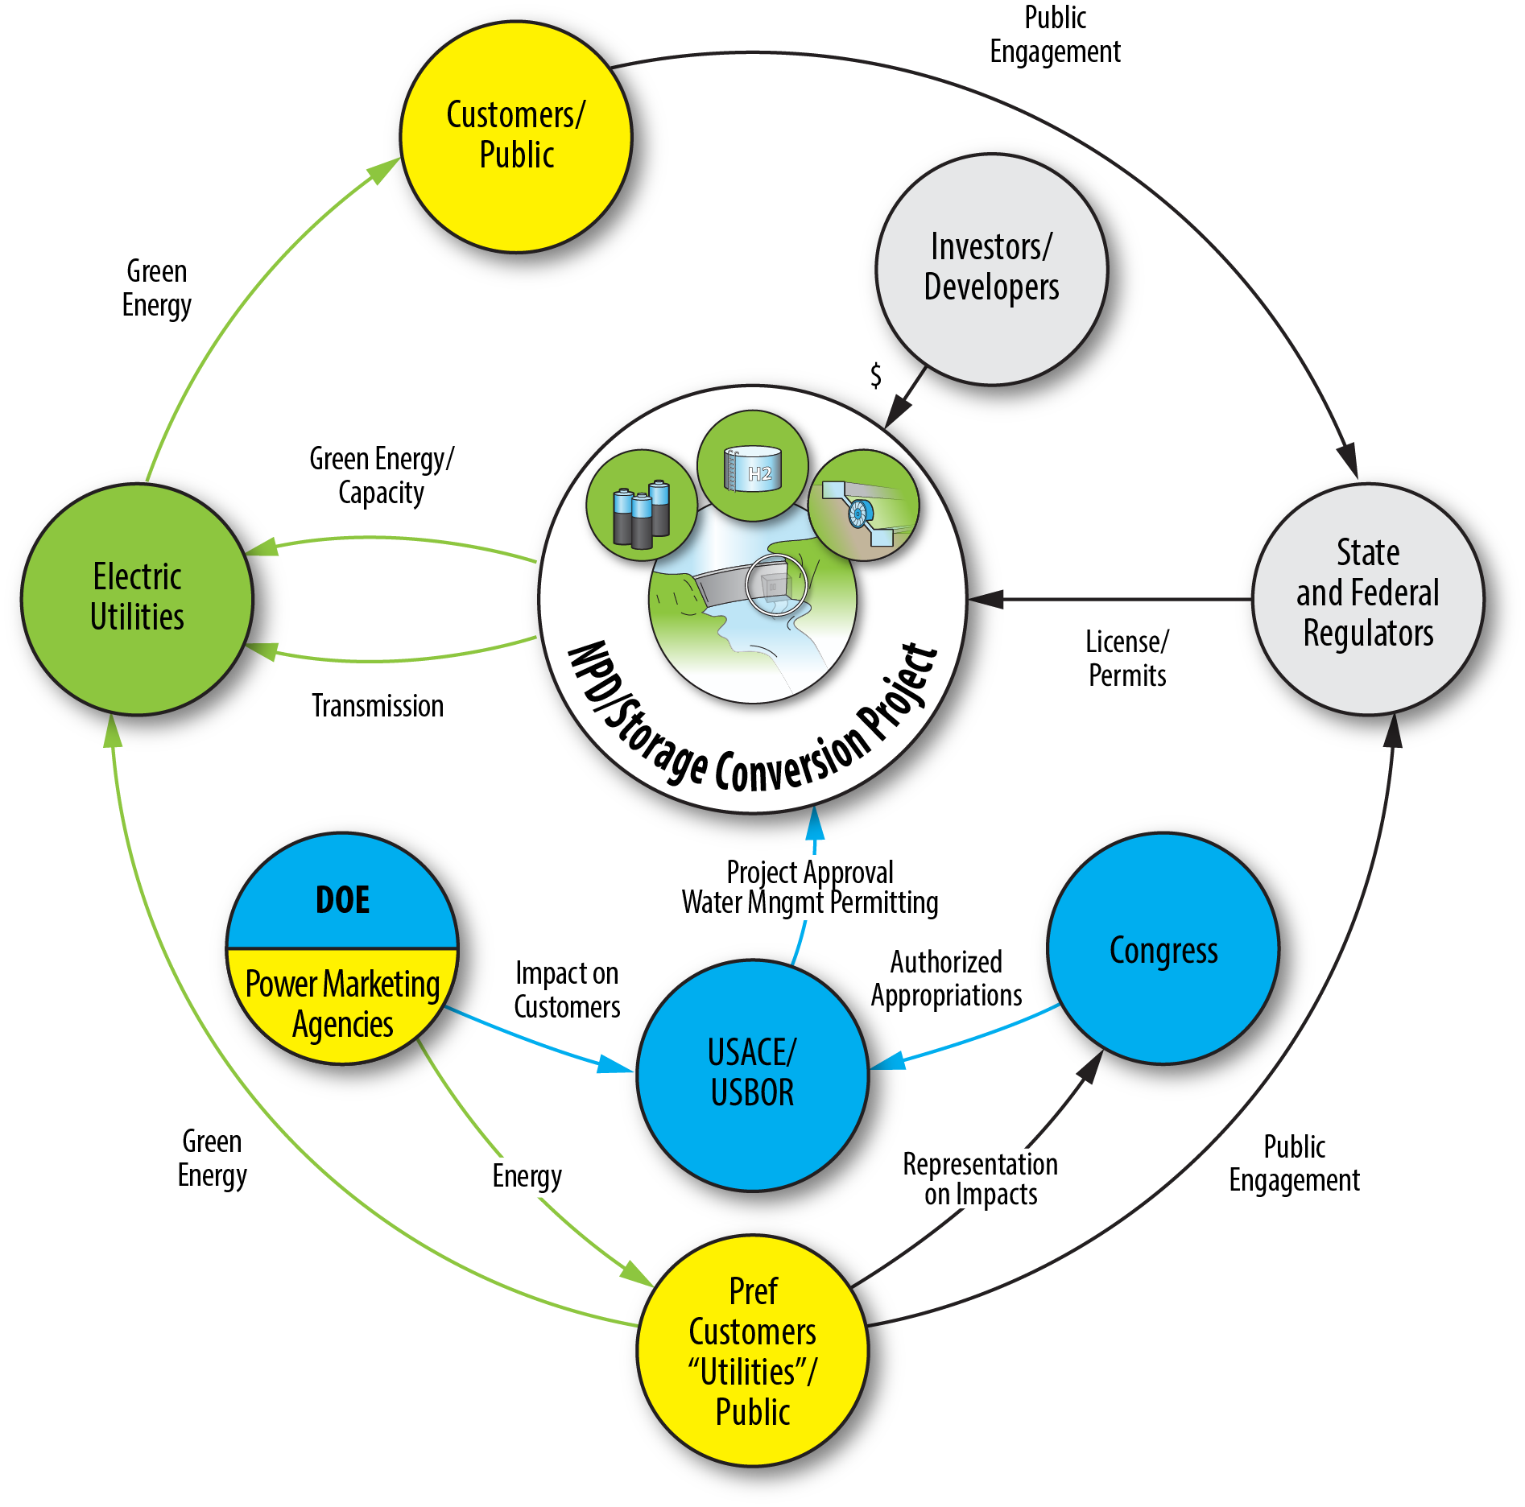
The current NPD retrofit paradigm puts the NPD at the center
Non-Powered Dams
Notes:
Sarah

Slide 11
The paradigm shift puts the community at the center as a co-equal
Non-Powered Dams
Notes:
Sarah

Slide 12
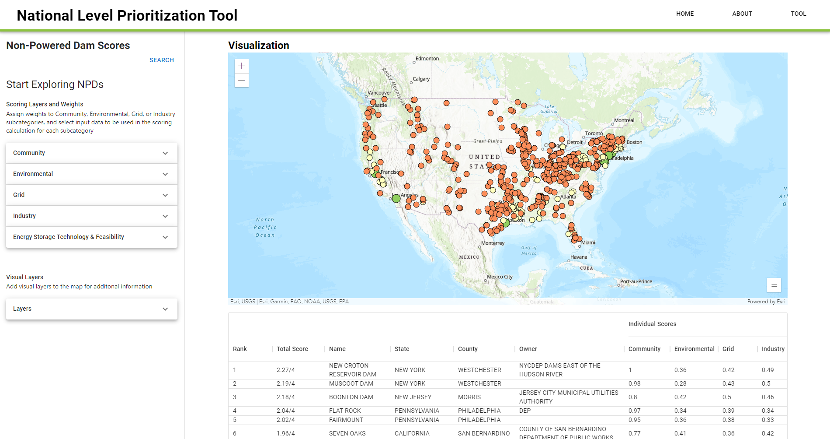
NPD Vis: Results
Non-Powered Dams
Interactive Map
Attributes Table

Slide 13
Open/Upcoming Funding Opportunities
Technical Assistance related to hydropower’s contribution to resilience, reliability, and renewable integration (e.g. hybridization)
Section 242: Hydroelectric production incentive program
Section 243: Hydroelectric efficiency improvement incentive program – capital improvements, improving efficiency by at least 3%
Section 247: Maintaining and enhancing hydroelectricity incentives – capital improvements related to improving grid resiliency, dam safety, and environmental impacts (e.g. hybridization)
$28.5 million of funding opportunities for hydropower recently closed, but more is on the way

Slide 14
Discussion
What hydropower challenges would you like DOE support on?
How do you view hydropower’s role in your system?
Questions for us?

