Slide 1
Missouri Basin Regional Office Quick-Look
Timothy Koczur
MBRO Power Manager
Dec 6, 2022

Slide 2
ECAO – East Portal Construction

Slide 3
ECAO – East Portal Construction

Slide 4
ECAO – East Portal Construction

Slide 5
ECAO – East Portal Construction

Slide 6
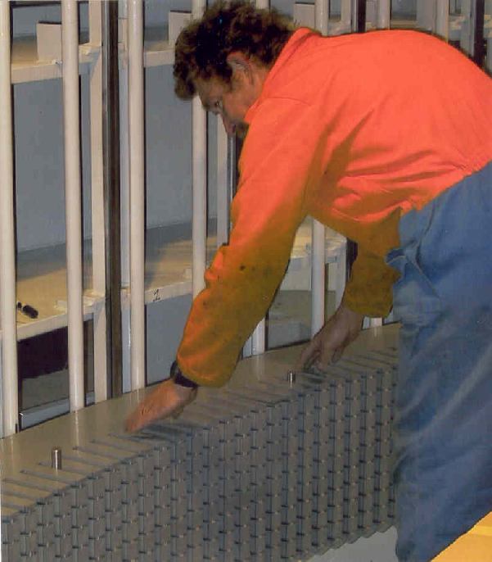
MTAO – Canyon Ferry Core Restack
CF Rewind is progressing on schedule. Andritz is on site stacking the new core. TVA progressing through component refurbishment at PSS. Voith is maintaining project schedule with components beginning to ship.

Slide 7
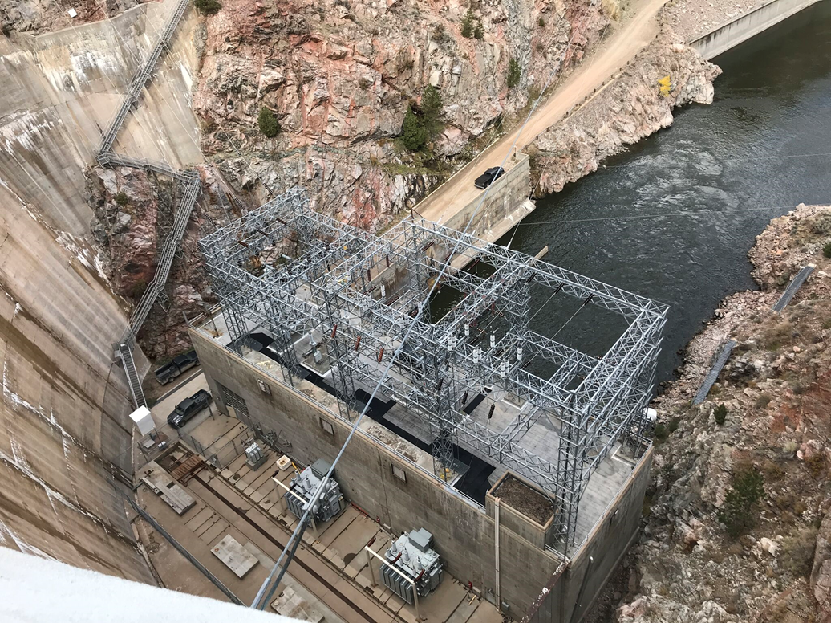
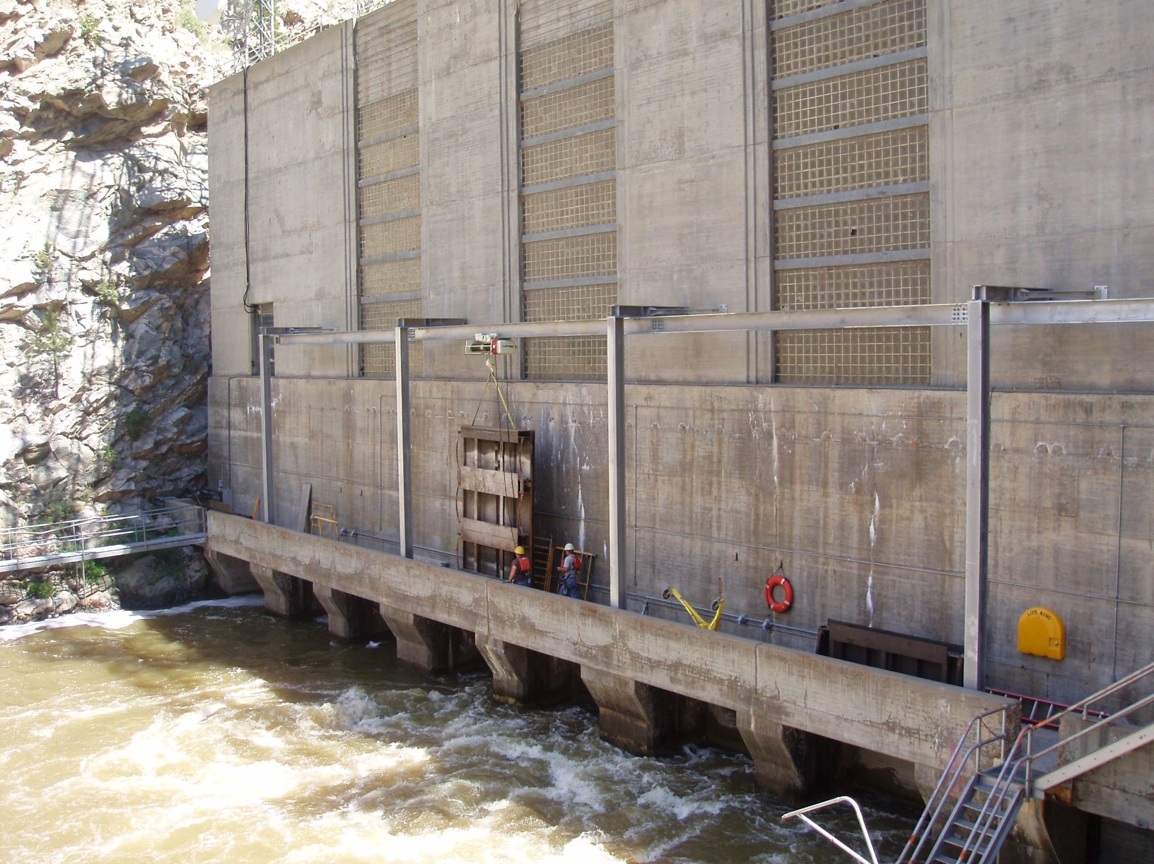
WYAO - Seminoe PP Roof & Window Replacement
Awarded February 2021 to MC2 Engineering
Construction Started August 29, 2022
Construction Completed October 21, 2022
Notes:
The Seminoe Powerplant Roof and Window Replacement was a RAX project which began in 2018. The total estimated cost was $1.7M and we are anticipating coming in slightly under budget. The design was completed in 2019 and it was awarded to MC2 Engineering out of Sheridan, WY in February of 2021. WAPA wanted to make some improvements to their substation on the Seminoe powerplant roof before the old roof was replaced so that any work they performed wouldn’t damage the new roofing system. The construction was delayed by one year due to this work. Mobilization took place on August 29th of 2022. The Contractors began with installing scaffolding both inside and outside of the powerplant to replace the glass blocks which had been damaged over the years. The Contractor was limited on the number of blocks which could be replaced due to the Wyoming State Historical Preservation Office requirements. The roofing material was also removed. One layer of roofing material contained non-friable asbestos so the materials had to be removed and disposed of in accordance with Wyoming Department of Environmental Qualities requirements. Once the roofing materials was removed, some concrete was repaired before placing the new roofing material. Some snow and rain delayed the Contractors original schedule but the finished product was completed on October 21, 2022 – 10 days before the contract completion deadline.

Slide 8
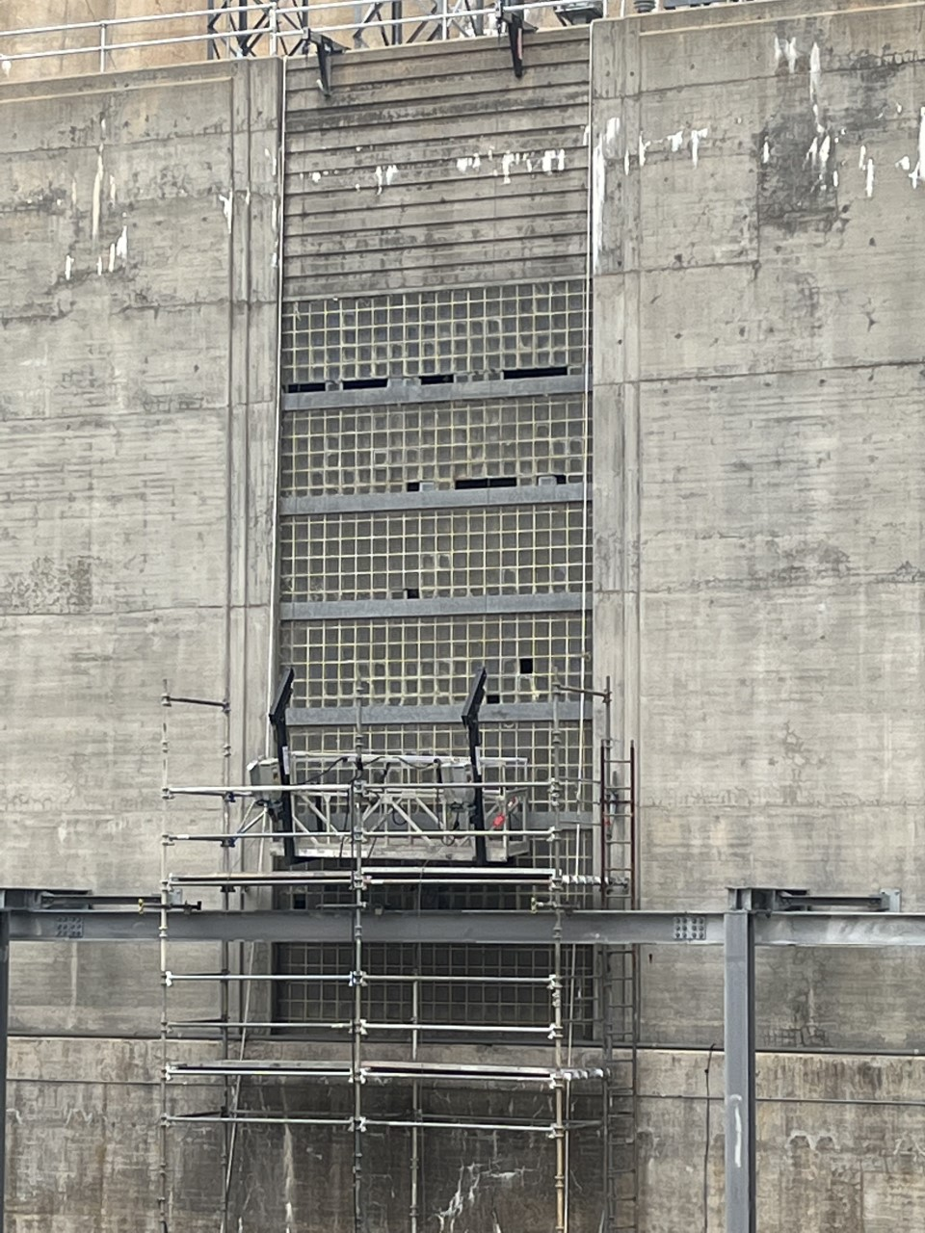
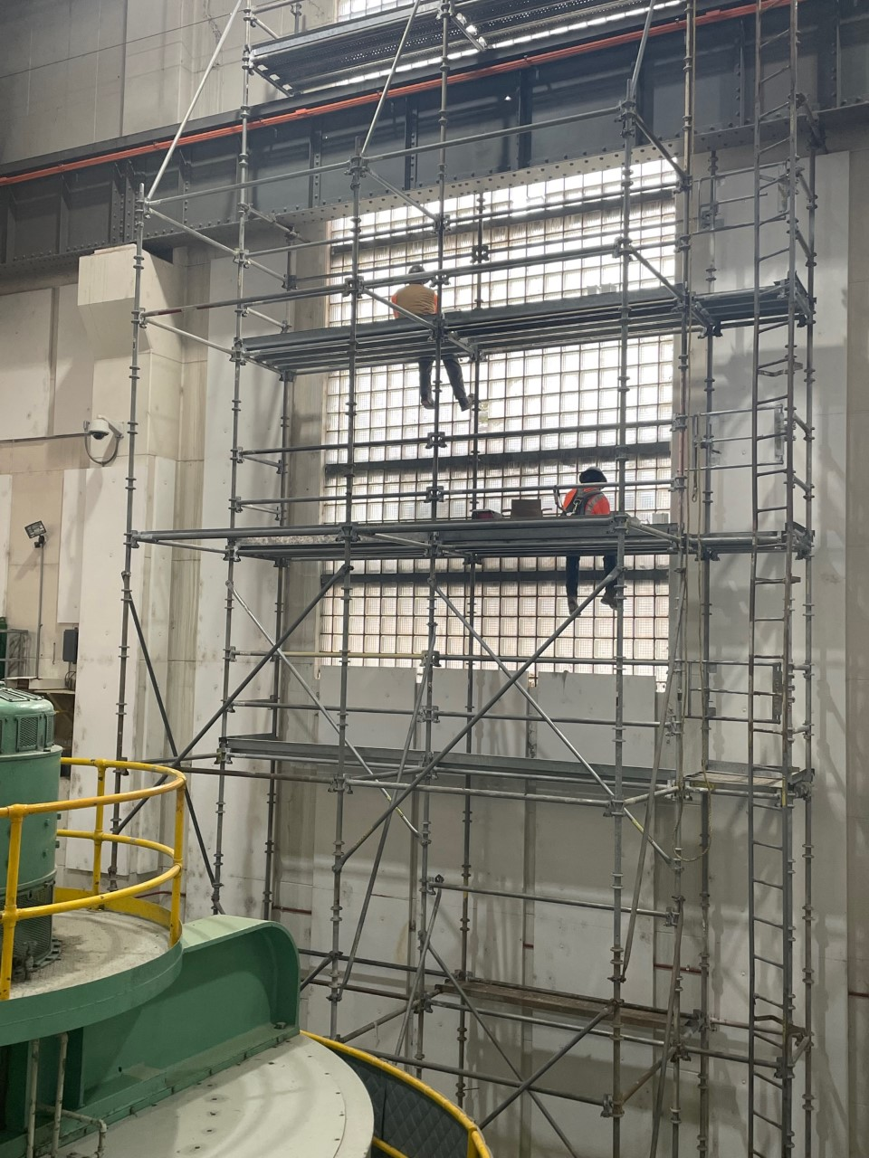
WYAO - Seminoe PP Roof & Window Replacement
Removing and replacing glass blocks on downstream side of powerplant.

Slide 9
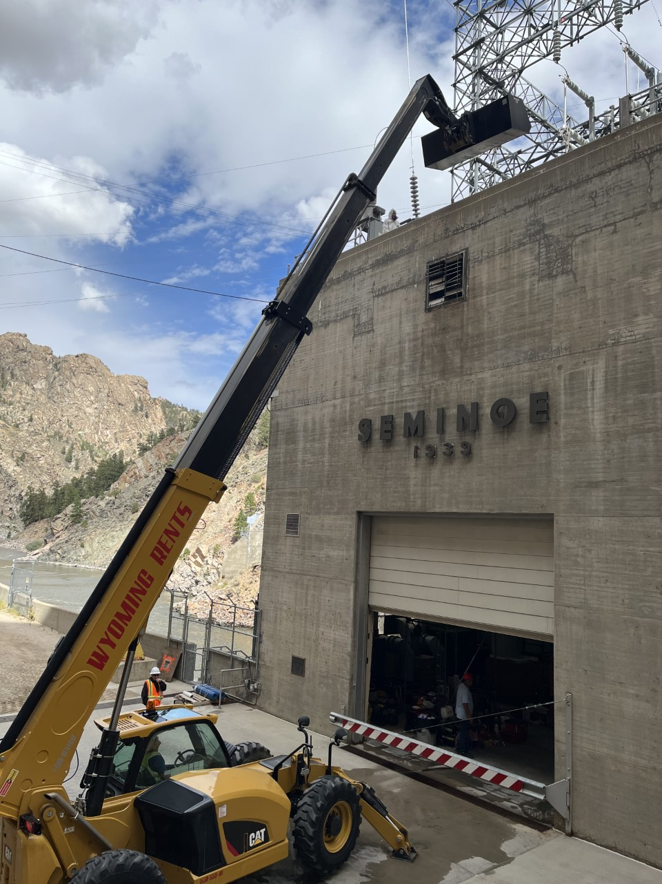
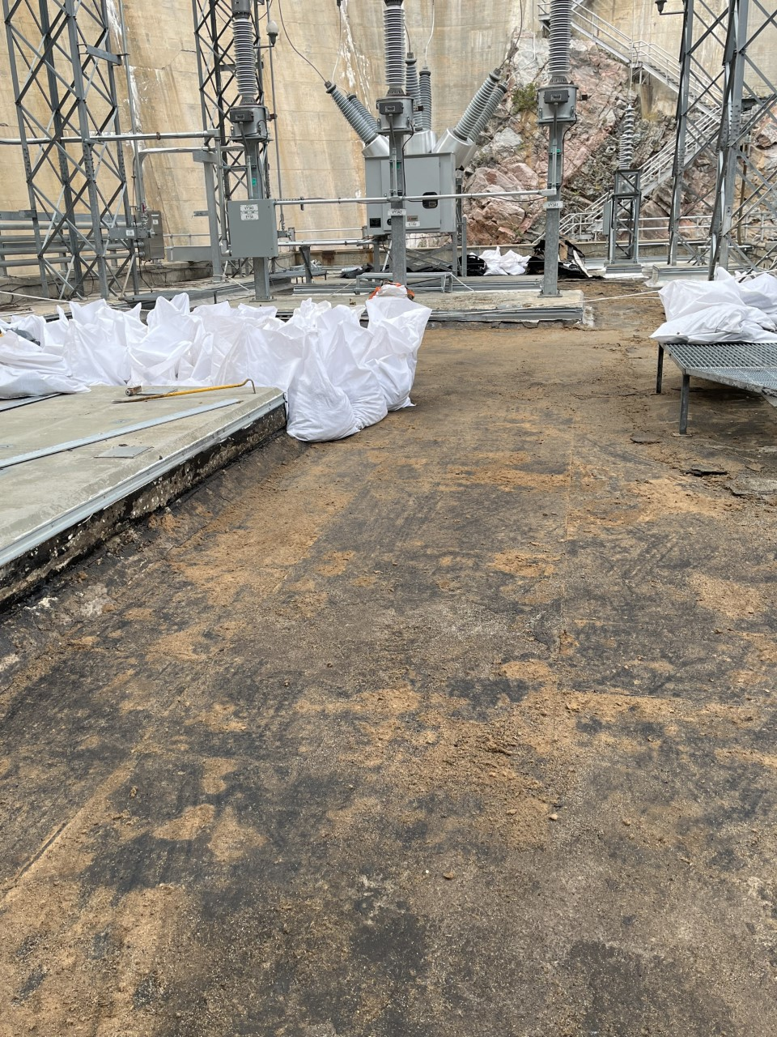
WYAO - Seminoe PP Roof & Window Replacement
Roofing material removal.

Slide 10
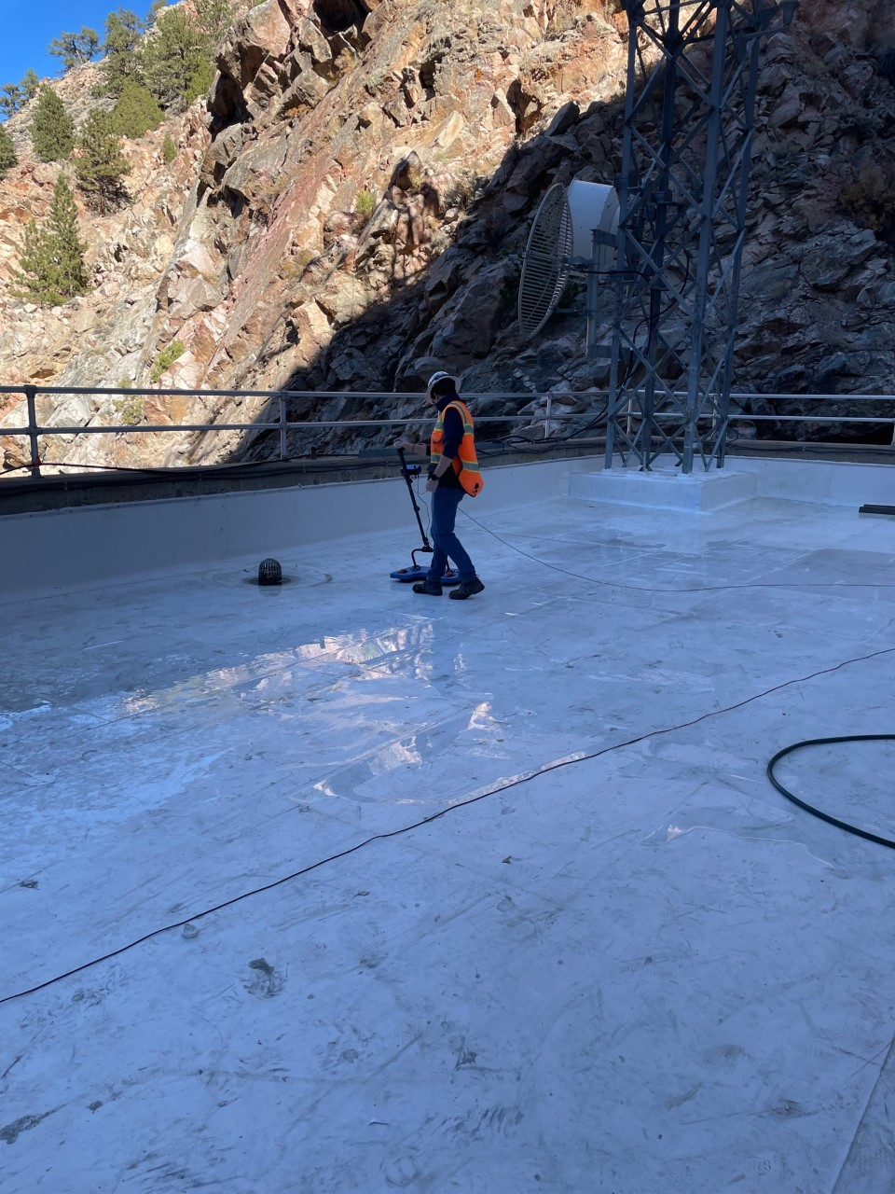
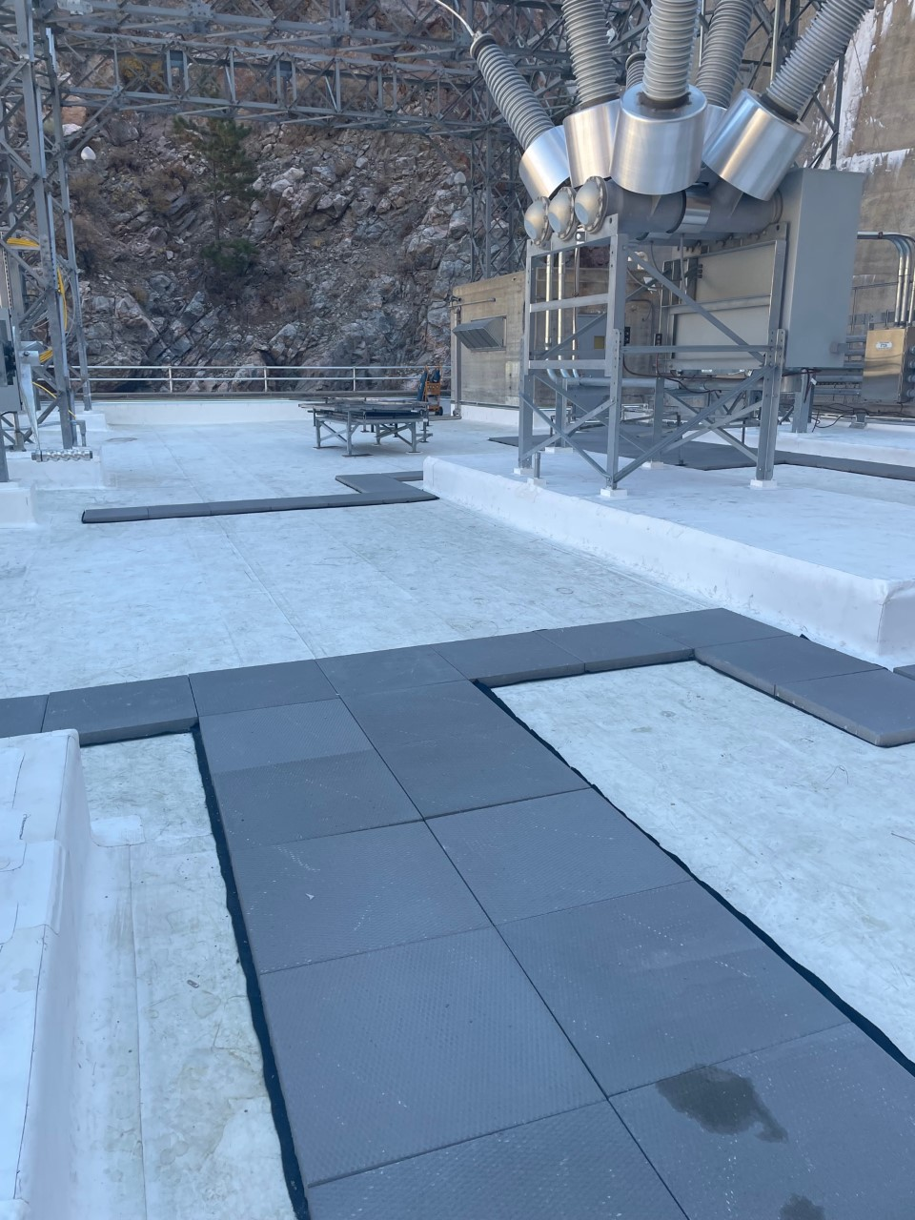
WYAO - Seminoe PP Roof & Window Replacement
Leak detection testing and finished product.

Slide 11
Introduction: Dr. Levi Brekke

Slide 12
Timothy Koczur
MBRO Power Manager
tkoczur@usbr.gov

